Slide 1
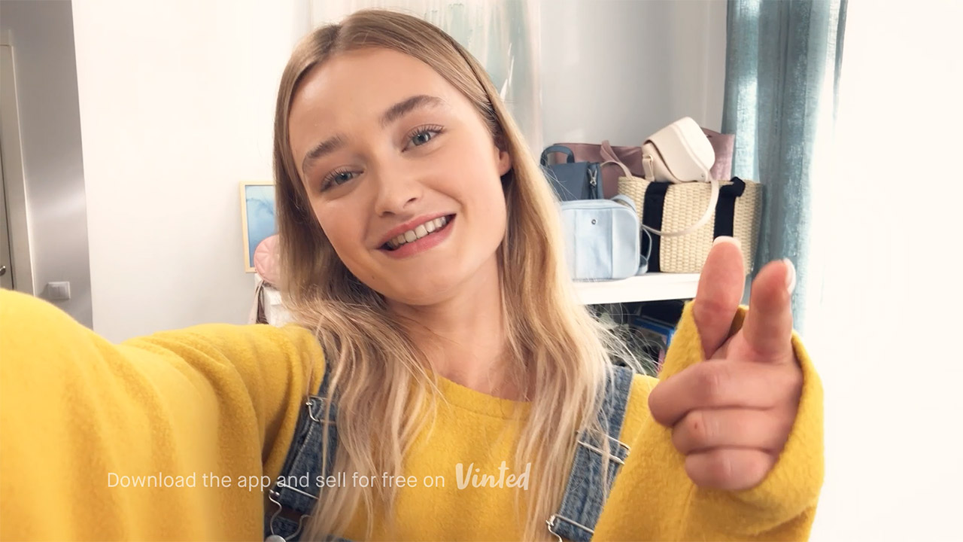
Get Minted with Vinted
Challenge
Following successful campaigns in Europe, Vinted were looking to launch their app in the competitive UK market
Solution
Adopted a test and learn approach around audience-centric planning, value optimisation, integrated creative and bespoke scheduling
This led to a younger target audience, a Sunday to Thursday skew into more peak, high quality programming with their 30” creative
Results
63% increase in the baseline of new listers
Notes:
The Challenge
Fashion marketplace app Vinted was looking to launch in the UK following successful TV campaigns in France and Germany. VCCP Media, Vinted’a media agency, knew the challenge of launching Vinted in the UK would be twofold.
Firstly, Vinted was entering an extremely competitive market already populated with established brands such as Ebay, Shpock, Gumtree and Depop. They also knew, due to the social nature of the Vinted app, they were competing against well-loved online fashion marketplaces such as ASOS, Boohoo.com and PrettyLittleThing for audience share and attention.
Secondly, Vinted’s success with their European TV campaigns came from their broad buying parameters and focus on inexpensive short-form TV ads. This meant that VCCP had to mimic performance with their own activity in the UK, while also setting them up for long-term growth.
The TV Solution
Across Europe, they had adopted a low-cost, high frequency and broadly targeted campaign. However, VCCP believed that Vinted’s European TV buying strategy wouldn’t cut through and create long-term growth in the UK due to local nuances, competitor aggression and audience insights. A test and learn approach, that would prove the benefit of taking a longer-term view to TV buying, was recommended and would cover four key areas: audience-centric planning, value optimisation, integrated creative and bespoke scheduling.
Research showed that younger audiences were more open than ever to their clothing and fashion choices, which suggested that Vinted could be a tool in helping them create their own images. VCCP also addressed the balance between cost efficiency and awareness and tested creative variations to understand what landed with the audience. Finally, the daytime-only scheduling brief was amended with the need to upweight weekends (as many of the audience were employed) and was expanded further into post-peak to test programming environments which were perfect for the audience.
The Plan
The launch plan in January 2018 was a small 3-week test to gather learnings around the audience and creative. They ran 30”, 20” and 10” adverts with two different stories – 6 copies in total – and started with a broad audience target of Women 18-44s with a Sky stations focus at a low adult CPT. While the plan had a female skew, VCCP also analysed the effect of airtime skews towards other audiences (e.g. Young vs Old, Male vs Female, ABC1 vs C2DE) to understand which audiences were more likely to download the Vinted app. The results from the initial campaign were promising, with Vinted beating their CPA target by 9% and quickly seeing the potential for further growth and expansion.
After a few months of data, VCCP could see that 70% of Vinted customers were aged 16-25. However, this segment only accounted for 7% of the population. Data analysis also provided an insight into the target market: the more young and female the airtime was skewed, the more responsive it became. The next stage was making the copy resonate with this audience and so Vinted developed an advert to connect with younger viewers which featured them using the app itself, with the talent talking in ‘selfie mode’ on a mobile phone and the phrase “Get Minted with Vinted!”.
After establishing the most optimal audience planning, the first large campaign was planned across 5 weeks in February and March 2018. The campaign was scaled up to reach a much larger audience and awareness was growing. The other major change was time-length, with Vinted preferring the 10” copy as this time length had performed better in Europe compared to the longer time-lengths. So, for this burst, they rotated the time lengths in a 3:1:1 ratio of 10”:20”:30”. The results of this campaign were positive, although VCCP believed that the increase in 10” activity had reduced the potential effectiveness of the campaign. They used regression analysis alongside an attribution model that showed that the 30” copy outperformed the 10” due to its longer-term effect over immediate response.
VCCP also noticed that, when looking at dayparts, weekends had a lower response rate than weekdays. However, Sunday had a similar response rate to Tuesday with many more impacts, meaning Sunday was performing well to maintain this response rate. It was decided that the next campaign would have a Sunday to Thursday upweight, fitting with the younger audience as they are more likely to be out and about or thinking about other things on a Friday/Saturday night compared to a Monday or Tuesday. This was important as it took Vinted away from the traditional “retail” day of week strategy and stood them apart from the competition, making their voice louder on key days.
The final campaign of the year had the most highly refined audience strategy, designed to cut-through and make a rapid and meaningful impact with the audience. VCCP focused on more expensive but highly targeted airtime where the 16-24 audience had a deeper connection with the content. They carefully examined competitive weights within the most efficient channels, concentrating on buying spots to ensure Vinted had a disproportionate share of voice. They also started measuring the impact of the TV campaign over a longer time period. For the first, smaller burst, there was a shorter lag period and the installs returned to the base level 11 days after the campaign finished. However, the second, larger burst provided a much more pronounced time lag. In fact, the day before burst three, installs were 253% above base, proving that the larger campaign had produced a much longer lag period. Vinted and VCCP therefore started measuring applications until they returned to their base level, to monitor the full effect of a targeted TV campaign
Results
In 2018, Vinted was a huge success, resulting in downloads exceeding expectations and a lower cost per download than the targets set. With the move away from a cheaper, performance-led approach to the TV campaign, Vinted was able to become a bigger player in a shorter period of time and had spots in key programming for 18-24s such as Love Island and I’m A Celebrity Get Me Out of Here, by being able to demonstrate their effect in both the short and long-term.
The final October-November campaign was the biggest and saw a budget increase of 15 times the initial January test spend. Performance across the year lead to an increase in the baseline of new listers of 63% in the UK. Because of these achievements, Vinted is set to invest more into TV in 2019.
The campaign was a finalist in the 2019 TV Planning Awards ‘Best Newcomer to TV’ category.

