Slide 1


TV partnerships nickable charts
`
UPDATED APRIL 2026
Love Island/eBay - ITV

Slide 2
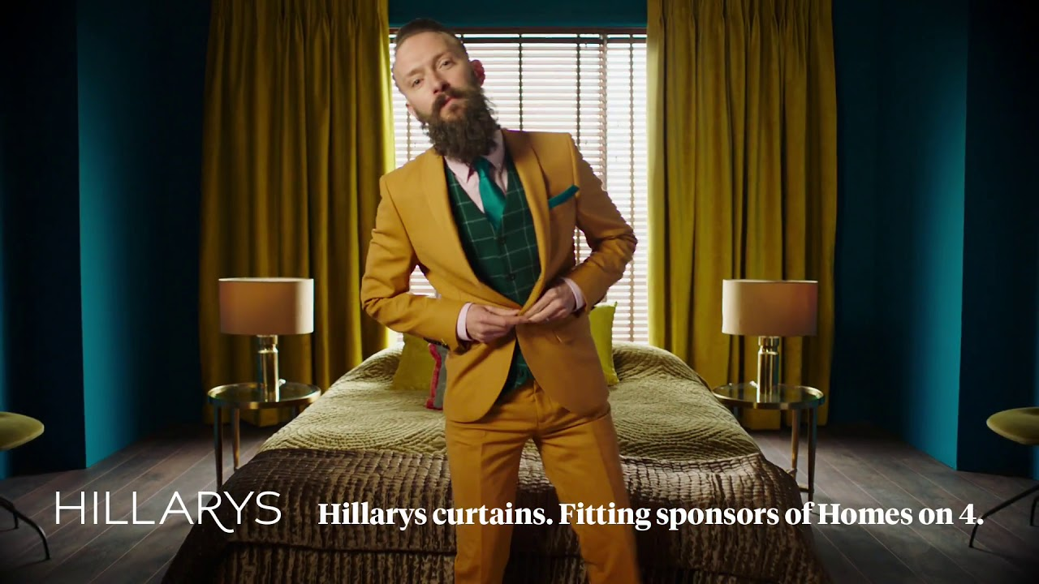
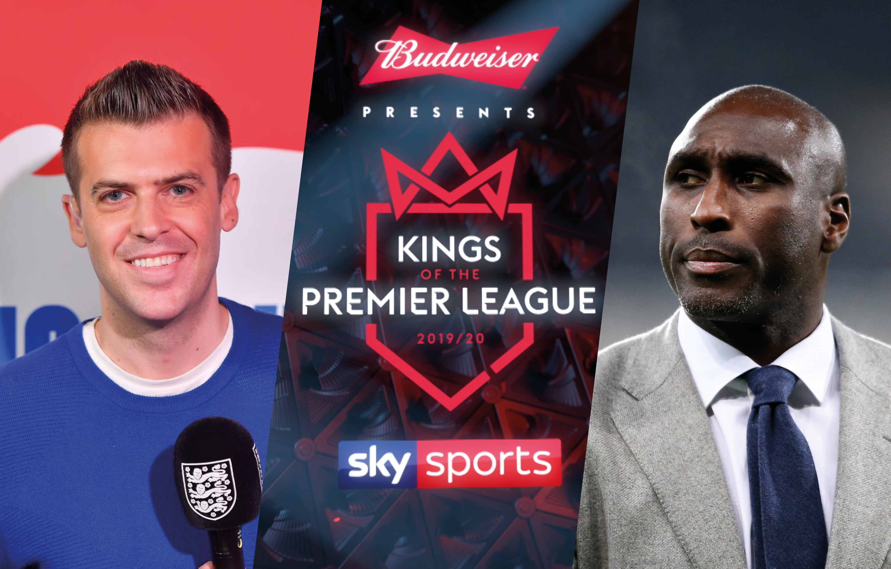
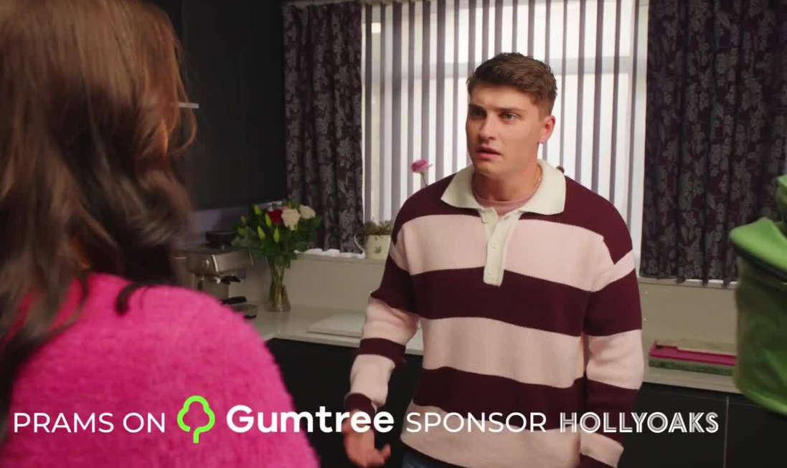
The power of TV partnerships
Programme partnerships drive brand awareness and strengthen brand health
Partnering brands benefit from increased brand stature
The effects of sponsorship are long-lasting
Notes:
TV partnerships have powerful effects
Programme partnerships drive brand awareness and strengthen brand health
Partnering brands benefit from increased brand stature
The effects of sponsorship are long-lasting

Slide 3

TV partnerships are special
Partnerships work implicitly by strengthening subconscious brand associations
Brands borrow values and attributes from TV content
TV sponsorship is perceived to be costly, so signals success by taking advantage of ‘costly signalling’
World Cup/ KFC - ITV
Notes:
TV partnerships are special. They have a certain magic of their own and form a relationship with the viewer that sets them apart from spot advertising and means they work quite differently.
TV partnerships work implicitly
TV partnerships can significantly drive brand health, by increasing and strengthening the positive subconscious associations viewers have with the partnering brand.
Borrowing values from TV content
People love their favourite TV shows, and brands that sponsor them can share in that love and borrow from the show’s personality. For example, if a brand sponsors a comedy show then they can come to seem more light-hearted, if it sponsors a youth programme they can be seen as more youth-oriented.
TV partnerships act as a ‘costly signal’
Partnering with TV shows takes advantage of ‘costly signalling’ – TV sponsorship is perceived to be costly, so it signals success.
For more info, please see:
https://www.thinkbox.tv/how-to-use-tv/sponsorship-and-content/content-partnerships/get-with-the-programmes/

Slide 4

Maximising effect
Creative fit is key
Integrated partnerships work much harder
Play the long game: long-term partnerships deliver better brand results
Future of Ageing / AXA - Sky
The Great British Bake Off / Sainsbury’s – Channel 4
Love Island/eBay - ITV
Notes:
Creative fit is key
TV sponsorships which have a strong creative fit with the TV show benefit from increased brand health metrics amongst viewers of the programme, magnifying the sponsorship’s effects.
Integrated partnerships work much harder
Fully integrated sponsorships – those that include additional activity such as bespoke spot advertising, microsites, product placement, programme talent or licensing – drive higher brand health metrics amongst viewers compared with a ‘badging-only’ sponsorship approach.
Play the long game
Longer-running sponsorship campaigns drive increased brand health when compared with shorter campaigns.

Slide 5
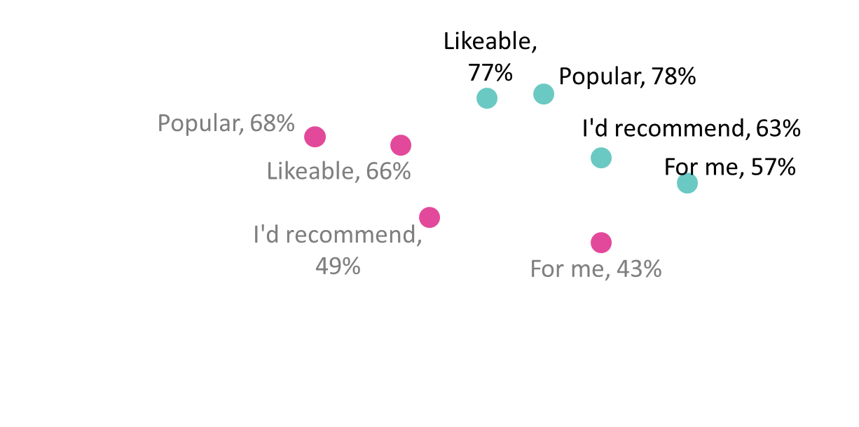
TV partnerships are a powerful driver of brand health
100%
HIGH, MORE EFFORT
HIGH & AUTOMATIC
% AGREE
Non Viewers
Viewers
0%
LOW, MORE EFFORT
Avg RT
across positive words
LOW & AUTOMATIC
Reaction time
Source: Get with the Programmes, 2017, Thinkbox/House 51. Perception of sponsorship brand.
Base: 8 sponsorships (1,199 viewers; 1,202 non-viewers)
Notes:
Thinkbox’s study ’Get with the programmes’ demonstrated how TV partnerships are a powerful driver of brand health.
This chart shows how the perceptions of brands sponsoring TV shows were more positive amongst viewers of the programmes, compared with non-viewers.
Research agency House51 tested eight partnerships and found that on average viewers of the TV programmes being sponsored are both more likely to agree with positive brand statements and are also likely to agree much faster than non-viewers. This shows that programme partnerships are working at an implicit level and driving automatic, positive brand associations.
For more information, please see:
https://www.thinkbox.tv/research/thinkbox-research/get-with-the-programmes/

Slide 6
Sponsorships magnify a brand’s stature for viewers
78%
*Sig higher
68%
% AGREE BRAND IS POPULAR
Source: Get with the Programmes, 2017, Thinkbox/House 51.
Base: 8 sponsorships (1,199 viewers; 1,202 non-viewers). *Statistically significant to 95%
Notes:
Viewers of sponsored TV programmes are significantly more likely than non-viewers to think of the sponsoring brand as popular.
This is because TV sponsorship is perceived to be costly, so it signals success by taking advantage of ‘costly signalling’.
For more information, please see:
https://www.thinkbox.tv/research/thinkbox-research/get-with-the-programmes/

Slide 7
Creative fit is key to maximising impact of TV sponsorship
CREATIVE CONSISTENCY BETWEEN IDENTS & TV SPOT ADS
SPONSORSHIP FIT WITH PROGRAMME
*
*
69%
62%
% BRAND CONSIDERATION
41%
32%
Source: Get with the Programmes, 2017, Thinkbox/House 51
Base: 8 sponsorships – all viewers (poor prog fit 115; good prog fit 608; poor consistency 156; good consistency 538). *Statistically significant to 95%
Notes:
Maximising the effects of TV partnership is dependent on creating a strong fit with the programme through the sponsorship creative.
Viewers who perceived a sponsorship to have a good fit with the programme, or a good fit with the brand’s other advertising, had significantly higher brand consideration for the sponsoring brand than those that considered the fit/creative consistency to be poor.
For more information, please see:
https://www.thinkbox.tv/research/thinkbox-research/get-with-the-programmes/

Slide 8
TV sponsorship boosts awareness for lesser-known brands
% POINT DIFF VIEWERS VS NON-VIEWERS
Source: Get with the Programmes, 2017, Thinkbox/YouGov.
Base: 6 high awareness brands, 5 lower awareness brands
Notes:
Analysis of YouGov research data demonstrates that TV sponsorship is effective at increasing awareness for lesser-known brands.
This chart shows that lower-awareness brands who sponsor TV shows are much more likely to benefit from increased brand and ad awareness than brands which are already better-known.
For more information, please see:
https://www.thinkbox.tv/research/thinkbox-research/get-with-the-programmes/

Slide 9
The more integrated the sponsorship, the better
% POINT DIFF VIEWERS VS NON-VIEWERS
Source: Get with the Programmes, 2017, Thinkbox/YouGov.
Base: 22 badging only, 9 some integration, 4 fully integrated
Notes:
Analysis of YouGov research data demonstrates that the more integrated a sponsorship is with other forms of marketing activity (e.g. bespoke spot advertising, microsites, product placement, programme talent or licensing), the harder it works at driving brand health measures for the sponsoring brand.
All TV sponsorship has positive effects, but fully integrated campaigns work the hardest.
For more information, please see:
https://www.thinkbox.tv/research/thinkbox-research/get-with-the-programmes/

Slide 10
Long-term partnerships deliver better brand results
% POINT DIFF VIEWERS VS NON-VIEWERS
Source: Get with the Programmes, 2017, Thinkbox/YouGov.
Base: 15 below twelve months, 7 three years and over
Notes:
Sponsorship works by facilitating, nurturing and embedding a relationship between programme and brand within the mind of a viewer. The longer a partnership runs for, the longer it has an opportunity to develop effects.
This charts shows how sponsorships which run for three years and longer drive improved brand health amongst viewers of the sponsored programmes, when compared with shorter sponsorships of less than 12 months.
For more information, please see:
https://www.thinkbox.tv/research/thinkbox-research/get-with-the-programmes/

Slide 11
The brand effects from sponsorship are long-lasting
% POINT DIFF VIEWERS VS NON-VIEWERS
Source: Get with the Programmes, 2017, Thinkbox/YouGov.
Base: 16 completed campaigns
Notes:
The brand effects of sponsorship are long-lasting.
Analysis of YouGov research data shows that brand health metrics for brands which had recently ended a sponsorship decayed at a much slower rate when compared with ad awareness.
For more information, please see:
https://www.thinkbox.tv/research/thinkbox-research/get-with-the-programmes/

