Slide 1


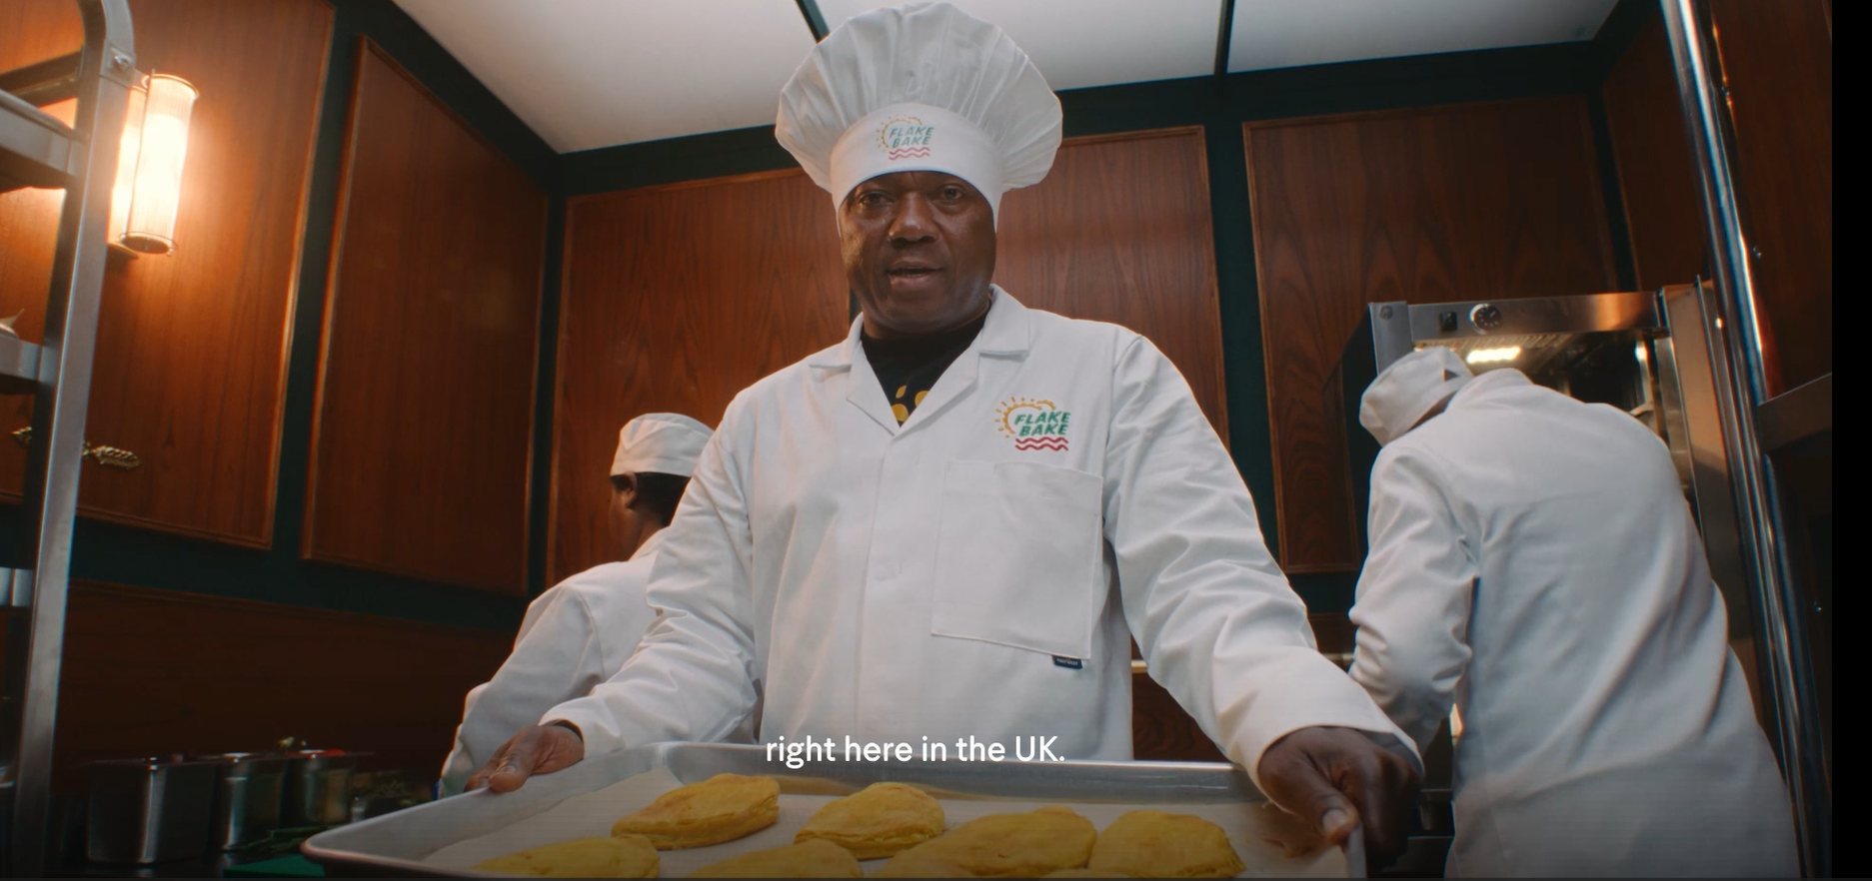
Flake Bake: First time TV with Channel 4 and Lloyd’s Black in Business Initiative
The Challenge:
Flake Bake are a black owned business that specialise in Jamaican Patties, a staple of Jamaican cuisine. Founded in 2012, the brand has sold over 6 million patties to date but were looking to continue to increase sales and grow brand awareness.
The Solution:
As beneficiaries of Channel 4 and Lloyds’ ‘Black in Business’ Initiative, Flake Bake launched on TV with £150,000 of gifted airtime from Channel 4.
The Results:
Brand awareness peaked at 20%, within 2% of their main competitors. Sales doubled in Aldi between September 2024 and September 2025.
Notes:
The Challenge
Flake Bake are a Black Owned business which specialises in Jamaican patties, the Cornish pastie inspired staple of Jamaican cuisine. Founded in 2012 by the father and son team of Paul and Mike Williams, the brand became South London’s largest provider of handmade Jamaican Patties, selling over 6 million patties.
But Flake Bake had ambitions to grow further as a business, looking to increase sales and grow brand awareness amongst a growing trend of Caribbean food lovers and a rapidly growing category.
The TV Solution
Having built their brand through organic growth and social campaigns, Flake Bake wanted to take the next step. Having learnt of Channel 4 and Lloyds ‘Black in Business’ Initiative, they jumped at the chance to enter the scheme and leverage the power of TV.
Black in Business, now in its second iteration, was designed to highlight the struggles facing black owned businesses when it comes to funding and growing a business, with research from Lloyds highlighting that the majority of Black Owned businesses only receive funding when already established, and just 0.24% of funding from venture capitalists going to black owned businesses.
Channel 4 saw an opportunity to rectify this by launching the initiative in partnership with Lloyds. The scheme sees Channel 4 gift £150,000 of airtime to 4 businesses who are looking to grow their brands. Alongside this, the winners also receive 6 months of mentoring from senior executives from both Channel 4 and Lloyds.
Flake Bake were one of 200 applicants to enter the initiative, viewing the scheme as the perfect way to drive awareness and sales through the unique power of TV.
Along with 3 other winners, Flake Bake won £150,000 in airtime to launch on TV for the first time.
The Plan
Armed with a brand-new creative produced by Quiet Storm, and a plan devised by Channel 4’s commercial sales team, Flake Bake were ready to take on TV for the first time.
Activity kicked off with a premier break on 1st July with Bake Off: The Professionals - the biggest show on Channel 4 that day.
Having successfully launched the brand alongside the other winners, Flake Bake continued their campaign in August across Channel 4, More4, E4 and Film4, as well as Channel 4’s partners sales channels in UKTV and Warner Brothers Discovery, and on linear and BVOD across Channel 4 Streaming.
Key programming for Flake Bake included Sunday Brunch - a weekend staple for Channel 4 - as well as spots in Countdown, Help! We Brought a Village, Channel 4 news and George Clarke’s Kitchen vs Garden. This access to top programming was mirrored on Channel 4 Streaming, with Flake Bake’s campaign showing in Gogglebox, The Great British Bake Off, Celebs Go Dating and Married at First Sight UK, ensuring the campaign reached their target audience regardless of the platform.
Results
Against their key objectives, the campaign was a huge success. Flake Bake increased brand awareness to a peak of 20%, moving within 2 percentage points of competitors in their category. This led to a rise in consideration, and subsequently an increase in sales, with sales doubling in Aldi stores between September 2024 and September 2025. As a result, the brand leveraged their TV activity into a product expansion with Aldi in 2026, allowing greater store access, shelf space, and products to be available across the country. When reflecting upon their TV activity, Paul and Mike acknowledged that the campaign had taken Flake Bake and elevated the business to a nationwide brand.

