Slide 1


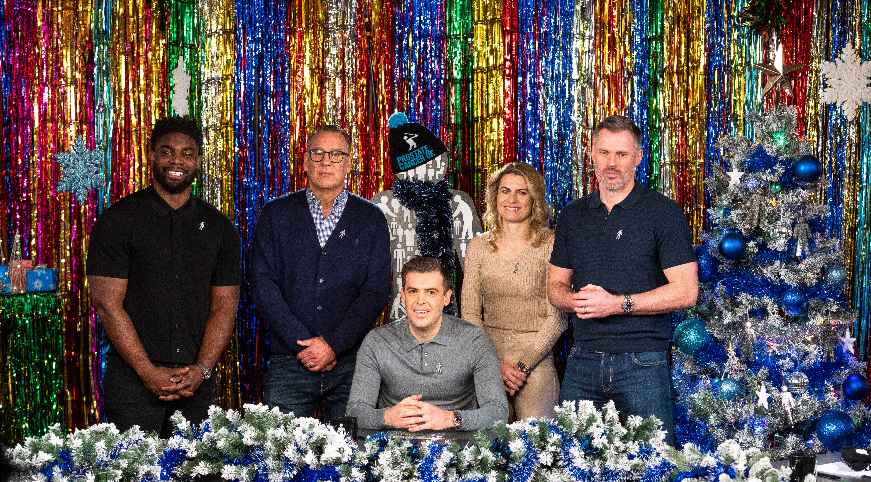
Prostate Cancer UK partners with Sky Sports
Challenge
Prostate cancer is the most common cancer in men, affecting 1 in 8 in the UK
Prostate Cancer UK wanted to increase brand awareness and emotional sentiment
Solution
They developed a branded content partnership with Sky Sports, sharing real-life stories and raising the profile of the cause by leveraging sporting talent
Results
Awareness increased by 2.5%
Brand consideration grew by 5.4%
An 8.4% uplift in brand familiarity was delivered
Notes:
The Challenge
Prostate cancer is the most common cancer in men. The disease affects about 1 in 8 men in the UK. Prostate Cancer UK exists to fund lifesaving research to stop prostate cancer killing, and so raising awareness and sparking conversation could not be more important.
The specific nature of the charity’s cause means they often rely on ‘connection to cause’ as a driver for awareness and fundraising, which automatically skews the audience focus to those who are most at risk - men 45+. In a category that spent almost £450m in 2021 and which was impacted by the pandemic-related shift in charitable giving to NHS causes, Prostate Cancer UK, with its modest budget, wanted to increase brand awareness and emotional sentiment towards the brand.
The TV Solution
The campaign encouraged men to open up to have conversations that sometimes feel awkward and avoidable. Prostate Cancer UK wanted to share real-life stories told by everyday people as they knew they would resonate with the audience and help to generate an emotive response.
Sport is a huge passion point for this audience, and so using it as the unifying force provided a natural territory to reach them in. As TV is by far the best channel to drive emotional connection and the leading story-telling medium, the7stars were certain that Sky Sports would be the perfect match. They developed a branded content partnership, driving value and providing access to strong editorial content, which would not only deliver Prostate Cancer UK’s emotive message, but also raise the profile of the cause by leveraging well known sporting talent.
The Plan
Knowing that relationships are central to peoples’ lives, three key periods were identified throughout the year focusing on men and their partners, families, and friends.
The first phase was Valentine’s season – short documentary assets were played out telling the real-life stories of men and their partners whose lives had been affected by a prostate cancer diagnosis.
The Summer of Sport with its rich array of sporting content and co-viewing family moments was the second phase and included three content pieces featuring sporting talent having open and honest conversations on the sometimes-uncomfortable subject of men’s health with close relatives. The content played out in relevant shows and during live sporting events such as the Lions Rugby Tour.
Finally, in December, where social occasions with friends were most pertinent, especially after almost 2 years of on/off lockdowns, well-known, high-calibre Sky talent were used to create a fun and engaging Christmas quiz which then went into an impactful conversation around men’s health and prostate cancer specifically. A shortened version of the quiz also featured in Sky Sports News coverage on Christmas Day and 20” and 90” cutdowns also played out across Sky Sports, Sky Entertainment, C5 and Sky Cinema broadening reach.
Furthermore, all of the elements were supported by cutdowns across linear TV, digital native articles and social media activity.
Results
Awareness increased by 2.5%
Brand consideration grew by 5.4%
22% of people exposed said they felt included and 19% said they felt inspired
Ad recall increased by 16%
8.4% uplift in brand familiarity
The Quizmas Cracker delivered 15.2m linear impacts and 436k views on YouTube

