Slide 1
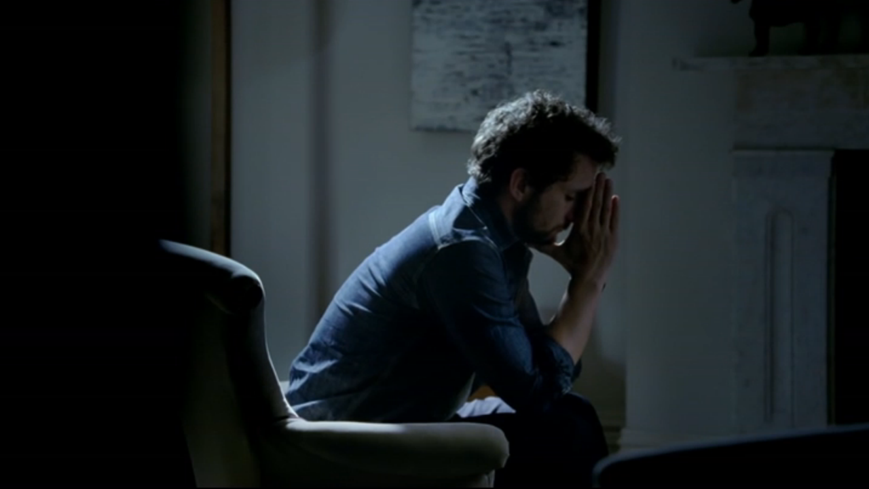
Pinterest pinned their hopes on TV
Challenge
Pinterest wanted to take their brand to the next level & increase comprehension that Pinterest is a source for everyday ideas
The challenge was to accelerate Pinterest’s growth in the UK by driving spontaneous awareness of the brand & unlocking its potential
Solution
Pinterest created innovative, contextual spots that were immediately relevant to the programming content that had just gone before, exclusively on Channel 4
Results
After one month, spontaneous awareness had doubled
Ad awareness tripled
Searches for ideas in the ads increased by 75%
Notes:
The Challenge
Pinterest is a visual discovery app that helps people find ideas for their life including dinner recipes, home and style inspiration, and more. It offers a catalogue of more than 100 billion ideas that inspires people to ‘go out and do that thing’. It is a treasure trove of everyday ideas – from how to entertain your kids on a rainy day, to how to wear Breton stripes, to what to do with your one pot salad that evening.
Pinterest launched in 2010 and had been growing in popularity. However, in 2016, they wanted to take the brand to the next level and increase comprehension that Pinterest is a source for everyday ideas from what to cook for dinner to how to create your own personal style. Non Pinners had heard about Pinterest but might have perceived it as a social network or a destination for only big ideas.. The challenge was to accelerate Pinterest’s growth in the UK by driving spontaneous awareness of the brand and unlocking its potential, making it THE place to go for every-day, useful ideas.
The Solution:
Mediacom, Pinterest’s media agency, advised them that TV was the best place to advertise if they wanted to drive brand perception shifts and top of mind awareness. However, their budget was limited and so they opted for an exclusive deal with Channel 4 in order to make their money work harder. They chose Channel 4 because it had the right audience profile for the brand and also the scale to reach enough people to make an impact. In addition, Channel 4 had a strong raft of programming that would allow Pinterest to make the association with everyday ideas in three topic areas where Pinterest has strong content - food, fashion and parenting.
Pinterest wanted to take full advantage of the ideal programme environment and so they created innovative contextual spots that were immediately relevant to the programming content that had just gone before. They turned dialogue from these programmes into everyday food, fashion and parenting ideas, pinned live in the ad break to the shows. This meant that the ideas were directly relevant to the content the audience was watching and the programmes they love.
Results
They reached 74.2% coverage at an average frequency of 8.6 with their always on presence from May to December
After only one month of activity, spontaneous awareness had doubled and by the end of the year it was at an all-time high – 242% higher than launch
Over the same period, ad awareness tripled
Significant movement with regards people agreeing to the statement – ‘Pinterest is great for useful everyday ideas’ – up 60%
Searches for the ideas in the ads increased on average by 75% at the time the content aired
Intent to download the Pinterest app increased by 132%
Campaign was shortlisted in TV Planning awards ‘Best Newcomer to TV’
To read the full case study and access the creative visit: https://www.thinkbox.tv/Case-studies/Pinterest-pinned-their-hopes-on-TV

