Slide 1
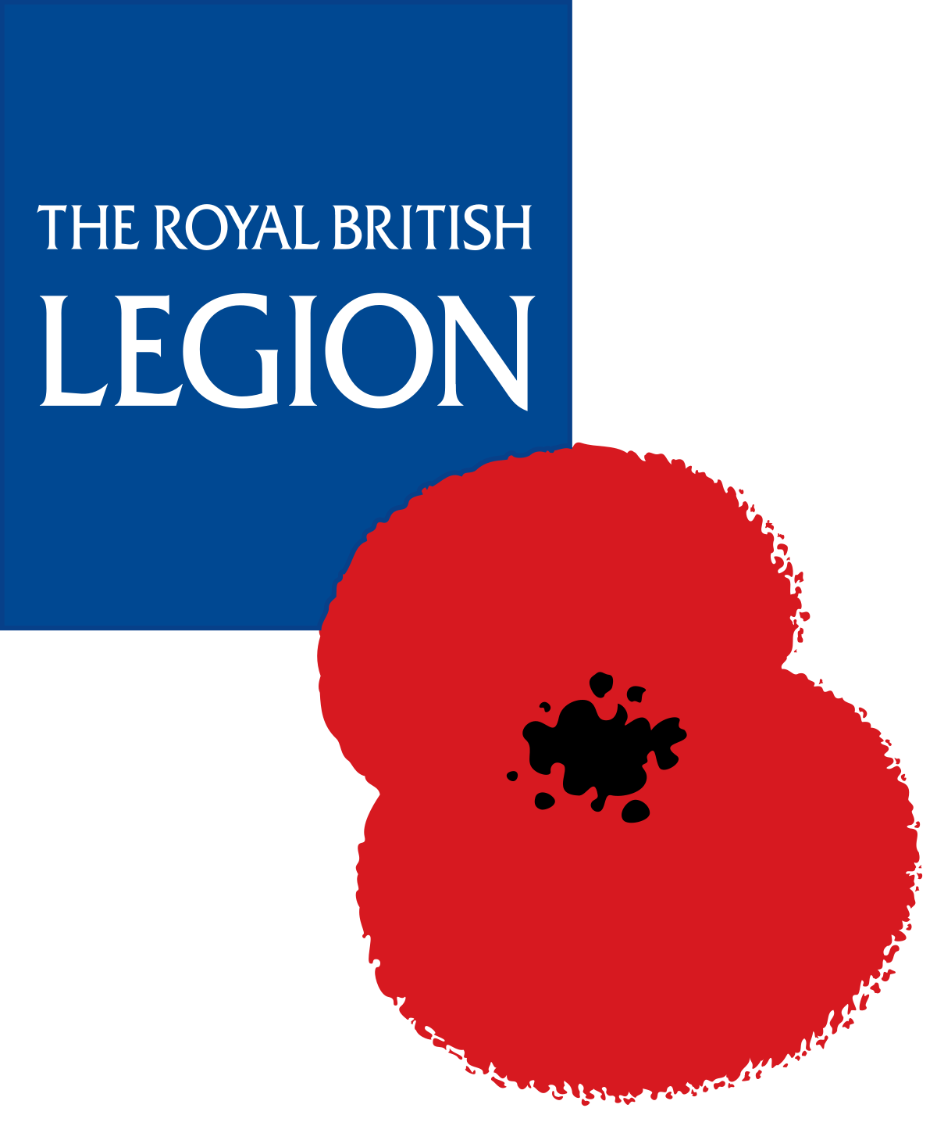

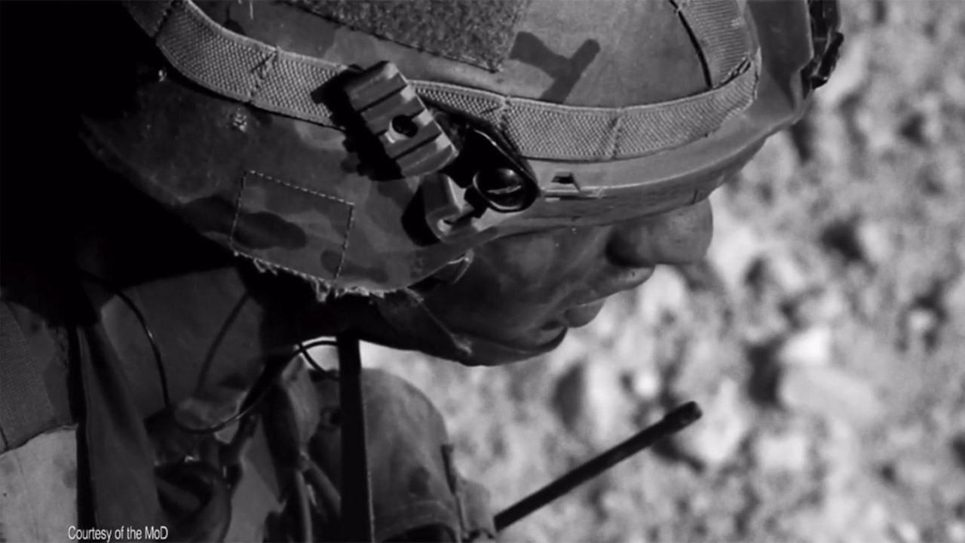
The Royal British Legion changed people’s perceptions
Challenge
The Royal British Legion needed to change perceptions and engage younger audiences
They wanted people to understand all the work they do to support current and ex armed forces personnel
Solution
They created a long form video to leverage the emotional power of TV and cherry picked spots in programmes that people watch together
Results
They engaged younger audiences and changed the way people feel about the RBL – 60% felt supportive, 52% felt proud and 57% felt closer
Notes:
The Challenge
The Royal British Legion (RBL) was founded in 1921, uniting four armed forces charities that had emerged from WW1. RBL supports serving and ex-serving members of the Royal Navy, Royal Marines, British Army, Royal Air Force, Reservists and their families.
The Legion is at work 365 days a year, running 16 pop-in centres, sports and art-based recovery programmes and award-winning care homes, providing practical advice, one-to-one support, community events, fundraisers and much more. The Royal British Legion also play a huge role during the Remembrance period, coordinating the Poppy Appeal and various events across the country.
However, most people didn’t know this. Many people thought that the Legion supported those who served in the World Wars and whilst they know of the Poppy Appeal, they think that money collected is given to older veterans and they do not associate it with RBL. Many people also thought that as WW1 veterans die, that the work of the Legion will be done.
The Royal British Legion needed people to understand that they are as relevant today as they were in 1921. It is just as important that they support the families of current serving armed forces as it is to maintain their care homes where older veterans live.
There were three clear objectives:
Change the way people feel about The Royal British Legion
Help them understand what they do beyond Remembrance
Engage younger audiences.
The TV Solution
It all started with an insight around conversations. Leagas Delaney, RBL’s creative agency, explored a powerful creative route called “They still go”. During the creative development focus groups, the media team noticed that the idea had the most power when people turned to their neighbours and said, “I never knew that” or “it really makes you think”. As an emotionally hard-hitting film, everyone left the room discussing The Royal British Legion and vowing to find out more.
VCCP Media, RBL’s media agency, wanted to use media to communicate to people in an environment where they could turn to family or friends and say, “I’ve never thought about it like that”. They wanted to inspire conversations by tapping into those moments when people come together.
The target audience was 25-44-year-olds and the goal was to evoke emotion. A long-format video was agreed upon to leverage the power of TV.
The Plan
The plan was to place the spots whenever there is shared viewing and in programmes likely to be discussed. VCCP Media started by mapping moments when the nation comes together to share experiences and opinions. The strategy was called “There when it matters”.
Autumn/winter is a strong time for TV viewing and contains some key cultural moments, such as the Rugby World Cup, The Great British Bake Off and The X Factor, with the post-Christmas period also an important time, as people watch more TV with their families and younger viewing increases. Therefore September 2019 – January 2020 was the broad campaign period that was chosen.
They created a cherry-picked schedule of national moments and shared viewing to build effective coverage and frequency whilst maintaining Adstock. They secured a package of seven spots in the Rugby World Cup which helped to reach lighter viewers. They advertised in live Premier league games on BT Sport to reach younger viewers and family and friends watching together. They also were able to identify contextually relevant spots such as an episode of Long Lost Family which was an unknown soldier special. They bought high levels of peak and centre breaks.
BVOD was utilised to reach lighter viewers in appointment to view programmes for viewers who had timeshifted to watch together. On ITV Hub and All4, the programme strategy mirrored the TV schedule to maximise incremental reach.
They leveraged multi-screening to extend discussions about RBL from the living room to social media. They also identified where people engage in broader conversations in digital spaces such as Facebook, Twitter and Instagram.
Results
The emotional connection of shared TV was leveraged to maximise audience conversations and digital channels deepened engagement.
68% reach of adults and 59% reach of ABC1 adults aged 25 to 44 on TV
84,600 click throughs from 16.5m social impacts
The campaign changed the way people feel about The Royal British Legion, as 60% of respondents to the brand tracker felt Supportive, 52% felt Proud and 57% reported feeling closer to The Royal British Legion
The campaign also helped people understand what The Royal British Legion do. 81% of respondents said they liked the creative and they understood it was about the sacrifice of the soldiers and the work of the RBL
Younger audiences were engaged – 41% of 18 to 24s recognised the campaign compared with 26% of 45+ adults

