Slide 1
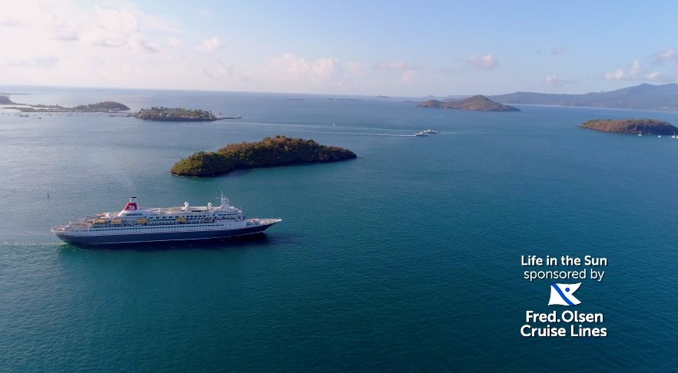
Fred. Olsen – Cruising up the awareness rankings
Challenge
Grow passenger booking in Scotland by 10%
Build trust and grow awareness in Scotland with the Fred. Olsen ABC155+ audience
Solution
Fred. Olsen had never used brand TV, Total Media proposed a solution different to anything they had done before.
Total Media & STV developed a sponsorship that would build awareness and trust of Fred. Olsen
Results
Doubled their % increase booking target for the Scotland port
In Scotland they were second only to P&O Cruises in unprompted awareness
Fred. Olsen had their ‘best year ever’ in terms of number of cruise sales
Notes:
The Challenge
In 2018 Fred. Olsen was rated the 10th best cruise liner in the world by Which? despite this, poor sales over several years had meant that their port in Scotland had become a ‘problem port’ and was on the verge of closing down.
In an attempt to prevent this and to appeal to a wider audience, Fred. Olsen decided to increase the number of routes from the port, but simply adding the new routes was not enough, with a modest budget, Fred. Olsen had to find a sustainable way to support and promote the port in order to sell enough cruises to keep the port open.
There key objectives were:
Grow passenger booking in Scotland by 10% to make the ‘problem port’ in Scotland a long term viable option for Fred Olsen to continue running cruises from
Build trust in Scotland with the Fred. Olsen audience, ABC1Ads55+ in TV demographics, to prove that Fred. Olsen is the cruise brand for them
Continue to grow awareness amongst the Scottish audience
The TV Solution
Fred. Olsen have never used brand activity on TV before. This existing approach would therefore make it difficult for Fred. Olsen to maintain awareness in Scotland and crucially drive sales. In order to meet the business objectives Total Media had to come up with a solution that was different to anything that Fred. Olsen had done before.
Learnings taken from various research resources including Thinkbox’s ‘Get with the Programmes’ helped Total Media arrive at the conclusion that a well-executed sponsorship would be a viable, cost effective and sustainable solution. Using Scot Pulse surveys, Total Media identified that STV would be the best environment to help Fred. Olsen
Total Media developed a sponsorship with STV that would build awareness and trust of Fred. Olsen and provide access to those relevant dayparts, across the most important sales period of the year (January and February). Working with Fred. Olsen and STV, Total Media cam up with the tagline ‘Escape the Winter Blues and get closer to the action with STV sponsored by Fred. Olsen’.
The Plan
‘Escape the Winter blues and get closer to the action with STV sponsored by Fred. Olsen Cruises’ launched on New Year’s Day.
The sponsorship gave Fred. Olsen great access to a daytime audience who may be familiar with Fred. Olsen due to their previous DRTV activity, as well as presence in 4 peak programmes – a daypart which was completely new to Fred. Olsen.
This was coupled additional DRTV on the STV2 channel which Total Media had negotiated to be included as part of the package. The activity in Scotland was part of a full funnel approach with the sponsorship sitting at the top of the funnel, with additional press partnership to give further information to the audience, and a significant amount of biddable and display activity running at the same time to effectively capture demand.
Results
Fred. Olsen more than doubled their % increase booking target for the Scotland port
Fred. Olsen Cruise Lines (FOCL) was mentioned by over 1 in 4 unprompted – meaning their unprompted awareness in Scotland was second only to P&O Cruises
Fred. Olsen deemed the sponsorship to be so much of a success they tasked Total Media to negotiate a deal to extend it to run for the rest of 2018.
Fred. Olsen went onto have their ‘best year ever’ in terms of number of cruise sales

