Slide 1
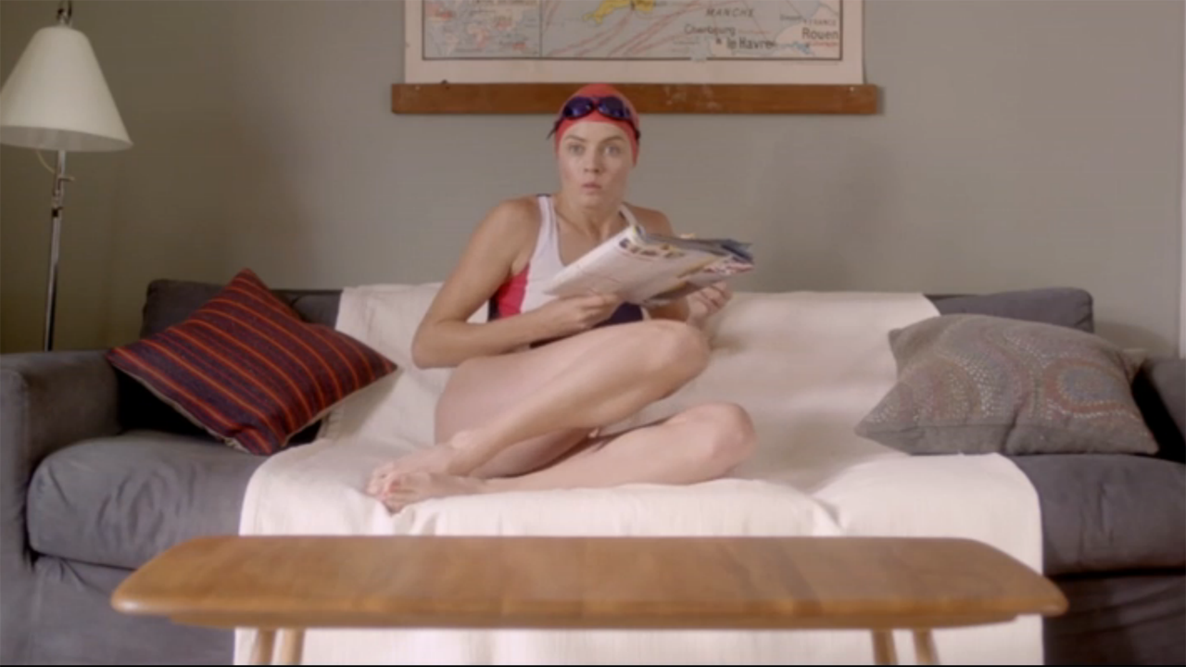
Radio Times achieved record sales with some tactical telly
Challenge
Radio Times needed to support their bumper Olympics issue with a sales target of 805,000 copies
Solution
With the message ‘Don’t miss it’, they created an ad showing a swimmer missing her race, encouraging viewers don’t to miss out on their favourite TV shows
To maximise reach, they had spots in 5 out of the top 10 programmes of the week and piggybacked Channel 4’s Paralympic campaign to add context
Results
Sales exceeded the target by 185,000 copies.
The ROI was 1.14:1.
Notes:
Challenge
Radio Times is one of the country’s best-loved brands and one that the Great British public look to for coverage of key national events. Despite the rapid growth of free sources of TV information, it is the 3rd biggest magazine in the UK.
In the summer of 2012, they were planning a bumper edition of the magazine covering the Olympics. However, the 72 page pull-out meant that the cover price would have to be pushed up to £2 from its normal £1.40.
The sales target was set at 805,000 copies. The challenge was to persuade the public to pay an additional 60p for the magazine when information around the games was already plentiful. This was made more difficult due to a marketing budget of under £100,000, at a time of incredible media noise and the fact that the magazine’s shelf-life was only a week long. They needed something that was fast and effective.
The Solution
Despite the fact that Radio Times had not advertised on TV since 2006, they made the decision that only TV could deliver the impact and scale of results they needed. They made an ad that was both light-hearted and emotive featuring an Olympic swimmer realising that she has missed her big moment in the pool. The ad was 10 seconds long in order to keep costs down. They felt that this quick and personal hit of emotion, which ran against the grain of their competitors, would deliver the hefty sales target required.
They had a very tight window in which to advertise and needed to make a big splash so opted for some big rating spots. Also, they felt that the message of ‘Don’t miss it’ would sit perfectly in shows that viewers dread missing. They bought spots in 5 of the top ten programmes in that week including Dancing on Ice and Coronation Street. In addition, they piggy-backed Channel 4’s ad for the Paralympics in order to add context.
Results
The gamble to invest in just one issue of the magazine paid off as sales reached 990,000 copies – smashing their sales target by a staggering 185,000 copies. This made it the highest selling issue in recent history (excluding the Christmas edition).
The ROI was 1.14 : 1
To read the full case study and access the creative visit: https://www.thinkbox.tv/Case-studies/Radio-Times

