Slide 1
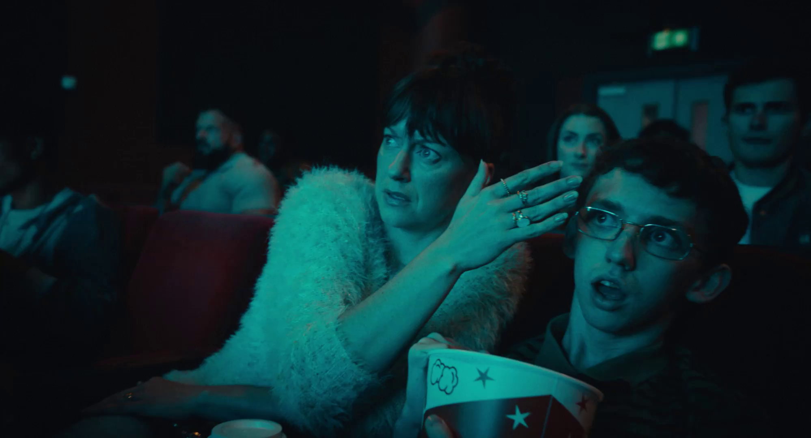

Monthly TV viewing report
February 2026
Pot Noodle – Nothing Satisfies Like Pot Noodle

Slide 2
February linear TV facts & figures
Total TV weekly reach %
Total TV viewed per day
Commercial TV viewed per day
Impacts
Individuals
72.9 | 41.8bn | 2h 10m | 1h 20m
75.9 | 40.7bn | 2h 28m | 1h 31m
75.2 | 15.8bn | 1h 57m | 1h 5m
52.7 | 2.1bn | 31m | 19m
74.6 | 18.1bn | 2h 22m | 1h 28m
77.2 | 22.6bn | 2h 32m | 1h 34m
72.6 | 2.2bn | 1h 5m | 39m
Adults
ABC1 adults
16-34
Men
Women
Housepersons with children
Sources: Barb February 2026, industry standard TV viewing in-home on a TV set. Reach 3min+. 30” equivalent impacts.
Notes:
February linear TV figures for weekly reach, impacts, total TV viewing hours and commercial TV viewing hours

Slide 3
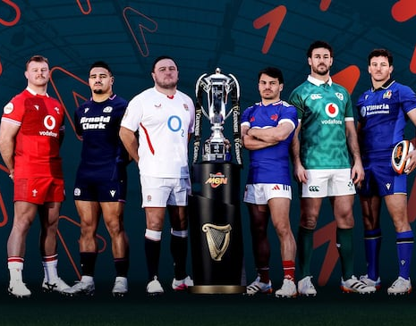


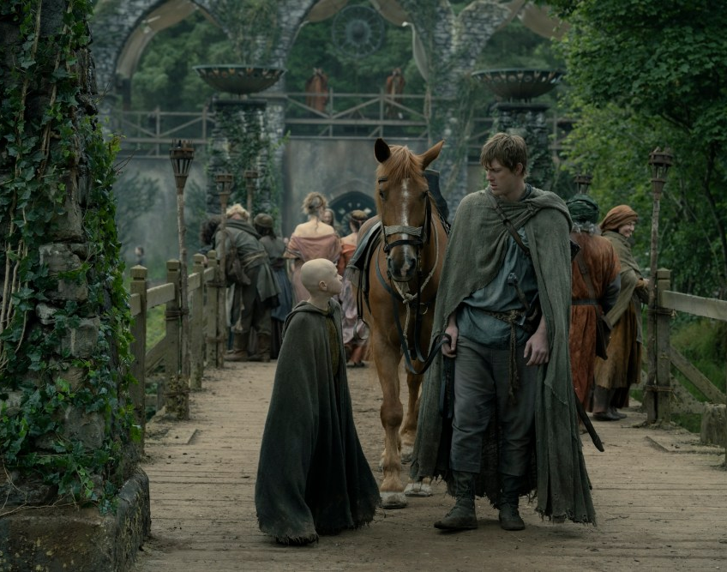
Some notable TV moments in February
On 14 February, Scotland played England at the Six Nations Championship to an average audience of 4.18m.
On 23 February, Channel 4 launched Dirty Business to an average audience of 2.10m.
On 3 February, Channel 5 aired an episode of The Good Ship Murder to an average audience of 1.50m.
On 22 February, Sky Atlantic aired the finale of A Knight of the Seven Kingdoms to an average audience of 1.08m.
Source: Barb, February 2026, individuals. Average audience figures, TV set and devices viewing 1-7 days (includes pre-broadcast figures, if applicable).

Slide 4
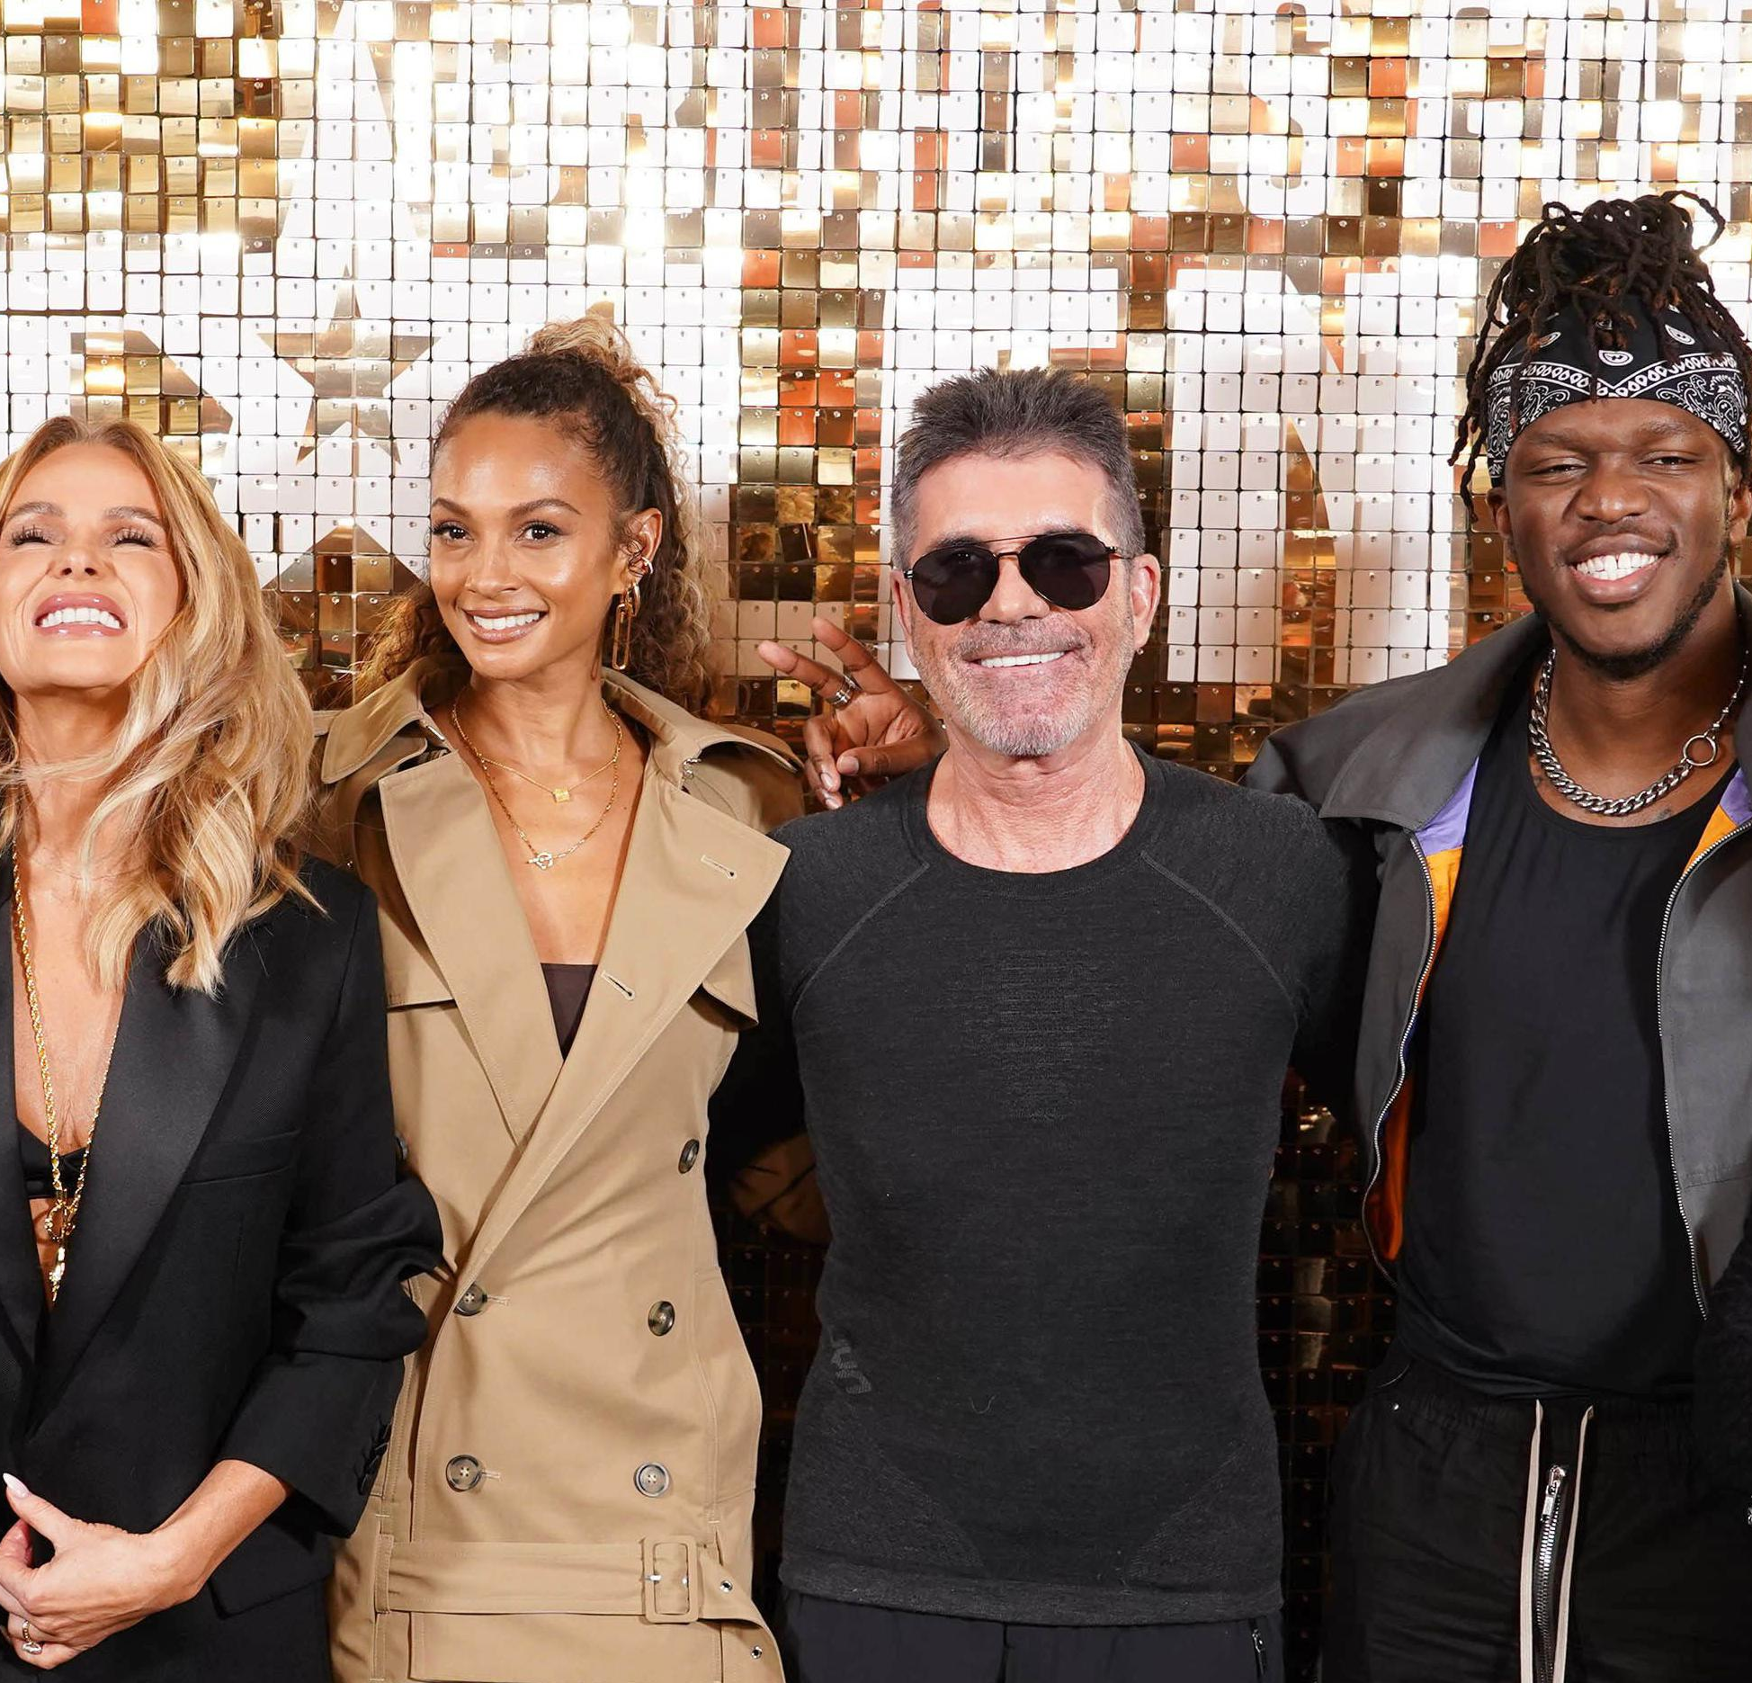
Top 5 ITV1 programmes
Britain’s Got Talent (21 February)
4.45 million viewers
Six Nations Championship: Scotland V England (14 February)
4.18 million viewers
Coronation Street (16 February)
4.14 million viewers
Emmerdale (2 February)
3.70 million viewers
After The Flood (2 February)
3.62 million viewers
Britain’s Got Talent – ITV1
Source: Barb, February 2026, individuals. Average audience figures, TV set and devices viewing 1-7 days (includes pre-broadcast figures, if applicable)
Notes:
Top 5 programmes - ITV

Slide 5
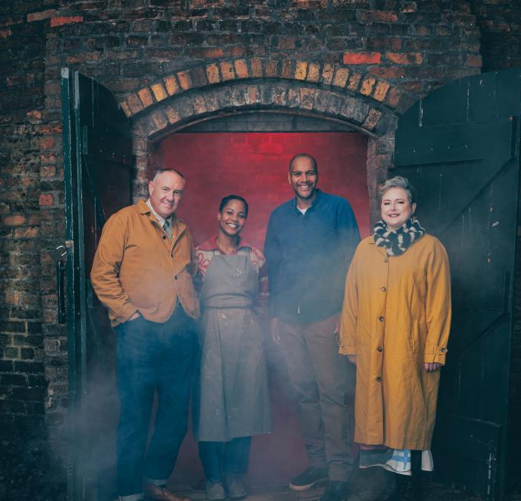
Top 5 Channel 4 programmes
The Great Pottery Throw Down (1 February)
2.67 million viewers
Gogglebox (27 February)
2.45 million viewers
Dirty Business (23 February)
2.10 million viewers
Secret genius (1 February)
1.86 million viewers
Kirstie and Phil's Love It or List It (4 February)
1.32 million viewers
The Great Pottery throw Down – Channel 4
Source: Barb, February 2026, individuals. Average audience figures, TV set and devices viewing 1-7 days (includes pre-broadcast figures, if applicable)
Notes:
Top 5 programmes – Channel 4

Slide 6

Top 5 Channel 5 programmes
The Good Ship Murder (3 February)
1.50 million viewers
Surgeons: A Matter of Life or Death (4 February)
1.21 million viewers
Ben Fogle: New Lives in the Wild (5 February)
1.11 million viewers
Motorway Cops: Catching Britain’s Speeders (9 February)
1.09 million viewers
Rich House, Poor House (15 February)
1.04 million viewers
Surgeons: A Matter of Life or Death – Channel 5
Source: Barb, February 2026, individuals. Average audience figures, TV set and devices viewing 1-7 days (includes pre-broadcast figures, if applicable)
Notes:
Top 5 programmes – Channel 5

Slide 7
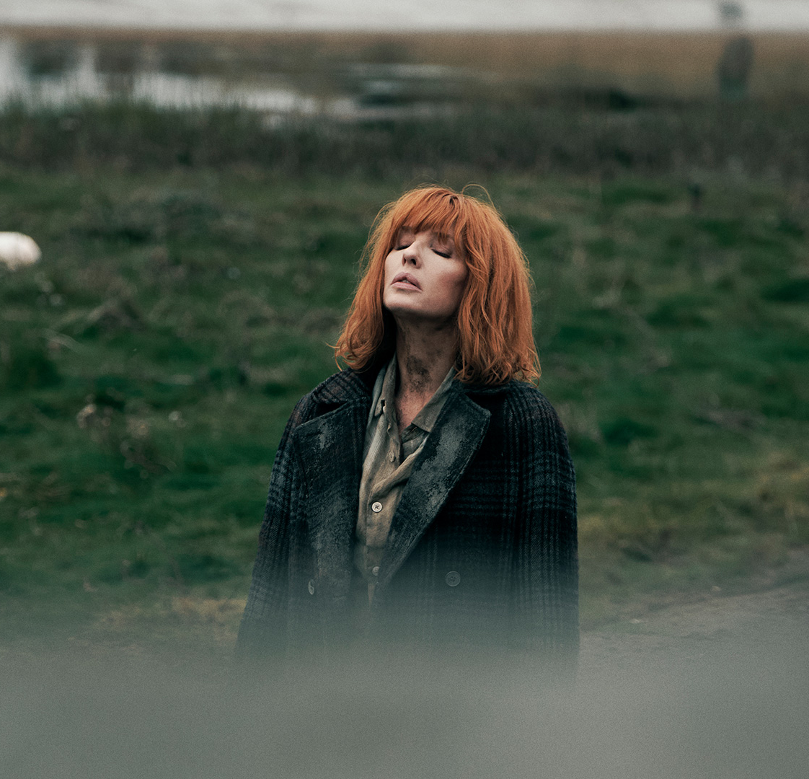
Top 5 commercial non-PSB* programmes (non-sport)
Love Island All Stars, ITV2 (16 February)
1.93 million viewers
A Knight of the Seven Kingdoms, Sky Atlantic (22 February)
1.08 million viewers
Under Salt March, Sky Atlantic (26 February)
1.01 million viewers
Our Farm Next Door: Amanda, Clive and Kids, More4 (2 February)
0.70 million viewers
Mock the Week, TLC (22 February)
0.68 million viewers
Under Salt March – Sky Atlantic
Source: Barb, February 2026, individuals. Average audience figures, TV set and devices viewing 1-7 days (includes pre-broadcast figures, if applicable)
Notes:
Top 5 programmes – commercial non-public service broadcasting channels

Slide 8
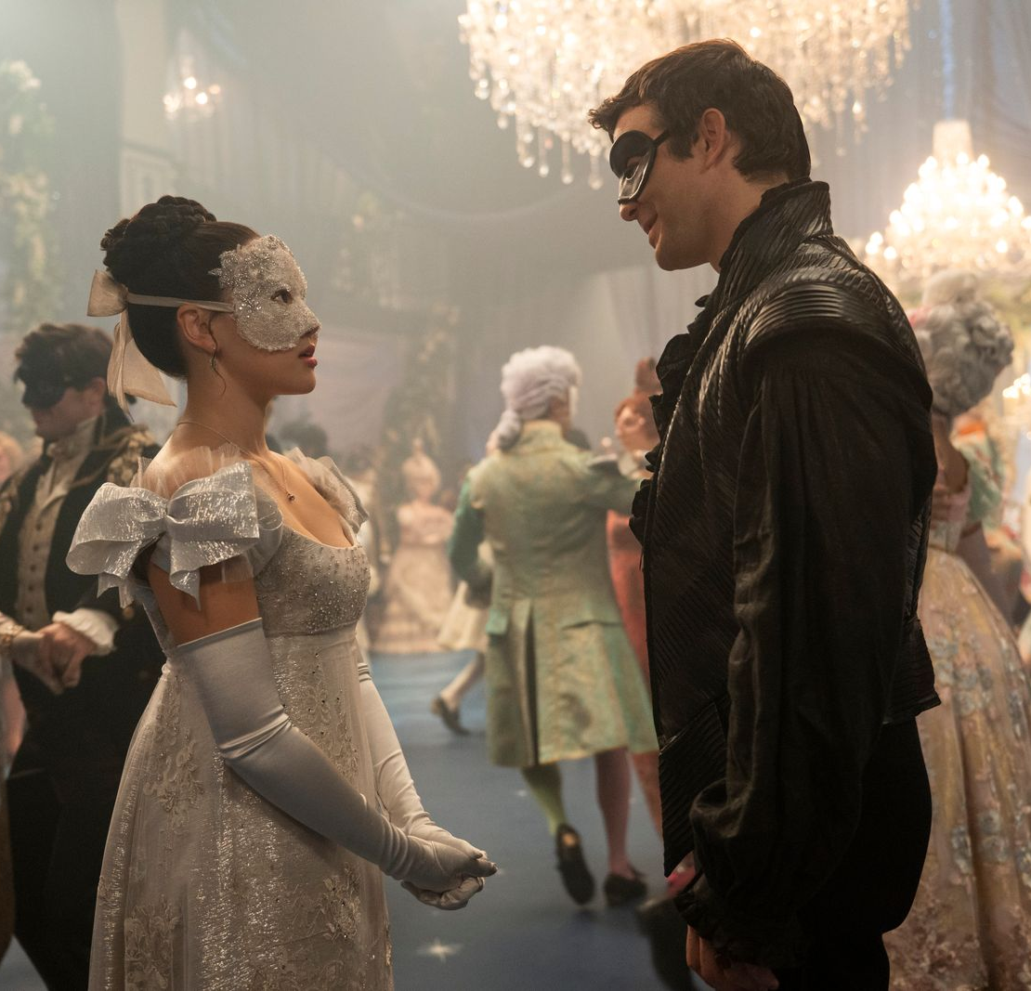
Top 5 Netflix programmes
Bridgerton (26 February)
3.16 million viewers
The Investigation of Lucy Letby (4 February)
2.97 million viewers
How to Get to Heaven From Belfast (12 February)
2.05 million viewers
The Night Agent (19 February)
1.53 million viewers
Being Gordon Ramsay (18 February)
1.39 million viewers
Bridgerton – Netflix
Source: Barb, February 2026, individuals. Average audience achieved during the first seven days of their availability. Only includes TV set viewing.
Notes:
Top 5 programmes – Netflix

Slide 9

Top 5 Amazon Prime Video programmes
Fallout (4 February)
1.60 million viewers
Beast Games (4 February)
0.60 million viewers
Cross (11 February)
0.45 million viewers
The Wrecking Crew (28 January*)
0.44 million viewers
Jesy Nelson: Life After Little Mix (13 February)
0.32 million viewers
Beast Games – Prime Video
Source: Barb, February 2026, individuals. Average audience achieved during the first seven days of their availability. Only includes TV set viewing. *Only viewing in February.
Notes:
Top 5 programmes – Amazon Prime Video

Slide 10

Top 5 Disney+ programmes
High Potential (4 February)
0.87 million viewers
Predator Badlands (12 February)
0.68 million viewers
The Muppet Show (4 February)
0.65 million viewers
Scrubs (26 February)
0.52 million viewers
9-1-1 (20 February)
0.38 million viewers
High Potential – Disney+
Source: Barb, February 2026, individuals. Average audience achieved during the first seven days of their availability. Only includes TV set viewing.
Notes:
Top 5 programmes – Disney+

Slide 11
Top commercial programmes with largest proportion of device viewing
Total audience
1.77m
1.01m
1.15m
2.37m
2.66m
Source: Barb, February 2026, individuals. Average audience figures, TV set and devices viewing up to 7 days post-broadcast. Based on programmes with 1 million+ total TV viewers
Notes:
Top commercial programmes with largest proportion of device viewing

Slide 12
Top commercial programmes with largest proportion of pre-broadcast boxset BVOD viewing
Total audience
1.01m
3.62m
1.14m
2.95m
2.77m
Source: Barb, February 2026, individuals. Average audience figures, TV set and devices viewing up to 7 days post-broadcast. Based on programmes with 1 million+ total TV viewers
Notes:
Top commercial programmes with largest proportion of pre-broadcast boxset BVOD viewing

Slide 13
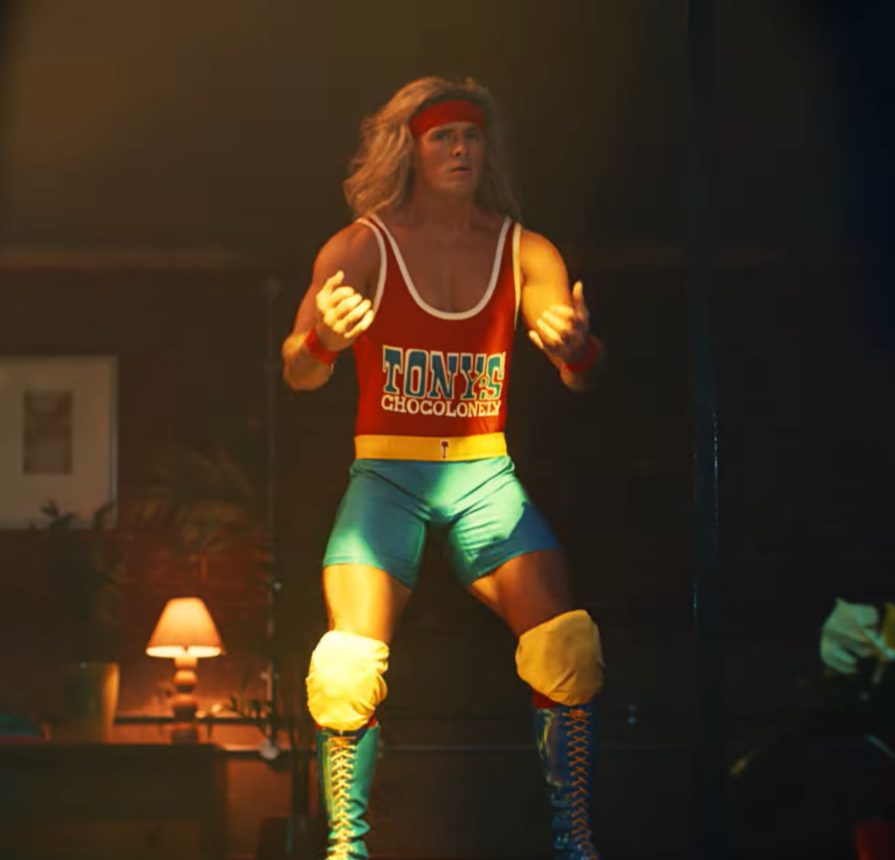
Key new to linear TV advertisers in February
Tony’s Chocolonely
Chocolate brand, Tony’s Chocolonely, made its TV debut letting us all know there is fight in every bite.
Marro
Fresh cat food brand, Marro, launched its first ever TV Advert, to promote its subscription service.
Heart Bingo
Heart Bingo launched its first ever TV spot with a DRTV campaign running across ITV, Channel 4, and Sky.
Tony’s Chocolonely- There's Fight In Every Bite
Notes:
New to TV advertisers in February.

