Slide 1
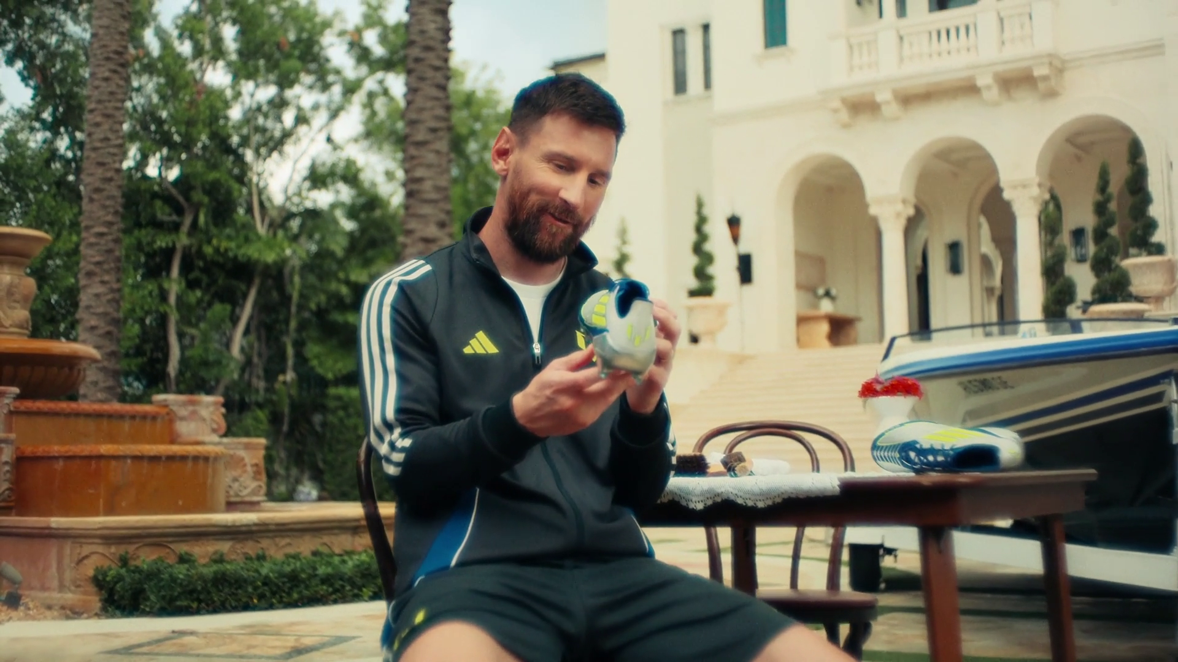

TV drives emotion and fame
Adidas – Just Relax

Slide 2
Fame and emotion generate the most sales and profit
58%
39%
Source: ‘Marketing in the Era of Accountability’, 2007, IPA
Notes:
Research from the IPA has shown that emotive and famous campaigns generate the largest business effects. Against the important, hard business success metrics of sales and profit, campaigns with emotion and fame outperformed more rational/information led approaches across the board. This was the case even in supposedly highly rational categories.

Slide 3



TV ads evoke emotion more than ads on other media
% who selected each medium
 | TV | Social Media | Radio | YouTube | Cinema | Magazines | Outdoor | Newspapers | Search | Direct Mail | Websites
Sticks in their memory | 57% | 28% | 19% | 13% | 12% | 12% | 12% | 11% | 10% | 6% | 3%
Makes them laugh | 52% | 35% | 13% | 21% | 16% | 5% | 6% | 6% | 4% | 2% | 3%
Entertains them | 51% | 30% | 13% | 19% | 21% | 9% | 3% | 7% | 9% | 3% | 4%
Makes them feel emotional | 47% | 17% | 6% | 10% | 15% | 5% | 3% | 9% | 4% | 2% | 2%
They like | 40% | 27% | 10% | 12% | 14% | 15% | 8% | 12% | 14% | 4% | 4%
They trust | 35% | 6% | 16% | 4% | 9% | 12% | 6% | 19% | 11% | 6% | 4%
Source: Adnormal Behaviour, 2022, Ipsos / Thinkbox. Q.TN3: In which, if any, of the following places are you most likely to find advertising that...
Base: ‘normal’ people (1,158)
Notes:
There is a wealth of effectiveness data out there that shows how advertising that elicits an emotional response creates a lasting impact. We asked ‘normal’ people about their attitudes to advertising to see what channels generated particular outcomes.
When asked what channel they were most likely to find advertising that sticks in their memory, makes them laugh and entertains them, the majority of ‘normal’ people selected TV, with over half claiming that TV has the ability to generate these emotions. Social media and radio also appeared at the top of the list however when looking at how the different media channels performed against the other attributes, TV outperformed all other media.
For more information, check out Adnormal Behaviour: https://www.thinkbox.tv/research/thinkbox-research/adnormal-behaviour/

Slide 4
TV ads drive the strongest popularity and success signals
Social signals
SOCIAL SIGNALS (% POSITIVELY SCORING / AGREEING TO STATEMENTS)
Source: Signalling Success, 2020, house51/Thinkbox. Base: all adults (3,654)
Notes:
TV advertising helps brands to be perceived as well known, popular and successful.
43% rated brands advertising on TV as being successful, slightly ahead of magazines at 41%. Social media and video sharing sites are least likely to signal brand success at 32% and 31% respectively.
TV, magazine and press advertising all help signal brand popularity. 50% of respondents rated TV advertising as demonstrating that lots of people were buying the brand, compared with 24% for social media and 29% for video sharing sites.

Slide 5


TV & radio signal the strongest emotional trust
TRUST
High, more effort
High & Automatic
% Agree
100%
SLOW
FAST!
Rational Trust
Emotional Trust
0%
Low, more effort
Avg RT
Low & Automatic
Reaction time
Source: Signalling Success, 2020, house51/Thinkbox. Base: all adults (3,654). Please see notes for detail on implicit trust calculation.
Notes:
In addition to capturing an explicit measure of brand trust, Signalling Success also used implicit research techniques to uncover the ‘emotional trust’ signals delivered by different types of advertising.
Research respondents were shown a series of words in relation to the fictional brand being tested. The explicit agreement/disagreement with the words shown was timed, and the speed of response was used as a measure of implicit brand association. This research technique is commonly used to give a ‘true’ reflection of deeper brand perception.
house51 used a score of four brand associations (see below for detail) to establish the ‘emotional trust’ signals delivered by media channel. This test demonstrated that the trust in TV and radio was significantly stronger and more automatic than the trust in social media and video sharing sites. This is important for brands as emotional trust is deeper, and therefore more resilient, than trust based on rational thoughts. Whilst rational trust can disappear after just one bad brand experience, emotional trust generally weathers the storm. It’s based on an understanding that even though the experience fell short of expectation, brands with high levels of emotional trust will effectively be given a ‘second-chance’ - the negative experience is seen as more of a blip than a dip.
NB. Trust is a composite of implicit reaction to popular, competent, honest, not cheap, not risky, not unreliable.

Slide 6
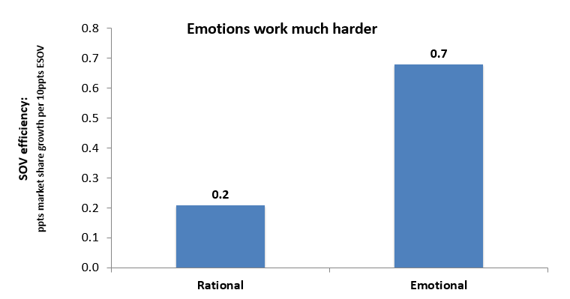


Emotional advertising drives effectiveness
Source: IPA Databank, 1998-2022 cases
Notes:
https://www.thinkbox.tv/research/nickable-charts/effectiveness-and-planning/tv-at-the-heart-of-effectiveness-by-peter-field
The IPA’s data has long proven that advertising that creates emotional associations with brands is the fast lane of effectiveness compared to rational advertising that communicates information about brands. You get a 3.5 multiplier in terms of share-of-voice efficiency [see chart above] – market share growth per unit of budget investment. Emotions work much harder because they create more powerful and more durable mental availability, so they are much better at driving continuous demand growth for brands.

Slide 7
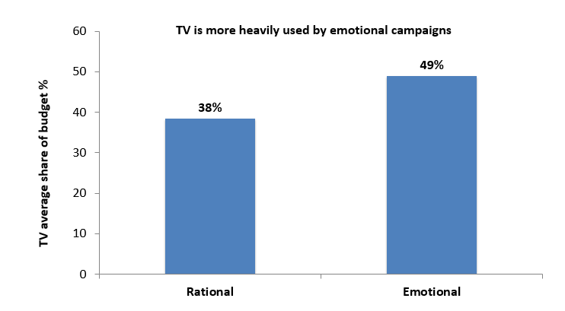
TV is important for emotional campaigns
Source: IPA Databank, 2014-2022 cases
Notes:
https://www.thinkbox.tv/research/nickable-charts/effectiveness-and-planning/tv-at-the-heart-of-effectiveness-by-peter-fi
If you look at media usage amongst emotional IPA case studies vs. rational ones, TV occupies a much bigger share of ‘emotional’ marketing budgets [see chart above]. Smart marketers worked out many years ago that TV is a brilliant platform for creating vital emotional, mental availability-building associations. TV is less important amongst the rational campaigns, but then who wants to work in the slow lane of effectiveness?

Slide 8
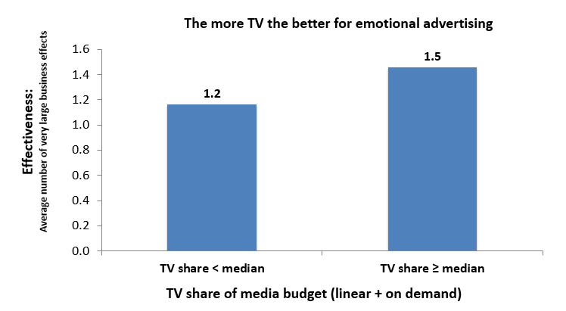
TV boosts effectiveness of emotional campaigns
Source: IPA Databank, 2014-2022 cases
Notes:
https://www.thinkbox.tv/research/nickable-charts/effectiveness-and-planning/tv-at-the-heart-of-effectiveness-by-pete
Examining the impact on effectiveness of TV share of budget by these emotional campaigns suggests that you almost can’t have too much TV advertising [see chart above]. Those that made above median use of TV were distinctly more effective than those that didn’t. Obviously, no one is arguing for 100% TV advertising campaigns, because there is the rest of the funnel to think about. But let’s be clear: there’s a particularly strong relationship between TV and the fast lane of effectiveness strategy.

