Slide 1
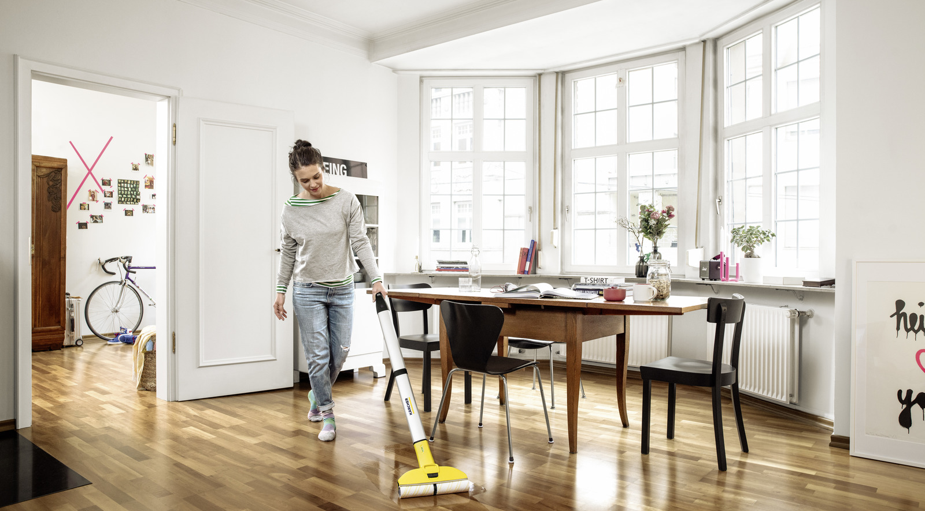
Kärcher’s DRTV business – success upon success
Challenge
Kärcher wanted to drive their direct to consumer business in the UK and showcase the range of products they offer
Solution
SmartResponse Media recommended DRTV
They began with a 30-minute infomercial and once they saw which products were most responsive, they created 3-minute TV ads for the top three products
Results
Kärcher increased their D2C business by 400%
313% increase in daily sales revenue
71% improvement in conversion rate
Notes:
Challenge
Kärcher are innovators, known for their quality and design, with a big foothold in the Pressure Washer sector and a lot of love for their Window Vacs. However, there was also a feeling that Kärcher’s depth of range was little known and this was an area they wanted to address.
Kärcher UK had high aspirations for their direct-to-consumer business, recognising this as an area they needed to grow. As a regular TV advertiser with 20 and 30 second brand adverts, TV was not a new concept to their marketing team, but they had yet to test the waters with direct response TV advertising.
The challenge was to drive awareness of the Kärcher D2C website and grow D2C sales. There were also specific objectives which were to deliver a sales to advertising ratio of 3:1 (£3 in sales revenue for every £1 spent on media) and to grow brand awareness and desirability.
The TV Solution
SmartResponse Media were tasked with developing Kärcher’s inaugural DRTV programme. With such a depth of range, SmartResponse’s advice was to find out as much as possible as quickly as possible about which product lines were the most responsive. The client and agency taskforce created a strategy to find the winning product lines and then to push forward with an ‘always on’ strategy with the proven winners.
Working with SmartResponse, Kärcher selected ten different products to test with DRTV. The creative was filmed across three days in a studio setting to create an ‘as live’ format, which was then combined with Kärcher’s existing footage to create eight 4.5-minute advert segments, two 9-minute advert segments and two 30 second promo elements to run between the product segments. These segments were then formatted into two 30-minute infomercial shows to showcase the products and to test whether Kärcher was going to be as successful in DRTV as the team believed.
The Plan
The advertising first launched in 2020 with the aim of educating people about the range of products and high quality that Kärcher offers and engaging as many people as possible on a limited test budget.
The 30-minute longform media test was planned across a broad range of both Editorial and Shopping Channels. The majority of longform ads aired early in the morning, where the fixed costs per spot are inexpensive and was therefore the optimal time to test multiple products within the same parameters.
The advertising drove an immediate discernible sales uplift from day one of the campaign launching. As with all DRTV campaigns, as the campaign built, so did response. Three very clear winning lines were identified (SC 3 EasyFix, FC 3 Cordless Premium and K 4 Premium Full Control Car & Home) within ten days and these then went into the next phase, which involved a DRTV campaign of 180-second spots. These three-minute ads continued for the remainder of 2020, through 2021, 2022 and into 2023.
The continued programme of the three-minute DRTV campaigns were planned to reach the desired audience depending on the product being advertised. Kärcher’s product range targets a wide variety of audiences, so stations were selected based on this. The spots were placed in daytime only, as this was the timeband that had been proven to deliver the optimum return on investment. An average monthly weighting was in the region of 80 TVRs across two product campaigns.
Campaigns were continually optimised by day of week, upweighting key times within the month (e.g. around payday) and by TV channel. All optimisations were analysed and proven to have a pronounced effect on the client’s ROI, whilst also delivering longer terms benefits of brand awareness and affinity.
Results
Kärcher increased their whole online D2C business by 400% in sales in the first year of running Direct Response TV advertising, very much aided by the unusual Covid19 lockdown and shift in working from home lifestyles
Kärcher have continued to see D2C growth on 2020, in both 2021 and 2022
DRTV campaigns continue to perform very well for Kärcher despite a challenging economic environment, with Dec ‘22/Jan ’23 campaigns delivering a 313% increase in Daily Sales Revenue for the advertised products during this key sales period, a 71% improvement in Conversion Rate and a Peak Sales Revenue vs. Advertising Investment Ratio of 10:1
The campaign created significant search volumes and improved traffic to their D2C website dramatically
DRTV products account for a significant proportion of the overall web sales
There was a halo effect of TV seen across other products and in an uplift of retail sales
Kärcher have seen some incredible results from DRTV, the top response drivers delivering Sales to Advertising ratios of 25:1 at the peak

