Slide 1


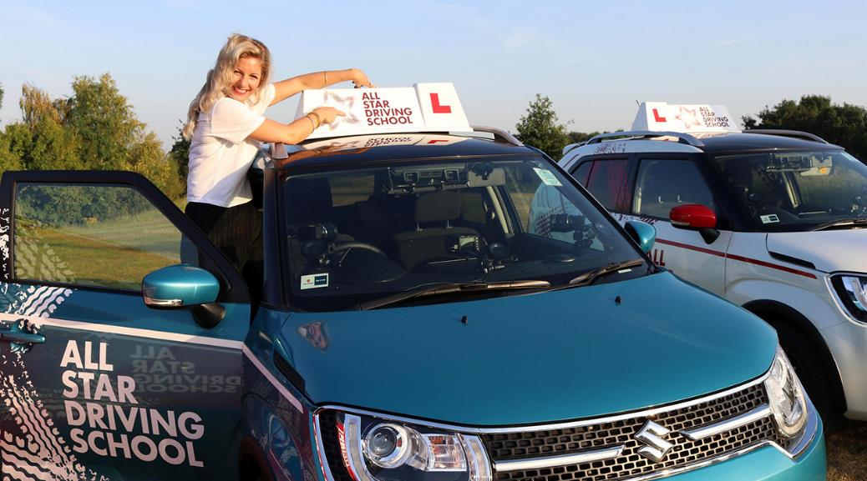
Suzuki All Star Driving School
Challenge
Suzuki wanted to appeal to the youth market with their new model, the Ignis
Solution
They funded All Star Driving School on E4, which featured celebrities trying to pass their driving test in a week
This allowed them to connect with their target audience and feature the Ignis throughout the show, highlighting the fun to be had in a first-time car
Results
Suzuki surpassed their sales target by 5%
Those exposed to the campaign were 86% more likely to take an Ignis for a test drive
Notes:
The Challenge
In 2017, Suzuki released a new model, the Ignis. This car was designed for a demographic of discerning 20-somethings, with a skew towards women. This was a completely new audience for Suzuki, as they had spent the two previous years carving out a distinctive place in the minds of a family audience. The challenge, therefore, was how to reach a new, younger, female demographic without losing Suzuki’s spirit of fun.
Suzuki Ignis was designed to be a rule breaker. It’s the size of a super mini but has the shape and capabilities of an SUV. In its advertising, Suzuki were keen to give the model an attitude that matched the image of the car, whilst also challenging stereotypical marketing of cars to women.
The key objective was to appeal to the youth market and sell 6,000 cars in the first year.
The TV Solution
Suzuki worked with their media agency the7stars to come up with a solution to engage their target audience in a relevant way. They understood that, to tap into this young demographic, they really had to connect with them via an area of interest whilst also avoid stereotyping.
20 something women are very similar to their male counterparts in that they seek independence and enjoy being adventurous. Therefore, the7stars created the ‘Ignis Adventure’ – a content led campaign that would highlight the fun you can have in a first-time car. The7stars felt that through this activity they could tap into the rite of passage that all young drivers go through and so really connect with Suzuki’s target audience. The Ignis Adventure campaign was crafted as an entertaining but realistic take on the fun and independence the Ignis could offer.
The7stars knew that TV offered the best route for engaging their target audience at scale. TV advertising has been proven to evoke emotion more than other media, and research by Binet and Field for the IPA has shown that emotive advertising campaigns and those that have fame at the core of their strategy are by far the most effective at creating large business effects like sales and profit. Therefore, by using TV at the core of their strategy, it would enable them to create fame which would in turn help Suzuki to reach their target of selling 6,000 models of the Ignis.
The Plan
The main part of the campaign was the advertiser funded programme, All Star Driving School. This was a 15-part, peak time show on E4, which followed nine celebrities on their mission of learning how to drive. The series was narrated by Katherine Ryan and involved the celebrities facing adventure-based challenges such as reversing in a bus or off-road hill starts.
As a funder, it meant that Suzuki had the possibility for product placement throughout, helping to shape consumers’ attitude of the brand. Every car featured in the programme was a Suzuki Ignis, which meant the car became the star of the show and its features could be demonstrated in action. Having this deeper brand experience was of particular importance, as the show highlighted the fun which can be had in a first-time car.
The celebrities that passed their test in the series transitioned into brand ambassadors, as they were each given a Suzuki Ignis for 6-months to continue their own Ignis adventure.
The programme was the centre piece of the campaign but the7stars created an integrated campaign around it with a wide variety of additional activity.
Social media played a key supporting role. For example, 32 female social influencers were loaned the Ignis and tasked with embracing a life free of public transport as they explored in their Ignis. They were encouraged to take on activities they’ve always wanted to try such as driving through a local safari park with the Ignis facilitating the adventure.
As well as this, Suzuki partnered with Buzzfeed to create a series of shareable articles around the theme of adventure. Supercuts and outtakes of the All Star Driving School were created and released across Suzuki and E4’s social channels to extend the reach beyond linear broadcast. In addition to this, all nine celebrities that featured on the show used their social media channels to spread the reach of the show further.
Suzuki also worked with The Outfit to create a series of comedy ad spots fronted by Katherine Ryan and Mark Francis. This unlikely duo were dropped in Dartmoor and tasked with having to find their way home in the Ignis, without using the Ignis’ satnav. The ad campaign ran across cherry picked programmes on Channel 4 and E4, targeting the younger demographic Suzuki were aiming for.
Results
Suzuki surpassed their sales targets, with Ignis sales up 5% on target, despite the small car market being down by -13%
The All Star Driving School show performed above the slot average by 20% and was recommissioned for a second series in 2018
It had a skew towards female buyers - 56% female vs. 47% average
The All Star Driving School was E4s most talked about show in 2017
Those exposed to the campaign were 86% more likely to take the Ignis for a test drive
The campaign was shortlisted for Best Use of Content at TV Planning Awards
To read the full case study and access the creative visit: https://www.thinkbox.tv/Case-studies/Sainsburys-Perfect-Christmas
https://www.thinkbox.tv/Case-studies/Suzuki-All-Star-Driving-School

