Slide 1
TV has become more effective over time
Adding TV increases effectiveness by 40%, making TV the most effective medium
INCREASE IN AVG. NO. VERY LARGE BUSINESS EFFECTS FROM ADDING TV%
Source: Media in Focus, 2016, Binet & Field IPA
Notes:
The IPA study ‘Media in Focus’ looked at how advertising effectiveness has changed over time. If we look at how TV’s effectiveness has changed over time you might expect that in an era of social media and online video that TV might have become less effective. But actually the reverse is true.
By adding TV to your campaign, you could now expect an average increase in effectiveness of 40%. That makes it one of the biggest differences you can make to the effectiveness of marketing.
For more information on this study please see:
https://www.thinkbox.tv/Research/Thinkbox-research/Media-in-Focus-free-download

Slide 2
Total advertising-generated profit by medium
Bubble size represents % of total profit
Total profit = all return (short + long-term)
generated over 3 years
Print: 18%
TV: 71%
Online Video: 4%
TOTAL PROFIT ROI EFFICIENCY
Radio: 3%
OOH: 3%
BREAK EVEN
Online Display: 1%
% OF BUDGET
Source: ‘Profit Ability: the business case for advertising’, Nov 2017
Ebiquity ROI campaign database (Feb’14-May’17) & Gain Theory. Campaign obs: 1,954
NB: Online Video includes Broadcaster VOD, YouTube, Facebook video & online programmatic video
Notes:
Only by looking at the combined short and long-term effects of advertising can you see the entirety of what each medium provides in profitable return. To do this we combine the results of the short and long-term section of the Profit Ability study to report total efficiency and profit volume returned by media channel.
TV delivers 71% of total advertising-generated profit over 3 years despite TV currently commanding 54% of average advertising budget.

Slide 3
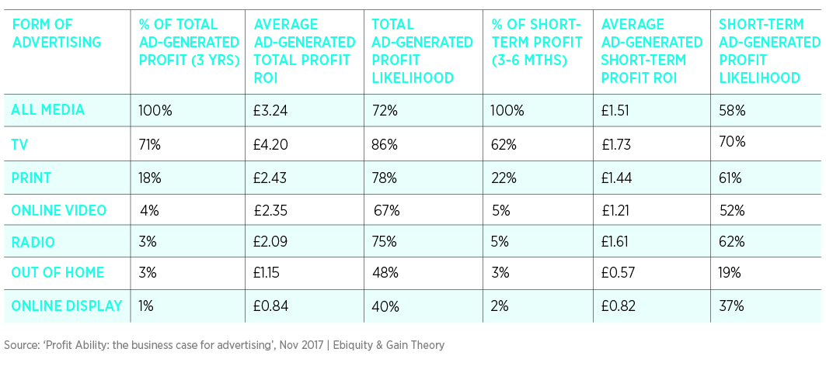
Media Channel breakdown of short-term and total profit
NB: Online Video includes Broadcaster VOD, YouTube, Facebook video & online programmatic video
Notes:
This table provides a breakdown, by media channel, of the key findings from the study.

