Slide 1


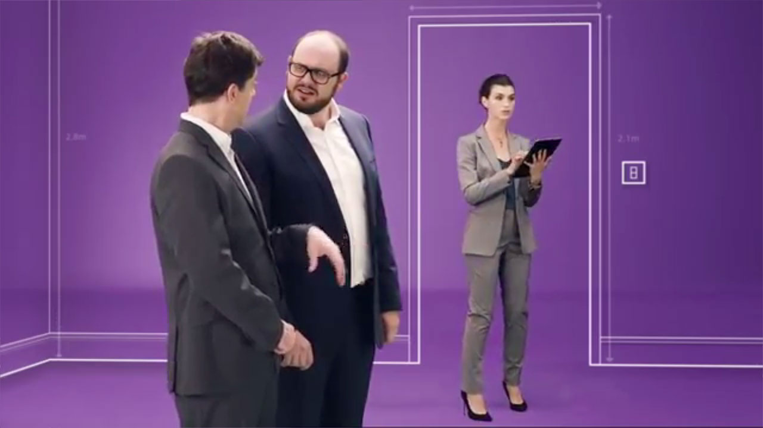
Purplebricks made TV their home with great success
Challenge
Purplebricks wanted to build awareness, drive consideration and educate consumers about the new way to sell their homes
Solution
They used a broad-reaching TV campaign to deliver cost efficient national reach, with regional upweights to deliver localised messaging
Activity focused around relevant programming, and dayparts to deliver shared viewing
Results
Market share of online agents averaged 50%+ over 2015
Despite being less than 2 years old, brand awareness was 54% and familiarity 26%
Notes:
Challenge:
Purplebricks is an online estate agent, founded in 2014 by two brothers. It combines the benefits of a traditional estate agent with highly motivated, local property experts and offers a 24/7 service to customers.
Until Purplebricks came along, the property market was completely dominated by the traditional high street estate agencies. In 2015, Purplebricks needed to establish consumer awareness not only of the brand itself but also of the new category it operated in.
As well as launching the brand, they wanted to capitalise on first mover advantage in a rapidly growing sector and also get across the benefits of their new way of operating.
They tasked their media agency, PHD, to help them achieve four key objectives:
Claim 2% market share of the total housing transactions by the end of 2015
Create brand awareness and increase consideration and preference amongst homeowners
Educate consumers about the new way to sell their house
Create excitement in the venture capital and investor market with a view to fundraising
Solution:
PHD recommended a TV campaign. They felt this was the only medium that could deliver cost efficient national reach, build significant awareness and talk to consumers in a way that built warmth towards the human side of an online brand. Trust is crucial for challenger brands in this sector and TV is the perfect channel to reassure customers they are dealing with a professional, large scale organisation who won’t disappear with their hard earned cash.
PHD felt that TV was unique in its ability to drive consideration throughout the purchasing journey and would allow them to convert early adopters whilst also cajoling those more reluctant to break with the habit of a lifetime. They felt they could take advantage of the multifaceted nature of TV to get across the Purplebricks message to the whole country, while retaining the characteristics of a local community estate agent.
Towards the end of 2014, they did some regional test and learn campaigns on TV, out of home, inserts, radio and door drops, using the standard expose/control methodology. When the results were analysed by both PHD Data Science and Purplebricks’ own qualitative research, it showed that TV was the reason behind the majority of homeowners instructing Purplebricks, with radio also making a small but significant contribution.
So a national TV campaign would be at the heart of the launch strategy for Purplebricks. No other media offered the stature, ability to build targeted awareness and frequency to provide immediate, measurable bottom line impact.
Results:
The campaign reached 87.8% of all adults
Throughout 2015, Purplebricks has dominated the online estate agency space, taking market share averaging at over 50% and growing
According to Rightmove, Purplebricks was taking over 60% market share at the close of 2015
Volume of Purplebricks’ property valuations has increased 244% from launch
Purplebricks’ volume of instructions to sell has increased 176% from launch
Purplebricks’ market share of ALL estate agents grew to 2.1%
Despite the brand being less than 2 years old, brand awareness was 54% and familiarity at 26%
On Trustpilot, Purplebricks received a five star rating and there were over 4,000 reviews, demonstrating that the market truly was educated about Purplebricks’ service led proposition
In November 2015, Purplebricks made its initial public offering and was valued at £230m on the stock market
Winner of Best Newcomer to TV in the TV Planning Awards 2016
For the full case study and to view the ad campaigns visit: https://www.thinkbox.tv/Case-studies/Purplebricks

