Slide 1
The drivers of profitability

Slide 2
Brand size is a key driver of category ROI
Source: The Drivers of Profitability, 2023, Paul Dyson - accelero, based on 2,500 UK ROIs across 4 key studies

Slide 3
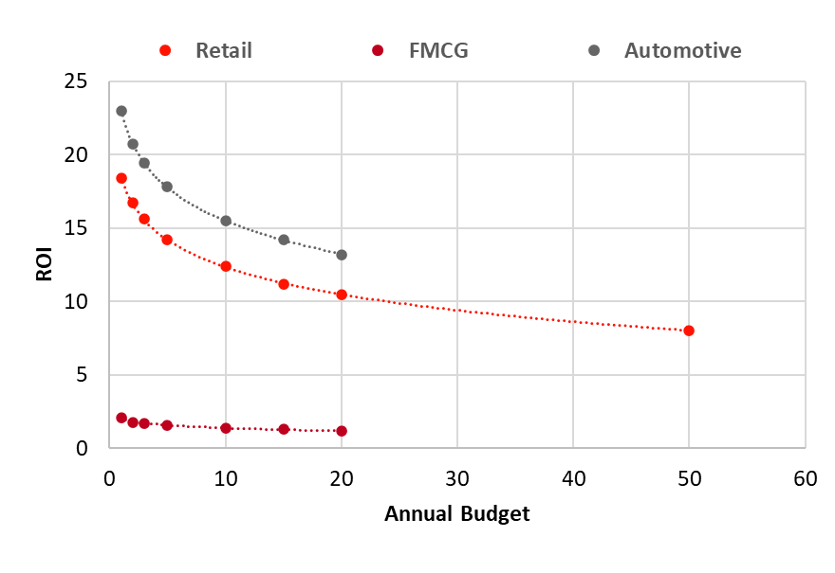
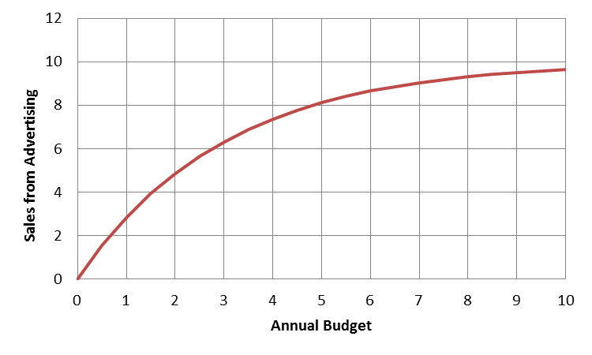
Advertising ROI is impacted by absolute budget level
Practitioners agree advertising experiences diminishing returns…
…this means ROIs drop as budgets increase
Source: The Drivers of Profitability, 2023, Paul Dyson - accelero, based on Media Mix Navigator, Accelero Optimiser

Slide 4
Interaction of budget and brand size impact ROI performance
 |  | Expected ROI performance by brand size and budget level
 |  | Brand Size | Brand Size
 |  | £50m | £100m | £200m | £300m | £500m | £1,000m | £2,000m
Budget (% of sales) | 1% | 0.6 | 1.3 | 2.7 | 3.9 | 6.2 | 11.7 | 20.0
 | 2% | 0.6 | 1.2 | 2.4 | 3.4 | 5.5 | 10.0 | 16.7
 | 3% | 0.5 | 1.1 | 2.2 | 3.2 | 5.0 | 9.0 | 14.7
 | 4% | 0.5 | 1.0 | 2.1 | 3.0 | 4.7 | 8.3 | 13.3
 | 5% | 0.5 | 1.0 | 2.0 | 2.9 | 4.4 | 7.8 | 12.2
 | 10% | 0.4 | 0.9 | 1.7 | 2.4 | 3.6 | 6.1 | 8.9
Source: The Drivers of Profitability, 2023, Paul Dyson - accelero

Slide 5
Creative executions deliver a range of ROI (IPA Awards)
Kevin the Carrot
Made of More
3x
4x
Source: The Drivers of Profitability, 2023, Paul Dyson - accelero

Slide 6
Creativity is the biggest ROI multiplier within our control
Potential multipliers of advertising profitability - (2023)
Potential multipliers of advertising profitability - (2023)
X 20
X 12
X 5
X 2.5
X 3
X 1.6
X 1.7
X 2.0
X 1.1
X 1.2
Cost / Product seasonality
Budget setting across variants
Brand : Performance
Multi-media
Budget setting across portfolios
Budget setting across geographies
Target audience
Laydown / Phasing
Creative quality
Brand size
Source: The Drivers of Profitability, 2023, Paul Dyson - accelero, ROI multiplier = area of the circle

