Slide 1


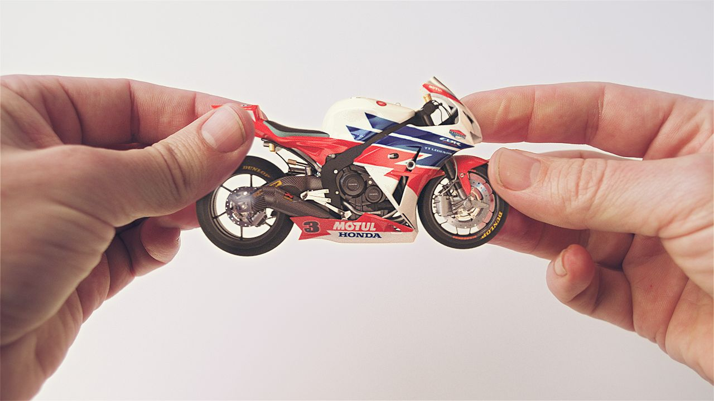
Honda’s TV event helped viewers fall in love with the brand again
Challenge
Honda wanted to restore brand love and desirability + increase purchase consideration by 5%.
Solution
Launched new creative with a two minute TV ad promoted by 10’’ teaser ads using the hashtag #HondaHands.
Teaser spots were placed around key Channel 4 programming, with the showcase ad in the Sunday night premiere of new drama Southcliffe
Results
Purchase consideration increased by 10%
Over 2 million people saw the 2 minute ad on TV
Notes:
Challenge
Honda UK had been facing a tough few years with the global recession, the Japanese tsunami and the squeezed UK car market. On top of this, their marketing budget had been reduced but their sales targets were as exacting as ever.
The brand has a history of innovative advertising and plenty of brand love. Research showed that people remembered Honda as a brand with a strong history of memorable advertising, citing examples such as “Cog”, “The impossible dream” and “Skydive”. However, there was also a feeling that Honda had ‘disappeared’ and so it was important to create a sense that Honda was ‘back’ and creating innovative experiences for people again.
The challenge in 2013 was to remind people what they loved about Honda and to engage as many people as possible but on an extremely limited budget. Specific objectives were to increase purchase consideration by 5% and to increase brand desirability by 10%
The Solution
Honda had been sponsoring documentaries on Channel 4 and this had been going well. Working with their agencies Starcom Mediavest and Wieden & Kennedy, they decided to use the partnership with Channel 4 to recharge the brand.
They took the creative idea for the sponsorship bumpers and repurposed it into new content of varying lengths.
For the launch of the new creative, they created a two minute execution and secured presence on Channel 4 in the first ad break of their new Sunday night drama, Southcliffe on 4th August 2013. This was to be the premiere of their new work and so they worked hard to ensure that as many people knew about it as possible.
They produced 10 second teaser ads that used the hashtag #HondaHands to encourage the audience to go on Twitter and ask what the Honda advertising premiere might be. These teaser spots were placed around key Channel 4 programming such as Rude Tube, 24 Hours in A&E, The Big Bang Theory and films.
There was also activity with national press, digital outdoor, online and radio to further build the sense of anticipation around the two minute ad.
Once launched, viewers were then able to access further content online on sites such as Facebook, Twitter and You Tube.
The two minute ad also ran on cinema for a period of 5 weeks around the film Rush
Results
Over 2 million people saw the two minute advert on TV and more than 660,000 engaged with the content on YouTube
They created significant levels of search volumes
Purchase consideration was increased by 10% - double the target set
Brand desirability also increased by 10% - achieving the objective
To read the full case study and access the creative visit: https://www.thinkbox.tv/Case-studies/Honda

