Slide 1


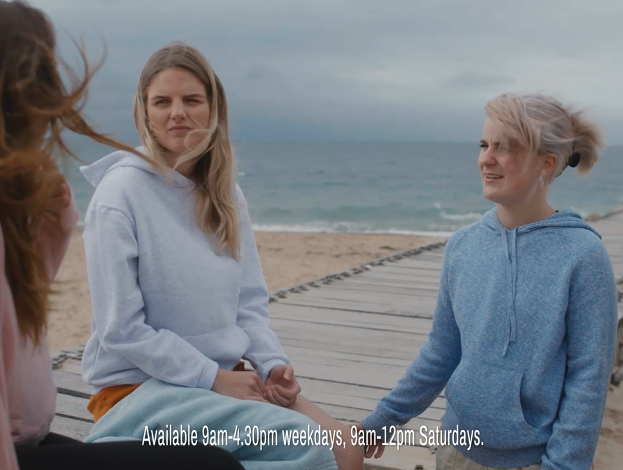
Nationwide: Planning for empathy to deliver Business results
The Challenge:
With an oncoming Cost-of-Living crisis hitting hard, Nationwide needed to show they were offering support to its customers.
The Solution:
Realising shame about struggling financially was rife amongst younger audiences, Nationwide launched a free cost of living hotline and used the emotional power of TV to promote it within the content they love the most.
The Results:
Doubling down on October, when the energy price cap increase was dominating the news, Nationwide achieved 1st place in Share of Voice for the financial services sector, reaching 75.4% of target audiences across Linear and BVOD. They saw increases in brand health measures against younger audiences and 7,000 new accounts opened directly attributed back to TV, higher than that of pure acquisition channel, PPC.
Notes:
The Challenge
Nationwide Building Society is different to the banks it competes with. It exists solely for the benefit of its members and has a long history of helping through the toughest times. With the onset of the Cost-of-Living Crisis, Nationwide couldn’t just sit by, they had a duty to respond.
TGI data showed that parents with young children were the hardest hit by the crisis. As younger life stages are a key priority for Nationwide’s business, there was an opportunity to improve brand perceptions amongst this group by supporting them when they needed it most.
The objective was clear; influence perceptions of younger audiences and show them that Nationwide was there for them.
The TV Solution
Wavemaker set out to show humanity in the face of the crisis – their strategy was to plan for empathy.. Nationwide needed actions not just words to connect with the audience, so they launched a free national helpline, staffed by dedicated cost-of-living experts.
They then crafted a campaign to encourage people to seek help and reassure them they weren’t alone.
TV would be crucial to this. With its unrivalled ability to drive an emotional connection, its broadcast nature would also provide a social proofing effect, helping to break down the stigma of seeking help. With a focus on younger audiences, it would have been easy to place money into channels like Social, but Wavemaker and Nationwide went all in on AV as they knew nothing gets people talking like TV does.
The Plan
Wavemaker doubled down on adults 25-44, and built proxy audiences for Nationwide’s most vulnerable younger segments across BVOD, based on media attitudes and financial behaviours. A small amount of budget was planned into YouTube and search data was used to target those that were showing ‘money worry’ signals. Research showed that families from ethnically diverse backgrounds were being disproportionately impacted by the crisis. To combat this Wavemaker directed spend into VOD environments with Red Media and Diversity Media Sales to increase reach and resonance with those audiences.
Launching the hotline couldn’t wait, so budget was planned into August to support its launch. But Wavemaker knew the energy price hikes were coming in October and would be dominating news cycles. Coupled with the half term and Christmas on the horizon, families would be feeling the strain. As a result, Nationwide were fully committed to a share of voice play in the market around this time. Instead of stretching the spend across the period, Wavemaker went heavy with a 4-week campaign in October when anxiety was likely to be at its highest. Buying around 560 TVRs, Nationwide were aiming to be the most prominent financial services brand at the most crucial time of year.
When looking at programming for the campaign, Wavemaker needed to strike the right balance between escapism and support. Wavemaker made sure that Nationwide were in the biggest entertainment shows that would naturally draw in viewers looking for an escape. This included the likes of The Masked Singer, House of the Dragon and Live Premier League football on Sky Sports. Along with this, Wavemaker looked to harness shows with the most contextual relevance that offered practical support; shows like the Martin Lewis Money Show, Jamie Oliver’s £1 wonders and Steph’s Packed Lunch Cost-of-Living special. In addition Wavemaker sought out TV moments that embodied empathy. Shows like Gogglebox, which showed real people talking and supporting each other; and the Pride of Britian Awards, celebrating kindness and humanity, to create the link that Nationwide was there to help its customers.
While cinema would usually have been part of Nationwide’s total media mix, the Crisis saw families forgoing leisure spending. As a result, Wavemaker increased spend back into TV,upweighted free-to-air channels and down weighted spend behind pay walls. This ensured that those who were cutting back would still be exposed to Nationwide’s message of support. Furthermore, Nationwide joined forces with the likes of Boots, Lidl and Co-Op for Channel 4’s ‘Ad Break that Gives back’, where brands that were offering practical help for those struggling with the growing crisis came together.
To supplement the TV activity, Nationwide focused on out of home to support their freephone Helpline, literally posting the number directly into UK communities. PPC activity was deployed to direct those looking for help to Nationwide. Finally, owned activity across branches, app and website all carried the support message.
Results
An Ebiquity audit showed that the campaign was market leading for the category, achieving first place in share-of-sector for 25-44 target audience, with leading peak and centre break access. The targeting of younger audiences was also shown to be extremely effective with the activity showing a 20% higher conversation vs previous campaigns. The use of BVOD to target younger audiences also proved very successful, delivering . huge incremental coverage, allowing the campaign to achieve 75.4% combined reach.
A study commissioned by Nationwide showed the campaign had positive impact on several brand sentiment and heath metrics.
There were statistical uplifts amongst younger non-customers for ‘Are Committed to Act on Their Social Responsibility’ (+6pp), making Nationwide the leading brand in the category for this measure
(Source: Brand Pulse from the 3 months ending Aug 22 to the 3 months ending Dec 22).
And statistically significant uplifts in ‘Advocacy’ (+11pp) and ‘Are Appropriate for Me Personally’ (+10pp) amongst Nationwide’s younger customers
(Source: Brand Pulse, from the 3 months ending Jun 22 and Sep 22 respectively.

