Slide 1
Linear TV and BVOD reaches over 90% of adults every week
Adults
ABC1 adults
15-34
90.3%
91.0%
80.7%
Men
Women
HP+CH
90.0%
90.7%
89.7%
Source: IPA TouchPoints 2024 SuperHub (W2 2023 + W1 2024 - Fieldwork Dates: 20th Sep 2023 – 3rd Dec 2023, 16th Jan 2024 – 12th Apr 2024).
Notes:
In 2021, linear TV and BVOD combined reached 90.3% of the adult population each week.
Total TV weekly reach (linear TV + BVOD)

Slide 2
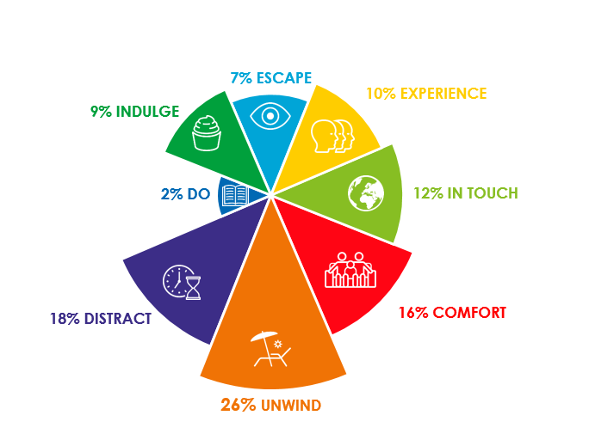
TV is fundamental in almost all viewing need states
Source: The Age of Television, 2018, MTM/Thinkbox

Slide 3
How we watch broadcaster TV – 16-34
Inds
16-34
2 hrs 36 mins
59 mins
Source: 2024, Barb
Notes:
BVOD is vital to different audiences
Breaking down broadcaster TV into the different ways reveals the increasingly important role of BVOD for 16-34, now 29% of all broadcaster TV viewing.
This data uses both Barb data and includes an estimate of any unknown viewing that is thought to fall into Playback and Live viewing.

Slide 4
675 advertisers spent less than £50k on TV in 2024
Source: Nielsen Ad Intel, 2024
Notes:
Looking at the make-up of TV advertisers across 2024, 675 - which is 30% of all advertisers - spent less than 50 thousand pounds on TV and 1,152, which is 51%, spent less than 250 thousand. 31% of all advertisers spent over a million pounds and 5% spent over ten million.

