Slide 1
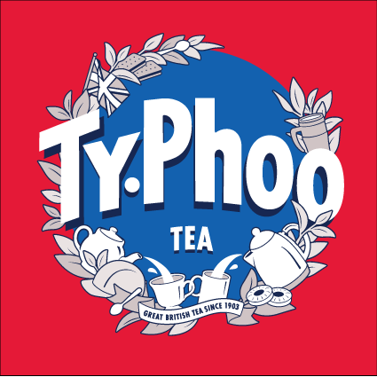
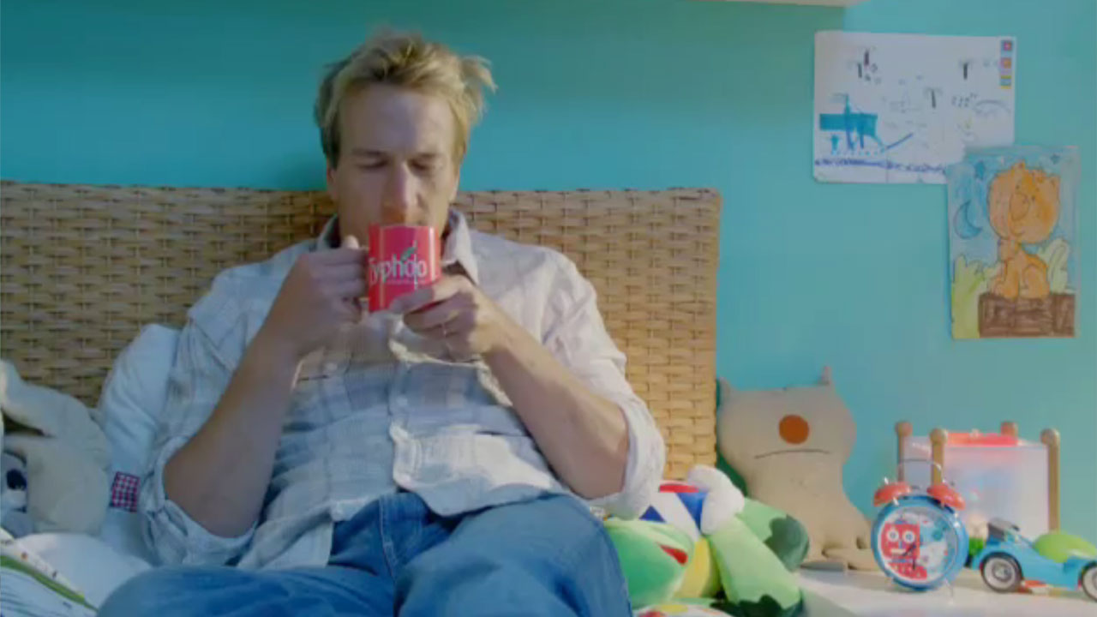
Typhoo Tea repositions itself using the power of TV
Challenge
In light of increased competition, Typhoo needed to reposition the brand to appeal to younger mums
Solution
They chose Ben Fogle to represent the brand in a programme-led campaign consisting of shorter 20 and 10” ads in cherry-picked spots to maximise the number of weeks on air
Results
Typhoo saw consistent growth in monthly volume share, rising from 3.6% to 6.2% one year later
It also became the ‘fastest growing of the top 5 tea brands’ for the previous 18 months
Notes:
Challenge:
Founded in 1903, Typhoo Tea had enjoyed many years as Britain’s favourite cuppa but had been in a continual decline in recent decades. This wasn’t helped by an antiquated plant and a general lack of investment into the brand. Alongside this, their key competitors PG Tips and Tetley were increasing their ad expenditure and other brands such as Yorkshire Tea, Twinings and Clipper were advertising on TV for the first time. With the overall tea market in decline, it would be a huge uphill battle for Typhoo to gain market share.
The profile of Typhoo drinkers was becoming older and more downmarket, so they knew they needed to reposition the brand to appeal once more to younger mums. TV, with its ability to change viewers’ perceptions of the brand through the power of emotion, felt like the obvious choice of medium.
Solution:
Typhoo felt they needed a new approach to TV advertising and opted to work with TVLowCost.
Firstly, they worked on coming up with a great creative idea. They wanted to appeal to ‘middle Britain’ and younger mums and families in particular. They wanted an idea that captured that indefinable tea moment we can all empathise with but one that also said “there are loads of teas, but only Typhoo will do.” They chose Ben Fogle to represent the brand – someone who, as both a family man and a popular Adventurer, could actively engage with Typhoo customers. The campaign memorably demonstrated that “Even Ben, the Adventurer, when it comes to looking after kids as mums do every day, was useless! But deserved a cuppa for trying”.
They produced two 20 second and four 10 second commercials. This shorter time length approach meant that the campaign could have higher frequency and also be on air for longer.
The campaign started in September 2011. The buying strategy focussed on a programme led approach, cherry picking only the best spots to reach the target audience. The tea market is not seasonal so they felt that opting for a drip campaign, in order to be on air for as long as possible would be the best way to achieve the objectives. They chose to go for four bursts of activity in the run up to Christmas using a 3 weeks on 3 weeks off flighting strategy. In the Spring of 2012, there were four additional bursts of activity. The campaign steadily built awareness with the right audience.
Results:
In August 2011, just before the campaign started, Typhoo’s volume market share was 3.2% and declining. This is the key metric they use to measure success. The TV campaign started in September and helped drive the monthly volume share up to 3.6%. In October, it had been pushed further to 3.8%, in November 4.3% and December 5.6%. Rolling 12 weeks went from 3.2% to 4.1%. One year later, the share had grown to 6.2%.
Later, Typhoo introduced an ECO pack supported by two 10 second commercials which grew that variant by 17%. The pattern continued over the next few years alongside impressive IpsosMORI Tracking scores on all levels.
Two years later, Typhoo was able to advertise the fact that it was the ‘Fastest growing of the top 5 tea brands’ for the last 18 months. TV advertising undoubtedly played the major role in this happy revival.
For the full case study and to view the ad campaigns visit: https://www.thinkbox.tv/Case-studies/Typhoo

