Slide 1
TV advertising is the most trusted
How much would you trust brands that you see or hear advertising in each of these media?
37%
38%
36%
27%
21%
21%
22%
19%
17%
16%
17%
15%
15%
12%
13%
11%
11%
9%
9%
8%
Source: Signalling Success, 2020, house51 / Thinkbox. Top 2 box agreement “How much would you trust brands that you see or hear advertising in each of these media?”
Notes:
House51 & Thinkbox’s ‘Signalling Success’ study showed that TV ads were most trusted by all adults and younger 16-34s.

Slide 2
Perceived cost signals trust
TRUST SIGNAL
Source: Signalling Success, 2020, house51/Thinkbox. Base: all adults (3,654)
Notes:
A very obvious linear relationship between perceived cost of an advertising channel, and key brand metrics, such as brand quality & brand trust.
As perception of advertising cost increases, so do trust & quality scores of brands advertising on those channels.

Slide 3
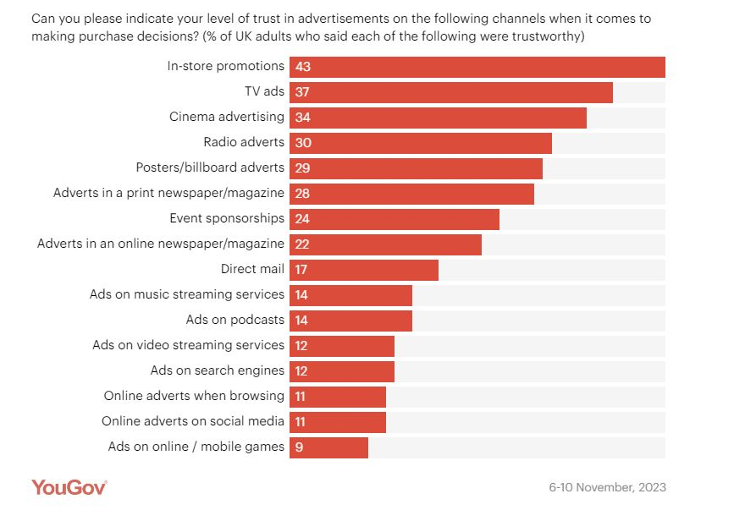
Trust is higher for traditional ad channels
Source: YouGov 2024, 3 big questions for advertisers marketers research
Notes:
Data from YouGov shows how Trust is higher for traditional ad channels such as TV and Cinema.
https://business.yougov.com/content/48911-3-big-questions-for-advertisers-marketers-research-2024

