Slide 1


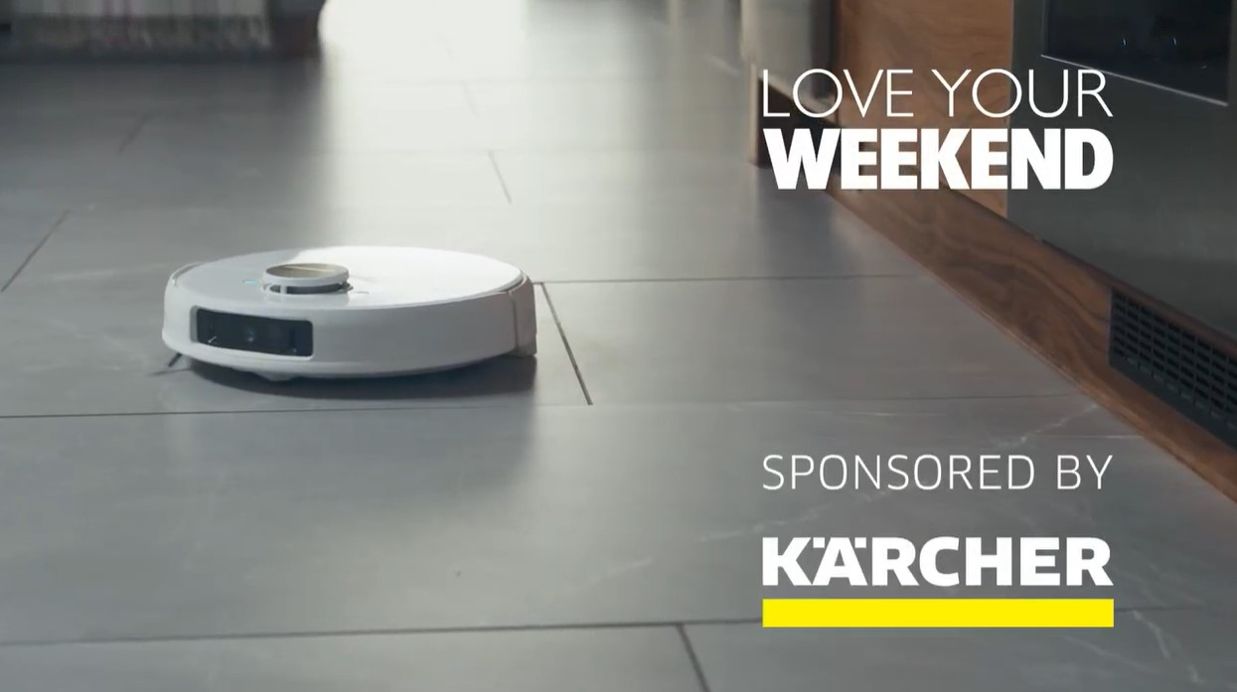
Kärcher: (Spring) Cleaning up with TV
The Challenge:
Kärcher is a brand long associated with high quality cleaning throughout the home and garden. But strong competition from cheaper own brand alternatives meant the brand needed more opportunities to grow by speaking to a broader audience . They needed to increase market share, grow sales of the pressure washer range and drive double digit site visit growth.
The Solution:
With a campaign running in the weeks leading up to the Easter Bank Holiday, Starcom targeted an audience of light and occasional buyers dubbed ‘The Procrastinators’. By using Epsilon data, they built custom audiences to target users across both linear and BVOD environments.
The Results:
35% increase in pressure washer sales matching the previous high of 3 years ago. Increase in unaided brand awareness among 24-35 age group reversing decline seen in past years. Finally Kärcher grew its market share, marking its highest performance since November 2022.
Notes:
The Challenge
Kärcher is a brand synonymous with high quality cleaning across a range of product categories and has long had a heartland audience, ABC1 adults aged 45+. They were familiar with the brand and continued to buy. With strong competition from the cheaper own brand alternatives, Kärcher needed to grow their customer base and target light and occasional buyers by showing them the superior quality of the brand over their competitors in the key sales period of the year, the 2 weeks leading up to Easter.
As a result, Kärcher tasked media agency, Starcom with clear objectives. They need to increase market share, grow pressure washer sales and drive double digit growth with site visits. Essentially Starcom needed to switch Customers from non-Kärcher brands to Kärcher and recruit customers who weren’t familiar with the wonder of a pressure washer.
The TV Solution
Armed with clear objectives, Starcom got to work in understanding the problem at hand. Insight had found customers who buy premium home cleaning products like Kärcher, tend to almost always follow seasonal cleaning routines. 59% of people claimed they engaged in spring deep cleans. This created the perfect opportunity to position Kärcher’s pressure washer as the go-to product for the job at the most relevant time of year. Heightened competition meant that Kärcher needed to shift its focus from repeat customers to the untapped segment of light and occasional buyers, a group Starcom dubbed ‘the Procrastinators’. Looking into this group's media habits highlighted only one channel that would deliver the required impact, storytelling, product demonstration and rapid reach to deliver in the lead up the Bank Holiday. That was TV.
The Plan
Armed with an approach that would see them targeting light and occasional buyers, the newly dubbed ‘Procrastinators’ audience; Starcom started to put their plan into action. Firstly by using in house Epsilon data, Starcom and Kärcher were able to identify the audience, there were largely 25-34 year old adults and were key to expanding Kärcher in a crowded market place. The data played a key role in helping to profile top performing programming for the activity. Detailed analysis had highlighted that soaps, entertainment and crime connected with the audience. Bespoke agency tool PMX lift was deployed to target Kärcher’s bespoke audience across BVOD environments. TV would remain the lead channel for reach with high frequency placements designed to ensure that the messaging was delivered at the time to the right people. Programming was key as well. Epsilon data insights optimised the media buying process ensuring that ads appeared in the best performing and most relevant programming across linear and BVOD; including Googlebox, The Great Celebrity Bake Off for SU2C, Ant & Dec’s Saturday Night Takeaway and the Six Nations, maximising impact and driving purchasing intent.
Sponsorship of Love Your Weekend on ITV was added to the mix as well. This ensured that Kärcher were able to target both their existing customer base and extend reach to new buyers. The contextual fit was clear from the off, Love Your Weekend appealed to Kärcher’s core audience who trusted the brand in regard to outdoor cleaning. An update to idents allowed Kärcher to incorporate their indoor cleaning products into the mix as well, providing an opportunity to cross sell and reinforce their position as leaders of home cleaning products.
The campaign ran across ITV stations, Channel 4, and Sky with BVOD running across all the remaining channels. Kicking off in Mid-March and running to early April to capture the lead up to the key sales period of the Bank Holiday, the campaign saw the brand have a consistent presence on TV, which was back weighted to support the mission of getting people spring cleaning to consider the brand as their first choice.
Results
The campaign in 2024 was a massive success for Kärcher delivering results across multiple metrics. Firstly, the brand saw 35% growth in pressure washer sales beating the previous sales high of the pandemic affected years, 3 years before. The campaign led to a trade in behaviour from existing customers, with more sales of the K3 and K5 model compared to a previous sales high 3 years before. The campaign also led to marked improvement in unaided brand awareness among those aged 25-34, reversing the decline seen with this age group the year before. And finally, the campaign saw Kärcher regain their market share, marking their highest performance since November 2022. Not bad going for a month long campaign.
Client quote
‘2024 was a big shift for us in prioritising long term brand growth through recruitment of more light and occasional buyers. Linear TV has always been a core media channel in our annual campaigns, but with more of a blend with VOD and Epsilon data integration we made our budget work harder to allow us to reach a broader but still relevant audience.’- Rosie Kinsey, Marketing Communications Manager, Kärcher UK

