Slide 1
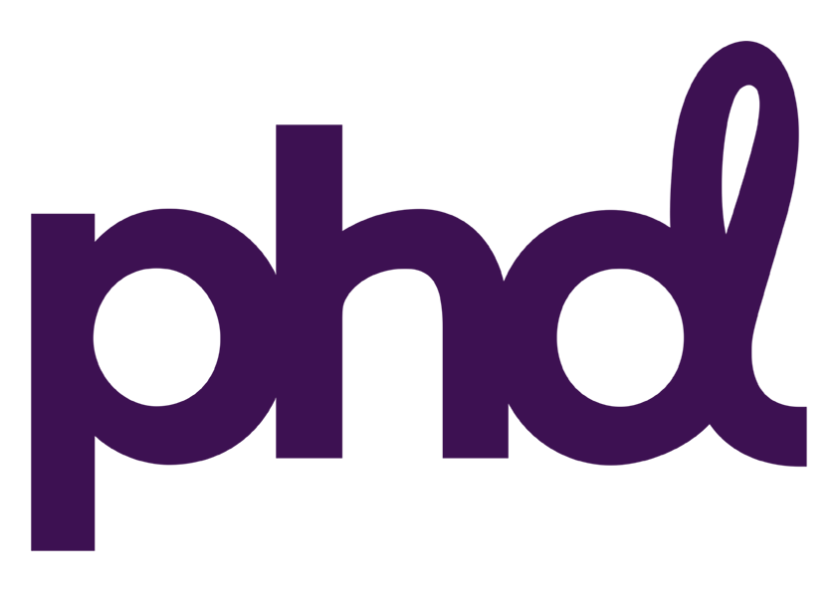
The BHF harness the storytelling power of TV
Challenge
In 2020, PHD were tasked with finding a new, compelling way to communicate the link between the pioneering research the BHF funds and the lifesaving treatments people receive every day.
Solution
They partnered with Channel 4 and made a bespoke episode of 24 Hours in A&E showing stories of people with heart conditions
They ran 20 second spots in the ad breaks to drive donations
Results
BHF received 62% more text donations in one night than they typically receive from an entire month of fundraising
86% of viewers are now more aware of the impact the BHF research has had on treatments used in A&E
Belief that the BHF is in urgent need of funds increased by 14%
Notes:
The Challenge
Collectively, heart and circulatory diseases are the UK’s biggest killers, responsible for 1 in 4 British deaths - conditions like heart disease, stroke, vascular dementia and diabetes.
The British Heart Foundation (BHF) currently funds over half of all non-commercial UK research into treatments and cures for these diseases, but the BHF’s life saving research is solely dependent on support from the public. If the donations stop, so does the research.
In 2020, PHD were tasked with finding a new, compelling way to communicate the link between the pioneering research the British Heart Foundation funds and the lifesaving treatments people receive every day.
The BHF has a long history of effective brand advertising, typically led by emotive TV spots. The challenge for this campaign was how to deliver a more complicated message that connected treatments to research to donations, all the while not losing the emotional impact that had proven to be so successful in the past.
The success of this campaign would be defined primarily by an increase in consideration to donate and secondarily, by the actions taken by those it reached.
The TV Solution
The answer to this challenge was to tell rounded stories about the frontline impact of the BHF’s work - stories about averting heartbreak and keeping loved ones together, stories that everyone could identify with, that would prompt people to act.
For this strategy of storytelling to succeed, they needed to work with the right partner – one with an existing audience that aligned with their core target of potential donors, that had credibility in the topic of health and a track record in moving the nation.
They decided to partner with Channel 4 and their award-winning documentary series ’24 Hours in A&E’. Working with the makers of the show, The Garden, they found stories of people who had arrived in A&E suffering with cardiovascular conditions. They wanted to feature the range of different conditions in which heart disease manifests itself and put the life-saving research centre stage.
The programme was perfect from an audience perspective, with the BHF’s target audience 65% more likely to watch the programme and offered the ideal programme environment.
The Plan
They created a bespoke 60-minute episode – ’24 Hours in A&E: Heart Special’ – which was broadcast at 8pm on 20th March 2020. This unique episode, funded by the BHF, told the stories of three individuals who found themselves in A&E with serious heart and circulatory conditions.
The programme concluded with the featured patients, now fully recovered, showing the long-term positive impact of the treatments they had received and demonstrating just how vital the BHF’s work is.
The programme did a great job of telling the stories of the patients with heart problems, but they also wanted to drive a response to raise donations. To do this, they filmed follow-up stories with the loved ones of the patients in the show and turned them into 20 seconds ads. These ads, placed at the start of each of the show’s three centre breaks, made the connection between the story and research that the BHF do and ended with a call for donations.
To promote the broadcast of the show, there were branded promotional trailers, promotion through Channel 4 PR, as well as paid social support targeting the BHF’s key donor audiences. The show was watched by 2 million viewers.
Results
Despite the show airing in week one of the UK’s first lockdown, when there was only one disease people were talking about, the programme captured the hearts of the public, shifted perceptions of the BHF and drove a considerable volume of donations:
The BHF received 62% more text donations in one night than they typically receive from an entire month of fundraising activity
One in eight of these supporters then signed up for regular giving – a 78% higher conversion rate than BHF’s benchmark
86% of viewers are now more aware of the impact the BHF research has had on treatments used in A&E
89% of viewers felt the programme was very clearly linked with the BHF
Belief that the BHF is in urgent need of funds increased by 14%
The campaign won Best Use of TV for Good at the 2021 TV Planning Awards

