Slide 1
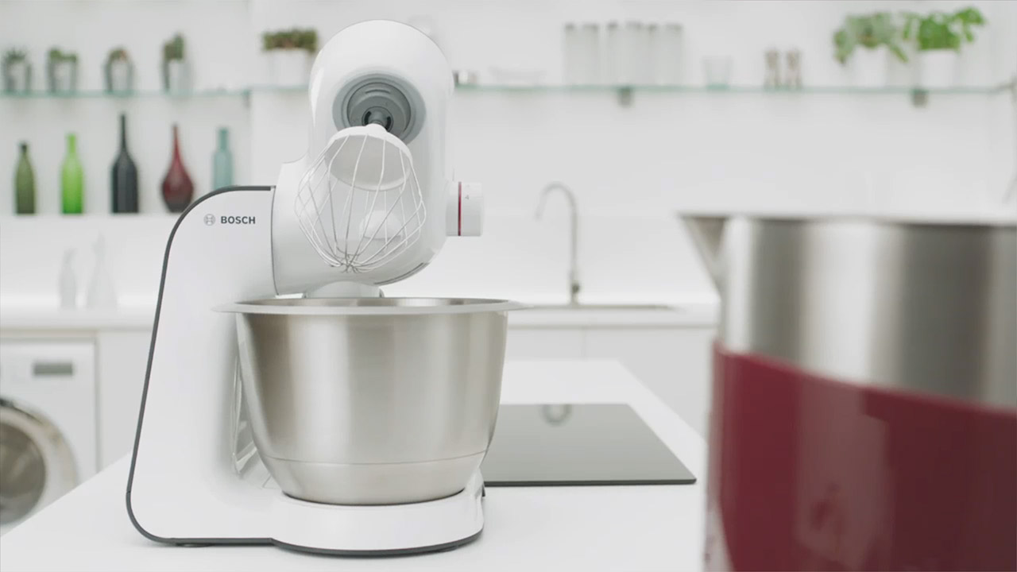
Bosch sponsors Sunday Brunch
Challenge
Bosch wanted to raise awareness of their small domestic appliances in a highly competitive market and increase consideration and purchase intent
Solution
Product placement on Channel 4’s Sunday Brunch was the perfect opportunity as well as a good fit with the affluent, middle aged target audience and was broadcast at a time when viewers would be most inspired to consider their home appliances
Results
Small domestic appliance sales were up 16% in value year on year
Amongst Sunday Brunch viewers, spontaneous awareness increased 53% across the year and consideration increased by 15%
Notes:
The Challenge
Bosch are a market leading home appliance brand. The brand’s heritage has been built on the quality, reliability and innovation of their major domestic appliances such as washing machines, tumble dryers, ovens and fridges.
However, in 2015, Bosch had a new business objective. They wanted to raise awareness of their small domestic appliances (SDA) such as food preparation products, kitchen mixers, kettles and toasters. The SDA category is highly competitive with a number of established brands like Kenwood, Morphy Richards, Breville and Russell Hobbs.
Their communications objectives for 2015 were as follows:
Primary - increase spontaneous awareness of SDA
Secondary – increase consideration and purchase intent of SDA
In 2015, Bosch SDA market share was almost half that of the major domestic appliances and so the challenge was significant.
The TV Solution
They tasked their media agency, Mediacom, to find a solution. They wanted something that could not only drive the awareness they needed, but also showcase multiple SDA products. Mediacom recommended a long term, multi-dimensional, always on TV partnership. TV sponsorship was chosen because of its ability to improve spontaneous awareness. A long term sponsorship was needed in order to keep the brand top of mind for as long as possible. Finally, the partnership needed to offer product placement opportunities so that multiple SDA products could be shown and demonstrated.
They found the perfect opportunity in Channel 4’s Sunday Brunch. It provided everything they needed, was a good fit with the affluent, middle aged Bosch target audience and was broadcast at a time when viewers would be most inspired to consider their home appliances. TGI figures showed that Sunday Brunch viewers are 33% more likely to influence others about home appliance purchases.
The product placement opportunity meant they could dramatise the product benefits, showing the Bosch products in action in an authentic way. This would allow them to shift brand consideration and purchase intent as well as awareness.
In addition, as the majority of Bosch SDA transactions are in-store as opposed to online, this partnership would benefit Bosch trade and retail partners alongside consumers.
Results
The sponsorship delivered 949 ratings across the year
Amongst Sunday Brunch viewers, spontaneous awareness increased 53% across the year and consideration increased by 15%
When comparing Sunday Brunch viewers to non-viewers at the end of the partnership, spontaneous awareness of SDA was 77% higher, consideration was 28% higher and purchase intent was 18% higher
As a result of the partnership, attitudes towards the brand improved, reaffirming Bosch’s high quality but also helping the brand seem more relevant
SDA sales were up 16% in value year on year
To read the full case study and access the creative visit: https://www.thinkbox.tv/Case-studies/Bosch

