Slide 1
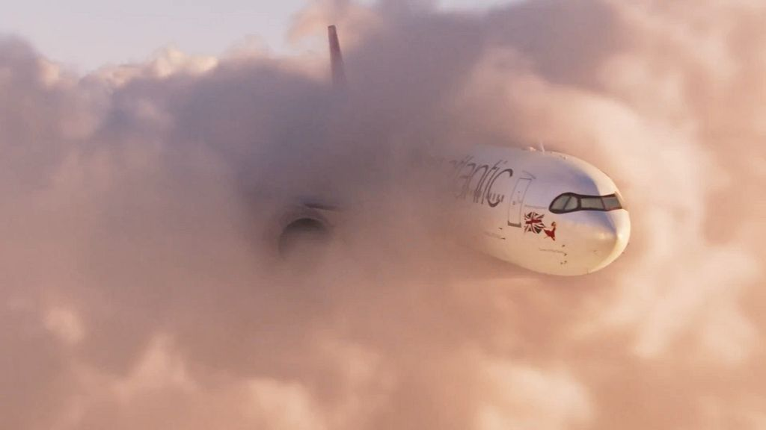

Travel Deep Dive
Virgin Atlantic - A Rainbow in the Clouds

Slide 2
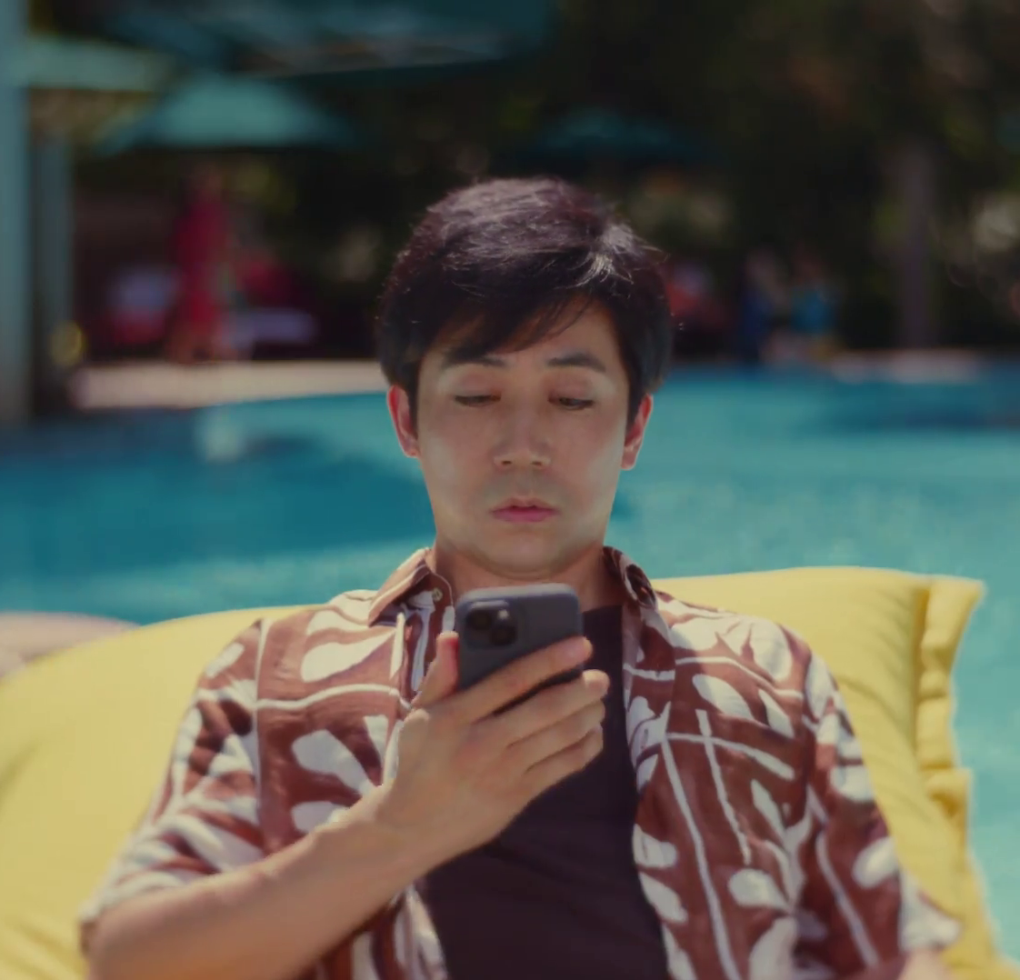
In this deck…
To provide an analysis of the travel category this deck explores the following areas:
Macro Spend Patterns:
Spending behaviour and patterns
Effectiveness:
TV is crucial to the plan
Media Planning:
Weekday, and daypart analysis
Ad time-lengths
Case Studies:
Jet2, P&O Cruises, and Fred. Olsen
Marriott – Loyalty’s Just That Easy
Notes:
To provide an analysis of the travel category this deck explores the following sections:
Macro Spend Patterns:
Spending behaviour and patterns
Effectiveness:
TV is crucial to the plan
Media Planning:
Weekday, and daypart analysis
Ad time-lengths

Slide 3
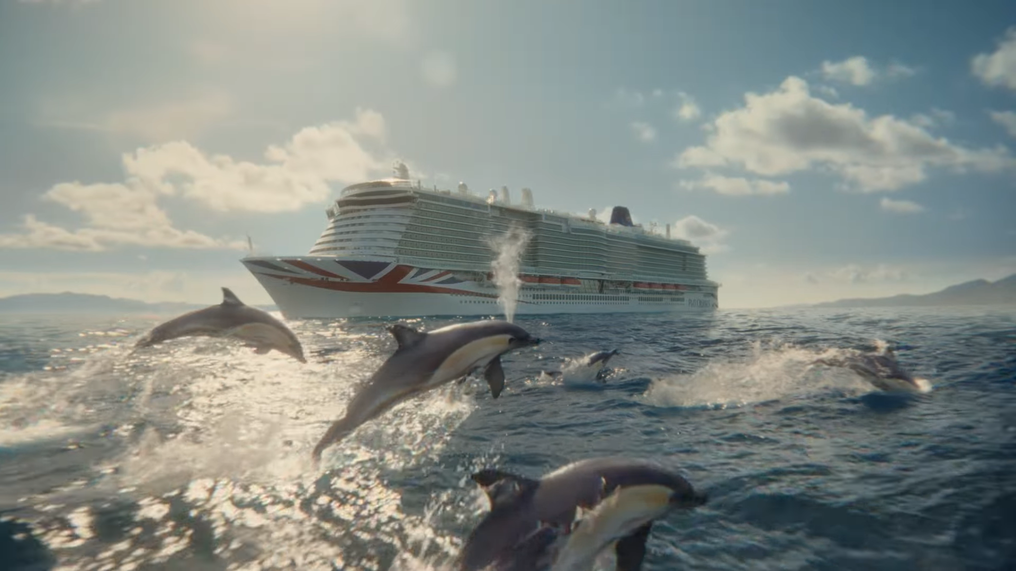
Macro spend patterns
P&O Cruises - Cruise the Mediterranean Like Never Before

Slide 4
Travel TV investment exceeds pre-pandemic levels
+£26m
+7%
+£160m
+84%
+£5m
+1%
-£2m
-1%
+55m
+40%
-50%
-£137m
Source: Nielsen Ad Intel, 2019-2025, Travel, TV Spend, %’s show YoY change.
Notes:
Travel's TV investment has remained above pre-pandemic spending levels since 2022.

Slide 5
In 2025, national rail and travel agents drove growth
+£26m
+7%
+£160m
+84%
+£5m
+1%
-£2m
-1%
+55m
+40%
-50%
-£137m
Source: Nielsen Ad Intel, 2019-2025, Travel, TV Spend, %’s show YoY change.
Notes:
In 2025, Rail Delivery Group increase spend by £7m year-on-year and Trivago increased spend by £5m.

Slide 6
Travels share of TV impacts at highest point in over a decade
Source: Barb, 2010-2025, individuals, linear impacts (R/W), travel share of voice vs all other categories.
Notes:
Travels share of voice relative to all other categories has increased since 2010.

Slide 7
Travel advertisers SoV has fluctuated across the last decade
Source: Barb, 2010-2025, individuals, linear impacts (R/W), top 10 travel advertisers by total linear impacts from 2010-2025.

Slide 8

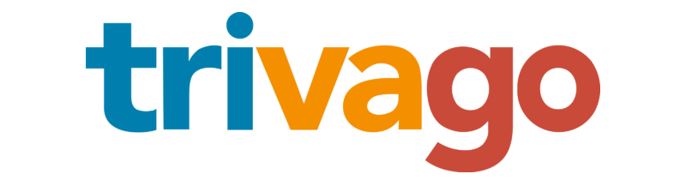

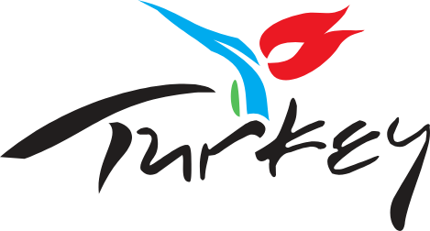






Expedia is the largest investor in linear TV
Source: Barb, 2025, individuals, linear impacts (R/W) (million). Top 10 2025 Travel & Transport advertisers by total linear TV impacts.

Slide 9
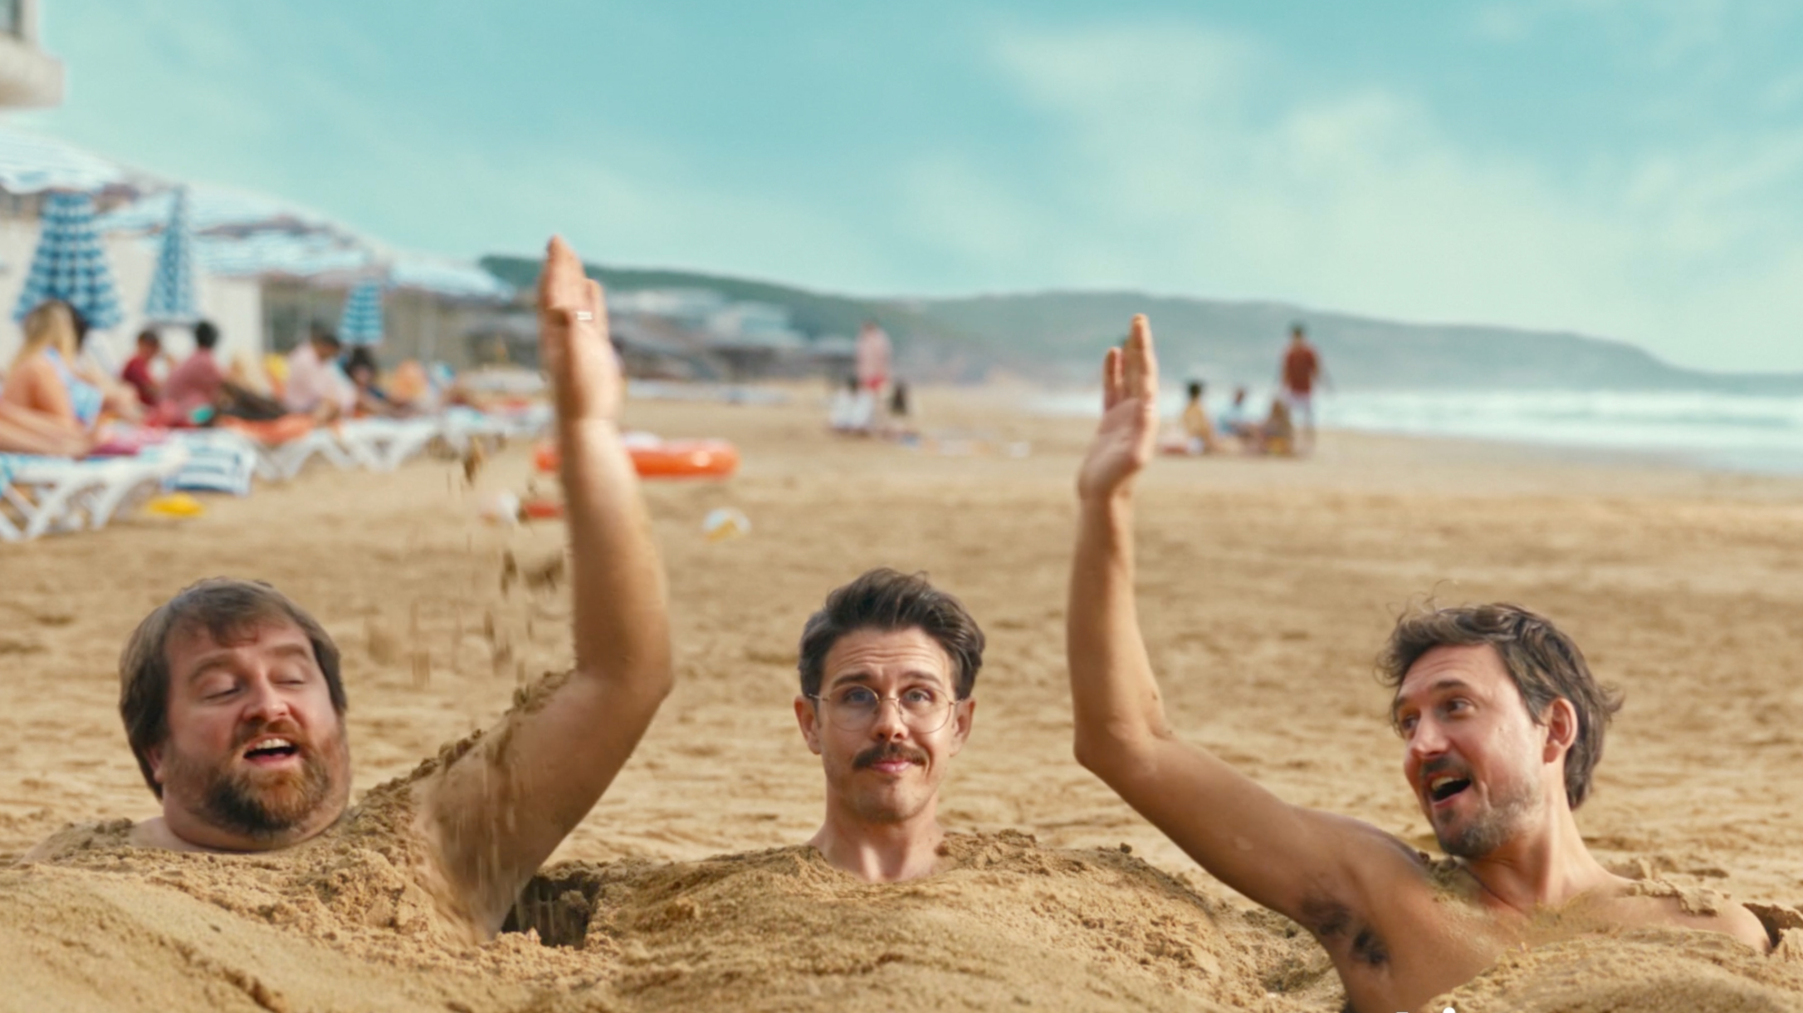
Effectiveness
Trivago – Three Heads

Slide 10

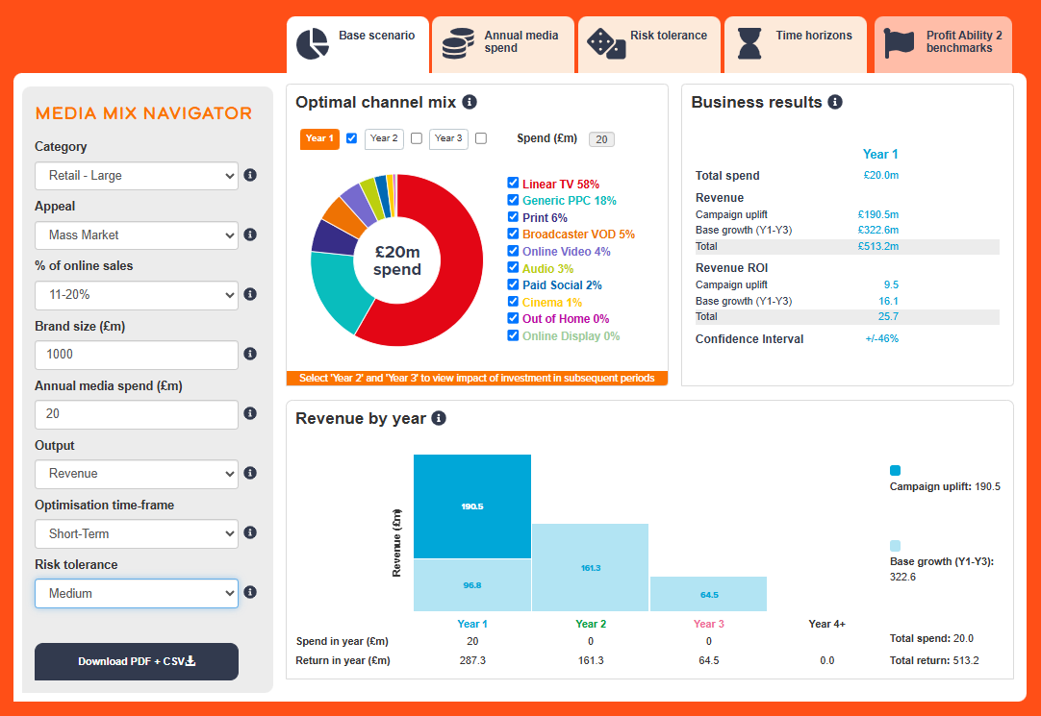
Profit Ability 2 and Media Mix Navigator
Profit Ability 2 was conducted by Ebiquity, EssenceMediacom, Gain Theory, Mindshare, and Wavemaker UK.
It’s a meta-analysis of econometric studies from 141 brands covering £1.8 billion of media spend across 10 media channels and 14 business sectors.
The Media Mix Navigator (MMN) tool, powered by the data from Profit Ability 2, allows you to explore different scenarios to define the optimum media mix for your business, whether your objective is to drive increased profit or revenue.

Slide 11
Optimised MMN scenario for Travel recommends higher share of TV vs. actual databank share
Actual vs. Media Mix Navigator Optimised channel mix
Source: Media Mix Navigator, Optimised based on Travel, £150m brand size, 71-80% online sales, mass market, full-term, medium risk and media budget of £10m.
Notes:
Channel investment strategy depends on not only a brand’s objective but also the category it is in, as well as budget, brand size and risk appetite. There is no better tool than the Media Mix Navigator (MMN) to provide a benchmark view that takes into account these crucial factors. The MMN recommends a higher share of Linear TV & BVOD when compared against the actual databanks share.
The Media Mix Navigator is available here:
https://www.thinkbox.tv/training-and-tools/media-mix-navigator/media-mix-navigator

Slide 12
Broadcaster TV delivers over half of Travel’s full profit volume
Short-term effects
Bubble size represents % of short-term profit volume
Travel Short-Term ROI: £1.19
Full effects
Bubble size represents % of full profit volume
Travel Full Profit ROI: £2.62
Source: Profit Ability 2, April 2024, Travel – Short Term Benchmarks: Ebiquity, EssenceMediacom, Gain Theory, Mindshare, Wavemaker UK. Broadcaster TV = Linear + BVOD.
Notes:
In the Travel sector, all channel short-term profit ROI is £1.19; although a number of channels only just breakeven.
Print and Online Video have relatively strong short-term ROIs. Travel focused titles and content is likely driving this - albeit off small spend levels.
In terms of scale of short-term profit volume, Linear TV, Generic PPC and Paid Social are the biggest contributors.
Looking at full payback, Profit ROI increases to £2.62.
Online Video and Print still have highest ROIs, off their modest spend levels.
A significant move is that BVOD’s ROI is now amongst the highest.
Linear TV becomes by far the standout channel in terms of total profit volume delivery – accounting for 43%.
AV as a collective performs very well - nothing lends itself more to inspiring people than AV; especially as diving an emotional response is key in this sector.
Travel is highly transacted online and has a fiercely competitive search bidding environment. However, the data suggests that there is overinvestment in Generic PPC vs. other channels.
When considering full effects, Generic PPC ROI is significantly lower than the sector average highlighting overinvestment vs other channels which all have stronger sustained effects.
It is possible that brands in this sector are hooked on the ‘trackability’ of search leading to an overly digital focused media mix.

Slide 13
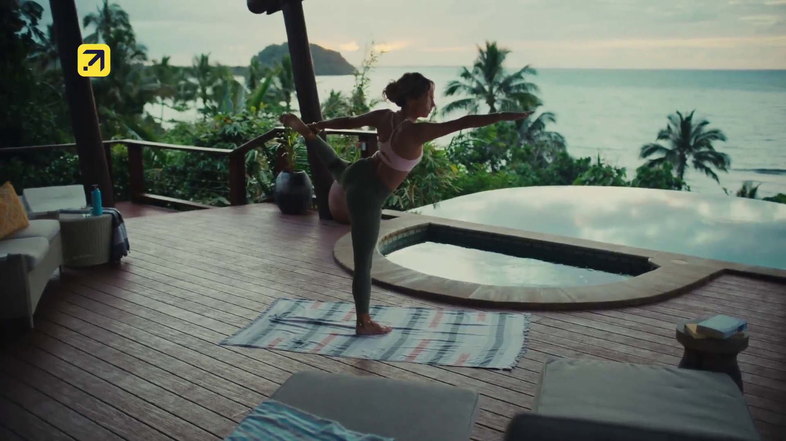
Media planning
Expedia – Made to Travel

Slide 14
Travel linear TV spend skews toward the start of the year
Index of travel commercial linear TV impacts vs all categories
Travel linear TV index by month
Jan | Feb | Mar | Apr | May | Jun | Jul | Aug | Sep | Oct | Nov | Dec
173 | 123 | 104 | 101 | 118 | 104 | 99 | 79 | 91 | 62 | 45 | 90
Top 10 travel advertisers commercial linear TV index by month
 | Jan | Feb | Mar | Apr | May | Jun | Jul | Aug | Sep | Oct | Nov | Dec
TUI | 117 | 107 | 68 | 122 | 122 | 84 | 107 | 105 | 35 | 70 | 110 | 146
Trivago | 113 | 108 | 108 | 76 | 108 | 163 | 178 | 197 | 38 | 0 | 0 | 118
P&O Cruises | 158 | 157 | 98 | 126 | 71 | 76 | 103 | 93 | 87 | 85 | 71 | 67
Turkish Tourist Office | 110 | 173 | 124 | 101 | 101 | 145 | 108 | 89 | 61 | 77 | 41 | 71
Disney | 204 | 13 | 135 | 28 | 250 | 34 | 0 | 0 | 297 | 169 | 0 | 56
Rail Delivery Group | 44 | 46 | 56 | 98 | 179 | 187 | 261 | 197 | 53 | 80 | 38 | 0
Expedia | 208 | 90 | 171 | 172 | 142 | 81 | 96 | 89 | 58 | 2 | 1 | 69
Airbnb | 131 | 109 | 97 | 116 | 173 | 165 | 188 | 86 | 149 | 0 | 0 | 0
Premier Inn | 141 | 0 | 130 | 96 | 99 | 241 | 6 | 73 | 291 | 72 | 0 | 62
Booking.com | 199 | 114 | 108 | 140 | 262 | 133 | 125 | 0 | 0 | 0 | 0 | 98
Source: Barb, 2025, monthly index vs full-year 2025, individuals, top 10 travel advertisers by total linear impacts.
Notes:
Travel linear TV spend skews toward the start of the year and early summer months.

Slide 15
Travel TV spend skews toward morning & evening viewing
Index of travel commercial linear TV impacts vs all categories
Travel commercial linear TV index by daypart
 | 6am | 7am | 8am | 9am | 10am | 11am | 12pm | 1pm | 2pm | 3pm | 4pm | 5pm | 6pm | 7pm | 8pm | 9pm | 10pm | 11pm | 12am | 1am | 2am | 3am | 4am | 5am
Monday | 120 | 117 | 102 | 97 | 89 | 90 | 89 | 87 | 87 | 91 | 97 | 110 | 114 | 114 | 110 | 96 | 95 | 92 | 81 | 81 | 74 | 72 | 81 | 93
Tuesday | 135 | 121 | 102 | 91 | 85 | 89 | 84 | 84 | 86 | 89 | 97 | 109 | 112 | 112 | 110 | 103 | 96 | 89 | 81 | 80 | 74 | 79 | 92 | 81
Wednesday | 120 | 121 | 103 | 91 | 88 | 89 | 89 | 85 | 87 | 86 | 96 | 109 | 109 | 115 | 109 | 104 | 97 | 90 | 83 | 76 | 73 | 77 | 82 | 88
Thursday | 115 | 120 | 104 | 94 | 89 | 88 | 88 | 86 | 83 | 86 | 95 | 108 | 109 | 115 | 114 | 103 | 96 | 89 | 80 | 78 | 70 | 78 | 89 | 96
Friday | 116 | 113 | 100 | 90 | 90 | 88 | 90 | 91 | 87 | 88 | 95 | 106 | 107 | 117 | 118 | 102 | 94 | 92 | 82 | 76 | 68 | 66 | 85 | 79
Saturday | 104 | 103 | 99 | 94 | 95 | 94 | 94 | 89 | 91 | 86 | 96 | 105 | 109 | 113 | 113 | 106 | 98 | 94 | 86 | 82 | 72 | 78 | 80 | 80
Sunday | 100 | 96 | 99 | 93 | 93 | 96 | 95 | 95 | 94 | 94 | 94 | 102 | 107 | 116 | 118 | 103 | 91 | 92 | 81 | 76 | 68 | 77 | 80 | 89
Monday | Tuesday | Wednesday | Thursday | Friday | Saturday | Sunday
103 | 101 | 102 | 99 | 100 | 97 | 98
Source: Barb, 2025, individuals, commercial linear, travel index vs all categories.
Notes:
The seasonality of Travel linear TV spend skews towards the start of the year and early summer months. Travel linear TV spend skews towards weekday early morning and evening viewing hours.

Slide 16
Use of 30” is high amongst Travel & Transport advertisers
Source: Barb, 2025, individuals.
Notes:
The most prevalent users of longer spots is the charity sector (Govt, Social, Political Org). This will consist of DR daytime and small channel spots, but shows the power of longer spots in delivering a more emotive impact. This emotive impact is dependent on good storytelling – something much easier to do successfully in longer ads.

Slide 17
Travel ad lengths have shortened over the last twenty years
Source: Barb, 2003-2025, individuals, travel & transport category.
Notes:
Travel ads have progressively shortened over the last 10 years, now typically lasting 30 seconds or less.

Slide 18
Travel advertisers opting for shorter ads
Source: Barb, 2025, individuals, linear only, travel & transport category, top 15 advertisers by total linear impacts.
Notes:
Use of spot length is relatively consistent across the travel category with 30” or shorter being the optimal choice.

Slide 19
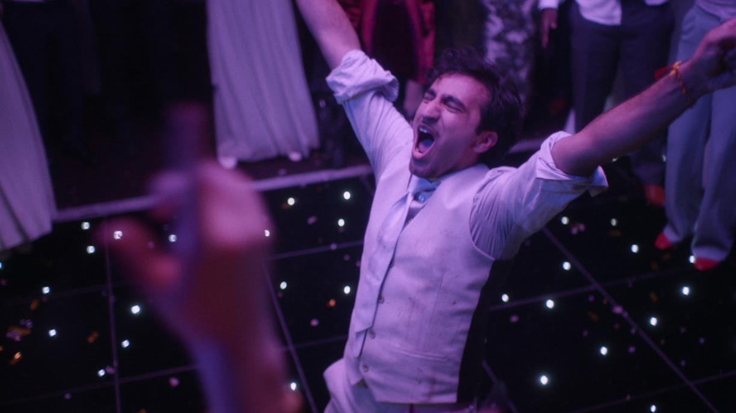
Case Studies
Premier Inn – You Know What You’re Getting

Slide 20
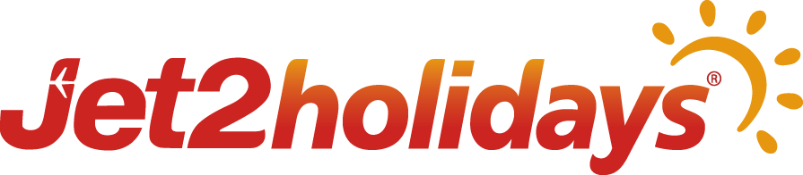

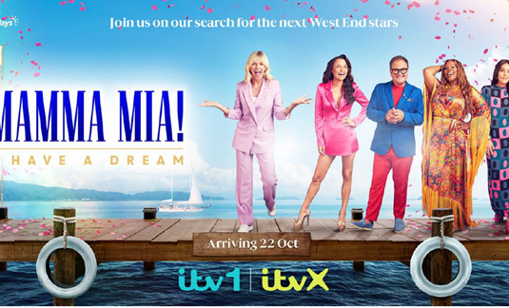
Jet2holidays: Welcome aboard sponsorship airways
Challenge:
Inflation, the cost-of-living crisis, and wild weather pushed many towards staycations. Jet2holidays needed to reinforce its position as a travel expert.
Solution:
By partnering with ITV’s Mamma Mia: I Have a Dream, Jet2holidays showcased its brand purpose, strengthened perceptions of its travel expertise, and boosted consideration and purchase intent.
Results:
Creative testing showed the partnership as improving statements like ‘telling me something new about the brand’ and ‘making me want to find out more about Jet2holidays’.
Those that recalled seeing the campaign saw strong improvements in consideration for the brand, with uplifts in likelihood to book with Jet2 in the next 12 months. Showing the movement from awareness to consideration to conversion.
Notes:
The Challenge
With 55% of Brits saying they look forward to their yearly dose of sun and sand over any other event in the year, Jet2holidays, the UK’s largest tour operator, should have been sitting back and enjoying the sun themselves. But against a backdrop of price inflation and a cost of living crisis had lead to questions around the affordability of European travel. Coupled with this was widespread media coverage of oppressive heatwaves, raging wildfires and mass evacuations which had prompted many holidaymakers to consider a staycation.
With the quality of the holiday being the main thing consumers look for when booking, Jet2holidays along with media agency Wavemaker, knew that any activity would need to build trust and convince users of the value of the package holidays on offer. Jet2Holidays would need to reinforce their position as experts in travel, moving the needle from awareness to consideration.
The TV Solution
With clear objectives, Wavemaker got to work in understanding the problem at hand. It was clear to them that a partnership would be the best way to strengthen brand associations. Research highlighted that the right partnership would deliver improvements in perception, consideration and purchase intent. Partnering with the right host would also see improvements in brand stature and improvements in trust.
Wavemaker knew that only one channel would deliver the required cut through with the target audience of families, TV. With more than a third of families saying they booked a holiday because they saw the destination on a TV show. TV would be the perfect environment and they just needed a TV show that would deliver on the brand purpose of Jet2holidays.
The Plan
Having landed on the idea of a TV partnership, Wavemaker went to work in seeking out the right partnership. In October 2023, Jet2holidays found the ideal brand partner. Enter the new ITV commission, Mamma Mia: I Have a Dream. The talent show format would see 14 of the best young performers in the UK compete for a starring role in the West End’s iconic production of Mamma Mia, set against the backdrop of a beautiful Greek island of Corfu. The show due to start in October would be perfect as it was outside of the traditional category window for marketing and would hopefully prime the audience ahead of the key first quarter booking period. The Sponsorship was designed in a way that would allow Jet2holidays to showcase their fun, family friendly credentials to the audience of 3 million a week across linear, BVOD and social channels to build favourability with the viewers across as many touchpoints as possible.
Wavemaker, working closely with Jet2holidays and partners Thames (production), Fremantle (distribution), ITV (broadcast) and IMA-HOME (creative), were able to devise a fully activated marketing campaign that would amplify the association with Mamma Mia: I have a Dream! Across all owned, paid, earned and performance channels. The linear sponsorship would provide the backbone to the campaign. Reaching 13 million adults in a relaxed state at the peak of their happiness and positivity, early on Sunday evenings. IMA-HOME produced bespoke idents and a commercial competition for each episode across the 8 week period showing the full scope of the offering and expertise in travel. Contextual creative would call out the previous week’s winner of the competition, which was designed to enhance engagement and maximise traffic to the site, where the consumer could find destination guides, travel info, family offers and behind the scenes content.
Branding was integrated into the show through passive placement to showcase the complete Jet2holiday experience, from end to end. Talent from the show were shown flying with the airline, transport was facilitated by the ‘red team’ resort helpers and mentoring and performances were set against the backdrop of Jet2’s exclusive resorts and hotels.
The launch of the show was supported with a series of events across all offices, bases and retail centres. ITV sponsored a Greek themed experience complete with an ABBA tribute band. Airports used the licence to rebrand check in decks and trade and contact centres gave away tickets to the live final. Long term partnerships with publishers were leveraged to amplify the partnership with exclusive imagery weaved into native articles, newsletters, competitions and advertorials. Some of this activity was lined up to match with promotional coverage including the front cover of the Daily Mail’s weekend supplement. This amplification continued when the campaign was live with Jet2holidays social team engaged with audience between episodes with reactive show messaging. Social content included licensed video, where audiences could watch talent being transformed from their everyday selves into sun kissed singers they see on TV.
Results
Jet2holidays partnership with Mamma Mia: I Have a Dream was a roaring success for the brand. The sponsorship allowed Jet2holidays to showcase their brand purpose and improve the key image metrics. Creative testing showed that the sponsorship out performed benchmarks for both ‘telling me something new about the brand’ and ‘making me want to find out more about Jet2holidays’. Key to fitting with the objective of moving awareness to consideration.
Independent research showed the partnership had shown growth in all the key consumer metrics. Of those aware of the sponsorship, there were strong uplifts in terms of future consideration of the brand and likelihood to book in the next 12 months. Prompted awareness increased amongst those who recalled seeing the activity. And 57% of those aware of the sponsorship saying that Jet2holidays ‘provides a better experience than other travel brands’. Truly positioning Jet2holidays as leaders and experts in travel.

Slide 21

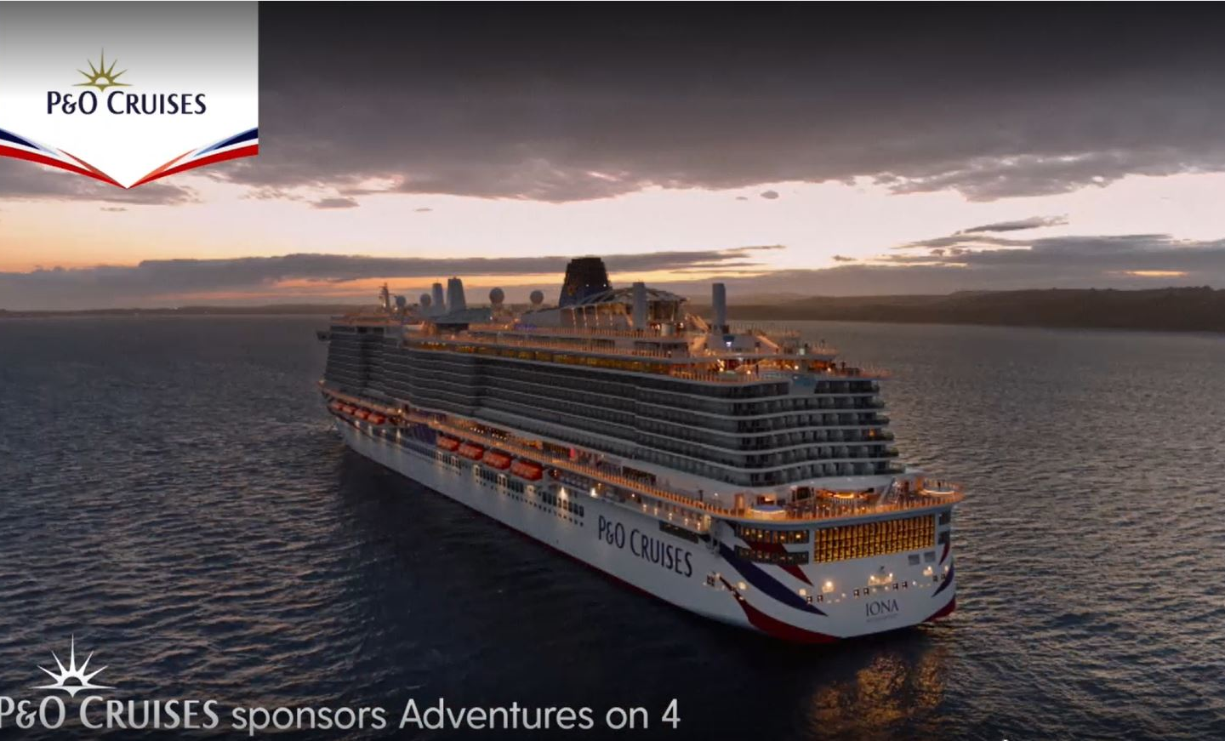
P&O Cruises uses sponsorship to cruise to success
Challenge:
P&O Cruises wanted to grow the market, attracting non-cruisers to the brand and challenging the perception of the category
Solution:
To position itself as a gateway to incredible experiences, the brand embarked on a two-year sponsorship of “Adventures of 4” - Channel 4’s most adventurous programming
Results:
Opinion improved by 28%
Consideration grew by 26%
42% said they learned something new
Notes:
The Challenge
P&O Cruises is the market leader within cruising but had bigger ambitions to be amongst the UK's favourite holiday brands. At the end of 2021, and with the impact of the pandemic still looming, this was a huge task.
Success lay in thinking beyond existing cruisers and looking to grow the market, attracting non-cruisers (newcomers) to the brand and challenging the perception of the category. With its spend achieving a 30% SOV within the cruise category, but only a 2% SOV within travel, it couldn’t simply spend its way to its objective - it was more than just a salience game.
It knew that holidaymakers only consider three brands when booking their holidays and so it had to find a powerful, persuasive way to connect with this new audience.
The TV Solution
Wavemaker, its media agency, knew the key to success was not just salience but also creating an emotional connection with the broader “newcomers” target audience, and associating the holiday experience they sought. To achieve this, a specific audience was constructed using TGI data, identifying individuals who valued variety and adventure in their travels.
Addressing misconceptions about cruising was another essential aspect of the strategy. Many non-cruisers perceived cruising as unexciting, limited, and lacking cultural immersion and adventure. These negative perceptions posed a challenge, especially after the impact of COVID-19.
TV was identified as a potent platform for showcasing experiences effectively and driving sales, but there was a need to stand out amidst more substantial spending by competitors. Data from Wavemaker revealed that TV sponsorships not only have a high impact, but they are also the most effective at changing perceptions. So, as the category continued to recover and the target audience began to consider their holiday options, Wavemaker set out to find a property which had the ideal personality to associate with adventure and exploration, provide consistent presence to help re-frame the brand, and capitalise on the high-attention environment that only TV can provide.
The Plan
P&O Cruises wanted to position itself as a gateway to incredible experiences rather than simply being a cruise provider and to achieve this, it partnered with Channel 4 to create "Adventures on 4" - a two-year sponsorship programme aligned with the broadcaster’s most adventurous programming.
The package included 36 hours of peak Channel 4 programming - including viewer favourites such as Hunted, Sue Perkins’ Big American Road Trip, Guy Martin and The Bridge - ensuring consistent visibility and exposure on Channel 4 throughout the year along with presence on All4, historic content and repeats across their portfolio.
Knowing that a strong set of idents would ensure the sponsorship felt fresh throughout the year, would align with different types of content easily and would appeal to a broader spectrum of audiences, the creative agency produced 14 different idents showcasing the adventurous spirit of cruising holidays.
To integrate further, P&O Cruises sponsored social content for shows like "The Bridge" and "Hunted" with its branding included on exclusive content each week, engaging a younger demographic and increasing brand exposure.
Results
A 6%pt increase in share of search across 2022
28% of viewers who recognised the sponsorship said their opinion of P&O Cruises was much better
26% of viewers who recognised the sponsorship said it made them much more likely to consider travelling with P&O Cruises for their next holiday abroad
Within this, 35% of our newcomer audience were now considering the brand (following exposure to the sponsorship)
77% respondents agreed that P&O Cruises was an appropriate sponsor of Adventures on 4
27% of this group attributing this sentiment to their newfound perception of cruises as being adventurous
42% of the audience stated that they learned something new about P&O Cruises from the campaign

Slide 22


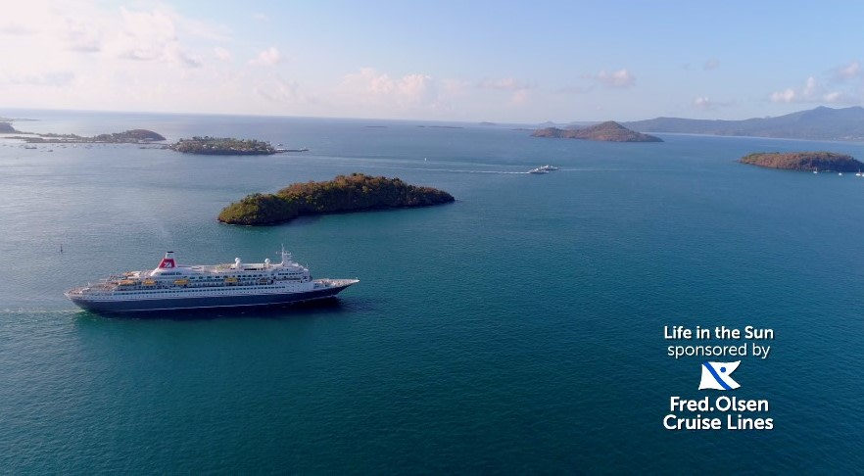
Fred. Olsen – Cruising up the awareness rankings
Challenge:
Grow passenger booking in Scotland by 10%
Build trust and grow awareness in Scotland with the Fred. Olsen ABC155+ audience
Solution:
Fred. Olsen had never used brand TV, Total Media proposed a solution different to anything they had done before.
Total Media & STV developed a sponsorship that would build awareness and trust of Fred. Olsen
Results:
Doubled their % increase booking target for the Scotland port
In Scotland they were second only to P&O Cruises in unprompted awareness
Fred. Olsen had their ‘best year ever’ in terms of number of cruise sales
Notes:
The Challenge
In 2018 Fred. Olsen was rated the 10th best cruise liner in the world by Which? despite this, poor sales over several years had meant that their port in Scotland had become a ‘problem port’ and was on the verge of closing down.
In an attempt to prevent this and to appeal to a wider audience, Fred. Olsen decided to increase the number of routes from the port, but simply adding the new routes was not enough, with a modest budget, Fred. Olsen had to find a sustainable way to support and promote the port in order to sell enough cruises to keep the port open.
There key objectives were:
Grow passenger booking in Scotland by 10% to make the ‘problem port’ in Scotland a long term viable option for Fred Olsen to continue running cruises from
Build trust in Scotland with the Fred. Olsen audience, ABC1Ads55+ in TV demographics, to prove that Fred. Olsen is the cruise brand for them
Continue to grow awareness amongst the Scottish audience
The TV Solution
Fred. Olsen have never used brand activity on TV before. This existing approach would therefore make it difficult for Fred. Olsen to maintain awareness in Scotland and crucially drive sales. In order to meet the business objectives Total Media had to come up with a solution that was different to anything that Fred. Olsen had done before.
Learnings taken from various research resources including Thinkbox’s ‘Get with the Programmes’ helped Total Media arrive at the conclusion that a well-executed sponsorship would be a viable, cost effective and sustainable solution. Using Scot Pulse surveys, Total Media identified that STV would be the best environment to help Fred. Olsen
Total Media developed a sponsorship with STV that would build awareness and trust of Fred. Olsen and provide access to those relevant dayparts, across the most important sales period of the year (January and February). Working with Fred. Olsen and STV, Total Media cam up with the tagline ‘Escape the Winter Blues and get closer to the action with STV sponsored by Fred. Olsen’.
The Plan
‘Escape the Winter blues and get closer to the action with STV sponsored by Fred. Olsen Cruises’ launched on New Year’s Day.
The sponsorship gave Fred. Olsen great access to a daytime audience who may be familiar with Fred. Olsen due to their previous DRTV activity, as well as presence in 4 peak programmes – a daypart which was completely new to Fred. Olsen.
This was coupled additional DRTV on the STV2 channel which Total Media had negotiated to be included as part of the package. The activity in Scotland was part of a full funnel approach with the sponsorship sitting at the top of the funnel, with additional press partnership to give further information to the audience, and a significant amount of biddable and display activity running at the same time to effectively capture demand.
Results
Fred. Olsen more than doubled their % increase booking target for the Scotland port
Fred. Olsen Cruise Lines (FOCL) was mentioned by over 1 in 4 unprompted – meaning their unprompted awareness in Scotland was second only to P&O Cruises
Fred. Olsen deemed the sponsorship to be so much of a success they tasked Total Media to negotiate a deal to extend it to run for the rest of 2018.
Fred. Olsen went onto have their ‘best year ever’ in terms of number of cruise sales

