Slide 1
Windrush Compensation Advocacy Support Fund (WCASF)
Year 2 - Information Session
Hosted by the Home Office WCASF Team
Date: 15th and 23rd January

Slide 2
Agenda
  Purpose and Objectives
  Eligibility for Year 2
  Geographical Coverage
  Pop-up Hubs
  Eligible Expenditure
  Overview of Application Process
  Overview of Competition Process
  Key Dates
  Assessment Questions
  Find a Grant portal
  Further Information
  Questions
  Links and Resource Materials

Slide 3
Purpose and Objectives
Purpose
To support people (claimants) via organisations and their respective advocates, who are trusted in the local community, culturally competent, with the end goal of facilitating a viable and eligible claim for compensation.
Objectives
Use established links in the local community to raise awareness to those who are eligible but have not yet applied.
Provide a safe space to enable claimants to tell their story and ensure this is articulated in their claim.
Support with documentation gathering and providing accurate viability and eligibility information and sign posting where appropriate.

Slide 4
Eligibility for Year 2
England, Scotland and Wales:
An unincorporated charity or community organisation, a community interest company, or a company with a charitable purpose or,
A registered charity or,
A joint venture consortium
A successful organisation or member of a consortium who received funding in WCASF Year 1.
Grass roots organisation
AND
An organisation with secure systems in place to ensure claimants data is securely stored, saved and destroyed (evidence of successful organisation’s privacy policy will be required) and,
Based in the UK and are already providing an Windrush Compensation Scheme advocacy service within your community. You must demonstrate that you are a trusted member of your community.
Northern Ireland:
An unincorporated charity or community organisation, a community interest company, or a company with a charitable purpose or,
A registered charity or,
A joint venture consortium
A successful organisation or member of a consortium who received funding in WCASF Year 1.
Grass roots organisation
AND
An organisation with secure systems in place to ensure claimants data is securely stored, saved and destroyed (evidence of successful organisation’s privacy policy will be required) and,
Based in the UK and are already providing an advocacy service within your community. You must demonstrate that you are a trusted member of your community.
***Following engagement with the Northern Ireland (N.I) executive office and stakeholders, we are aware that awareness of WCS is limited. Therefore (in N.I only) previous WCS advocacy experience is not a requirement; however organisations must showcase how they are currently offering an advocacy service(s) in their area

Slide 5
Geographical Coverage
For Year 2 we have split the UK into ten regions. You may apply for more than one region.
Northern Ireland has been broken down further into 6 sub-regions. You may apply for more than one sub-region.
Region Number | Region
1 | Northern Ireland
2 | Wales
3 | Scotland
4 | Northeast, England
5 | Northwest, England
6 | Yorkshire & Humber, England
7 | East Midlands, England
8 | West Midlands, England
9 | Outer London and Southwest, England
10 | Southeast, England and Inner London
Region Number | Area
1a | Antrim
1b | Armagh
1c | Down
1d | Fermanagh
1e | Londonderry
1f | Tyrone

Slide 6
Pop-up Hubs
Part of Year 2 of the funding will include a minimum of 5 Pop-up hubs delivered by organisations.
The location and date is the organisations choice, but the locations must be outside of your immediate locality, to maximise outreach.
Maximum 2 staff to attend per pop-up hub event
Reasonable travel expenses will be reimbursed. Overnight stays will be subject to approval from Live running team.
Organisations need to clearly demonstrate their plans for pop-up delivery during the application process.

Slide 7
Funding for England, Scotland and Wales
Bids split into three sections –
Start-up Costs which has a cap of £6,000 or 10% of the overall bid, whichever is lower and
Administrative and Travel Costs which has a combined cap of £9,000 or 15% of the overall bid, whichever is lower and
Advocacy Hours (Staffing) which together with Start-up, Administrative and Travel costs, will not exceed a total bid value of £60,000.
Overall minimum award available - £10,000.00.
Overall maximum award available - £60,000.00.
Advocacy Hours (staffing) costs
Bid placed for number of hours, with the expectation that the vast majority of this is spent providing direct advocacy support to potential claimants. Organisation to supply their hourly rate up to a maximum of £50 per hour. The number of hours that can be bid for depends on the hourly rate set by the bidding organisation. The entire bid may be allocated to staffing costs if the organisation chooses, with no restrictions or percentage limits. This is receipt based.
Start-up Costs
Optional. Can bid for up to 10% of the overall bid (max £6000), this can be paid up-front but invoice/receipts/quotes required. This covers the costs associated with the mobilisation plan to allow swift and successful delivery of the project.
Administrative and Travel costs
Optional. These categories combined are capped at a maximum of 15% of the overall bid (max £9000). These are ongoing costs needed to deliver the project successfully, to be paid on a receipt basis.
Optional and can be paid upfront for admin and overhead costs. Quotes, invoice or receipt required for payment.
.

Slide 8
Funding for Northern Ireland
Bids split into three sections –
Start-up Costs which has a cap of £1,000 or 10% of the overall bid, whichever is lower and
Administrative and Travel Costs which has a combined cap of £1,500 or 15% of the overall bid, whichever is lower and
Advocacy Hours (Staffing) which together with Start-up, Administrative and Travel costs, will not exceed a total bid value of £10,000.
Overall minimum fund available - £5,000.
Overall maximum fund available - £10,000.
Advocacy Hours (staffing) costs
Bid placed for number of hours with the expectation that the vast majority of this is spent providing direct advocacy support to potential claimants. Organisation to supply their hourly rate up to a maximum of £50 per hour. The number of hours that can be bid for depends on the hourly rate set by the bidding organisation. The entire bid may be allocated to staffing costs if the organisation chooses, with no restrictions or percentage limits. Receipt based.
Start-up Costs
Optional. Can bid for up to 10% of the overall bid (max £1,000), this can be paid up-front but invoice/receipts/quotes required. This covers the costs associated with the mobilisation plan to allow swift and successful delivery of the project.
Administrative and Travel costs
Optional. These categories combined are capped at a maximum of 15% of the overall bid (max £1,500). These are ongoing costs needed to deliver the project successfully, to be paid on a receipt basis.
Optional and can be paid upfront for admin and overhead costs. Quotes, invoice or receipt required for payment.
.

Slide 9
What can funding be used for?
Advocacy Hours (staffing costs)
Direct claimant support: Time spent assisting potential claimants with WCS-related advocacy.
Pop-up hub delivery: Staffing costs for delivering a pop-up hub, including the time to travel to and from the location and the time spent delivering the hub. If more than two staff members are required, prior approval must be obtained from the Live Running Team.
Ongoing Training: Time spent receiving training specifically related to WCS advocacy support, prior approval must be obtained from the Live Running Team.
Warm handover: Time to prepare for and complete the warm handover call.
Travel time for attending appointments with potential claimants face to face who are unable to receive support digitally.
Non-Eligible costs:
Time spent attending internal team meetings.
Staffing costs for purposes other than direct claimant support (e.g., project management, administrative support, preparing and delivering marketing materials).
Advice and guidance on the Windrush Scheme - formerly Windrush Taskforce.
Legal representation or advice (whether in person or in writing) in relation to the Windrush Compensation Scheme.
Advocacy support following the submission of the claim to the Windrush Compensation Scheme and the completion of the ‘warm hand-over’ call, unless part of the 5 allocated hours.
Administrative Costs
Administrative and project management staffing costs – including WCASF specific internal team meetings
Time taken to produce and deliver marketing materials at events – excluding pop-up hub delivery.
Ongoing marketing and promotional activities, including materials needed for the pop-up hub delivery.
Reasonable costs for refreshments for external meetings and events, excluding alcohol.
Reasonable telephone charges, postage, and printing costs.
Data and reporting: Time to compile data requested by the Home Office and attend monthly check-in meetings.

Slide 10
What can funding be used for?
Travel
All travel expenses must be directly related to project delivery and fall under one of the following purposes:
Delivering a pop-up hub within your region.
Providing face-to-face support to a potential claimant who is unable to travel or be supported digitally.
Eligible costs include:
Public transport must be used wherever possible. Standard class tickets must be booked, prebooked where possible, for up to 2 staff members per visit. Travel costs must be supported with evidence of purchase.
If travelling by car, mileage will be reimbursed at the HMRC approved rate (currently £0.45 per mile).
Overnight accommodation can be booked in exceptional circumstances if it would be unreasonable for the staff members to travel back on the same day. Bookings for overnight accommodation must be preapproved by the Live Running Team.
Start-up Costs
This covers the costs associated with the mobilisation plan to allow the swift implementation and successful delivery of the project. (specifically costs needed to mobilise)
Eligible costs include:
Initial venue hire.
Initial marketing expenses.
Development and delivery of staff training directly related to WCS advocacy support.
Staffing costs directly related to these activities.
Non-Eligible Costs:
IT equipment (including laptops and phones).

Slide 11
Application Process
Fully completed applications must be submitted on the Find and Apply Grant Portal by 5pm 6th February 2026. No late applications will be accepted.
Applications will be assessed by the Windrush Compensation Scheme within the Home Office, alongside the Commercial Grants team.
If you are already providing Windrush Compensation advocacy support and wish to continue this work, we expect that any funds received under this grant will be used to support additional people that without this funding, you would be unable to currently support.
Outcome letters will be shared with organisations that apply to confirm if your application was successful or not.
Our aim is for grant agreements to be completed and signed between Home Office and successful bidders in April 2026.
Most money paid will be in arrears, and as soon as grant agreements are completed and signed, work towards the objectives of the fund can begin.
Activities for Year 2 must be concluded by 31st March 2027.

Slide 12
Competition Process
The competition is being managed by the Grants Commercial Team.
The competition is advertised on Find-A-Grant where you can see all competition documents and apply.
It is important that organisations read the Guidance for Applicants and the Draft Grant Agreement before completing the Application Form. The Evaluation and Award process is also detailed here.
Clarification questions can be asked during the competition period via email to WCSAdvocacySupportFund@homeoffice.gov.uk do not send any emails/correspondence to anyone within the Home Office, this email address is your only communication channel. The deadline for clarification questions is 5pm 28th January 2026.
Clarification questions and responses will be uploaded to the supporting information section on the Find and Apply Portal. If you sign up for updates on this grant, you will be notified when these are uploaded.
Application forms must be completed and submitted by 5pm on 6th February on the Find and Apply Grant Portal. Once submitted you will receive a notification.

Slide 13
Key Dates
Competition Bidding
12/01/2026 – Launch of competition
15/01/2026 & 23/01/2026 – Bidder information sessions
28/01/2026, 5pm – Deadline for Bidder clarification questions
06/02/2026, 5pm – Deadline for Bid submissions
Indicative dates based on volume of organisations that apply
16/02/2026 – 13/03/2026 - Bid Evaluation, Moderation & Due Diligence checks
March / April 2026 – Bidders notified of award decisions
31/03/2027 – Projects fully delivered and closed

Slide 14
Assessment Questions
For organisations applying for England, Scotland and Wales
Q 5.1: What experience does your organisation have as advocates for the Windrush Compensation Scheme within both your community, and the region that you are applying for? (max 1000 words)
A good response must include, but not necessarily be limited to:
Clear demonstration of your organisations’ experience as advocates for the Windrush Compensation Scheme within your community and,
How you have built awareness of your organisation and its services within your community and,
How you have built trust within your community and,
If you are bidding for multiple regions, outline your approach to engaging with each community within each region and how you have or will build strong, trusting relationships.

Slide 15
Assessment Questions
For organisations applying for Northern Ireland
Q 5.1: What experience does your organisation have as advocates within both your community, and the sub-region that you are applying for? (max 1000 words)
A good response must include, but not necessarily be limited to:
Clear demonstration of your organisations’ experience as advocates within your community and,
How you have built awareness of your organisation and its services within your community and,
How you have built trust within your community and,
If you are bidding for multiple sub-regions, outline your approach to engaging with each community within each sub-region and how you have or will build strong, trusting relationships.

Slide 16
Assessment Questions
Q 5.2: Please provide your engagement strategy including a list of key activities with timelines, that you will complete to engage with your community and all communities in the region(s) you are bidding for. You should include how and when you will advertise the WCS advocacy service during the period of grant funding. This should include details of your organisation's websites or social media pages. If you do not intend to use websites or social media pages, please explain why outlining your preferred solution.
Please also provide an outline of your mobilisation plan, including timeframes. Your response should detail the staffing structure and numbers required to ensure sufficient key personnel are in place to deliver the advocacy work effectively. (Max 1500 words)

Slide 17
Assessment Questions
Q5.3: The Windrush Compensation Scheme is designed to provide redress to individuals who suffered losses or impacts as a result of being unable to demonstrate their lawful status in the UK. Based on the scheme’s rules and guidance, please outline your understanding of the following: (Max 2000 words)
Instructions:
Please provide concise but complete answers to each part. Your response will be assessed for accuracy, clarity, and understanding of the scheme’s purpose and procedures.
a) Who is eligible to claim compensation under the Windrush Compensation Scheme?
b) What is needed for a claim to be viable?
c) What categories of losses or impacts can be compensated for under the scheme?
Continued on the next slide

Slide 18
Assessment Questions
5.3 continued
d) What supporting information is typically required when submitting a claim that includes a claim under Loss of Access to Employment, Homelessness and Impact on Life?
e) What are the key stages in the claim and review process?
f) How many claim form types are there, and what is the difference between each of them?
g) Can you explain the difference between eligibility to claim compensation, and entitlement to compensation? Please explain your answer.

Slide 19
Assessment Questions
Q5.4: Please outline your delivery model to ensure potential claimants are fully supported up to a claim being submitted to the Windrush Compensation Scheme? (Max 1500 words)
A good response must include, but not necessarily be limited to:
A high-level overview of your delivery model, and
How you will make reasonable adjustments so that services are inclusive and accessible, and
How you will ensure that claimants receiving support remotely are provided with the same quality, consistency, and level of service as those supported in face-to-face settings, and
How you will work to meet safeguarding standards, like working with vulnerable people, ensuring claimants are signposted to appropriate organisations for additional support if needed, how will you identify the list of organisations you may refer to, and
How you will prepare claimants for the Warm Handover call, so that they understand the process and will participate in it.

Slide 20
Assessment Questions
Q5.5: How will you ensure staff have the knowledge and skillset necessary to be a strong advocate for claimants? (Max 2000 words)
A good response must include, but not necessarily be limited to:
What training you will provide to staff prior to working with claimants and throughout the grant funding period, and
How you will ensure staff maintain a full working knowledge of Windrush Compensation Scheme rules and guidance, and
How you will ensure staff identify and gather the appropriate additional information - specific to the individual being supported to make a claim, and
What quality assurance you will undertake to maintain consistency and a high level of quality support throughout the claim submission process , and
What support you will put in place for staff who may be listening to traumatic accounts, and
Continued on the next slide

Slide 21
Assessment Questions
Q5.5 continued
How you will ensure all staff are aware of your organisational GDPR processes (evidence of privacy policy/notice will be required), and
Details of your governance and project management arrangements, including roles and responsibilities of all parties that are involved.

Slide 22
Assessment Questions
Q5.6: How will you determine the locations for the 5 pop-up hubs to be held within your region? (Max 750 words)
A good response must include, but not necessarily be limited to:
The rationale behind your proposed locations, including strategic, demographic and logistical considerations, and
Evidence you have drawn upon to inform your proposed approach.

Slide 23
Assessment Questions
0 | 20 | 40 | 60 | 80 | 100
No evidence | Very limited evidence | Limited evidence | Satisfactory evidence | Good evidence | Outstanding evidence
The Applicant did not answer the question | The Applicant has provided very limited detail and evidence in response to the question. This creates a major risk to delivery | Some detail and evidence have been provided but there are important omissions. This creates a significant risk to delivery | Satisfactory detail and evidence have been provided. The response covers most of the relevant requirements but with minor omissions. There is reasonable confidence in the Applicants ability to deliver against objectives | A good level of evidence has been provided, and the response covers all relevant requirements. There is a good level of confidence in the Applicants’ ability to deliver against the objectives. | A strong level of detail and evidence has been provided that fully meets all requirements. There is a high level of confidence in the Applicants ability to deliver against all objectives

Slide 24
Assessment Questions
Question | Weighting (%) | Minimum score | Weighted minimum score | Maximum Score Available
5.1 | 10 | 60 | 600 | 1000
5.2 | 10 | 60 | 600 | 1000
5.3 | 20 | 60 | 1200 | 2000
5.4 | 20 | 60 | 1200 | 2000
5.5 | 20 | 60 | 1200 | 2000
5.6 | 10 | 60 | 600 | 1000
Funding Toolkit | 10 | 100 | 1000 | 1000
Total | 100% | 460 | 6400 | 10000

Slide 25
Assessment Questions
 | Bidder 1 |  | Bidder 2 |  | Bidder 3
Question Number | Unweighted Score | Weighted Score | Unweighted Score | Weighted Score | Unweighted Score | Weighted Score
5.1 (weighted 10%) | 100 | 1000 | 60 | 600 | 60 | 600
5.2 (weighted 10%) | 60 | 600 | 60 | 600 | 80 | 800
5.3 (weighted 20%) | 100 | 2000 | 60 | 1200 | 60 | 1200
5.4 (weighted 20%) | 60 | 1200 | 100 | 2000 | 60 | 1200
5.5 (weighted 20%) | 60 | 1200 | 100 | 2000 | 60 | 1200
5.6 (weighted 10%) | 60 | 600 | 80 | 800 | 60 | 600
Funding Toolkit (weighted 10%) | 100 | 1000 | 100 | 1000 | 100 | 1000
Totals | 540 | 7600 | 560 | 8200 | 480 | 6600

Slide 26
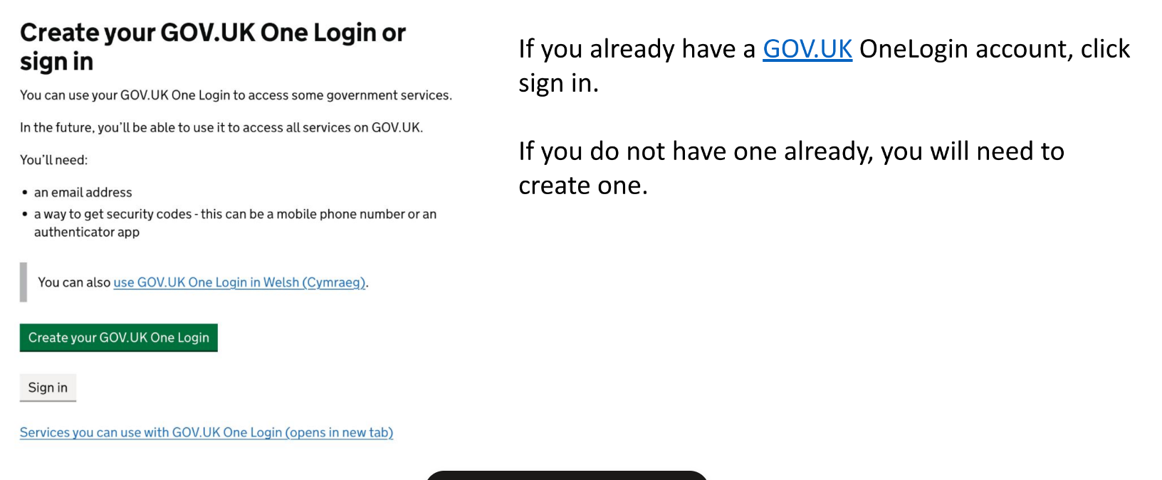
Find a Grant
1. Sign in or register with GOV.UK OneLogin

Slide 27
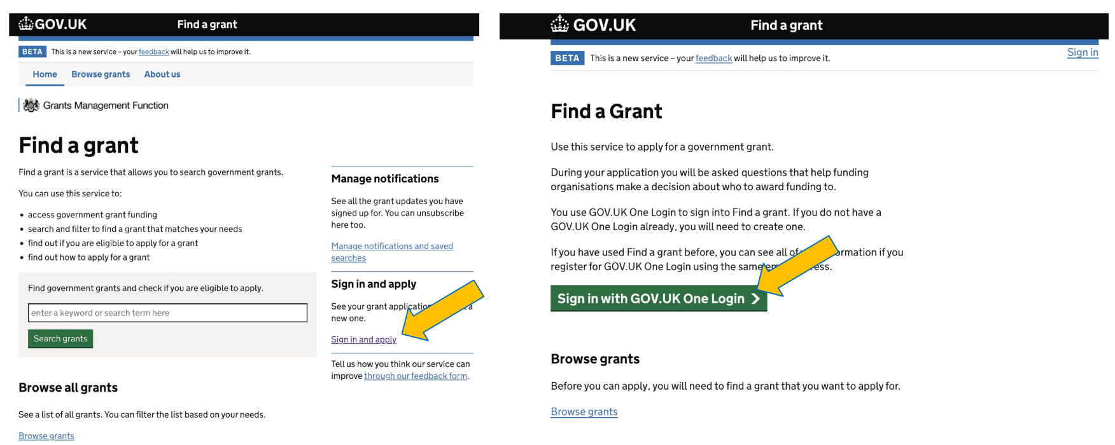
Find a Grant
1. Sign in or register with GOV.UK OneLogin

Slide 28
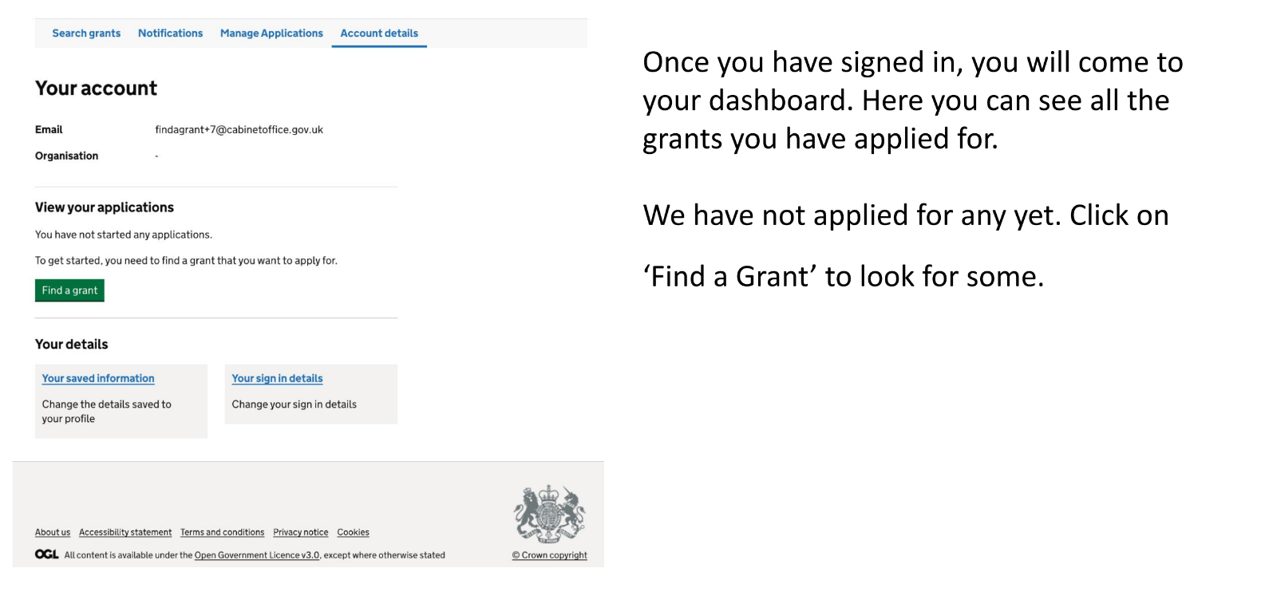
Find a Grant
2. Your grants dashboard

Slide 29
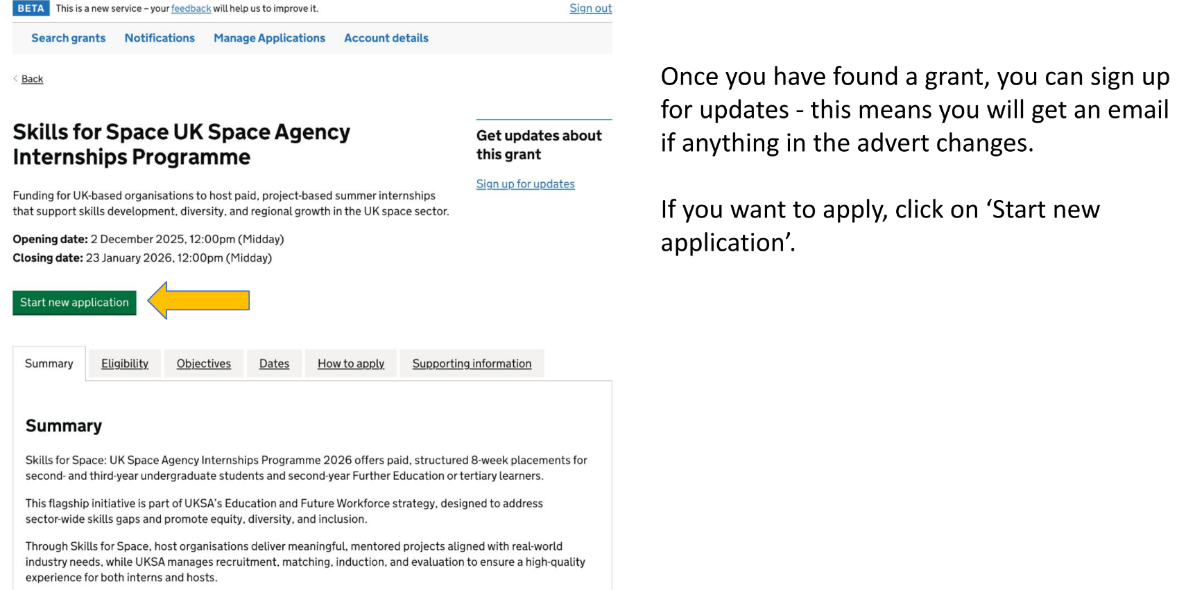
Find a Grant
3. Apply for a Grant

Slide 30
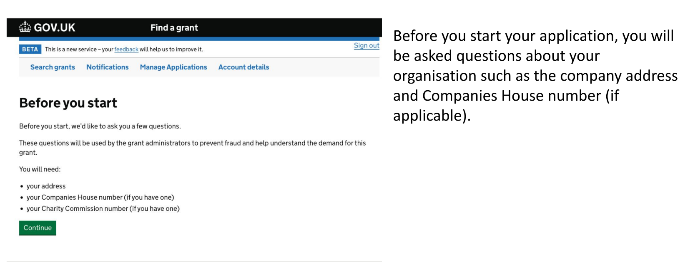
Find a Grant
4. Due diligence questions

Slide 31
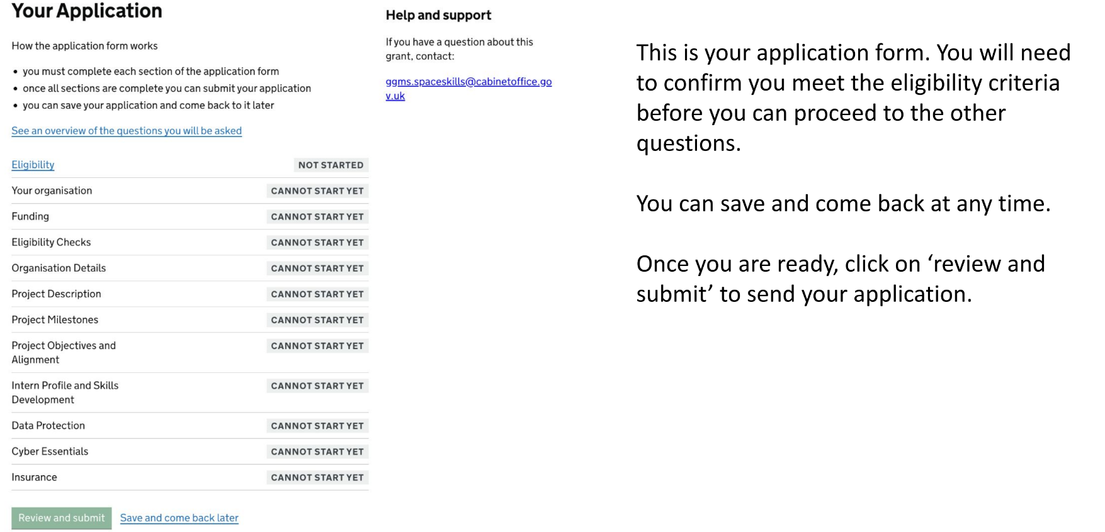
Find a Grant
5. Your application

Slide 32
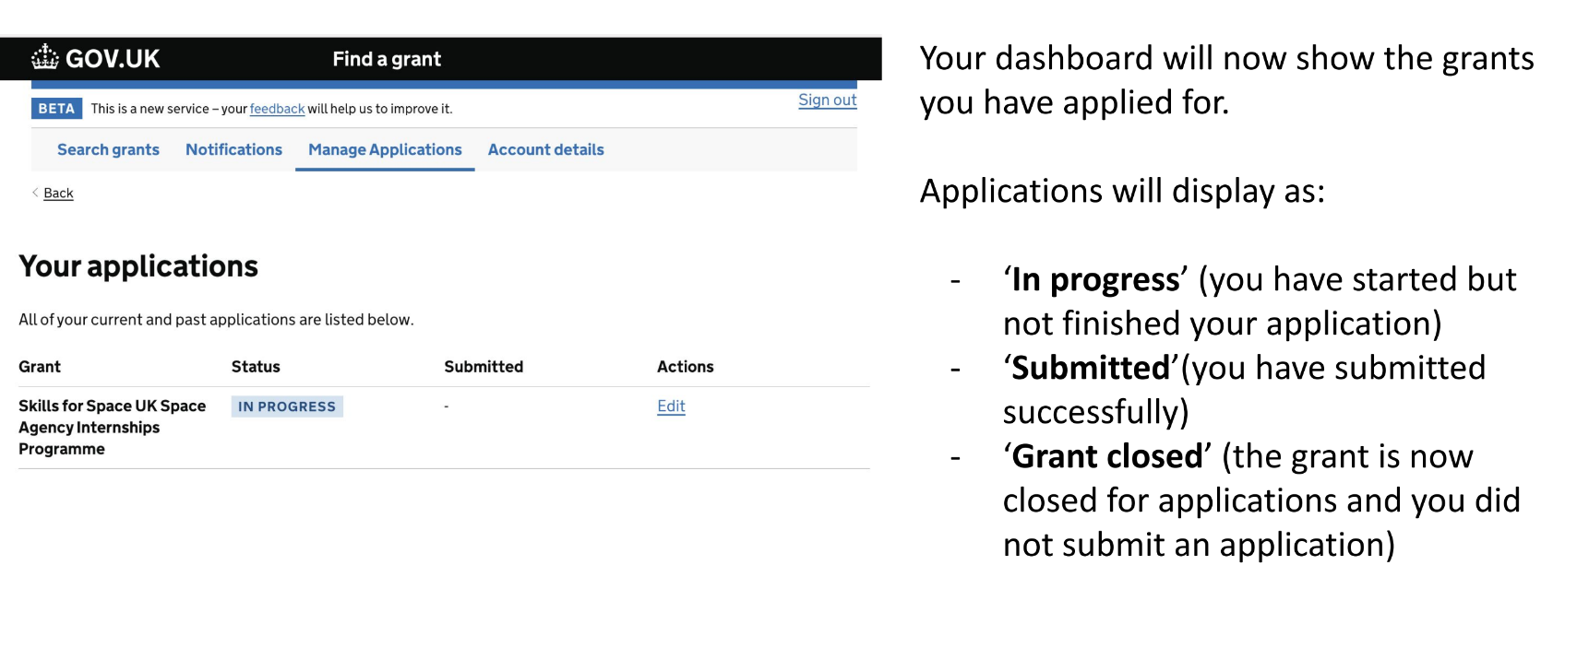
Find a Grant
6. Your dashboard

Slide 33
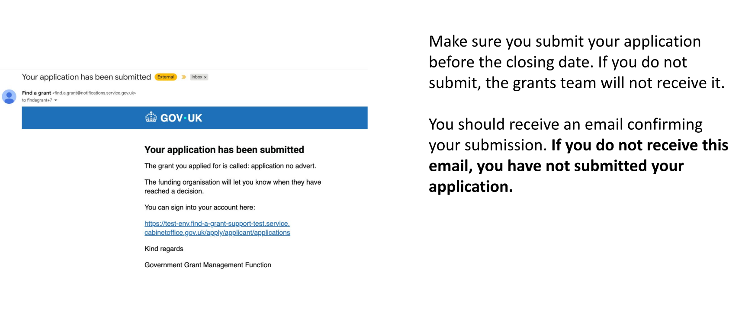
Find a Grant
7. Submitting your application

Slide 34
Find a Grant
Points to note
Once you have submitted your claim through Find a Grant portal, you will receive a system generated email confirmation. If you do not receive an acknowledgement, please check that you have correctly submitted your claim. Email the WCASF email to check if you are unsure.
Please submit all supporting documents at the time of submission to reduce delays. If your claim submission has missing information or documents, we may decline your application.
All supporting documents need to be in the correct format, using any pre-populated templates given by Home Office. For example, the funding toolkit needs to be fully completed as per the template.
If applying as a joint venture consortium, the consortium agreement needs to be fully completed and signed by all involved parties.

Slide 35
Further Information
The application and key documents
WCASF FAQs
Guidance for Applicants
Draft Grant Agreement
WCASF Funding Toolkit Template
Applicant Clarification Question Submission Template
WCASF Y2 Information sessions January 2026
Find A Grant Walkthrough

Slide 36
Questions?
Any questions?
Further questions contact:
Email: WCSAdvocacySupportFund@homeoffice.gov.uk
Dates to note:
Application closing date: Funding will be payable after April 2026, largely receipt based, any up front (for example marketing) costs to be paid by Summer 2026
Year 2 completion: 31st March 2027

Slide 37
Links and Resources
Useful links and resources
Communications Partner Packs:
UK Partner Pack
Overseas Partner Pack
Windrush Scheme and Windrush Compensation Scheme:
Windrush Scheme: full eligibility details - GOV.UK (www.gov.uk)
Apply to the Windrush Compensation Scheme: Overview - GOV.UK (www.gov.uk)
Find A Grant:
Home - Find a grant

