Slide 1
Debt Advice Modernisation Fund 2025 / 26
8TH May 2025

Slide 2

Today's Agenda
Debt Advice Modernisation Fund Overview
Eligibility Criteria
Consortium Applications
Project Focus Areas
Funding and Timeline
Evaluation Criteria
Reporting and Accountability
Application Process
Conclusion
Innovation and Technology Forum
Q&A

Slide 3
Debt Advice Modernisation Fund Overview

Slide 4
Fund Objectives
We are pleased to announce the launch of our Debt Advice Modernisation Fund 2025 / 26 – total funding pot of £1.5M for the debt advice sector.
The Debt Advice Modernisation Fund is an initiative designed to enhance and modernise debt advice services, driving meaningful improvements for both organisations and their clients. The fund is specifically targeted at enabling not-for-profit organisations to implement innovative solutions that improve accessibility, efficiency, and overall effectiveness in the delivery of debt advice, particularly for vulnerable groups.
The key objectives of the fund are:
Enhance Service Delivery and Accessibility - This objective aims to improve internal service delivery and make debt advice more accessible, especially for vulnerable or underserved clients. It supports the use of new tools, technologies, and processes—such as digital platforms and remote services—to enhance efficiency, scalability, and inclusivity.
Drive Sustainable Change – This objective focuses on creating sustainable improvements in service delivery that extend beyond the funding period. It aims to help organisations build the capacity and systems needed for ongoing, high-quality debt advice.
Foster Innovation - This objective supports innovative approaches to debt advice that respond to emerging challenges and changing client needs. It encourages the use of new technologies, creative service models, and forward-thinking strategies to help organisations remain adaptable and future-ready.

Slide 5
Eligibility Criteria

Slide 6

Applicant Requirements
Not-for-Profit Registration
Organisations must be registered not-for-profit entities like charities or Community Interest Companies.
FCA Authorisation
Organisations need to be authorised by the Financial Conduct Authority to provide debt counselling services.
Annual Turnover Limits
Annual turnover must be below specified limits based on the funding lot
Lot 1 – turnover of less than £2,00,000
Lot 2 – turnover of more than £2,000,00 but less than £10,000,000
Funding Duplication Avoidance
Proposals already funded from another source will not be considered to prevent duplication of funding.

Slide 7
Additional Criteria
Free Debt Advice Services
Clients must receive free debt advice directly from the service providers to ensure accessibility.
Financial Status Requirement
Service providers are required to demonstrate a sound financial status to maintain credibility and reliability.
Project Completion Deadline
All projects must meet the completion and expenditure deadline of 31st March 2026 to ensure timely execution.
Modernisation Element
Proposals should focus on modernisation or innovative solutions, not just ongoing operational costs.
Location Requirement
Services must be located in England and provide free to client debt advice in that region
Compliance with Data Protection
All services must comply with the Data Protection Act 2018 and UK GDPR to protect client information.

Slide 8
Consortium Applications

Slide 9

Consortium Requirements
Lead Applicant Responsibilities
The lead applicant must be identified and meet all eligibility criteria, managing the grant effectively.
Consortium Partner Details
Applications must include comprehensive details about all consortium partners, including roles, legal status, and contributions.
Eligibility Criteria for Partners
Consortium partners do not need individual eligibility, but their roles should align with project objectives.

Slide 10
Funding and Timeline

Slide 11

Grant Amounts and Deadlines
Grant Amounts Overview
Applicants can apply for grants in two lots, with specific minimum and maximum amounts.
Lot 1 ranges from £15,000 to £50,000, while Lot 2 ranges from £25,000 to £100,000.
Milestone Funding
Funding is released on a milestone basis, ensuring payments are tied to the completion of agreed project milestones.
Completion Deadline
All projects must be completed and funds expended by 31st March 2026, ensuring timely project delivery.
Eligibility Criteria
Funding is available exclusively to organisations that provide free debt advice services within England.

Slide 12

Key Dates
Applications will open on Monday 19th May 2025 and close on Friday 13th June 2025, midday (4 weeks). Only one application per organisation can be made.
Applicants will be informed of the outcome of their application by Mid-July.
The timeframe for assessment and award is indicative and subject to change, as it is dependent on the volume of applications received.
Grant Funding Period - to commence from 1st August 2025
All funding must be spent by 31st March 2026.

Slide 13
Project Focus Areas

Slide 14
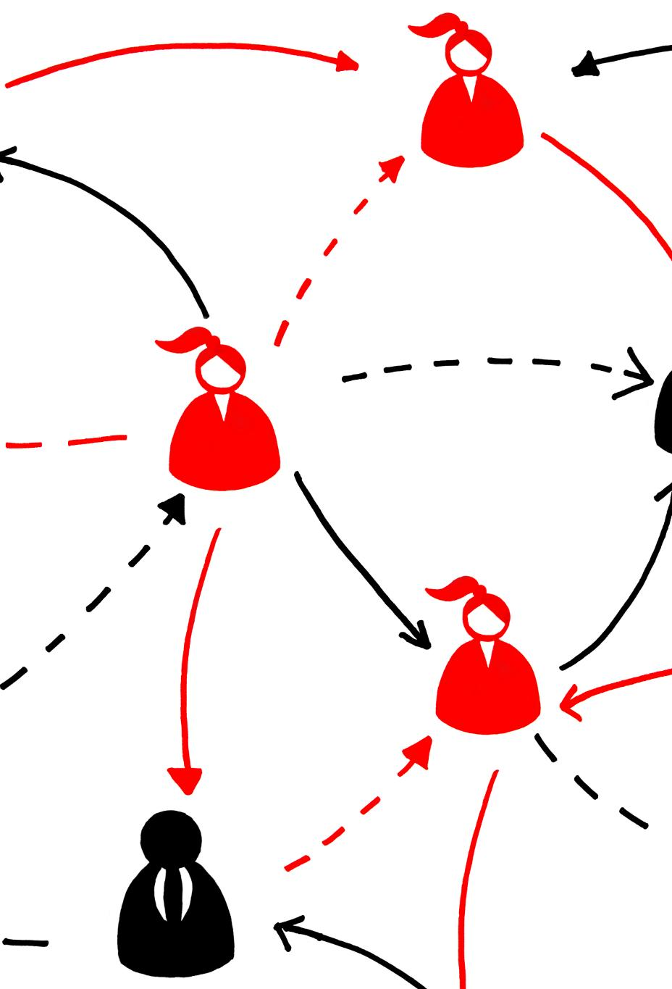
Modernisation Goals
Projects should aim to modernise debt advice services, enhancing the quality assurance, accessibility, and effectiveness of service delivery.
Activities and expenditures must be completed by 31st March 2026.
Eligible project areas include, but are not limited to:
Digital Transformation
Projects should adopt new technologies like mobile apps and AI tools to improve service delivery efficiency.
Access and Inclusion
Expanding access to debt advice for underserved populations is crucial for effective service delivery.
Operational Modernisation
Streamlining internal processes and improving case management will increase the scalability of services.
Workforce Development
Enhancing staff skills through training in digital and technical competencies improves modern service delivery.

Slide 15
Evaluation Criteria

Slide 16
Assessment Factors
Project Relevant / Problem Statement
Applicants must describe the specific problem or challenge their organisation is facing, which the proposal intends to address. This section should explain how the challenge impacts your debt advice services, clients, or operations. Applicants should also describe how the project aligns with the fund's objectives and specify which aspects of your service delivery will be improved or transformed.
Deliverability – Capacity
In this section, you will be asked to provide an overview of your project management approach, including the resources available within your organisation (e.g. staff, technology, infrastructure) and how these resources will be allocated during the project delivery period. You must also provide a delivery plan outlining timelines and milestones, and how you intend to ensure that the project is completed by 31st March 2026.

Slide 17
Assessment Factors
Deliverability - Capability
Organisations must outline any similar projects they have completed in the past that demonstrate their ability to successfully deliver projects like the one proposed. This section should include the impact these past projects had on improving your services or operations. You will also be asked to describe the skills, qualifications, and experience of the team that will be delivering the project. If you are working with external partners, you should explain their roles and contributions to the project.
Impact
Applicants will be asked to provide a clear description of the expected outcomes of their project and how these will improve the efficiency, effectiveness, or reach of their debt advice services. You will need to identify specific, measurable indicators of success. Additionally, describe how your project will create long-lasting benefits for your organisation and the communities you serve, and whether the improvements will be scalable or replicable in other services or areas.

Slide 18
Assessment Factors
Financial Methodology
Applicants must provide a working budget request for their proposed project through the Financial Methodology - Budget Management Tool MS Excel Template provided.
Applications will not be assessed on the amount of funding requested; however, an assessment will be made of the fitness/reasonableness of the funding being requested against the submitted delivery plan and may seek clarification.
The Financial Methodology - Budget Management Tool should correlate with the Delivery Plan, e.g. expenditure costs are clearly named, clearly associated with activities stated within the delivery plan or costs aligned to milestone delivery.
Funding requests should meet the objectives of the grant schemes, either enhance service delivery, improve accessibility, drive sustainable change, foster innovation, to create a more efficient, client-centred debt advice service capable of meeting current and future demands. Funding requests should not be used to cover the direct costs of delivering business-as-usual operations.

Slide 19
Reporting and Accountability

Slide 20

Reporting Requirements
Progress Monitoring Reporting
Recipients will need to provide regular updates tracking progress against planned milestones and forecasted spending.
Final Reporting
A comprehensive final report is required within three months post-project completion detailing finances and outcomes.
Financial Reporting
A milestone-based claim system necessitates submission of the Budget Management Tool and final spending validation.

Slide 21
Application Process

Slide 22

Application Steps
Application Submission
Organisations will need to apply online via: Find a Grant located at
https://www.find-government-grants.service.gov.uk/
with only one application accepted per organisation.
Due-Diligence Requirements
Applicants must provide necessary details for due-diligence checks to prevent fraud and ensure compliance based on organisation type.
Project Relevance
A clear problem statement must be provided to show how the proposal aligns with the fund's objectives and improves service delivery.
Financial Methodology
Applicants must submit a budget that aligns with the project delivery plan, outlining how funds will be used effectively.

Slide 23
Conclusion
Enhancing Debt Advice Services
The Debt Advice Modernisation Fund offers a chance for organisations to improve their debt advice services significantly.
Understanding Fund Objectives
Understanding the fund's objectives is crucial for organisations to align their services with the expected outcomes.
Eligibility and Application Process
Familiarity with eligibility criteria and application processes allows organisations to position themselves to receive support effectively.
Follow-up Questions
If you have any questions relating to this grant application process please email GGMS at ggms_mapsdebtfund2526@cabinetoffice.gov.uk.

Slide 24

Innovation and Technology Forum
Bringing together the debt sector and technology providers to share best practise as well as an industry wide horizon scan of new opportunities and current initiatives.
Events - With external speakers, Updates on ongoing initiatives, sharing lessons learned and successes. As well as the opportunity to network across the sector and technology providers.
Showcase - Anyone can provide a one-page briefing on a innovation or technology initiative. This will provide everyone in the forum with a wide horizon scan of activities happening across the sector and create opportunities for further collaboration.
Share your Views by filling out our survey

Slide 25
Anna Hall – Corporate Director of Debt
Samantha Leach – Debt Advice Development Lead
Daniel Kelly – Senior Sector Development Manager

