Slide 1
Information Session: VCSE Gambling Harms Prevention Fund
Published 19/01/2026
Notes:
- APCC
-Quarterly meetings

Slide 2
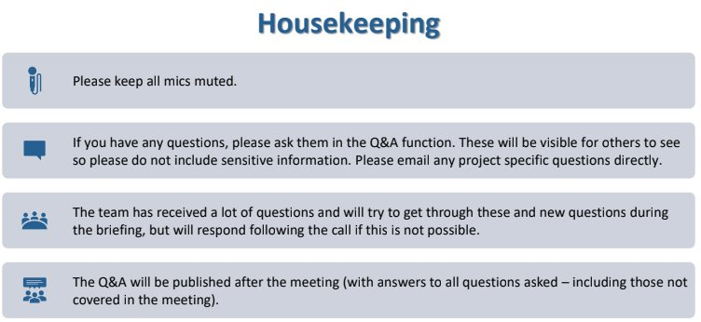
Notes:
No AI recording please.

Slide 3
Agenda
​ | Agenda item​ | Timing​ | Presenter
1. ​ | Welcome to session – OHID grant launch | 11:00 – 11:05​ | Rebecca Worboys
2.​ | VCSE Gambling Harms Prevention Fund: launch update and information | 11:05 – 11:20​ | Will Holley & Katie Apps
3.​ | NHSE update | 11:20 – 11.25​ | Alex Mehaffey
4. | Data collection – Discovery phase | 11:25 – 11:30 | Amy Wyatt & Andrew Duckworth
6. | Q&A​ | 11:30 – 11:40​ | All
7. | Closing remarks​ | 11:40 – 11:45​ | Rebecca Worboys

Slide 4
Session aims and OHID's approach to gambling related harms
Preventing Gambling Related Harms
Funded
Interventions
Local and Regional
National*
LA & regional programmes
VCSE programmes
Digital Tools
Brand & Campaign
Guidance & best practice
Foundations
Data
Research, Monitoring and Evaluation
Stakeholder Engagement
Lived Experience
Build Local and National Infrastructure to Deliver Prevention Programmes
OFFICIAL SENSITIVE - NOT FOR ONWARD SHARING
Notes:
New public health approach;
Shift to a unified public health model.
Focus on reducing risk factors and strengthening protective factors.
Equity-driven: targeting communities disproportionately affected.
Prevention at population level alongside targeted interventions.
Clear pathways connecting activities → outputs → outcomes → long-term impact.
Strengthens evidence base for effective prevention.
Supports consistent monitoring across all funded organisations.
Improves national understanding of ‘what works’ in gambling harm prevention.
Standardised reporting creates national insights.
VCSEs supported to develop evaluation skills and data capability.
Learning shared across the sector to scale effective interventions.
Creates foundation for long-term commissioning under the levy.

Slide 5
VCSE Gambling harms prevention fund
Milestones:
Conclusion of the Expression of Interest Market Engagement Exercise for VCSE prevention grant.
Launch of the VCSE prevention grant on 14 January and upcoming OHID projects.
Upcoming NHSE Gambling Harms Treatment VCSE Grant Fund
Indicative timescales for the grant
June - Nov 25
Nov 25 – Jan 26
14 January 26
Launch the fund for VCSE applicants.
EOI published.
March/April 26
Grants Awarded to successful orgs – notified 19th-26th March.
Feb - March
Application assessment window – 9th February-27th February*.
Clarification question window to run until 30th January.
MOUs signed.
First tranche of funding asap.
Independent assessment board to review bids.
Nov 25 – Jan 26
EOI published.
Market Engagement.
Jan 27 – Mar 28
  Stocktake exercise
  Design of VCSE grant
  Advice to Ministers
  Project governance
  2nd round of funding in January.
  Evaluation of programme.
  End of transition period.
Indicative timescales for LA Fund
Nov – Dec 25:
Jan – Mar 26:
Apr 26 – Apr 28:
  Fund pilot projects
  Conduct maturity assessment survey
  Develop data package with LA prevalence estimates
  Create menu of interventions with resources
  Allocate funding to all LAs April 2026
  LAs develop JSNA for current landscape
  LAs build local and regional networks
  LAs to utilise menu of interventions
  Ministerial approval
  Host webinar for all LAs 20 Nov
  Establish pilot projects with BJC approval
  Develop project and programme BC
OFFICIAL SENSITIVE

Slide 6
Development of the VCSE gambling harms prevention fund
We ran an Expression of Interest phase for 6 weeks to better understand sector needs and to allow time for adjustments based on the feedback. Thank you for your participation and interest.
Insights from the EOI and engagement events have been helpful for refining the fund and application process. We have refreshed objectives and simplified funding.
The grant objectives in relation to gambling harms prevention in England:
Sustain and strengthen the VCSE sector to deliver equitable and innovative prevention strategies.
Build capacity and capability for effective and sustainable project delivery.
Develop an independent, evidence-based approach to public health policy decision making.
Supporting documents
Project proposal
Budget tool
DoI
Guidance and FAQs
Notes:
Successful EOI process, not a prerequisite
Keen to ensure we are offering an opportunity that meets the expertise within the system to understand what works well, as well as providing scope to try new approaches.
We have kept the fund broadly open and it centres around meeting these three objectives. In order to really understand the work and plans of orgs.
Guidance for applicants and supporting documents to provide greater opportunities for detail and scoring. we have provided a project proposal and a budget tool on this round to also provide some due diligence. The DoI is key for demonstrating our move to the public health approach and we have done our best to provide as much support as possible by providing guidance and a FAQ doc.

Slide 7
Scoring principles
Eligibility
Eligibility statement (VCSE, DoI, intended cohorts, prevention activity)
Meeting the objectives
Clear project proposal and theory of change
Budget template
Partnering with other organisations
Capacity to input into data collection and evaluation
Ability to deliver project
Building in lived experience.
Secondary considerations
Fair distribution of localities
Fair distribution of intervention types
#Tie break consideration
Notes:
In the event of a tie, assuming all other criteria are met, it may be necessary to assess applicants’ previous revenue streams to determine the most appropriate organisation to fund, with a view to moving towards a prevention programme that is independent of industry influence. We will be publishing our approach to scoring.

Slide 8
What does a strong application look like?
The Basics:
Take time to read through the application form.
Understand New Public Health approach
How well the project meets the objectives of the fund (strong project proposal and ToC)
Engagement and partnership with the sector
Does the project target the population groups of concern and/or marginalised groups and/or areas of high geographical need?
Support the evaluation process
How they will build ‘lived experience’ into their plans.
In line with government best practice, to include:
Ability to deliver
Demonstration of value for money
Sustainability of project/further learning

Slide 9

Data collection – Discovery Phase
Who we are
We are a multidisciplinary team in DHSC working with partners from Oxford Insights and Blüm.
We blend expertise in design, user research, and agile development to deliver public value.
We’re here to design and deliver the way data is collected.
Context
As part of the VCSE Gambling Harms Prevention Fund
there’s a need to report on the impact of funding. This will support our 'test and learn' approach.
We want to ensure we have the right process and digital systems to make this easy to do and with as low a burden as possible to organisations.
Our goal
We aren’t starting with a finished product. We are starting by trying to understand your needs and the constraints you face.
Doing this helps us codesign the right process and collection together and helps us meet the goals of the Gambling Levy prevention programme.

Slide 10



Help us create the right solution
What we’re exploring
How to get involved
We will be sharing opportunities to get involved via email.
If you’re particularly interested in helping or giving your views in a more in-depth manner, please post a contact in the chat and we will follow up with you.
Understanding Users
Identifying who in your organisation will handle relevant data and why.
Mapping the Journey
Documenting how data currently flows from your frontline activities to reporting.
Identifying Pain Points
Understanding the "hidden" work, like data cleaning and manual entry, that takes you away from delivery.
Ultimately, learning and hearing your points of view
Gambling Levy Data Portal Team

Slide 11
NHS England's Gambling Harms Treatment VCSE Grant Fund
Presented by:
Alex Mehaffey
Notes:
Standard title slide

Slide 12
Overview of NHSE's Gambling Harms Treatment VCSE Grant Fund
The purpose of this fund is to ensure that those experiencing gambling harms can continue to access VCSE sector provision during 2026/27, whilst Integrated Care Boards implement longer term commissioning arrangements from April 2027.
There will be two funding strands:
Core Treatment Delivery Fund: focused on the provision of treatment and support services for those harmed by gambling, from the point of referral and triage through to aftercare and recovery support.
Innovation Fund: focussed on new, adapted or emerging treatment and support interventions.
Eligible VCSE organisations will be able to apply to either or both funding strands.
The fund will also be administered by the Government Grant Management Service.
Organisations can apply for funding from both the NHSE and OHID schemes.

Slide 13
Key details
Timescale | Grants are for a 12-month period between 1 April 2026 and 31 March 2027
Eligibility | Open to Voluntary, Community, and Social Enterprise organisations who intend to deliver gambling harms treatment in England, can mobilise activity in Q1 2026/27 and deliver all outputs by 31 March 2027
Expectations | Organisations will also need to show Evidence of intervention need and effectiveness Plans for involving lived experience Commitment to data collection, reporting and participation in evaluation Ability to work collaboratively with system partners and share learning
Conflicts of interest | Organisations must adhere to the conflicts-of-interest policy developed by statutory levy commissioners
Funding range | Organisations can apply for between £50,000 and £5,000,000 in funding
Out of scope | Projects outside of England Projects delivering prevention and research activity (excluding proportionate evaluation)
Notes:
Plain slide with subhead and bullets

Slide 14

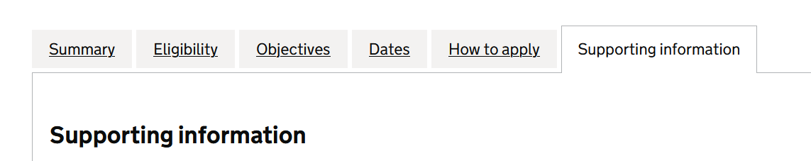
Reminder: Fund is now live!
Supporting documents
Project proposal
Budget tool
DoI
Guidance and FAQs
For guidance and support, please contact GGMS at ggms.ohidgamharmprev@cabinetoffice.gov.uk
Gambling Harms Prevention: Voluntary, Community and Social Enterprise (VCSE) Grant Fund - GOV-UK Find a grant

Slide 15

Questions

