Slide 1
Expo City Dubai Ariba Guide for Supplier Registration
Registering as a new vendor with Expo City Dubai on award of sourcing event

Slide 2
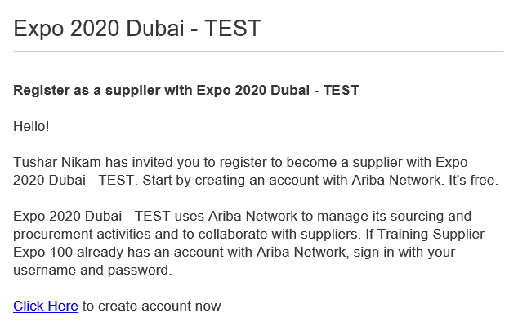
Complete Supplier Registration by Invitation
Provide all company and bank account information
Before you are awarded a Purchase Order or Contract by Expo City Dubai, you will be invited to complete Supplier Registration via Ariba.
This includes submission of all required company information and your banking information.
You will need an Ariba account to transact with Expo City Dubai throughout the procure-to-pay cycle
You will receive an invitation by email
Subject: Invitation: Register to become a supplier with Expo 2020 Dubai
Expo 2020 Dubai invites
Click here to access Ariba

Slide 3
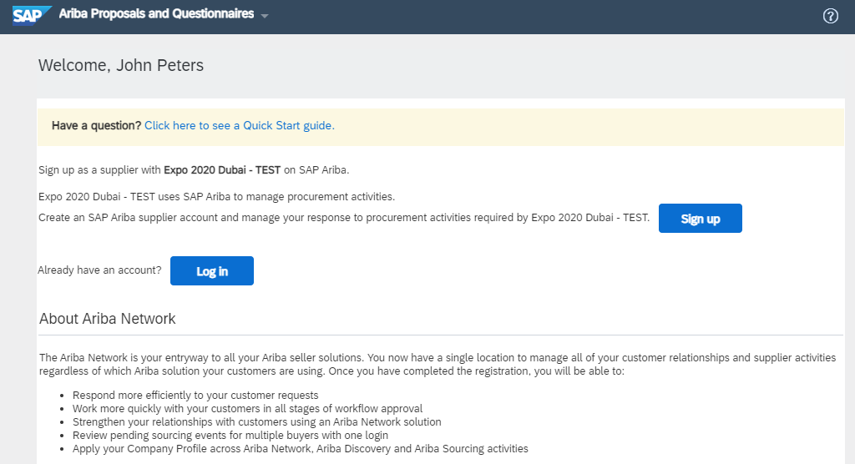
Login to your existing Ariba account
If you don’t have one, click Sign Up to complete account set up
Sign up for a new Ariba account for your company
Login if you already have an Ariba account for your company
Refer to page X for account creation steps

Slide 4
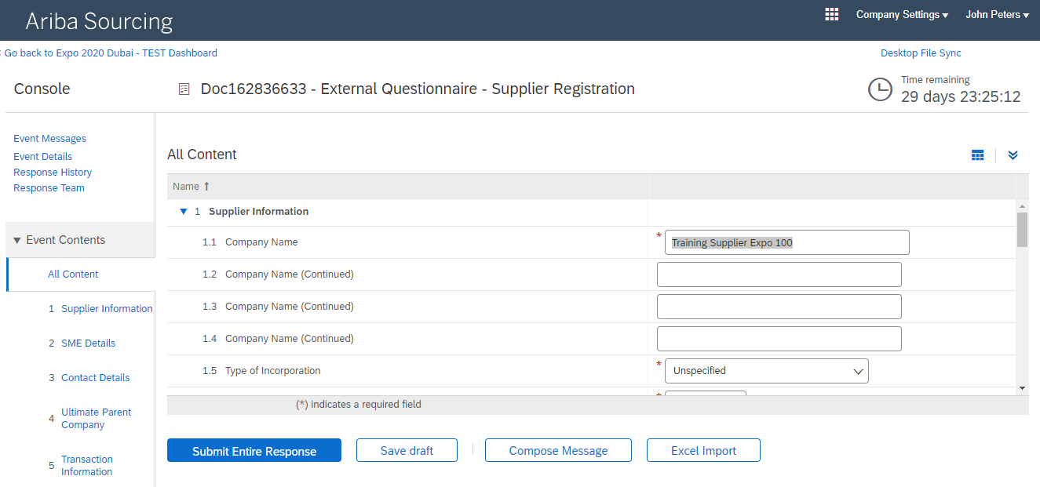
Complete supplier registration questionnaire
Please complete all mandatory fields and submit
Questionnaire includes
Supplier Information – provide your key company details
SME Details – confirm your SME classification status
Contacts Details – confirm your address and contact details
Ultimate Parent Company – confirm details of parent company (if relevant)
Transaction Information – email contacts for receiving POs
Bank Information – input your company’s bank account details for future payment
VAT / Tax Information – provide your VAT details

Slide 5
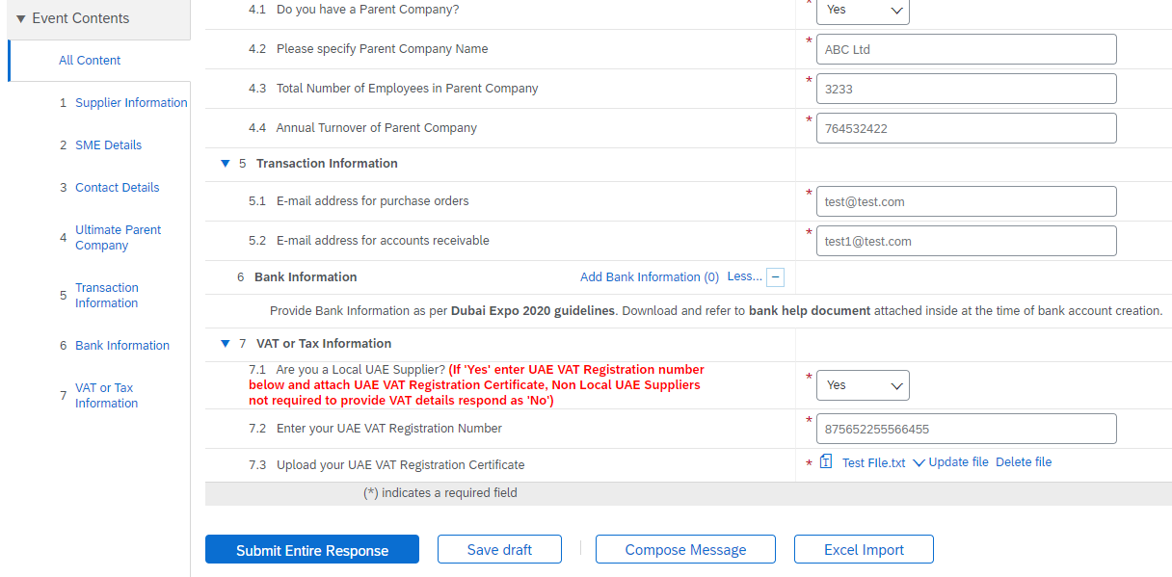
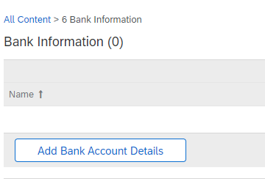
Complete supplier registration questionnaire
You can provide information for one or more Company bank accounts
Click to ‘Add Bank Information’
Click to ‘Add Bank Account Details’

Slide 6
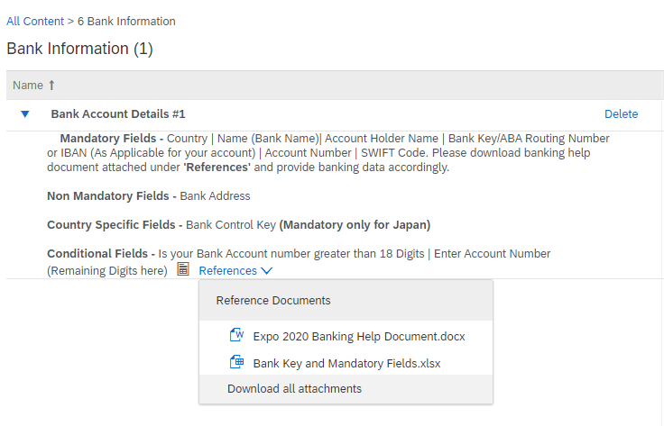
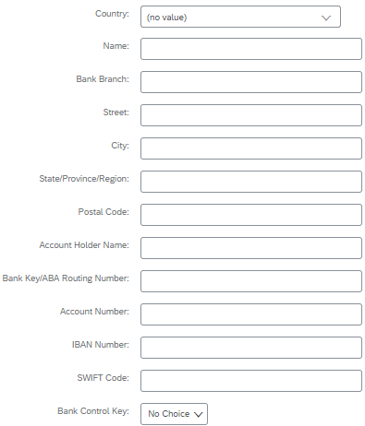
Complete supplier registration questionnaire
Provide required Bank Account details
Please carefully provide your complete Bank account details.
Attach a bank reference letter or bank statement for the bank account you’re adding.
Follow on screen instructions & download bank help

Slide 7
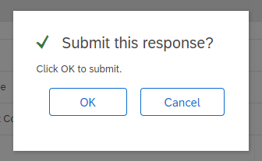
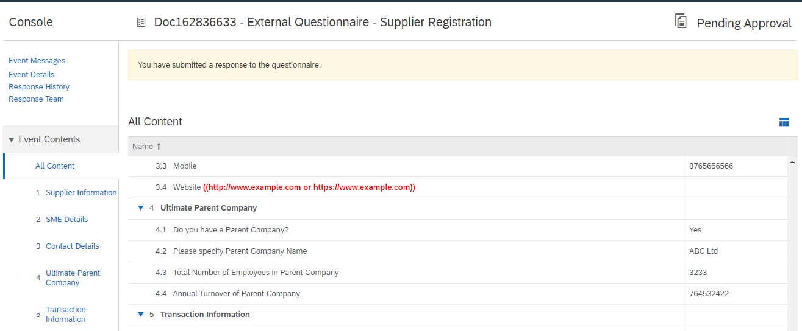
Complete supplier registration questionnaire
Submit your questionnaire
1
You will receive a notification of submission, and once approved
2
Click ‘Save’ and then ‘OK’ to submit your questionnaire
3

Slide 8
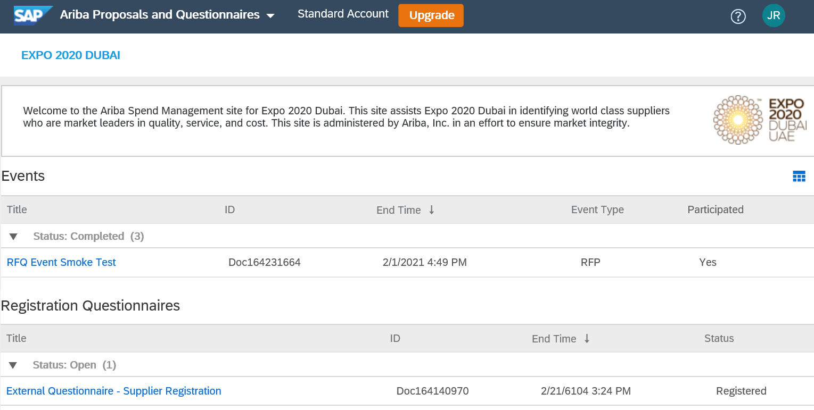
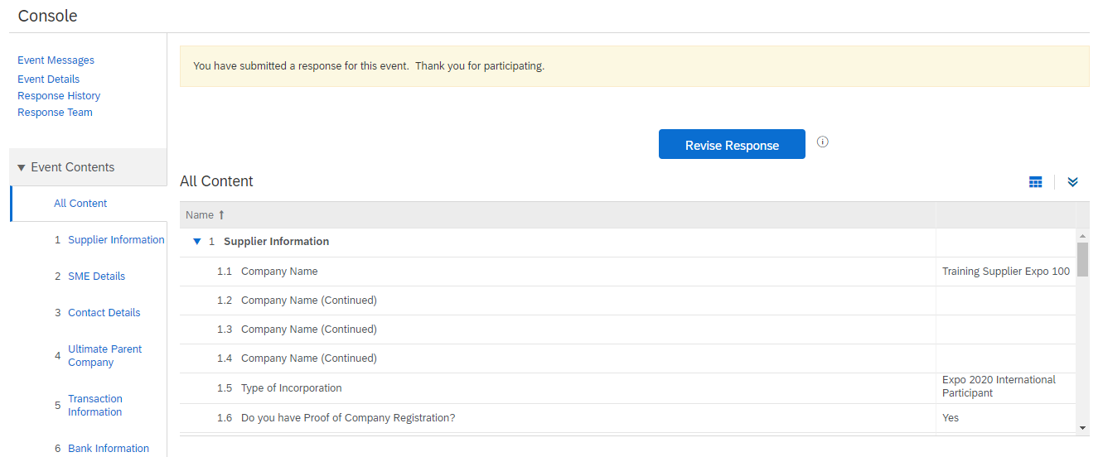
Update your registration details
At any point, you can update your company’s registration details with us
1
Login to your Ariba account here
Navigate to ‘Ariba Proposals & Questionnaires’
Click to open the Supplier Registration form
Click ‘Revise Reponse’ button to edit your existing answers and re-submit
2
3

