Slide 2
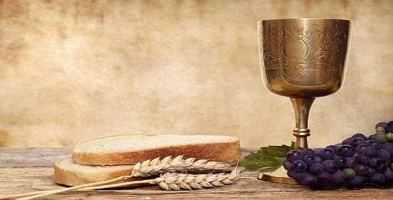
Communion
Service

Slide 3
Great and marvelous are your deeds,
Lord God Almighty.
Just and true are your ways,
King of the ages.
Who will not fear you, O lord,
and bring glory to your name?
For you alone are holy.
All nations will come and worship before you,
for your righteous acts have been revealed.
Revelation 15:3-4

Slide 4
Come, people of the Risen King
Come, people of the Risen King,
who delight to bring Him praise;
Come all and tune your hearts to sing
to the Morning Star of grace.
From the shifting shadows of the earth
we will lift our eyes to Him,
where steady arms of mercy reach
to gather children in.
Stuart Townend, Keith Getty.

Slide 5
Refrain
Rejoice, Rejoice!
Let every tongue rejoice!
One heart, one voice;
O Church of Christ, rejoice!

Slide 6
Come, those whose joy is morning sun,
and those weeping through the night;
Come, those who tell of battles won,
and those struggling in the fight.
For His perfect love will never change,
and His mercies never cease,
but follow us through all our days
with the certain hope of peace.

Slide 7
Refrain
Rejoice, Rejoice!
Let every tongue rejoice!
One heart, one voice;
O Church of Christ, rejoice!

Slide 8
Come, young and old from every land -
men and women of the faith;
Come, those with full or empty hands -
find the riches of His grace.
Over all the world, His people sing -
shore to shore we hear them call
the Truth that cries through every age:
“Our God is all in all”.

Slide 9
Refrain
Rejoice, Rejoice!
Let every tongue rejoice!
One heart, one voice;
O Church of Christ, rejoice!

Slide 10
Confession
(Short Silence then read together)
Have mercy on me, O God,
according to your unfailing love;
according to your great compassion
blot out my transgressions.
Wash away all my iniquity
and cleanse me from my sin.
For I know my transgressions,
and my sin is always before me.

Slide 11
Create in me a pure heart, O God,
and renew a steadfast spirit within me.
Do not cast me from your presence
or take your Holy Spirit from me.
Restore to me the joy of your salvation
and grant me a willing spirit, to sustain me.
Psalm 51: 1-3, 10-12

Slide 12
Assurance of forgiveness
Christ died to sin once for all;
but the life he lives, he lives to God.
In the same way, count yourselves dead to sin but alive to God in Christ Jesus.
Romans 6:10-11
God, who is rich in mercy,
out of the great love with which he loved us, even when we were dead in our trespasses, made us alive together with Christ
—by grace you have been saved.
Ephesians 2:4-5

Slide 13
Bible Reading: Luke 24:13-32
Reader: Charlie Fletcher

Slide 14
¹³ Now that same day two of them were going to a village called Emmaus, about seven miles from Jerusalem. ¹⁴ They were talking with each other about everything that had happened. ¹⁵ As they talked and discussed these things with each other, Jesus himself came up and walked along with them; ¹⁶ but they were kept from recognising him.

Slide 15
¹⁷ He asked them, ‘What are you discussing together as you walk along?’
They stood still, their faces downcast. ¹⁸ One of them, named Cleopas, asked him, ‘Are you the only one visiting Jerusalem who does not know the things that have happened there in these days?’
¹⁹ ‘What things?’ he asked.

Slide 16
‘About Jesus of Nazareth,’ they replied. ‘He was a prophet, powerful in word and deed before God and all the people. ²⁰ The chief priests and our rulers handed him over to be sentenced to death, and they crucified him; ²¹ but we had hoped that he was the one who was going to redeem Israel. And what is more, it is the third day since all this took place.

Slide 17
²² In addition, some of our women amazed us. They went to the tomb early this morning ²³ but didn’t find his body. They came and told us that they had seen a vision of angels, who said he was alive. ²⁴ Then some of our companions went to the tomb and found it just as the women had said, but they did not see Jesus.’

Slide 18
²⁵ He said to them, ‘How foolish you are, and how slow to believe all that the prophets have spoken! ²⁶ Did not the Messiah have to suffer these things and then enter his glory?’ ²⁷ And beginning with Moses and all the Prophets, he explained to them what was said in all the Scriptures concerning himself.

Slide 19
²⁸ As they approached the village to which they were going, Jesus continued on as if he were going further. ²⁹ But they urged him strongly, ‘Stay with us, for it is nearly evening; the day is almost over.’ So he went in to stay with them.

Slide 20
³⁰ When he was at the table with them, he took bread, gave thanks, broke it and began to give it to them. ³¹ Then their eyes were opened and they recognised him, and he disappeared from their sight. ³² They asked each other, ‘Were not our hearts burning within us while he talked with us on the road and opened the Scriptures to us?’

Slide 21
Short Reflection

Slide 22
At The Cross (Love Ran Red)
There's a place where mercy reigns
and never dies
There's a place where streams of grace
flow deep and wide
Where all the love I've ever found
Comes like a flood
Comes flowing down
Chris Tomlin

Slide 23
At the cross
At the cross
I surrender my life
I'm in awe of You
I'm in awe of You
Where Your love ran red
And my sin washed white
I owe all to You
I owe all to You Jesus

Slide 24
There's a place where sin and shame
are powerless
Where my heart has peace with God
and forgiveness
Where all the love I've ever found
Comes like a flood
Comes flowing down

Slide 25
At the cross
At the cross
I surrender my life
I'm in awe of You
I'm in awe of You
Where Your love ran red
And my sin washed white
I owe all to You
I owe all to You Jesus

Slide 26
Here my hope is found
Here on holy ground
Here I bow down
Here I bow down
Here arms open wide
Here You save my life
Here I bow down
Here I bow

Slide 27
At the cross
At the cross
I surrender my life
I'm in awe of You
I'm in awe of You
Where Your love ran red
And my sin washed white
I owe all to You
I owe all to You Jesus

Slide 28
Prayers – Led by Jane Window

Slide 29
Communion:
1 Corinthians 11: 23b- 26
The Lord Jesus, on the night he was betrayed, took bread, and when he had given thanks, he broke it and said, “This is my body, which is for you; do this in remembrance of me.”

Slide 30
In the same way, after supper he took the cup, saying, “This cup is the new covenant in my blood; do this, whenever you drink it, in remembrance of me.” For whenever you eat this bread and drink this cup, you proclaim the Lord’s death until he comes.

Slide 31
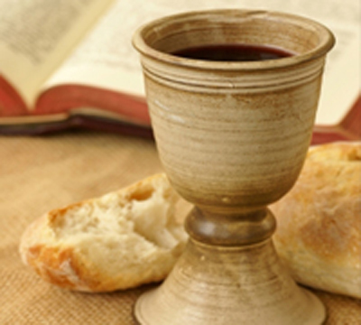
Do this in remembrance of me

Slide 32
Post Communion Prayer
Father of all ……….. give Light to the world
(Read Together)
Keep us in this hope that we have grasped;
so we and all your children shall be free,
and the whole earth live to praise your name. Amen

Slide 33
In Christ Alone
In Christ alone my hope is found,
He is my light, my strength, my song;
This Cornerstone, this solid Ground,
Firm through the fiercest drought and storm.
What heights of love, what depths of peace,
When fears are stilled, when strivings cease!
My Comforter, my All in All,
Here in the love of Christ I stand.
Stuart Townend, Keith Getty

Slide 34
In Christ alone! - who took on flesh,
Fullness of God in helpless babe.
This gift of love and righteousness,
Scorned by the ones He came to save:
Till on that cross as Jesus died,
The wrath of God was satisfied -
For every sin on Him was laid;
Here in the death of Christ I live.

Slide 35
There in the ground His body lay,
Light of the world by darkness slain:
Then bursting forth in glorious day
Up from the grave He rose again!
And as He stands in victory
Sin's curse has lost its grip on me,
For I am His and He is mine -
Bought with the precious blood of Christ.

Slide 36
No guilt in life, no fear in death,
This is the power of Christ in me;
From life's first cry to final breath,
Jesus commands my destiny.
No power of hell, no scheme of man,
Can ever pluck me from His hand:
Till He returns or calls me home,
Here in the power of Christ I'll stand.

Slide 37
Benediction (read together)
“Now to him who is able to do immeasurably more than all we ask or imagine,
according to his power that is at work within us,
to him be glory in the church and in Christ Jesus throughout all generations, for ever and ever!
Amen.”
Ephesians 3:20-21

