Slide 1
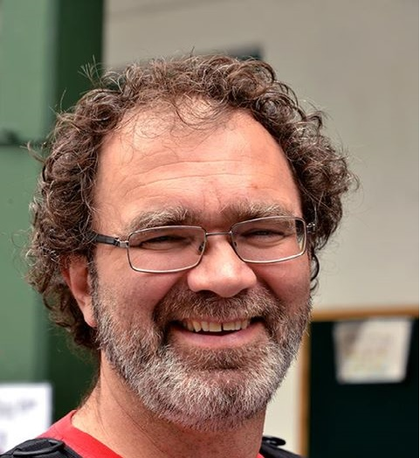
Mark Glover
MK and ‘re-entering’ missionary
CMS / Missions Interlink
Notes:
Introduce myself briefly – Engineering / Asberger’s: Emotions for Engineers.
Ice-breaker
Slips of paper, a fishbowl and a white board.
Give each participant a slip of paper and ask them to write down one word or short phrase that they would use to describe the re-entry process. When finished, fold and place in the fish bowl. Explain that someone else will read it out, so keep it decent!
Pass the fish bowl and have everyone draw out a slip of paper and read it out to the group.
Write the words on the white board.
<number>

Slide 2
Words used to describe Re-entry:
Hard
Horrific
Hell
Confusion
Relief
Stressful
Painful
Emotional Rollercoaster
Out of Control
Lost
Notes:
These are few words from past retreats.
NOT everyone’s journey is negative. Re-entry can feel very different for different people. And for different members of the same family at different times.
Of the words that were read out, what words stood out to you? Surprised you?
Do list of words p.2
<number>

Slide 3
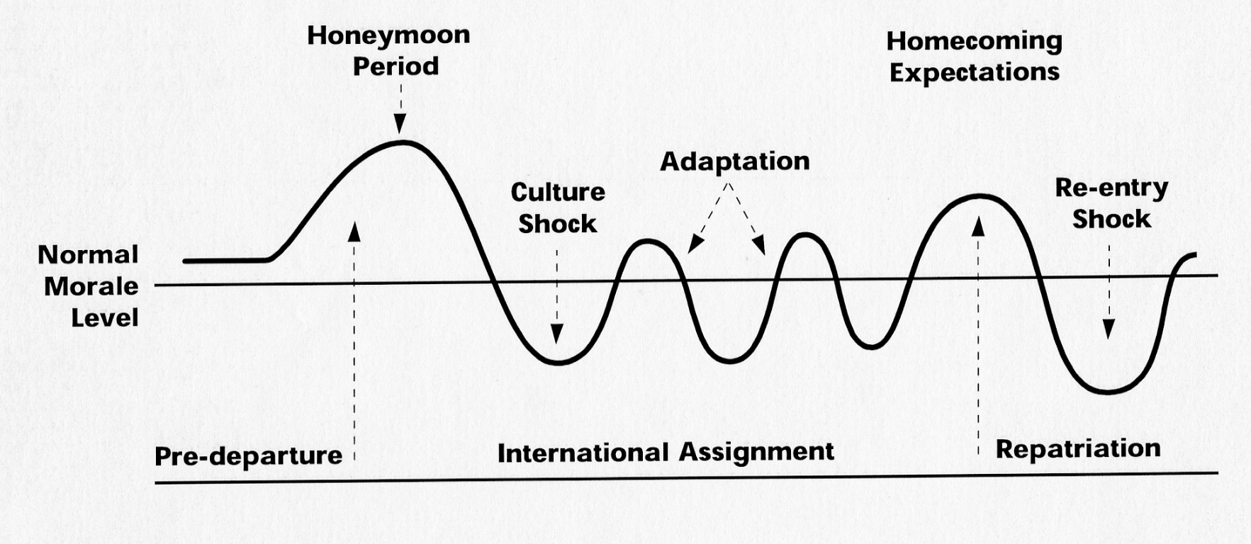
Typical Expatriate Morale Curve
<number>
Notes:
A “typical” expat morale curve, what do you notice? A: deep emotional dip for re-entry, often deeper than the initial culture shock on going ‘out’. It is usually tough. Even when it is “mixed”.
<number>

Slide 4
Re-entry – Why is it so hard?
A culture change
A major transition
Expectations challenged
A time of stress
An identity shift
<number>
Notes:
28/09/2018
Pricoa
<number>
Why is re-entry so hard? Why can’t we just FIT BACK IN??? We are supposed to be returning to our “home culture” right?
These are some of the reasons why the initial ‘outgoing’ was stressful.
The same thing happens when we return...

Slide 5
A culture change
Notes:
<number>

Slide 6
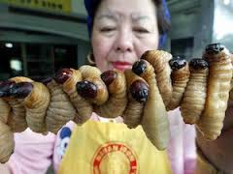
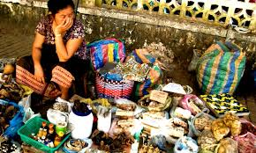
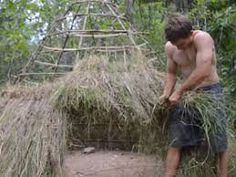
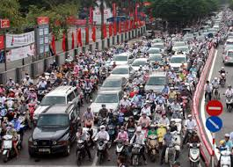
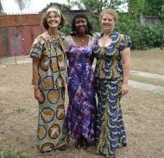
The Process of Enculturation
Notes:
When first went to new culture, started a process of Enculturation – food, shopping, transport, dress and living are different
<number>

Slide 7

Notes:
The Apple and Orange People
We are apples among apples before we go on mission
Look same as everyone around us
Know how to be an apple
<number>

Slide 8
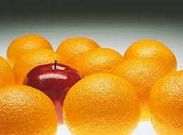
Notes:
We enter our field of service as an apple among oranges
Clearly different and stand out
<number>

Slide 9
Cultural Stress…
‘The anxiety that results from losing all our familiar signs and symbols of social intercourse’
Oberg
<number>
Notes:
28/09/2018
Pricoa
<number>
We experience cultural stress

Slide 10
Causes of Cultural Shock:
Physiological factors
Absence of cultural cues
Questioning of values
Little opportunity for escape
High performance stress
Shrinking of support system
<number>
Notes:
And probably cultural shock at times
<number>

Slide 11
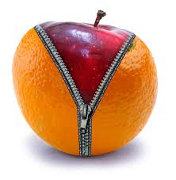
Notes:
We become an apple dressed as an orange
We learn how to fit in, speak the language, blend in amongst those we came to serve —
cultural adaptation
But underneath, we’re probably still apples
<number>

Slide 12
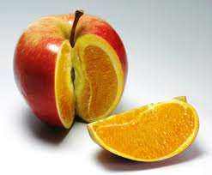
Notes:
But on our return – we find we are an apple outside but orange inside –
some of that orange has changed who we are at the core
we still look like an apple to the apples we return to
but on the inside we have changed
people don’t often see or understand this.
We might not even have realised it!
<number>

Slide 13

Notes:
And sometimes it feels like something else happened to all those other red apples...

Slide 14
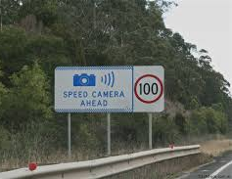
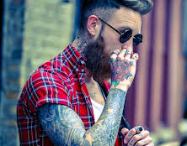
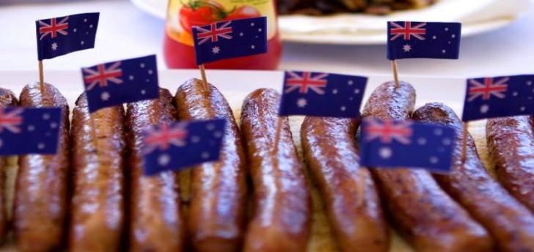


The Process of Re-Enculturation
Notes:
The process of re-enculturation – returning home – we need to learn to eat, shop, get around, dress, and live different again
culture shock again
How many have had the ‘Squatting in shopping centre breakfast cereal aisle”?
<number>

Slide 15
Transition
Notes:
The Transition Experience
<number>

Slide 16
Notes:
Involvement
Field culture sees us as belonging and understands our role
We are committed to them
We experience intimacy w/ that culture
Leaving
Field culture may celebrate and farewell us, and seek closure
We may start to withdraw/distance
We may experience denial of the upcoming change or other emotions
Transition
Neither field nor “home” culture see us as belonging
We may feel isolated
We experience significant anxiety
Entering
Home culture tentatively accepting, may be uncertain of our position
We establish superficial connection with home culture
We might feel vulnerable, sometimes ambivalent
Involvement
Home culture sees us as belonging, understands our fit
We are committed to the home culture, we belong and fit in
We experience intimacy with our home culture again
Circle dot-points that reflect your current experience
Which stage do you feel you are up to?
OK to be in transition stage – but if stuck there may need to get professional help.
<number>

Slide 17
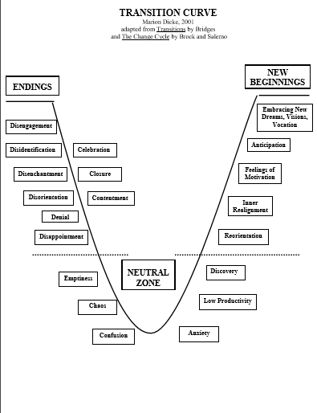
Notes:
<number>

Slide 18
Re-entry feelings may be stronger where ...
you had a lot of stress
you have changed a lot.
your home culture has changed a lot while you were away.
you have spent a lot of time away from your home culture.
your host culture is vastly different from your home culture.
you unexpectedly left your host culture.
your personality adapts slowly to change.
you are unsure of what you will do in your home culture.
those who receive you have difference of inner values.
you are leaving the mission that arranged things like homes, transport, insurance, and utilities.

Slide 19
Problems of resettlement
Communicating the overseas experience 58%
Fitting in again ……………………………………….. 53%
Finding work……………………………………………41%
Lack of money………………………………………... 32%
Finding accommodation…………………………. 12%
<number>
Notes:
28/09/2018
Pricoa
<number>
Australian Member Care survey revealed problems of resettlement among returned Aussie missionary workers

Slide 20
Managing expectations
Notes:
<number>

Slide 21
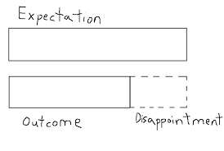
Notes:
Managing expectation upon your return is key – if they are too high we end up disappointed
<number>

Slide 22
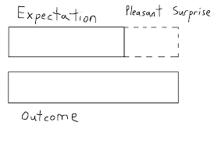
Notes:
If we have realistic expectations, we often end up with a more positive outcome
DO EXPECTATIONS SHEET
<number>

Slide 23
Unmet Expectations
Disappointment
Disappointment
Disappointment
Disillusionment
Notes:
Expectations are often unrealised until they are unmet- this leads to disappointment upon disappointment which can result in disillusionment
<number>

Slide 24
Disillusionment
Yields
Self protective behaviour / Withdrawal
↓ Hope ↓ Trust ↓ Faith ↓ Effectiveness
↑Isolation ↑ Cynicism ↑ Scepticism
Notes:
Disillusionment can yield self protective behaviour/withdrawal and unhelpful outcomes – decreased hope, decreased trust, decreased effectiveness, increased isolation, increased cynicism and increased scepticism – this thwarts our smooth transition back into Aussie life/relationships
<number>

Slide 25
Stress
Notes:
<number>

Slide 26
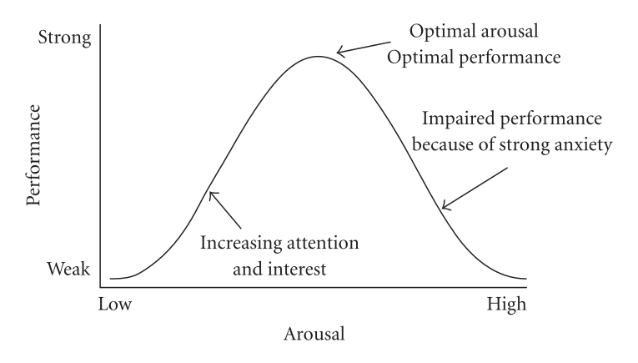
Yerkes–Dodson law
Notes:
Not all stress is bad… but when stress is too high, performance goes down, and as we will see, risk of problems goes up.
<number>

Slide 27
Own stress curve…
Another new role!
Civil riots
Stress!
Team issues
Mental health “crash”
uncertainty
New role
Move OS
Retreat
Counselling and medication help
Notes:
Draw your own stress timeline…
<number>

Slide 28
UPHEAVAL = STRESS
The Holmes and Rahe Stress Scale: Understanding the Impact of Long-term Stress
Stress score (sustained in 12-month period)
100: USA norm (average)
150-199 = Low vulnerability to stress related disorders (burnout, depression, illness)
200-299 = Moderate vulnerability
300+ = High vulnerability
Notes:
DO THE EXERCISE
<number>

Slide 29

Cross-Cultural Worker Results:
Deployment / First Year = 600+
Long-term Average = ca. 400+
Re-Entry results are similar to original deployment
Notes:
Missionaries often cope better – (Grace?)
But we are NOT immune
Refer to page in handout for stress signs
<number>

Slide 30

Coping Capacity
Notes:
Coping capacity glasses – the more stress, the fuller the glass
- Capacity varies from person to person, inc. within families
- need to manage your stress, bring levels down so you don’t overload
<number>

Slide 31
How can we increase coping capacity?
Notes:
On whiteboard and in notes…
<number>

Slide 32
Identity
Notes:
<number>

Slide 33

Who Am I Now & Where Do I Belong?
Notes:
<number>

Slide 34

Notes:
Parts of our identity are forever, other parts change very slowly, other times parts of our identity change more quickly.
Identity challenged through re-entry – no longer a missionary. Unclear role. No job?
Similar to ID changes when we moved to the field – here a fully-functioning highly educated adult. Then moved to China and spoke like a three-year-old.
<number>

Slide 35
Who am I?
Strategic gamer
Friend
Husband
(Missionary)
Father
Project Manager
ME
MK
Singer
(Engineer)
Man
Cycling enthusiast
Australian
Nepali? / Indian ?
Christian
Basketballer
Son
Notes:
Parts changing all the time. Other parts more stable.
Return from field – was an Area leader, clear role, lot of responsibility. That part of my identity changed. Both we and our church quite unsure how we fitted in.
<number>

Slide 36
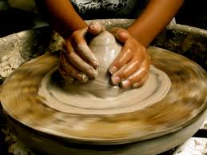
Who am I?
Some key truths to remember:
  Identity begins before birth (Jer. 1:5; Ps. 139:13-18)
“Before I formed you in the womb, I knew you…”
Notes:
The stable, never-changing foundation of our identity…
<number>

Slide 37
Who am I?
Some key truths to remember:
  Identity begins before birth (Jer. 1:5; Ps. 139:13-18)
“For you created my inmost being; you knit me together in my mother’s womb. I praise you because I am fearfully and wonderfully made; your works are wonderful, I know that full well. My frame was not hidden from you when I was made in secret…ALL the DAYS ordained for ME were written in your book before one of them came to be…”
Notes:
<number>

Slide 38

Who am I?
Some key truths to remember:
  God is conforming our identity
“And we know that in all things God works for the good of those who love Him, who have been called according to His purpose. For those God foreknew He also predestined to be conformed to the image of His Son, that He might be the first-born among many brothers and sisters.” (Rom. 8:28-30)
Notes:
God is also changing our identity – slowly conforming us to be more like his Son.
<number>

Slide 39
Who am I?
Some key truths to remember:
  God is conforming our identity
“…we are being transformed into His image with ever increasing glory, which comes from the Lord, who is Spirit.” (2 Cor. 3:17-18)
Notes:
<number>

Slide 40

Who am I?
Some key truths to remember:
  Our journey is part of that process
“The steps of a good man are ordered by the Lord, and he delights in his way. Tho he stumble, he will not fall, for the Lord upholds him with His hand.” (Psalms 37:23-24)
Notes:
Our re-entry journey was not a surprise to God, and is a part of his work in our lives.
<number>

Slide 41
Checklist for the Returnee
Take your time
Arrange temporary structures
Don’t act for the sake of action
Recognise why you are uncomfortable
Take care of yourself in little ways
Explore the fun and opportunity-rich sides of change
Get someone to talk to
Find out what is waiting in the wings of your life
Use this transition as the impetus to a new area of learning
Recognise that finding transition hard is normal
<number>
Notes:
28/09/2018
Pricoa
<number>

Slide 42
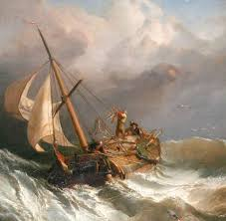
A Smooth Sea
Never made a
Skilled
Sailor…
“And after you have suffered a little while, the God of all grace, who has called you to his eternal glory in Christ, will himself restore, confirm, strengthen, and establish you.”
1 peter 5:10
Notes:
You are being made into skilled sailors!
Life will settle down again and feel less unstable.
<number>

Slide 43

Questions and thoughts?
Notes:
<number>

