Slide 1
Feline Hyperthyroidism and I-131 at Hopkinton Animal Hospital, NH
Mike Dutton, DVM, MS,
DABVP (Canine & Feline), DABVP (Avian), DABVP (Exotic Companion Mammal), DABVP (Reptile & Amphibian), CVPP, CertAqV

Slide 2
Feline Hyperthyroidism
First described by Peterson in 1979.
Now most common endocrinopathy of cats.
98% are benign thyroid adenomas.
The etiology of hyperthyroidism is not known.
Exposure to certain chemicals (fertilizers, herbicides, flea powders, and sprays have been implicated).
One study showed Siamese and Himalayan are less likely to become hyperthyroid.
Cats eating canned foods and those using litter have been shown to have about a three-fold increase in hyperthyroidism.
Notes:
Feline Hyperthyroidism was first described by Peterson in 1979. It is now recognized as the most common endoccrinopathy in cats.
98% of cats are benign adenomas.
A variety of etiologies have been put forth why we not see more hyperthyroidism. Exposure to certain chemicals have been implicated. One interesting hypothesis is that plastic lining to canned foods may be a risk factor.

Slide 3
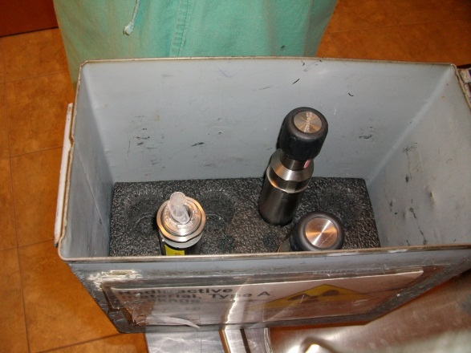
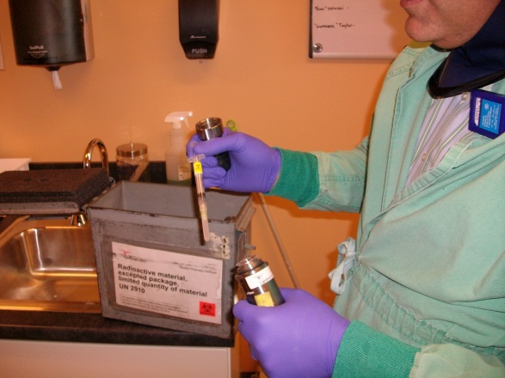
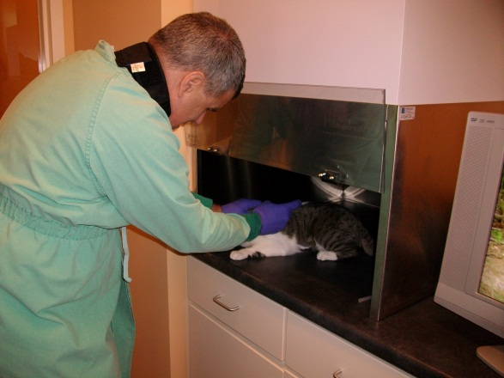
I-131
Currently is considered gold standard for treating hyperthyroidism.
Non-invasive, cures 95-97% of cats. Of the 3-5% that fail the first time, most will be cured with a second injection. If still fails, consider malignant neoplasia (1 cat/200-300 cases).
SQ injection.
Numerous Federal and State regulations to comply with.
Notes:
I-131
Radioactive iodine is now considered the gold standard.
Non-invasive, cures 95-97% of cats with first injection. Of that number requiring a second injection, about 90% will cure with a second injection. That does leave a very small number of cats that the I-131 does not work on. Most of the failures will be malignant neoplasia (e.g., thyroid adenocarcinomas).
Life expectancy = 4+ years.
Side effects include voice change, hypothyroidism (controlled with T4 supplementation. Many times temporary), dysphagia.
The biggest issue is that the cats are radioactive and need to be quarantined. Typically this period is 4-5 days. When the pet is at or below the allowed radiation level, they are discharged to the owners with instructions on post-care.
The T4 is rechecked in 30 days then every 6 months afterwards. It would be good to recheck the creatinine at these times.
Post-care of I-131
Basically, strict hygiene for 2 weeks. NO cuddling, especially around neck. Wash hands after handling. All stool and urine is collected for 2 weeks (a 5 gallon plastic bucket with cover works well). At the end of two weeks, close bucket and date for 3 months (technically 82 days – 10 half lives of I-131). At the end of 3 months, can be disposed like regular trash.

Slide 4
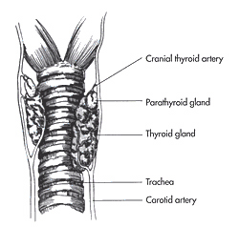
Diagnosis
Age
Feldman, UC Davis
Notes:
Hyperthyroidism is an age related disease with the peak of cases diagnosed being 12 to 14 years of age.

Slide 5
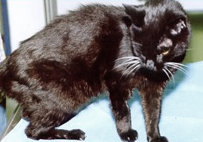
Diagnosis
History
Weight loss | 87%
Polyphagia | 49%
Hyperactivity | 31%
Polyuria | 36%
Vomiting | 44%
Diarrhea | 15%
Peterson, ACVIM Proceedings
Notes:
A variety of classic signs are noted. These include weight loss, polyphagia, hyperactivity, polyuria, vomiting, and diarrhea.

Slide 6
Exam Findings
Palpable Cervical Mass | 83%
Thin | 65%
Heart Murmur | 54%
Tachycardia | 42%
Gallop Rhythm | 15%
Hyperactive | 15%
Aggressive, Unkempt, Increased nail growth, Alopecia, CHF, Ventral neck flexion | Each one of these is 10% or less
Notes:
Examination Findings
Exam findings can include palpable cervical mass. Some thyroid gland may be intra-thoracic and not palpable.
Lack of body condition, heart murmur, tachycardia, gallop rhythm and hyperactivity in the exam room are common. Less common are aggression, unkempt fur, increased nail growth, alopecia, congestive heart failure, and ventral neck flexion.

Slide 7
Common things happen commonly
Signs are variable and numerous.
This is a common disease in old cats.
Therefore: old, sick cats should be checked for hyperthyroidism.
Notes:
Remember to include hyperthyroidism on your ruleout list for the older cat, it’s that common.

Slide 8
Direct Thyroid Tests
Serum Total T4 (TT4) and T3 (TT3) Concentrations. Diagnostic accuracy is about 70%.
Serum Free T4 (fT4) Concentrations. Use equilibrium dialysis (ED). Diagnostic accuracy is 90%.
Notes:
Direct Blood Testing
No blood thyroid test is 100% accurate. TT4 and TT3 have an accuracy of about 70%. TT4 is the standard tests on most in-house chemistry machines. If the TT4 is high and the cat is showing typical signs, assume the cat is hyperthyroid.
Free T4 by equilibrium dialysis (fT4-ED) is about 90% accurate. It is best used for early or mild hyperthyroid cats. It does have a tendency to be falsely elevated in non-thyroidal disease.
In cats with high normal TT4 (> 2.5) and classic signs, >75% of these cats are hyperthyroid. These are typically confirmed with a fT4-ED.
As a general statement, TT3 is less reliable than TT4 for high thyroid values.
For the general practitioner, the development of a feline validated TSH concentration will probably be the best test. The current TSH on the market (such as Michigan State) is canine and there is some cross reactivity with feline TSH. But at this time it appears only valid for diagnosing hypothyroidism in cats.
A good primer is at http://www.animalhealth.msu.edu/Sections/Endocrinology/Thyroid_Feline.php
M.S.U. does describe a T3 Suppression test and details are at the same website.
Most reference labs have combination test panels that test a variety of thyroid hormones.

Slide 9
Overview of Tests
Serum total T4 concentration (TT4, this test measures for protein-bound and free (unbound) T4)--high resting concentration confirms the diagnosis of hyperthyroidism.
Serum total T3 concentration--high concentration less reliable than serum TT4.

Slide 10
Algorithm
If cat is normal or sick and has high TT4 (>4.5), consider hyperthyroid.
If cat is exhibiting typical signs and has a TT4 that is high normal (> 2.8), consider that 75%+ of those cats are hyperthyroid. A fT4 may help (high fT4 in this case = hyperthyroid).
If cat is exhibiting typical signs and has a normal TT4 (<2.8), either the cat does not have hyperthyroidism or is ‘sick thyroid syndrome (euthyroid sick syndrome).’

Slide 11
Complete Work-up
Exam
CBC
Biochemical profile
Expect low BUN, normal to high Crt
SAP, ALT may be normal to high
TT4 (+/- fT4)
UA
2 or 3 view thoracic radiograph
Normal to mild enlarged

Slide 12
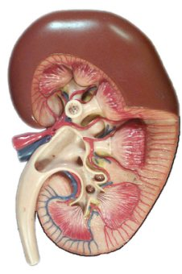
Can you expect post-tx azotemia?
Hyperthyroidism increases glomerular filtration rate (GFR). It is suspected by activation the RAS and not always due to hypertension.
This elevated GFR hyperperfuses the kidneys reducing azotemia.
Correction of the hyperthyroidism reduces GFR and an ‘occult’ azotemia can become apparent.
Notes:
Renal Manifestations of Hyperthyroidism in Cats ¹
Glomerular Filtration Rate
Several studies have been performed on cats and show that GFR decreases with treatment for hyperthyroidism. The decline in GFR is detectable 1 month after treatment for hyperthyroidism but then remains stable for at least 6 months.
Urea and Creatinine
Urea and creatinine concentrations are inversely related to GFR; therefore, values typically increase after treatment of hyperthyroidism as GFR falls. Increases in creatinine concentration occur fairly consistently in hyperthyroid cats after treatment, although in many instances, these increases occur within the laboratory reference range. Creatinine concentration is also reflective of the patient's muscle mass; thus, in an emaciated hyperthyroid patient, the creatinine concentration may be low for several reasons before treatment.
Assessment of urea concentrations in hyperthyroid cats is more complicated. Urea concentrations tend to be decreased by hyperthyroidism because of the effects on GFR, but an increase in dietary protein intake and protein catabolism may tend to increase urea concentration. Mild elevation of urea is common in untreated hyperthyroid cats and is poorly correlated with the development of significant azotemia after treatment. For these reasons, in the discussions that follow, only elevation of creatinine is considered as evidence of significant azotemia.
Urinalysis
Polyuria or polydipsia was observed in up to 74% of cats with hyperthyroidism in early reports of the condition. Thus, it is important to recognize that some hyperthyroid cats are polyuric or polydipsic without having any evidence of renal disease and that this problem may resolve with treatment for hyperthyroidism. It has been suggested that psychogenic polydipsia, possibly caused by heat intolerance, may play a pathogenic role in some cats.
Mild proteinuria is frequently present in cats with hyperthyroidism. The proteinuria tends to resolve with treatment, even in cats that develop azotemia. It is thought that the proteinuria is a reflection of the glomerular hypertension and hyperfiltration that is known to occur in the hyperthyroid state. Alternatively, changes in urinary protein excretion may reflect differences in tubular protein handling. Although, as discussed previously, a change in the structure of the glomerular barrier has been proposed as a cause for the proteinuria observed in hyperthyroid animals, the rapid decrease in protein excretion with treatment for hyperthyroidism seems to make this explanation less likely.

Slide 13
Hyperthyroidism and GFR
Creatinine is a better indicator of azotemia in the hyperthyroid cat.
BUN can lower because of increases in GFR but may elevate because of protein catabolism. Also, pet may exhibit increased protein intake due to polyphagia. BUN is not as reliable as Crt.
Mild proteinuria is common in hyperthyroidism. Typically resolves with treatment.

Slide 14
When to be GFR suspicious
Baseline creatinine is above the normal range or in high normal range.
Pre-Tx values are not a good predictor of post treatment CRF. Recommends methimazole trial. (J Feline Med Surg. April 2008;10(2):160-6)
But it does not appear that development of azotemia post-treatment significantly changed life expectancy values. (Vet Clin Sm Anim 37. 2007)
Since there is some evidence that hyperthyroidism may contribute to CKD, it is not recommended to keep cats slightly hyperthyroid for the sole purposes of normalizing or decreasing serum creatinine.
Notes:
Unfortunately there is no current test to accurately test post-treatment azotemia. An article in the Journal of Feline Medicine and Surgery recommends a trial of methimazole of 10 days and checking the creatinine at the end of the trial.
Another report states whether the cat is azotemia post treatment or not does not impact the life expectancy of the cat.
It is felt that untreated or poorly treated hyperthyroidism leads to hypertension leading to increased GFR which can cause more kidney damage.
N-acetyl-β-d-glucosaminidase enzyme may be a future test we can use in determining kidney damage prior to treatment.

Slide 15
SDMA
Symmetric Dimethylarginine may be a useful kidney biomarker for underlying kidney issues in the hyperthyroid cat.
The IDEXX SDMA™ Test reliably identified 6 times more hyperthyroid cats with kidney disease than creatinine. Creatinine missed 82%† of hyperthyroid cats that the IDEXX SDMA Test identified as having kidney disease.
Elevated GFR = decreased SDMA.
40% + decreased GFR = increased SDMA.

Slide 16
SDMA Conclusion
Conclusions and Clinical Importance
Finding a high serum SDMA concentration in a hyperthyroid cat can help predict development of azotemia after treatment. The test has high diagnostic test specificity (few false‐positive results) but relatively low sensitivity (fails to predict azotemia in most hyperthyroid cats).

Slide 17
Treatment Options
 | I-131 | Methimazole | Surgery | y/d
Total cost over life expectancy | $1,650 at Hopkinton | $2,450-3,150 | $2,000-2,500 for unilateral disease | $2,000-4,000
Life expectancy | Cured | 3.5 years (avg 2 to 5) | Variable. Recurrence common after 1-2 years in other gland | 4+ years
Notes:
Treatment Options
Medical – Methimazole, carbimazole
Surgery – Removal, ethanol ablation
I-131

Slide 18
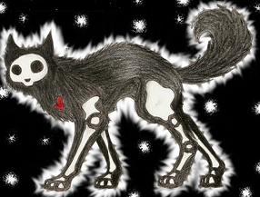
I-131 Mechanism
Normally, iodine is joined to the amino acid tyrosine in the thyroid gland to create T4. Iodine 131 is carried directly to the thyroid gland as though it were regular iodine.
I-131, being radioactive, emits high speed electrons that kill the surrounding abnormal thyroid tissue.
Because these electrons penetrate only fractions of an inch, only the thyroid gland experiences the radiation, and the rest of the body is spared.

Slide 19
Thyroid Recovery
As abnormal cells die and stop producing T4, the normal thyroid cells come back on-line and produce T4 with the normal negative feedback loop.

Slide 20
I-131
Since most cats are cured, normal life expectancy.
Cost is less than methimazole total cost, about equal with extra-thoracic thyroid surgery at a General Practitioner.
Lower recurrence rate with I-131.
Cats are in strict isolation for 4-5 days.
TT4 rechecked 30 days after dismissal.
Then routine TT4 screening every 6 months.

Slide 21
I-131
Needs significant client education post-release. Basically, minimal contact with cat for 2 weeks. Be hygienic. Store stool/litter for 3 months.
Side effects: change in voice, dysphagia, occasional hypothyroid (usually resolves within 6 months. Use thyroid supplement as needed).

Slide 22
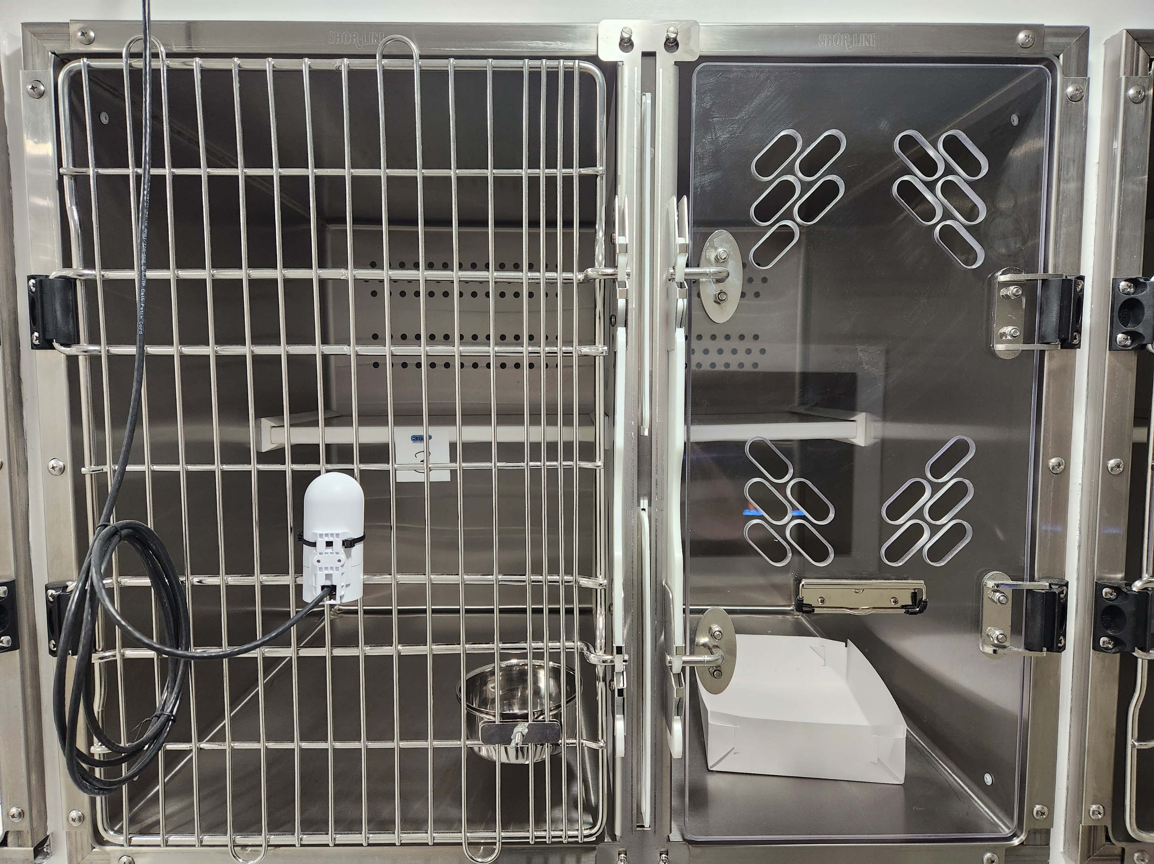
Owner’s concerns with I-131
A big concern owners have is being separated from their cat for 4-5 days.
To alleviate that, Hopkinton has webcams. These have been received VERY positively.

Slide 24
Owner’s concerns with I-131
The webcams have helped significantly in reducing owner’s anxiety.
Cost. It about doubles the life expectancy and has a cheaper TOTAL cost than methimazole.

Slide 25
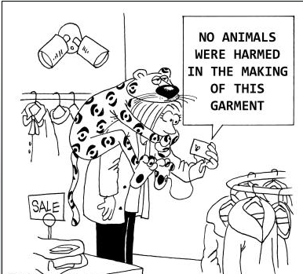
At Home Care
No close contact (e.g., snuggling) for 2 weeks.
All stool/litter for those 2 weeks bagged and kept for 90 days. Can then be thrown away in regular trash.
Hygiene. Wash hands after handling cat.

Slide 26
I-131 referrals
Check out NHi131.com for downloads and information. This is the client site also.
Need CBC, profile, T4, lateral and VD chest radiographs.
Owners can call Hopkinton Animal Hospital (603-487-6447) to talk to technicians to schedule. Currently we are admitting cats the second and fourth Mondays of the month. We can accommodate up to 8 cats per session.

Slide 27
I-131 referrals
If on methimazole, discontinue it 7-10 days before I-131.
No fish (i.e., iodine) containing foods for 7-10 days before treatment and for 2 weeks post treatment.
Cats are examined by me with client in room. All paperwork is reviewed and signed.
Cats are dismissed when radiation level is appropriate and at home care instructions are repeated (and owner signs again).
We send you a referral report.

Slide 28
30 days after treatment
You, the rDVM, repeat a TT4 and BUN/creatinine 30 days post dismissal.
If thyroid still high, I-131 can be repeated. It is at a lower cost to owner.
For the rare cat (approximately 1 cat in 200-300), I-131 will not work. Consider the cat has a malignant neoplasia.
Notes:
Overview of Treatments
Methimazole. Cheaper short term but more expensive long term. 2.5 years life expectancy. Owner has to give daily medication.
Surgery. Cost varies, may equal I-131. High recurrence rate. One to 3 years life expectancy. Can be technically difficult.
I-131. Higher initial cost. High cure rate. 4+ years life expectancy. Pet in isolation for 4-5 days, owner needs to be aware of radiation issues (especially first 2 weeks post-dismissal).

Slide 29
Questions?
Please call Hopkinton Animal Hospital, NH at 603-487-6447
www.NHi131.com
Notes:
References
1. Cardiovascular and Renal Manifestations of Hyperthyroidism, VCNA-Small Animal. Syme HM. Vol 37, Issue 4, Pgs 723-743. Jul 2007.

