Slide 1

Smart contracts
Josh Solinger

Slide 2
Before I get started
The views expressed in this presentation are my own and not those of my employer
I will avoid referring to any specific blockchain projects

Slide 3
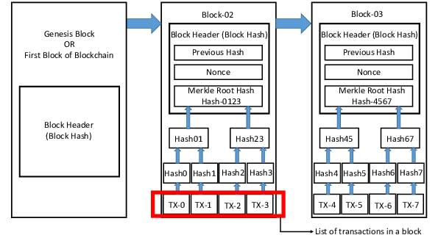
What is a blockchain?
Block: Contains many transactions
Blockchain: A collection of blocks
Disincentivizing Double Spend Attacks Across Interoperable Blockchains - Scientific Figure on ResearchGate.
Available from: https://www.researchgate.net/figure/Typical-structure-of-a-block-in-a-blockchain_fig1_337915589 [accessed 30 Nov, 2022]

Slide 4
What is a smart contract?
Written in code and stored on a blockchain
Uses conditions such as “if/then”
Automatically execute when conditions are met
Entity A
Entity B
Smart Contract
(blockchain)
Payment
Blockchain

Slide 5
Example of a current process
Incentivizing development by providing cash grants to developers to assist them with their costs for construction.
Payments are typically not made unless the development surpasses a guaranteed assessed value.
The developer may owe the city money if the development falls below the guaranteed assessed value.
1
Contract is formalized
2
Property values reviewed annually
3
Enter data into spreadsheet
4
5
Spreadsheet indicates who pays who based on contract
Request for payment or invoice
6
Mail payment or invoice
7
Record activity in general ledger

Slide 6
Same example using smart contract
Assessed Value
Oracles are entities that connect blockchains to external systems, allowing smart contracts to execute depending on real-world inputs and outputs*.
Oracle
Smart Contract
(recorded on blockchain)
N
Value Met?
Y
Payment Developer to City
Payment
City to Developer
Recorded on a blockchain
*https://cointelegraph.com/blockchain-for-beginners/what-is-a-blockchain-oracle-and-how-does-it-work

Slide 7

Other possibilities for blockchain
Grant administration
Government-to-government payments (near-instant settlement)
Property transaction records
Digitizing local stores of value like “Chamber bucks”
https://www.computerworld.com/article/3254202/ibm-sees-blockchain-as-ready-for-government-use.html

Slide 8
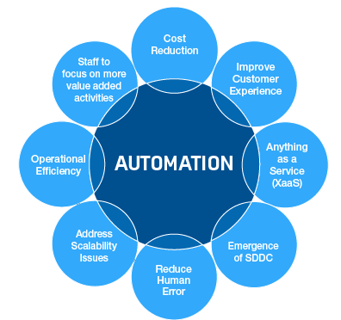
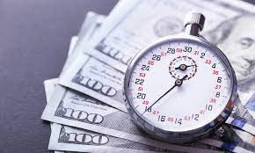
Summary of benefits
Automation
  Verification process
  Accounts payable and receivable activities
Near-instant settlement
Immutable and trustless
https://blog.shi.com/next-generation-infrastructure/getting-started-with-automation/
https://www.pymnts.com/digital-payments/2019/ingo-money-instant-settlement-merchant-sales/

Slide 9
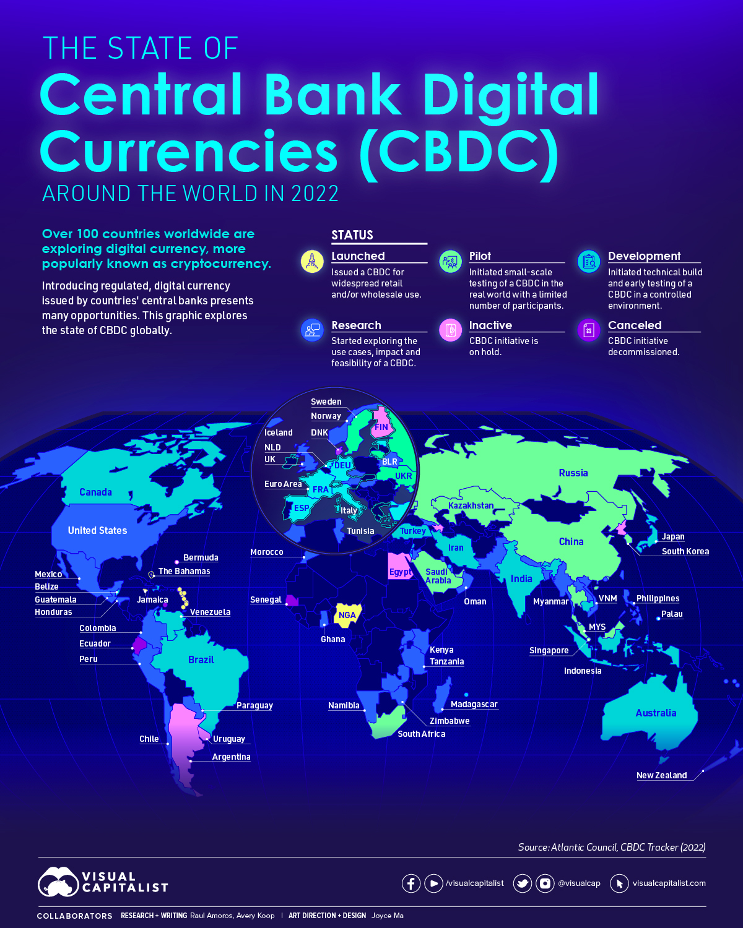
challenges
Reputational hurdles of blockchain
No widely accepted, government-backed digital currency
Technological hurdles
  Digital wallets
Clerical functions shift to I.T. functions for programming
https://www.visualcapitalist.com/visualized-the-state-of-central-bank-digital-currencies/

Slide 10
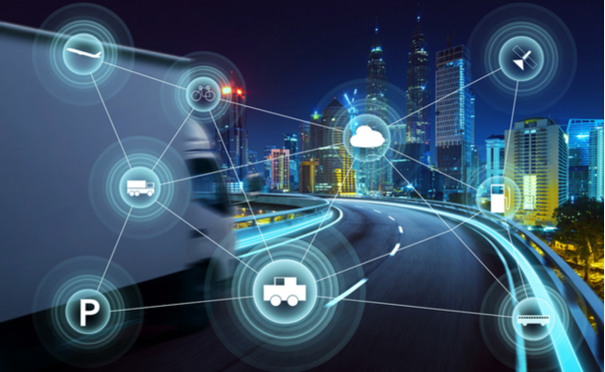
Conclusion: here comes the Internet of things
Internet of things: Physical objects with technologies that enable them to create and exchange data with other devices and systems over the internet or other communications networks.
Modern bureaucracies risk falling behind in a rapidly changing world.
Knowledge doubling curve posits that human knowledge may double every 12 hours with the IoT.
Blockchain offers a way to automate our bureaucratic processes by leveraging a world increasingly rich with information.
https://www.iiot-world.com/smart-cities-buildings-infrastructure/smart-cities/the-iot-and-the-creation-of-smart-roads/

