Slide 1


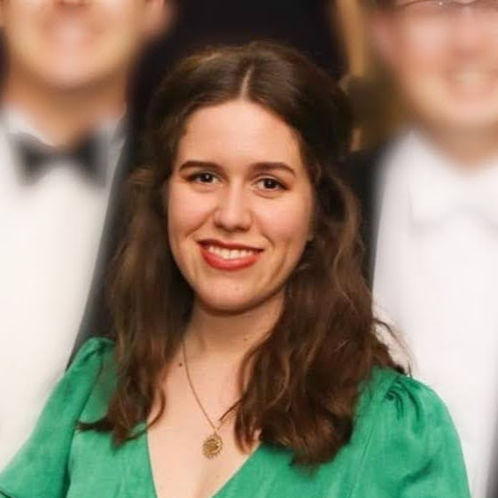
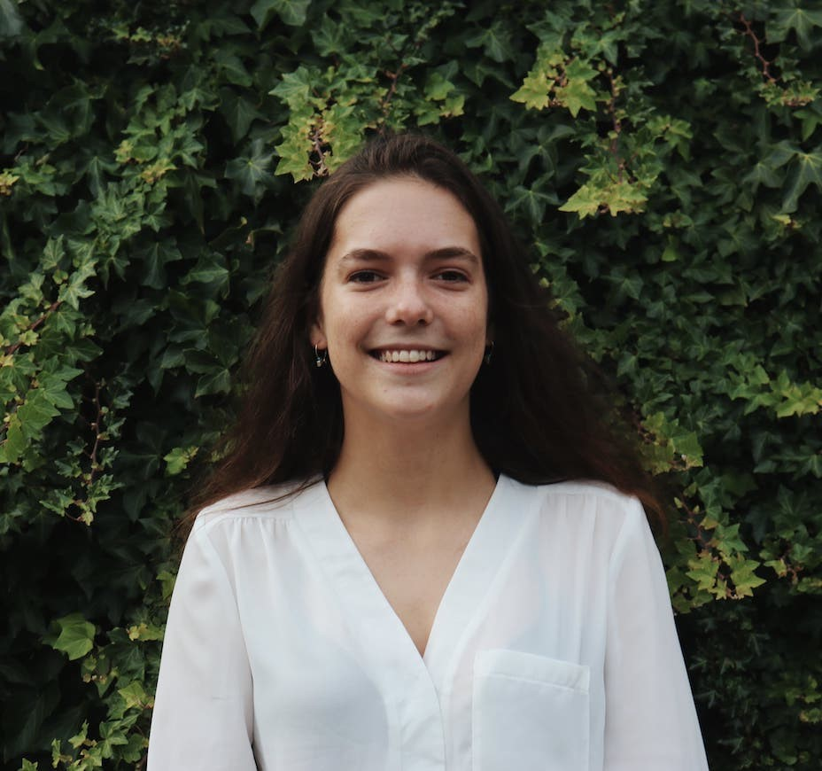
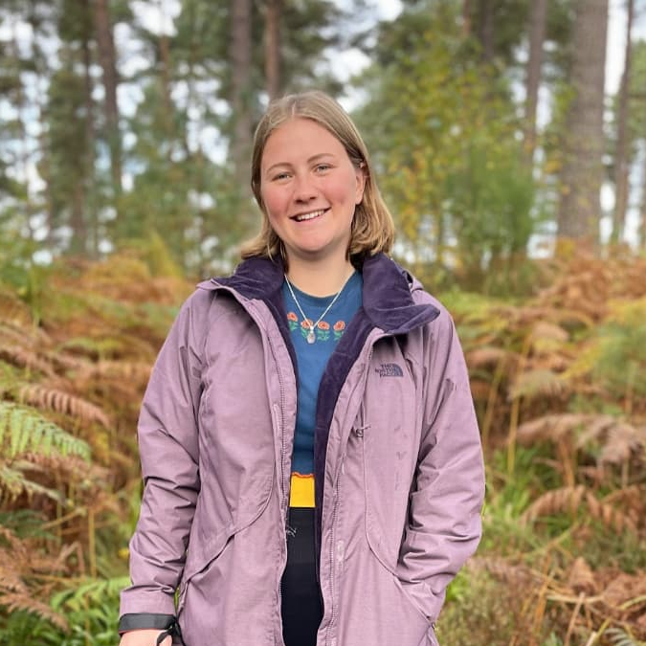
Growing environmental capability in the Civil Service
Civil Service
Environment Network
Who are we?
A network of over 3300 UK Civil Servants
Representing over 100 Departments and Agencies
Run by a committee of 40+ volunteers
Aiming to bring together, educate and upskill UK Civil Servants in Climate and Environment Issues
Charlotte Araya Moreland
Amy Campbell
If you are a UK Civil servant you can;
Join us: www.civilserviceenvironmentnetwork.org
Email us: environment.network@faststream.civilservice.gov.uk
Follow us: on Twitter (@_CSEN) and LinkedIn
Rebecca Hellard

