Slide 1

APOLITICAL SPEAKER SERIES
Leadership For All
Lead
Erin Donahue,
Leader and Senior Manager
Ontario Public Service
Erin.Donahue@Ontario.ca
01.
Notes:
Thank you for having me today - I feel privileged to be here. I also feel privileged to be speaking on a topic I am so incredibly passionate about - and that is leadership for all. The concept of leadership without titles and recognizing that each of you can be a leader.

Slide 2
Inspire
Leader | Manager
One is not synonymous with the other.
02.
LEADERSHIP FOR ALL | MARCH 2022
Erin.Donahue@Ontario.ca
Notes:
To jump right in I want to emphasize that there is a big difference between a leader and a manager. The two are not synonymous, but we often get hung up in the idea that they are one and the same. Any manager can be a leader. Can. Not is. Having a title and a team reporting to you does not make you a leader.
And in that vein, being a leader does not mean you hold a formal title. Anyone can be a leader. Absolutely anyone. Regardless of rank, role, seniority, background or culture. Each of you on this call can.. Leadership is for all..
Leadership is a mindset. Yes, there are actions that we do as a result, but leadership is innately internal - its about how we look at the world, how we consider others and how we identify opportunities to build those up around us. Its our core values. then its these internal thoughts and values that reflect outwards in our actions.
I often consider leadership to be based on those humanistic principles whereas management focuses on the technical skills. Forbes defines Managers as those who plan, measure, monitor, coordinate, solve, hire, fire, and so many other things. Typically, managers manage things. Leaders lead people.
They are vulnerable and show humility. They have courageous conversations and break the mold. They challenge the norm and support their peers. They lead with heart and show they care.

Slide 3
Grow
Before you are a Leader, success is all about growing yourself. When you become a Leader, success is about growing others.
- Joel Welch
03.
LEADERSHIP FOR ALL | MARCH 2022
Erin.Donahue@Ontario.ca
Notes:
But leadership doesnt happen overnight. and its isnt a cookie cutter or one size fits all. You need to work for it. to develop and hone it. and to figure out who you are as a leader for it to really stick.
I like to reflect on this quote from Joel Welch... Before you are a leader, success is about growing yourself. When you become a leader, success is about growing others.
This is important to reflect on because as you navigate your own leadership journey, you will spend alot of time developing yourself, trying new approaches, re-evaluating and learning some hard lessons along the way. This is part of growing. and its an important part of becoming an effective leader.

Slide 4


Develop
You can't give others tools that you, yourself, are not equipped with.
04.
LEADERSHIP FOR ALL | MARCH 2022
Erin.Donahue@Ontario.ca
Notes:
Why is growth important?
because you cant give others tools that you, yourself are not equipped with.
How can you model leadership, and teach others how to lead or develop their skills if you have not done the same?
So although, yes, being a leader is about developing those around you - You will need to spend time developing yourself first.
So this is what we are going to do today.

Slide 5



Your Leadership Skills
Reflect
Time for Reflection
  Who is a leader in your life that you admire?
  What skills and attributes do they have that make you admire them?
  How do they demonstrate these skills?
Check mark beside the skills you also possess.
Star beside the skills you want to enhance.
  How do you demonstrate the skills that you have?
  How can you grow the skills you want to enhance?
05.
LEADERSHIP FOR ALL | MARCH 2022
Erin.Donahue@Ontario.ca
Notes:
as I mentioned, Effective leadership really reflects on Your values and your mindset and how these showcase these outwards through your actions
So i want you to grab a pen and piece of paper and answer these questions. Its your chance to start reflecting on the type of leader you are today and the type of leader you want to be tomorrow.
Who is a leader in your life that you admire
What skills and attributes do they have that make you admire them?
How do they demonstrate these skills?
Put a check mark beside the skills that you also have - these are the things you already possess that make you a leader This is what you already bring to the table.
and a star beside the skills you want to enhance. These are the things you will focus on and work to build. This is your opportunity to learn.
Now - ask yourself... How do you currently demonstrate the skills you have? Think about your actions and interactions. What you do in either, your personal and professional life that demonstrates these leadership skills.
and lastly, how can you grow the skills you identified that you want to enhance? What avenues do you have to explore and develop? maybe its through a developmental opportunity at work, or volunteering in your community, or taking a course. leading a project or a meeting. How can YOU grow your skills? this is your homework.

Slide 6






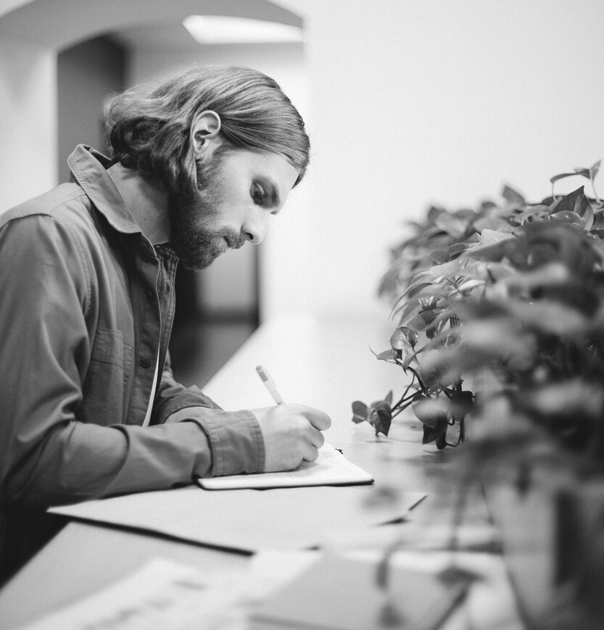

Advocate
The best skill you have is your ability to advocate for your own growth
Don't be your own barrier. Be your biggest cheerleader.
Don't create barriers. Build opportunities.
06.
Notes:
Now i can guess one skill that didnt make it on anyones list.
It is often missed but it is crucial to your develoment as a leader. and that is your ability to advocate for your own growth.
Part of being a leader is taking control of the narrative, and in this instance, you need to take control of your own growth narrative. No one is going to do it for you.
So - lead your leadership development by asking for support. Advocate for yourself.
i truly respect it when people approach me for guidance and support.
and its easier said than done. asking for help and saying you want opportunity is putting yourself out there. its vulnerable.
but A good leader will want to build you up- but you have to ask. and some times you need to help them find opportunities that are right for you.
If you dont, you are only creating barriers to your development, when instead you need to build yourself up. cheer yourself on and believe that you deserve the chance to grow.
So advocate for your development. Dont create barriers for yourself. Build opportunities.

Slide 7
Care
We don't need a title to lead. We just need to care. People would rather follow a leader with a heart, than a leader with a title.
- Craig Groeschel
07.
LEADERSHIP FOR ALL | MARCH 2022
Erin.Donahue@Ontario.ca
Notes:
I want to leave you with another quote.
We dont need a title to lead. We just need to care. People would rather follow a leader with a heart, than a leader with a title.
This reminds me that each of us can be a leader. We just need to be human. We need to care and show compassion. We need to reflect inwards and consider who we want to be and what we value. Then we need to align our actions with those values.
Anyone can be a leader.
You dont need a title. You just need to care.

