Slide 1
Romina Boarini, Director of the OECD WISE Centre
18 January 2023, Apolitical Workshop on Green Growth
A people-centred transition to the green economy

Slide 2
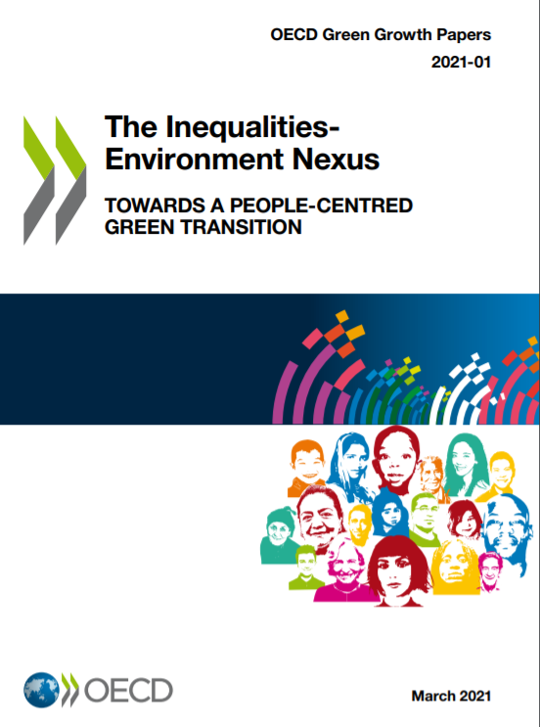


Inequalities-Environment Nexus: Towards a People-Centred Green Transition
  Context: OECD Green Growth and OECD Inclusive Growth frameworks
  The Inequalities-Environment Nexus report:
  Looks at air pollution and climate change impacts
  Notes that the policies to achieve green transition have social implications, with distributional implications at household, business and regional levels
  Argues for policies to address inequalities and environmental challenges considered together
Source: OECD (2021), "The inequalities-environment nexus: Towards a people-centred green transition", OECD Green Growth Papers, No. 2021/01, OECD Publishing, Paris, https://doi.org/10.1787/ca9d8479-en.

Slide 3
Enabling a people-centred green transition through policy packages that consider distributional impacts by design
Recycling revenues of price-based measures
Active labour market, skills and social policies
Place- based policies, (boosting new economic activity)
Mitigating regressive impacts of pricing on households.
Targeting support to those in need.
Encouraging further energy savings.
Job-search training
Requalification and skill updates
Adapting social protection
Advice and support for relocation for families (e.g. housing, health, education).
Entrepreneurial training
Ease of doing business
Green public investment & infrastructures
Embedded in inclusive, responsive and green governance

Slide 4
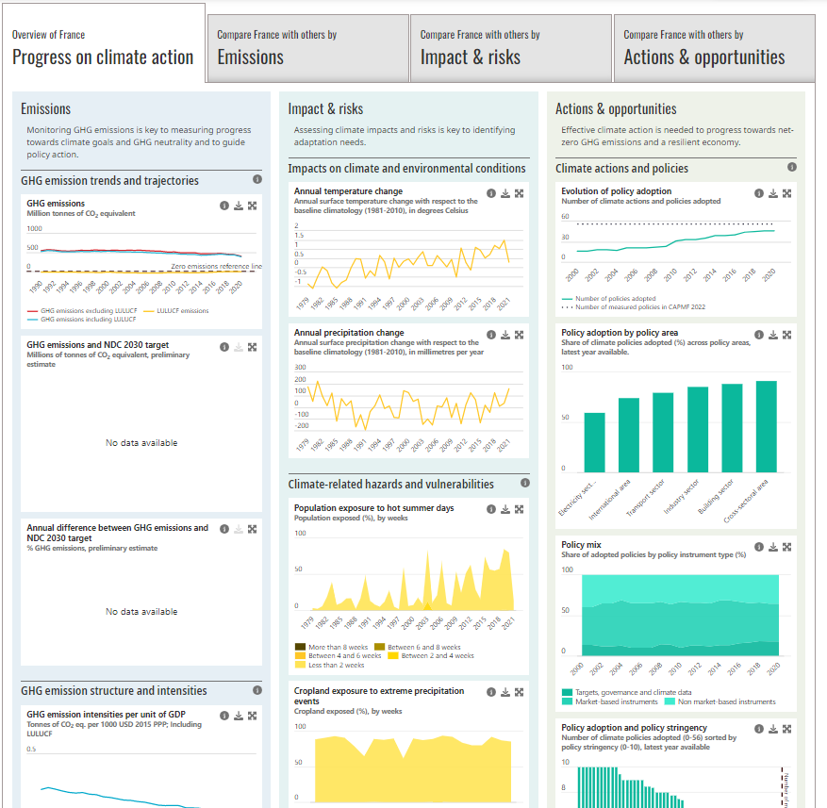
Examples of ongoing and planned OECD work contributing to people-centred green transition
The OECD Climate Action Dashboard - key indicators to track progress towards climate objectives and provide a snapshot of country climate action.
Energy prices and pricing – impacts on vulnerable groups and options for support through revenue recycling.
Skills for a net-zero economy – anticipating local skill needs and devising strategies to master them.
Greening the public administration – OECD best practices for green procurement.

Slide 5
Thank you!
Find out more about WISE’s work: www.oecd.org/wise
Subscribe to WISE’s newsletter: https://oe.cd/wellbeingnews
Contact us:
Romina.Boarini@oecd.org
wellbeing@oecd.org

