Slide 1
Success Profiles
Webinar 19.4.23

Slide 2
Behaviours vs Strengths
Behaviour-Based | Strengths-Based
No baseline
Includes an engagement ‘baseline’ warm-up question
Qs = predominantly past behavioural, with some situational
Qs = past behavioural, hypothetical/situational, closed, open, assumptive...
Many probing questions (‘ad lib’)
No probing questions (sometimes includes a scripted follow-up Q)
Positive indicators defined by grade level requirements
Positive indicators universal
1 to 7 rating scale (ineffective to effective)
1 to 4 rating scale (weakness to strength)

Slide 3
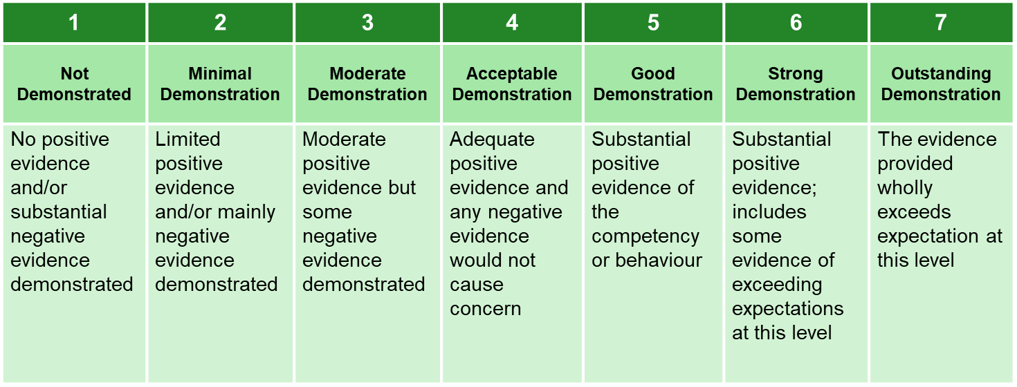
Behaviours Scoring Scale

Slide 4
The WOW factor - PRITI
Problem Solving
How have you resolved a complex problem?
Resources
How have you achieved more with less?
Improvements
How have you done things easier, better, simpler?
Targets
What have you done faster, cheaper?
Innovation
When have you created something new

Slide 5
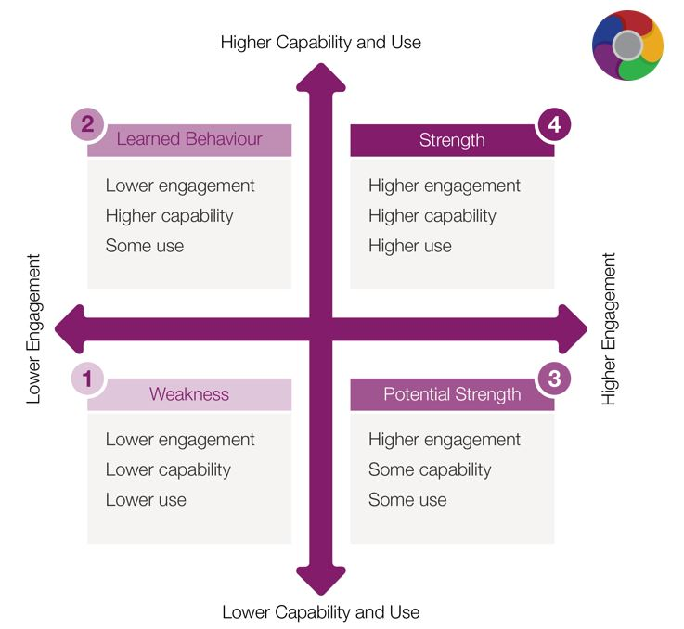
Scoring
Strengths

Slide 6
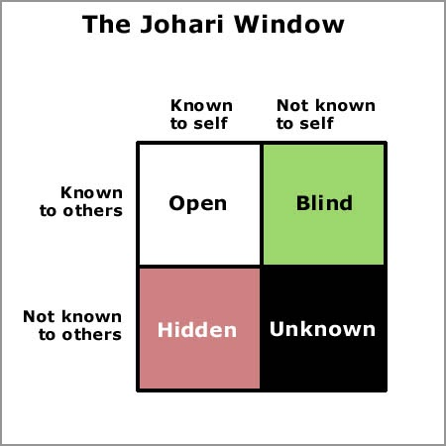
The Johari Window and Strengths
A useful tool to increase self awareness
To reach the ‘blind–spot’ pro actively ask for feedback from colleagues, coaches and mentors. Review 360 information
Consider a ‘leadership style’ or preferences psychometric; Myers Briggs to support your understanding of your own strengths and the right roles for you
Aim to reduce the ‘unknown’ area through reflecting and recording when you discover new strengths and attributes in personal and working life.

Slide 7
Example questions for “Adaptable”
Adaptable: You can adapt to variations in work or environment and your effectiveness isn’t impacted by change. You are flexible and versatile and act as an advocate for change.
Question Type | Examples
Open | How easy do you find it to embrace change?
Closed | Do you enjoy being flexible?
Hypothetical/ Situational | Imagine that your manager has asked you to stop one task and start doing something else. How would you react?
Leading | Are you someone who considers yourself to be versatile?
Assumptive | What kinds of situations lead you to be inflexible?
Past-behavioural | What did you do the last time the goal posts shifted significantly on a piece of work you were doing?
Statements | “To be effective you need the ability to adapt to change”. To what extent do you agree or disagree with this?

