Slide 1


Fostering economic growth and climate resilience in cities
Jagan Shah, Director, Artha Centre for Emerging Cities
8 November 2023

Slide 2


Contents
1. Cities are engines of economic growth
2. Decoupling growth from carbon-intensity
3. Pathways to decarbonization
4. Illustration: the dilemma of managing density
5. Quiz: Manifest Density
6. Cape Town’s challenges in achieving green growth
7. Growth for Jobs Strategy 2035 for the Western Cape
8. Lesson 1: Build Capabilities for Green Growth
9. Lesson 2: Focus on delivering outcomes

Slide 3
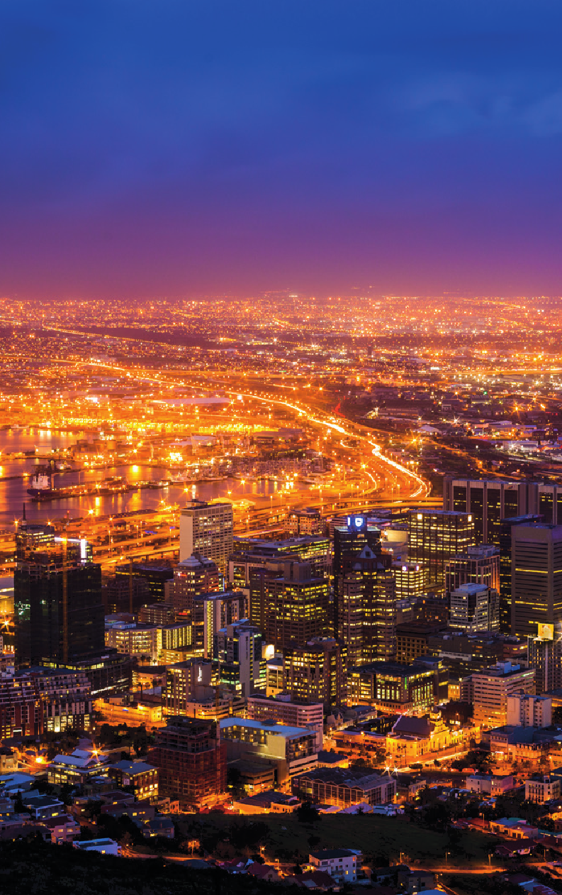
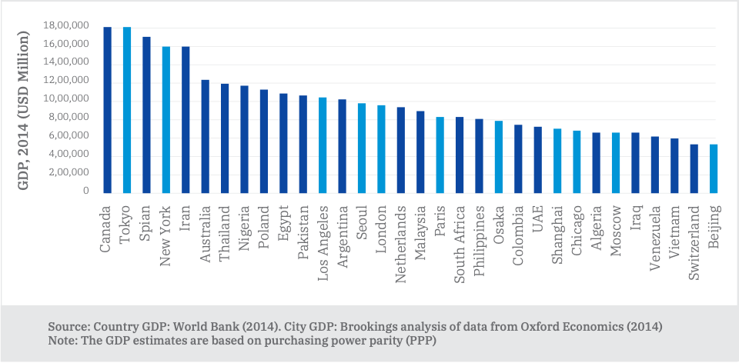
Cities are engines of economic growth
1

Slide 4
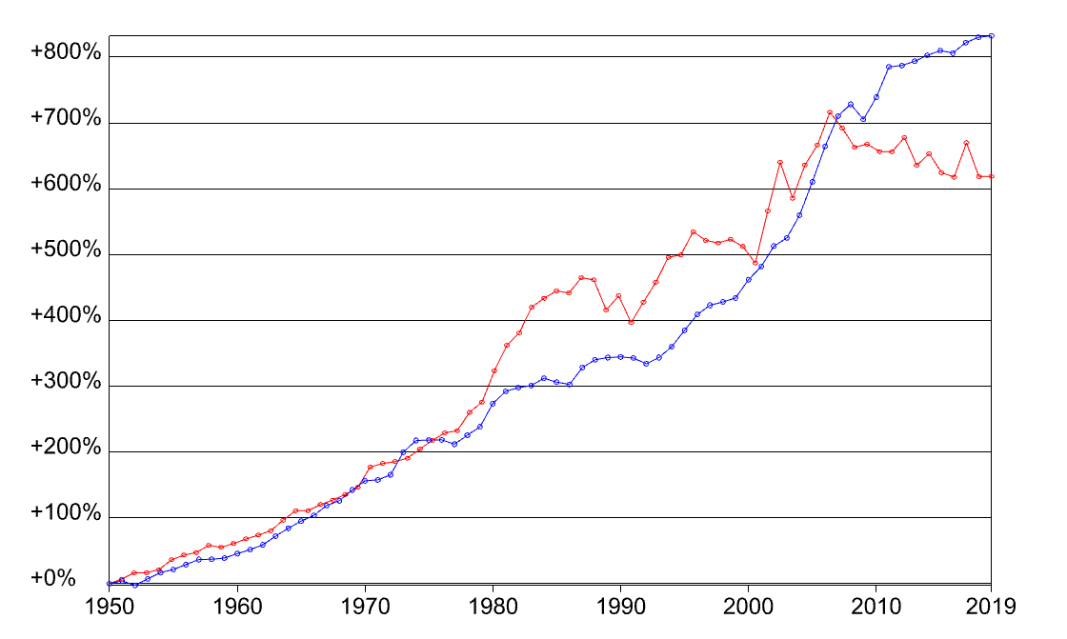
Decoupling growth from carbon-intensity
2
Green growth is a development approach that seeks to deliver economic growth that is both environmentally sustainable and socially inclusive. Economic growth is of central importance for development and reducing poverty, and achieving environmental sustainability and social inclusion are equally important and necessary to ensure that economic development is sustainable over the long term
(Global Green Growth Institute)
GDP
Total CO2 emissions
South Africa: GDP and Total CO2 emissions 1950-2019 (Our World in Data)

Slide 5
Pathways to decarbonization
3
In the developing world, poor urban planning and mal/dysfunction of systems is a barrier to creating the positive correlation between urbanization and economic growth. Green growth pathways can overcome the barriers.
SPRAWL
BUILDINGS
GG PATHWAYS
URBANISATION
CONGESTION
WASTE
POLLUTION
TRANSPORTATION

Slide 6
Illustration: the dilemma of managing density
4
Well-managed density (positive externalities) |  | Poorly managed density (negative externalities)
I live close to work and basic services | Compact, mixed-use development | Sparse, segregated development | I live far from work and basic services
I am able to choose when and how I socialize | Building standards and codes ensure livability | Congested/crowded neighborhoods | I have zero privacy
My commute is cheap and quick | Affordable mass transit | Mobility dominated by private cars | My commute is expensive and long
My community can easily access public amenities & open spaces | Dense urban form, privileging public land uses | Sprawling urban form privileging private land uses | My community must travel to access public amenities & open spaces
Economy of scale in use of infrastructure | Lower energy demand: (Emissions per capita urban << rural) | High energy demand: (Emissions per capita urban >> rural) | City wastes money on conveying services over long distances

Slide 7
Quiz: Manifest Density
5
Buildings, Waste and Transportation are the most critical components of cities that must be managed efficiently to achieve green growth .
Density is an attribute of urban growth.
Recall the previous slide about “dilemmas of urban density”.
Drawing from your local context and experience, jot down three ways in which density matters to buildings, waste and transportation.

Slide 8

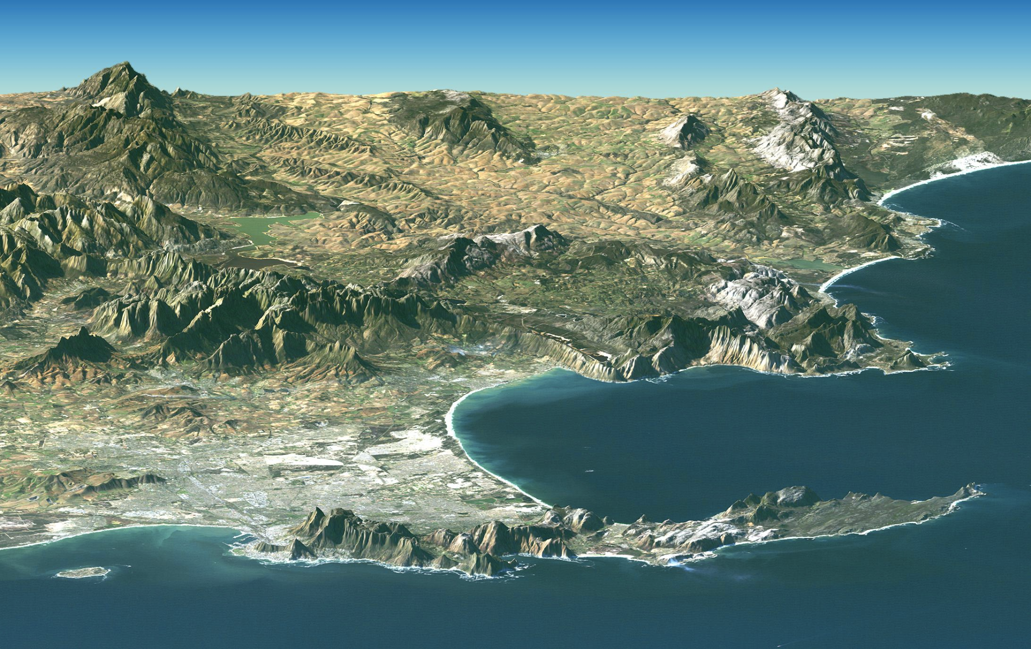



Cape Town’s challenges in achieving green growth
6
Density of ~1800/sqkm vs. HK (~6800/sqkm)
600,000 people on housing waitlists
Residential segregation based on class
62% of energy demand from transportation
Small-Scale Energy Generation (SSEG) - leader in renewables
High levels of congestion due to car dependence
Underutilised BRTS
Geographical challenges in expanding transit
Large slum population, influx of migrants across SA and Africa
Worsening water supply and rising energy demand
Climate change’s impacts on public service delivery
Physical constraints on Cape Town
Notes:
Important to highlight the connections between each of these categories, eg. lack of formal housing creates informal housing on the periphery which lacks basic services and hence pollutes
https://climate.mit.edu/posts/day-zero-still-looms-over-cape-town
https://www.sciencedirect.com/science/article/pii/S0197397523000139
https://www.ren21.net/cities-2021/cities/capetown/capetown/

Slide 9
Growth for Jobs Strategy 2035 for the Western Cape
7
STRENGTHENING SPATIAL SYNERGIES (Provincial Spatial Development Framework)
      What kind of spatial arrangement is most conducive to the objective of a jobs-rich provincial economy, rolling back poverty and improving citizens’ wellbeing?
PRIORITY FOCUS AREAS
Driving growth through Investment
Building exports and domestic markets
Energy Resilience and transitioning towards net zero carbon
Securing our water future
Partnering for Technology and Innovation
Connecting through infrastructure and digitalisation
Improving learners, entrepreneurs and aspirant job seekers
Systems Thinking is all about causalities…
Select 3 focus areas that would be directly impacted by the choice of a spatial arrangement.

Slide 10
Lesson 1: Build Capabilities for Green Growth
8
Define Delivery Units
Local governments: Roles and Competencies
Leverage the Power of Ecosystems
Quadruple Helix: Functionaries, Institutions, Businesses, Communities
Secure ‘Green’ Supply Chains
Green Procurement & Financing: Products, Tech, Services, Human Resources

Slide 11
Lesson 2: Focus on delivering outcomes
9
Create Integrated Plans for
Area-based Development
City as system of systems
Testing ground: mobility, energy, surveillance, AQM
Practice Convergence across domains and departments
Localise and contextualise challenges
(
Urbanisation & Green Growth
Monitor & Evaluate Results
Use data-driven log-frames
Sustain Feedback Loops
Build stake; translate into political salience

Slide 12
Thank you

