Slide 1



Accessible Information Standard
Gary Jevon
18th October 2022

Slide 2
Reducing Health Inequalities
The facts:
Of 139 hospitals who responded to a recent FOI request, only 1/3rd said they met ALL the requirements of the Standard:
  53% said they asked patients and carers about their accessible needs
    only 36% said they had assessed their compliance over the last 3 years
  There is a crisis in adult literacy that directly impacts on people’s health.
    In the UK 7.1 million adults read and write at or below the level of a nine-year old and, critically, 43% of adults do not understand written health information.

Slide 3
Reducing Health Inequalities
The challenges:
Information Technology:
  There are over 100 clinical IT systems at Mid-Yorkshire Hospitals
  Not all of these systems interface with each other
  Whilst not unique to Mid Yorks (this is an issue across the NHS as a whole), this means that the Trust are unable to readily share information on a patient’s accessible need

Slide 4
Reducing Health Inequalities
What have we done so far:
Work with AIS leaders at MYHT:
  Head of Diversity and Inclusion
  Senior Programme Manager for AIS
  Senior Responsible Officer
Aims and objectives:
  Better patient experience
  Informed choice
  Faster and appropriate patient care
  Reduce Health Inequalities

Slide 5
Reducing Health Inequalities
What have we done so far:
  New work streams set up across the Trust
  Created AIS “Purple promise”: champions, posters, screensavers
  Developed a training package for all staff which has started with Champions
  Increased availability of BSL training for front line staff
  Revised communications strategy – developing videos (e.g. CEO / Chief Nurse / Matron for Ophthalmology, all using a BSL interpreter and captions); Website development; social media accounts.
  “Patient Knows best” – developing educational material/letters
  Sensory Impairment Insights Group – led by Healthwatch CEO

Slide 6
Reducing Health Inequalities
What have we done so far:
  Development and implementation of interoperable IT systems which can record AIS need
  Development of AI solution so that all systems will interface and talk
  Developed partnerships with other organisations and included those with an accessible need in developing:
    Staff Guides
    The AIS Policy
    Literature which is sent to patients/carers
    Easy Read information (Easy Read UK)

Slide 7
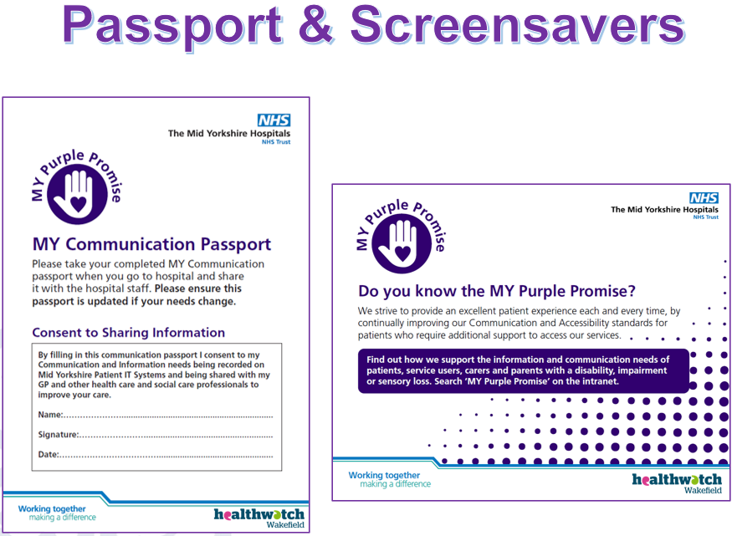
Reducing Health Inequalities
What have we done so far:

Slide 8
Lessons Learned
Working with stakeholders:
  Create an evidence base (e.g. patient feedback and intel, case studies) and use it!
  Identify, analyse and prioritise stakeholders
  Encourage stakeholders to communicate with each another as well as with you
  Seek to understand the stakeholders’ points of view (listen and ask questions, and seek compromises)
  Lead with transparency and build trust

Slide 9
Lessons Learned
Working with stakeholders:
  Commit to an agreed engagement schedule
  Communicate Communicate Communicate! Especially as soon as possible with your stakeholders when things change. Use the most effective channels too.
  Collaborate, don’t dictate; work with your team and the wider communities
  Strive to set the right expectations from the start
  Show your gratitude for all they do in your project

Slide 10

For more information
  Healthwatch Wakefield
  The Plex
  Margaret Street
  Wakefield
  WF1 2DQ
    www.healthwatchwakefield.co.uk
    t: +44 (0) 1924 787379
    e: enquiries@healthwatchwakefield.co.uk
    @HealthwatchE
    Facebook.com/HealthwatchWakefield

