Slide 1

Reading and Interpreting Data
How to build a data-driven public service:
A virtual conference
Notes:
In an increasingly interconnected and data-driven world, being able to read and understand data is an essential skill.
Nowhere is this more true than in the public service, where data is used in all departments and organisations, from creating policies to delivering services to citizens.

Slide 2

Where is the wisdom we have lost in knowledge?
Where is the knowledge we have lost in information?
“
– T. S. Elliot, Choruses from ‘The Rock’, 1934
Notes:
I’m going to start in a slightly unusual way, with a quote from the poet T. S. Elliot -
Where is the wisdom we have lost in knowledge?
Where is the knowledge we have lost in information?
It serves as a warning to us: it is not enough merely to have a lot of data - to admire how much we have available!
What matters is the knowledge, the wisdom we can ultimately gain from it.

Slide 3
WISDOM
?
KNOWLEDGE
INFORMATION
DATA
Notes:
Elliot was clearly on to something, because a frequent theme in Information Science is the ‘Data Pyramid’, which I’ve represented here.
Let me first pose the question What is data? Or rather, what are data?
We’ll agree not to worry about this at all after this slide, but it’s helpful (when answering this question) to remember that the word ‘data’ was originally a plural.
Data are (collectively) the individual, disorganised facts, statistics, and signals we collect and store for reference and analysis.
On its own a single datum isn’t much use. But when you have a large collection of data it is possible to process and organise it for particular purposes. And that is how you create information - by understanding the context and significance of your data.
Let me be more specific. By processing and organising data (converting it to information), we may be able to use it to answer questions - what, where, when, how? - and resolve uncertainty.
Knowledge is generated when we ask and answer such questions; when we resolve uncertainty.
The reason I bring this up is because that’s the bit we’re mostly going to be focusing on in this talk.
Now, wisdom may seem a rather unscientific word, but let’s be clear: I mean the ability to make good predictions, judgements, and decisions. This is our end goal.
We might also call this ‘insight’, but clearly it must be based on knowledge.
Specifically, once we have knowledge, we can reason about that which we know and make inferences using logic.
We can create models with the aim of explaining what we know - understanding why - and, if those models are any good, we can use them to make predictions and (therefore) decisions.
A few years ago I gave a talk to public servants about data analysis, and one attendee made an insightful comment: some of you are focused on analysis whereas others are focused on synthesis.
The first of these covers the work of transforming data into information and information into knowledge.
The second is more about identifying trusted sources of knowledge and drawing together what is known in order to make good decisions; in this framework, to convert knowledge into wisdom.
However, these boundaries are not perfectly defined in practice. So it’s important for everyone to understand the process of converting information into knowledge.

Slide 4
BIG DATA
The Rise of
Data take many forms
‘Datafication’ of society: pervasive and expanding collection of data on all aspects of daily life
It’s now much easier to get evidence for ‘what works’ than ever before!
Notes:
But before we get into that, let’s talk about the raw material.
About a decade ago the term ‘Datafication’ was coined to describe a rising trend: the collection and storage of data from an ever-wider variety of aspects of daily life. Data can take many forms - numbers, text, images, and more - and it’s increasingly big. So-called ‘big data’ is typically trading off massive scale against careful curation - that is, we increasingly have datasets that are too large to fit on your personal computer and that have only undergone automated, rather than human, review.
This data doesn’t simply appear - it’s created.
It’s important to understand how, when, and by whom.
Let me give a few examples.
Buildings have sensors strewn throughout them now, as do vehicles, and (increasingly) transport infrastructure;
the signals from these are data and can be used to detect problems (or predict them in advance).
Supermarket loyalty schemes have turned our purchasing habits into data.
Twitter has even turned our idle thoughts into data!
In short, there’s data on everything. It’s increasingly all stored electronically, it’s increasingly ‘big’, and it’s becoming ever more widely accessible.
Now here’s what that has to do with public service:
Policy works best when it’s based on evidence. By this, I mean that you make particular policy interventions when you’re confident that they will contribute towards achieving your policy goals.
Data - or rather, information - can be used to provide evidence, which ultimately becomes knowledge about what interventions are likely to have the desired effect (and avoid undesirable side-effects).
Data-driven policy is not a new idea. But our capacity for this is now greater than at any time in the past.

Slide 5

I had an interview with the Board of Guardians of St. James's parish, on the evening of Thursday, the 7th September, and represented the above circumstances to them.
In consequence of what I said, the handle of the pump was removed on the following day.
“
– Dr John Snow
Notes:
Let’s take a quick trip back to 1854 and a key breakthrough in the field of Public Health.
At that time there was an outbreak of Cholera in Soho, London.
The disease had first arrived in 1831 during a global pandemic and at that time had killed thousands of people.
This new, acute outbreak had killed hundreds of people in a matter of days: a serious crisis.
At the time, no-one understood how disease spread. The prevailing theory was that it had something to do with bad vapours, or ‘miasma’, in the air.
However, Doctor John Snow had a different theory, which he set out to investigate.
Here is his original map, which is really an infographic: the black bars show the number of Cholera cases at different properties in the district - data he painstakingly collected.
At the epicentre of the outbreak, on Broad Street, a water pump is marked. Snow’s theory was that Cholera was water-borne. And now he had evidence.
As you can see from the quote, the local government officials removed the pump handle. The outbreak subsided.
It would be a simplification to say that Snow’s theories were widely accepted overnight, or that policy pivoted dramatically.
Nevertheless, a year later legislation was passed that paved the way for the construction of London’s Victorian-era sewers — although, in truth, this may have had as much to do with the terrible smell outside parliament as public health per se...

Slide 6
The greatest value of a picture is when it forces us to notice what we never expected to see.
“
– John W. Tukey, 1977
Notes:
John Snow was said not to be a charismatic speaker, but a good data visualisation can be very persuasive.
I really like this quote from John Tukey, the American statistician -
The greatest value of a picture is when it forces us to notice what we never expected to see.
That’s the power of data visualisation, a big part of what I want to focus on today. Let me illustrate why for you.

Slide 7
Picture this…
x y
1 55.3846 97.1795
2 51.5385 96.0256
3 46.1538 94.4872
4 42.8205 91.4103
5 40.7692 88.3333
.. ... ...
138 39.4872 25.3846
139 91.2821 41.5385
140 50.0000 95.7692
141 47.9487 95.0000
142 44.1026 92.6923
x y
count 142 142
mean 54.263273 47.832253
std 16.765142 26.935403
min 22.307700 2.948700
25% 44.102600 25.288450
50% 53.333300 46.025600
75% 64.743600 68.525675
max 98.205100 99.487200
Notes:
Imagine you’ve just been given a spreadsheet - a table.
And it only contains two columns, x and y (it could be anything).
You can stare at those data all day. You can compute summary statistics - that’s often a useful thing to do. We can see the y values are a bit more spread out than the x values.
But. I can guarantee you - no matter how hard you stare …

Slide 8
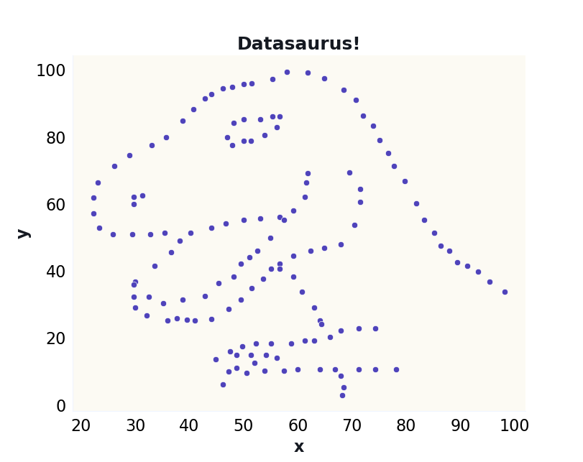
Dataset provided publicly by Prof. Alberto Cairo
Notes:
… you will NEVER spot the dinosaur.
There are really two types of data visualisation. There’s visualisation like this, which is really about exploration. A data analyst might spend time making lots of different visualisations in order to uncover the most important features of some data - to convert data into information. Our Datasaurus friend here is a case in point.
On the other hand, there’s visualisation as a presentation. As a way of telling a story. That’s more about turning information into knowledge, and communicating that knowledge to others.
Once someone has decided what certain data tell us, they can make a series of choices about how to display it.
Their job is to create a kind of guided tour of the data that will help you reach the same conclusions as them, without putting the same work in.
You, the reader, have at least one job of your own: to figure out what they were trying to tell you.
(You may have a second: to spot what’s being downplayed, or hidden. That’s harder.)

Slide 9
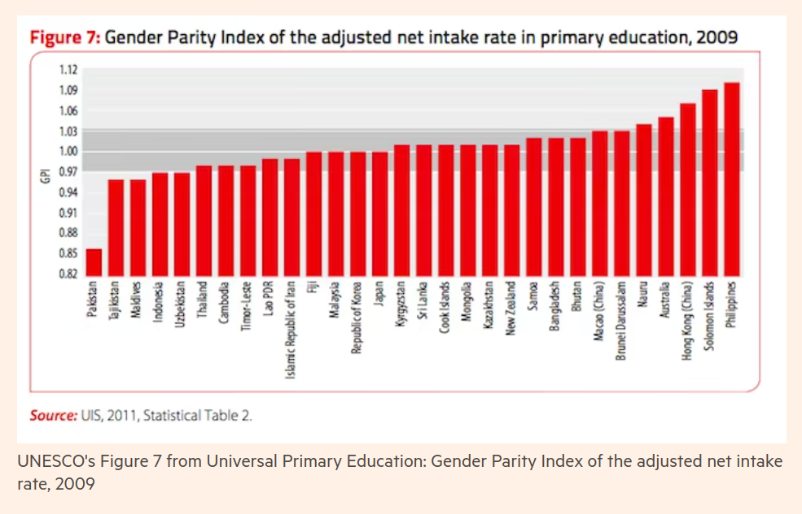
From Data visualisation mistakes — and how to avoid them
Financial Times, 28 Nov 2017
Notes:
Let me illustrate that difference between the two types of visualisation.
A really common issue is an exploratory plot being used for presentation purposes.
Alan Smith of the Financial Times wrote a brilliant article illustrating the difference. He gave this example of when he worked with UNESCO as a data visualisation expert.
Here is a bar chart which, fundamentally, is a serviceable exploratory plot. If you are a data analyst who is investigating the data in context, this might be okay.
For anyone coming in cold it’s much more difficult to figure out what it means, or what your takeaways ought to be. This is not a suitable plot for presentation.

Slide 10
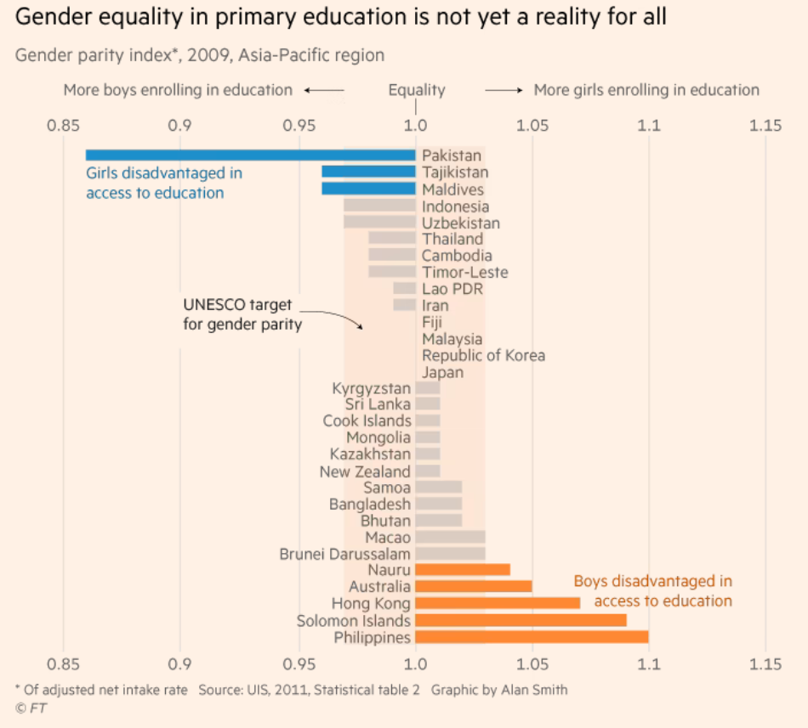
From Data visualisation mistakes — and how to avoid them
Financial Times, 28 Nov 2017
Notes:
Here it is after Smith reworked it for UNESCO. These are the same data!
To highlight some choices that have been made:
The title tells you what this is about and what to conclude. The plot is mainly there to persuade you.
An additional guide to what the index means has been included. 1 has been marked as ‘equality’. Previously the numbers in concert with the vertical axis label were insufficient to convey their meaning.
It’s important whether the Gender Parity Index is above or below 1. So 1 has been centered, and the chart rotated because we have a lot of categories and the labels are easier to read left-to-right.
A further element of categorisation has been added. The random grey shaded area is now explicitly labelled as the ‘UNESCO target for gender parity’ and (colour-blind friendly!) colour coding used to show countries that meet the target, or where boys or girls are disadvantaged.
For a decision-maker, this is much better. The outliers are now clearly identifiable and the key takeaways are clear.
The first chart made you work.
The second is a guided tour of the data - knowledge has been created and transmitted.

Slide 11
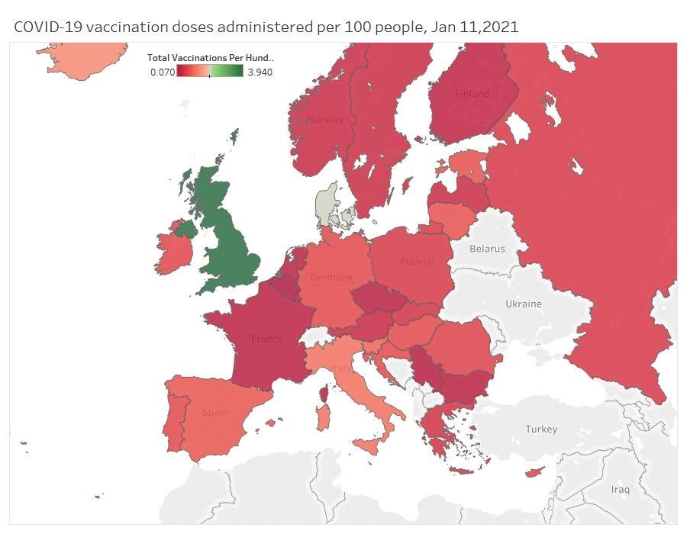
Notes:
A good presentation chart tells a story. But what about when that story is contested?
When you read a chart you need to be aware that it’s possible to disagree with the author - but to make that kind of judgement you need to be able to work backwards - to recognise the choices that have been made and imagine what the alternatives were.
Here’s an example of a chart that stirred up a great deal of controversy last year, during the early stages of the COVID-19 vaccine rollout.
Naturally there was a political element to that, but here we’ll focus on its technical qualities as a presentation chart.
The first thing to say is that, compared to a table of raw numbers, the story the chart’s author is telling you is exceptionally clear.
(that is, for those of you in the audience who don’t have red/green colour-blindness. For others the chart will look like mud,
instead of having the United Kingdom strongly contrasted with its neighbours)
I also don’t find anything wrong with the choice of metric.
Sometimes a carefully chosen type of data, or a very artificial rescaling of the data, can be used to make one category stand out (or not stand out!).
These are things to be aware of when reading any chart.
But total vaccinations per capita is a very natural choice.
However, the colour scale is inappropriate, in my opinion.
This is a quantity that varies from zero to one hundred (or more, because of multiple doses), yet we have a two-tone colour scale with deep red around zero and strong green at 3.9.
The motivation for choosing this scale is understandable, in the sense that the British target audience would mostly take red and green to indicate bad and good (a fairly widespread convention) - that was the message the chart author wished to convey. But the scale is not a natural fit to these data, for which a single-tone colour bar running from light to dark would have been a good representation.

Slide 12
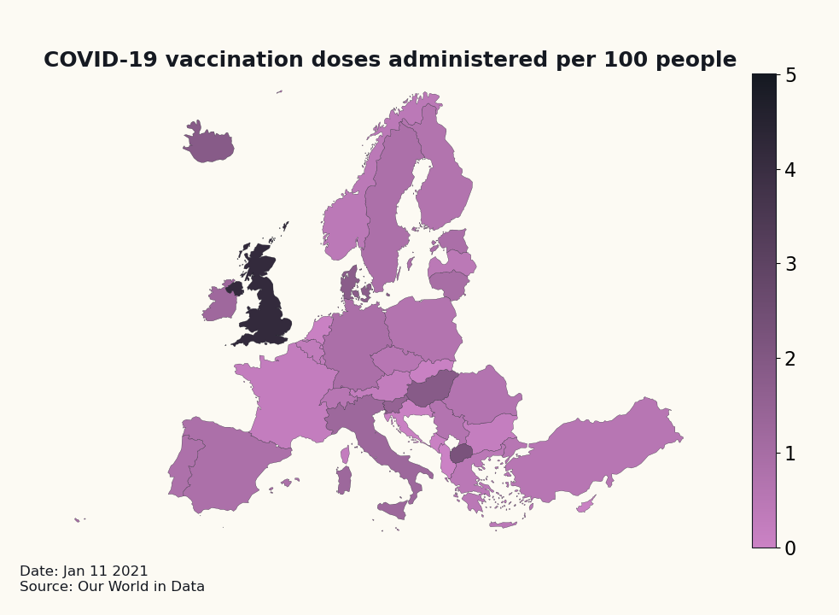
Notes:
This would have told essentially the same story, as you can see.
However, as it was, many in the audience instinctively felt that the chart author was over-egging the conclusion, manipulating the scale to impose a story on the data.
So this actually had a counterproductive effect.
A good presentation chart should have a clear message, but ultimately it must let the data speak for themselves.
We should be converting information into knowledge, not the other way around!

Slide 13
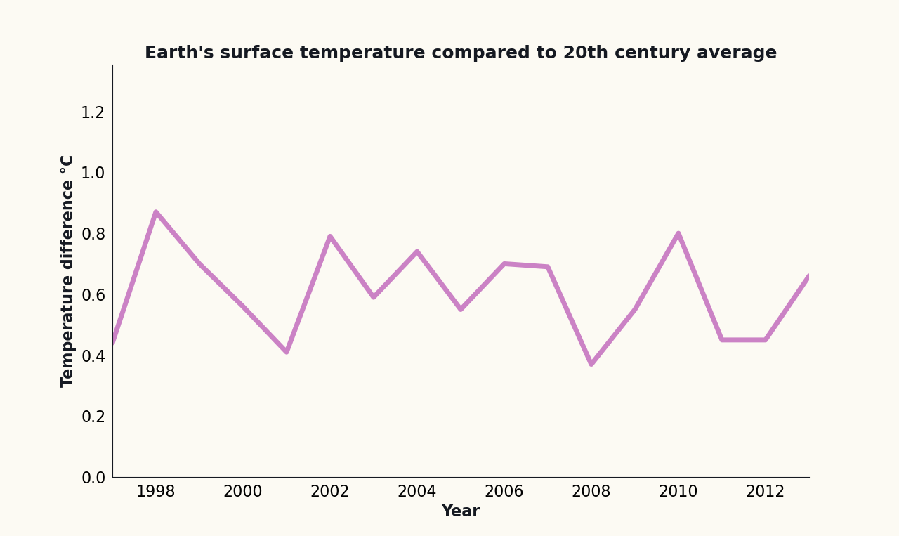
(source: NOAA)
Notes:
Let me elaborate on that.
This is my version of a famous chart that did the rounds in the British press around a decade ago.
It caused a real stir because the message the chart author wanted to convey was that
‘Global Warming has stopped’
And it seems convincing: a fifteen year period with no noticeable change in the Earth’s average surface temperature.
But.

Slide 14
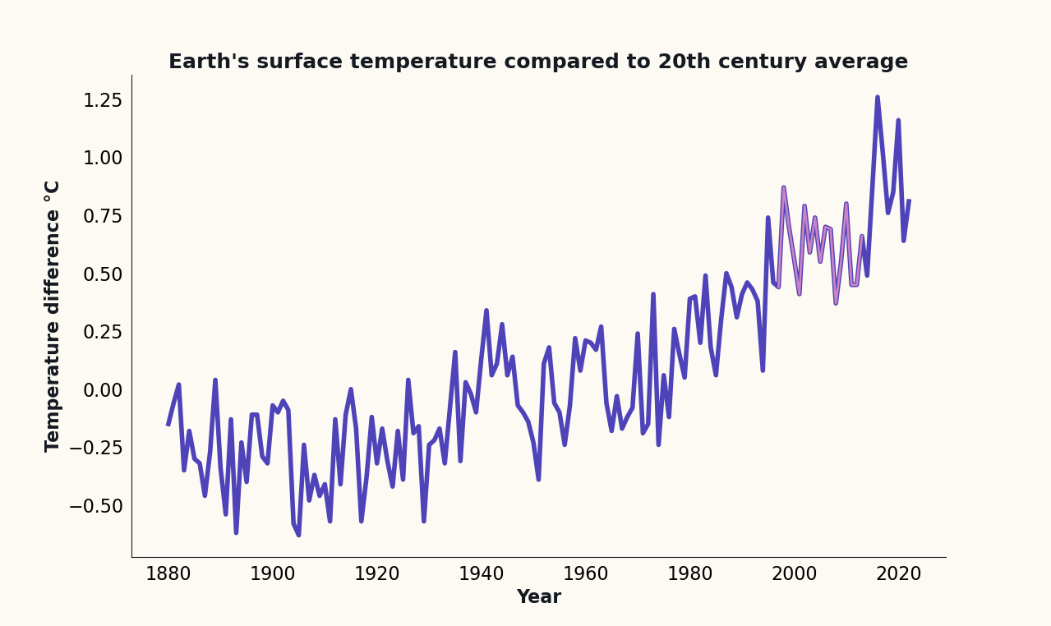
(source: NOAA)
Notes:
… you have to be careful.
Here you can see the previous graph in context. Looking at the plotted range on the graphs you’re given and considering whether you have all the context is a good practice.
I really want to emphasise, this isn’t just the benefit of hindsight.
Let’s ignore the post-2013 data. Can you see that these data are pretty variable year-on-year? The trend is upwards, but it’s really ‘noisy’.
A plateau in temperature for over a decade isn’t unusual, but the overall trend is clear.
If you’d looked at this in 2012 with the full context you could still have understood that the plateau in the 2000s isn’t remotely conclusive.
Selecting a subset of data to make the story you want to tell ‘clearer’ is a bad practice - we call this cherry-picking.
I told you earlier that you sometimes have to do the hard job of figuring out how a visualisation might be downplaying or hiding data. This is one example of what to look out for.

Slide 15
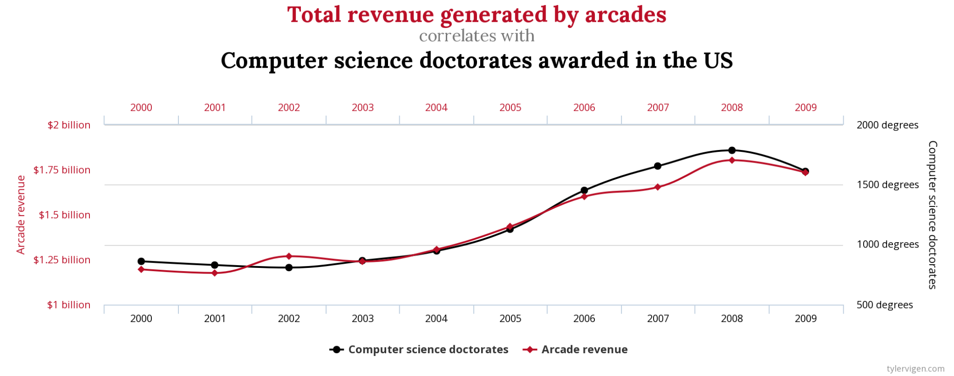
Correlation = 98.5%/R=0.985
(from Tyler Vigen’s Spurious Correlations project)
Notes:
Here’s another.
There can sometime be good reasons to plot two quantities on the same plot using different vertical axes … but always remember:
Correlation does not imply causation
If two quantities are correlated, it could be because one influences the other. It could also be that they are both influenced by some third factor, whether real or to do with the way the data were collected. But … it could also just be a coincidence.
The era of Big Data has made this last issue a much bigger problem. The ‘Spurious Correlations’ project is a fun demonstration of that.
If you just go looking for a correlation, any correlation, and the dataset is big enough, you’re going to find some correlations! We call this ‘data mining’.
Throw in some carefully chosen double y-axis ranges and we can surely come up with a compelling story about how Computer Science PhDs actually spend their research funding…
The problem, of course, starts when you try to make decisions based on this, thinking it to be predictive of the future!
In the bottom right I’ve included a summary statistic, telling you the correlation is greater than 98%. [You have to be cautious…]

Slide 16
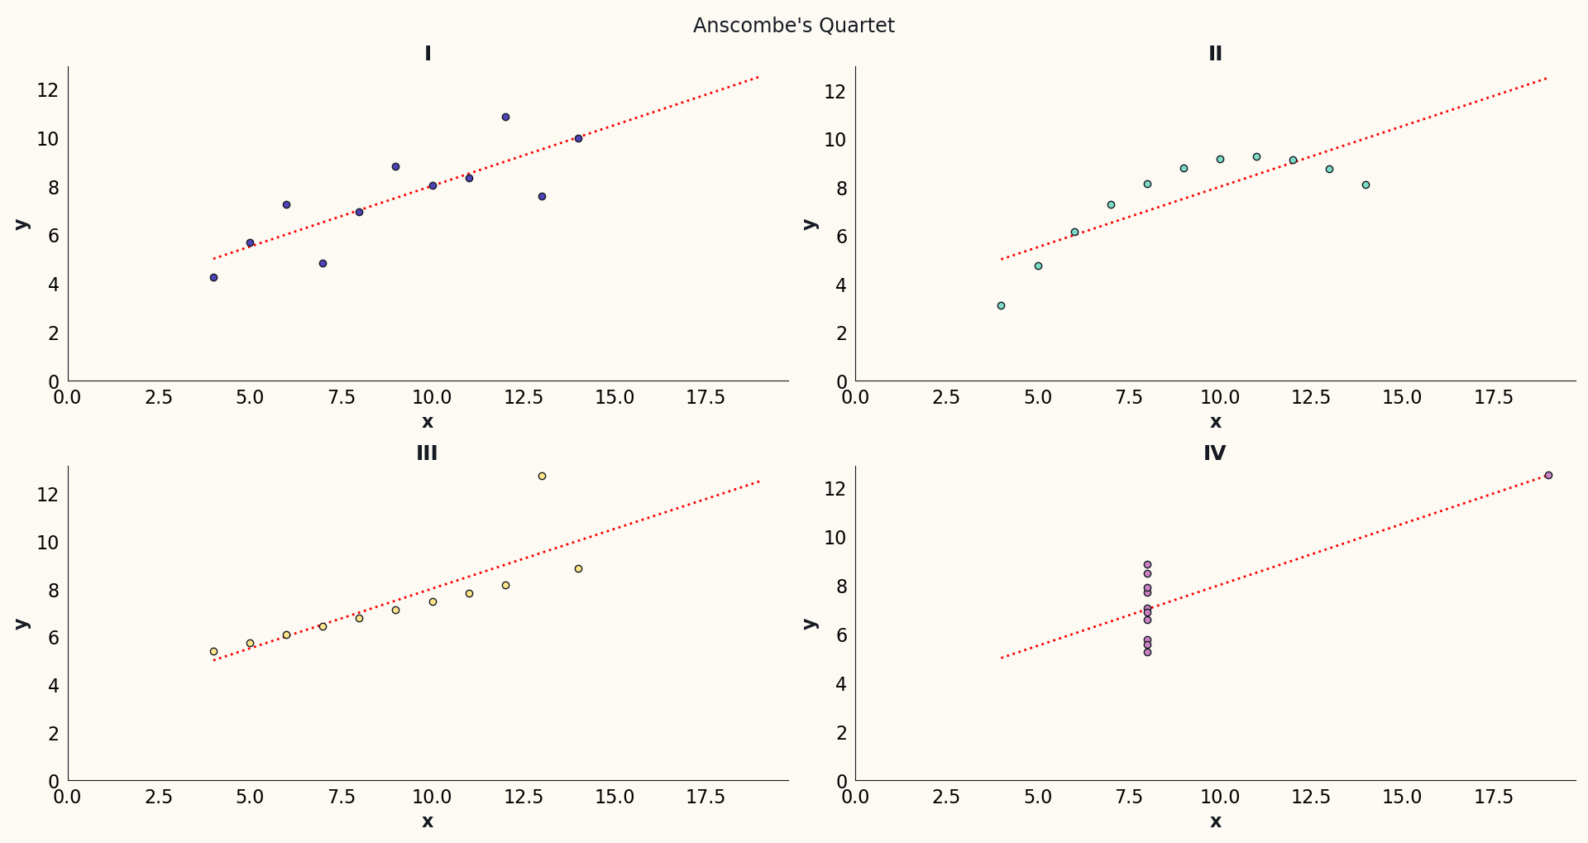
Notes:
You have to be cautious of such things. Here is a famous combined dataset called Anscombe’s Quartet.
These four sets of data have exactly the same correlation and various other summary statistics. But a visualisation reveals more information - the story for each of these four is quite different.
This doubles as a warning: beware of trendlines! A trendline is a way of implying that you can extrapolate from the data, that you can predict things. In other words, it represents a simple model. A trendline should never be added carelessly.
Anscombe’s quartet consists of some exaggerations of real situations that might arise:
I - trendline is quite appropriate, the data increase linearly with a small scatter
II - a linear trendline is inappropriate, this is a curve - a completely different model is needed
III - a linear trendline is appropriate, but the fit is being skewed by a single outlier - the real trend is different and the correlation is probably much stronger
IV - a single datapoint strongly leverages the trendline. The x=8 points have quite a broad scatter and we know nothing about what happens in between the groups. There may not be any link at all between X and Y in this case!

Slide 17
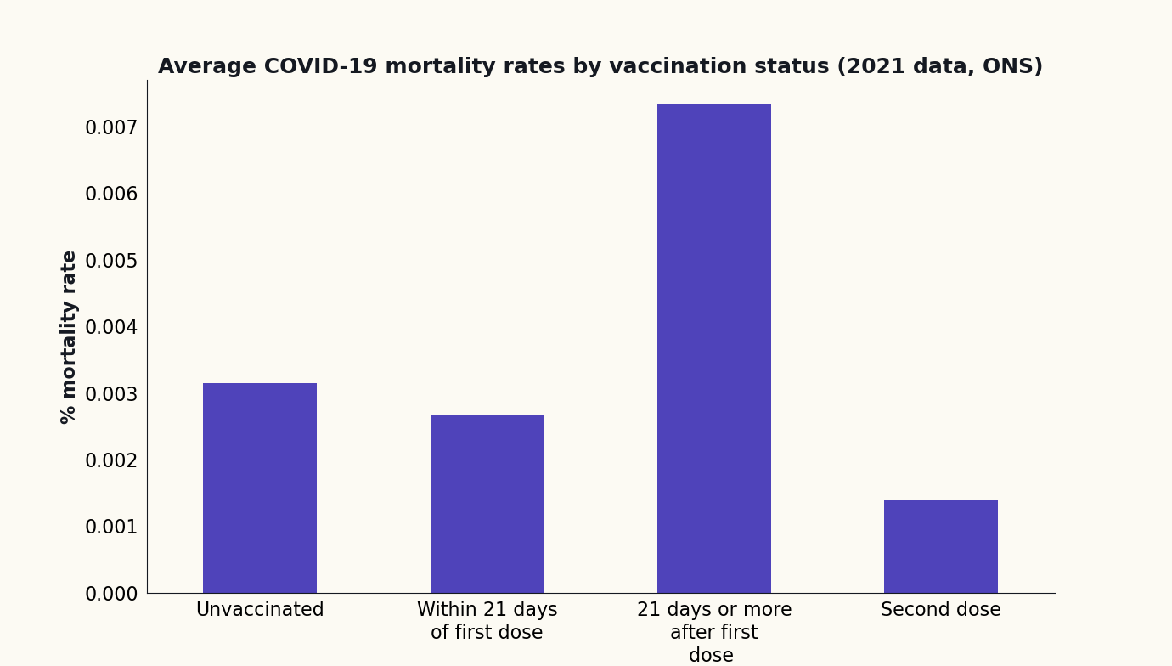
!?
Notes:
Sometimes there are more subtle issues with data visualisations.
Here’s an apparently bizarre finding:
In the UK during the first nine months of 2021, people who’d had one vaccination for COVID-19 (and waited a long enough time for immunity to develop) had higher mortality rates than the completely unvaccinated…
There’s nothing wrong with this graph or with the underlying data. But we are lacking some important context.
This is example of something called Simpson’s Paradox, and you’ll be relieved to know I’ll now show you the resolution.

Slide 18
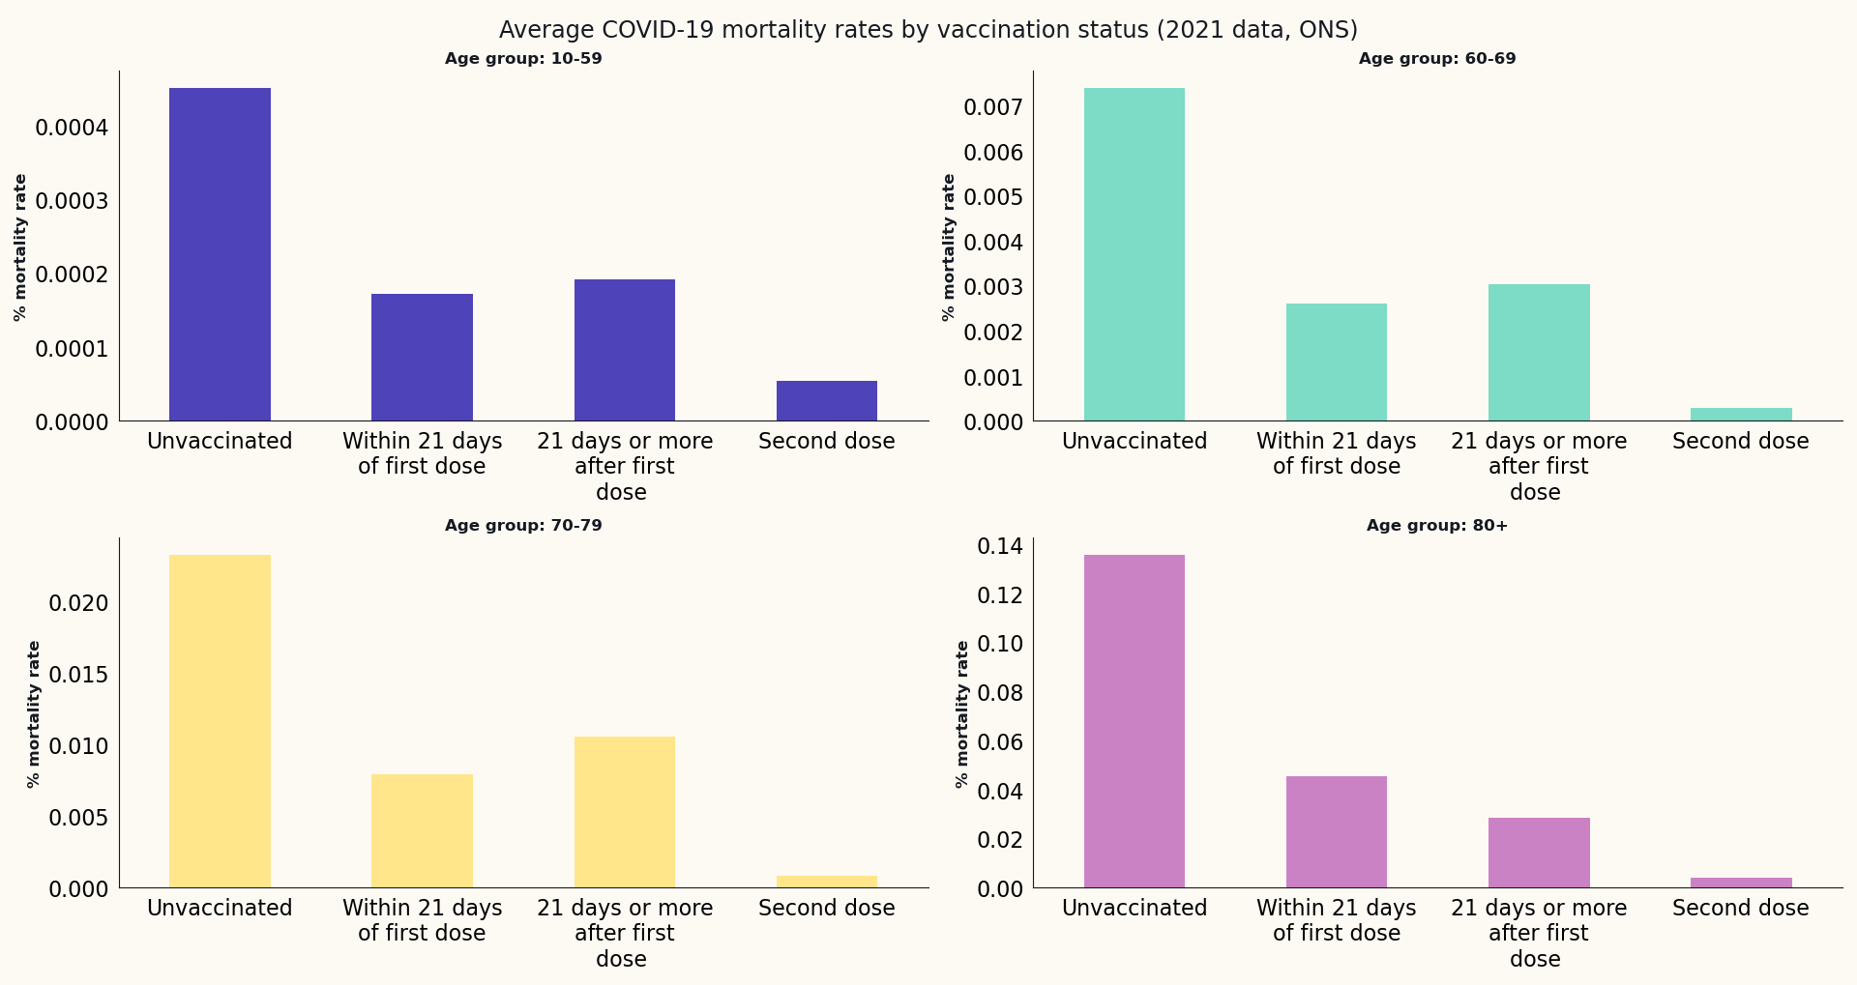
Notes:
Here I’ve broken down the same data by age group. In every single age group the mortality rates are highest in the unvaccinated group.
So how can it be that in the aggregated data, mortality rates are higher in those who’ve had one dose of vaccine?
Well, it’s quite simple:
Older people tend to be many times more vulnerable than younger people
For this reason the UK prioritised people in reverse age order for vaccines
During 2021, the older you were, the more likely you were to have been vaccinated
Getting vaccinated once brings your risk, as an elderly person, down a lot - but not to the level of a young person
The result: in every age group we see vaccinations decrease mortality risk, but if you look at the entire population during this particular time frame, the rate increases after one dose.
That’s Simpson’s Paradox.

Slide 19
Thank you
Notes:
When I showed you the Data Pyramid at the start, I told you that the ultimate aim is to build wisdom, by which I meant the creation of models for the world that can be used to decide how to act. It’s important to keep testing and refining those models with new data.
To do that, you need to be able to effectively and reliably develop your knowledge of the area into which you’re seeking insight. Having a good understanding of how to interpret graphs and summary statistics will help you to do that - and avoid being misled, whether maliciously or accidentally.
Of course, it takes practice and we’ve only scratched the surface of this important topic, but I hope I’ve inspired you to go further.
In the meantime, we can move on to the Q&A, in which I’ll be happy to answer your questions.

