Slide 1



Inclusive Data Charter
Apolitical Data Conference

Slide 2






























Inclusive Data Charter Champions

Slide 3
Five principles of the Inclusive Data Charter
1
2
3
3
4
5
All populations must be included in data and able to shape data processes.
All data should, wherever possible, be disaggregated to accurately describe all populations.
Data should be drawn from all available sources.
Those responsible for the collection of data and production of statistics must be accountable.
Human and technical capacity to collect, analyze, and use disaggregated data must be improved, including through adequate and sustainable financing.
Full principles available here.

Slide 4

The UK government guided by civil society and academia through an independent Inclusive Data Taskforce
Led consultative activities with the public, civil society, academia, local authorities, devolved administrations and central government
Identified critical data gaps and excluded population groups; technical and methodological challenges; and barriers to people’s participation in data activities.
Recommendations put forth by the Taskforce
Committed to pursuing key activities to fulfil recommendations and progressing a high-level work program

Slide 5
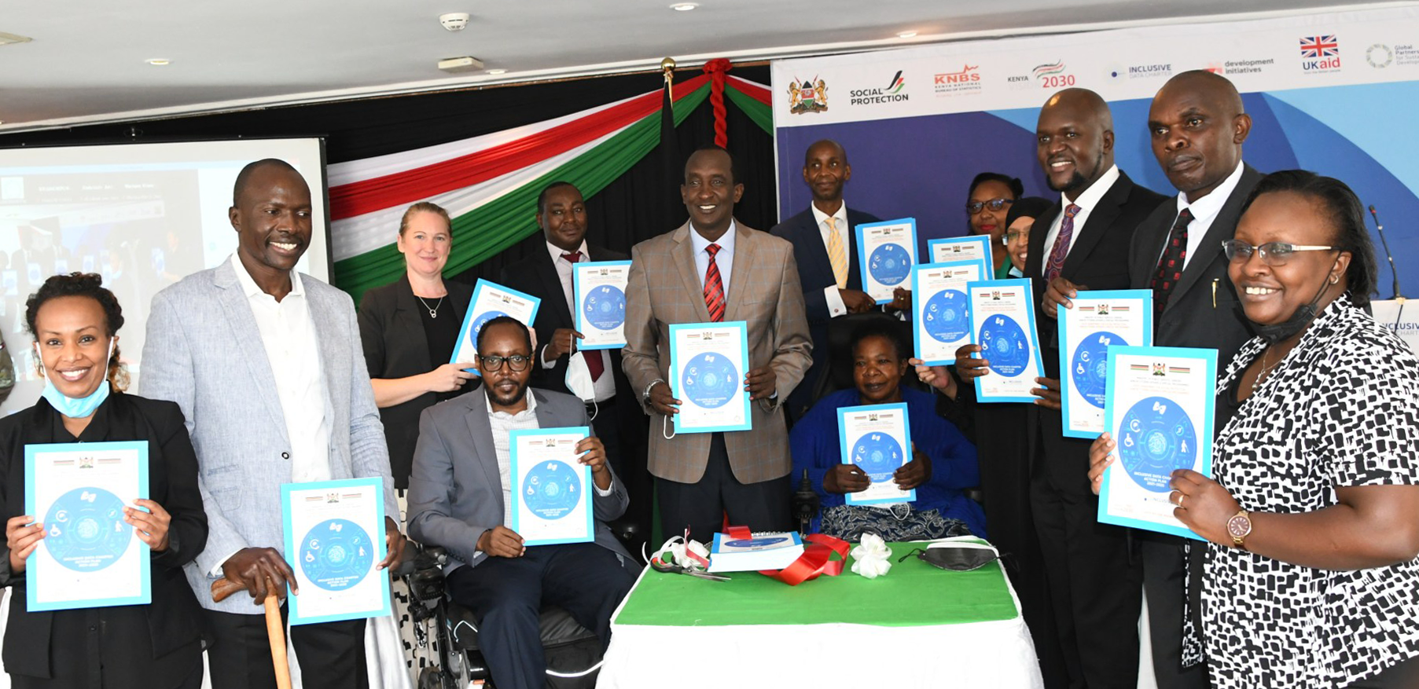
The Government of Kenya took a participatory approach to address a lack of disability inclusive data
Initiated a participatory consultation to define priorities and develop action plan
Organizations of persons with disabilities shaped the gap assessment and informed the activities and processes taken forward
Strengthened government agencies’ cooperation and streamlined data practices
Commitment to generate and use data to empower and include persons with disabilities in employment and social programs

Slide 6
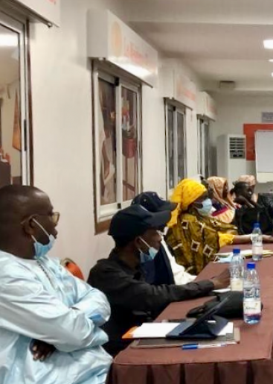
200 community members and 40 civil society organizations shape the Government of Senegal’s approach
Coalition of civil society organizations and the government began a national dialogue on inclusive data
Consulted with young people, women, persons with disabilities, and local farmers on data
Developed broad consensus on priority data gaps and deepened political will
Participatory process to define Government’s action plan on inclusive data.

Slide 7

To address historical inequities, the Government of Colombia adopt an intersectional and differential approach to data
Institutional recognition that data did not reflect pervasive inequities and was contributing to the marginalization of certain communities.
Developed and rolled-out new guidelines for mainstreaming a differential and intersectional approach in national statistical production
Co-developed global guidance on intersectional approaches to data, alongside several other IDC Champions

Slide 8
For questions, contact krichards@data4sdgs.org
Visit https://www.data4sdgs.org/initiatives/inclusive-data-charter for more information.

