Slide 1


Solve Both or Solve Neither
Tackling the Biodiversity and Climate Crises
Bee Morgan
Notes:
Hello everyone and welcome my presentation on Climate Change and biodiversity loss – My name is Bee and I am a UK civil servant.
Before I begin, If you didn’t recognise the background, this series of stripes represents the global average temperature for every year since 1850 in the form of a coloured line. The darker the colour, the further away from the average value. As you can see, temperatures today are well above historical records.

Slide 2
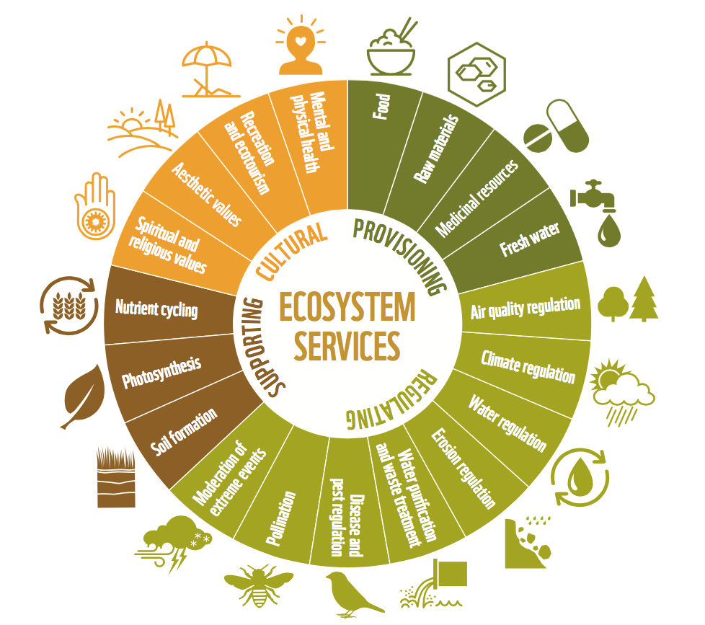
The Importance of Biodiversity
Ecosystem - a biological community of interacting organisms and their physical environment
Biodiversity - the biological variety and variability of life on Earth
Extinction - permanent and irreversible loss of nature
Ecosystem Services – the varied benefits to humans provided by the natural environment and from healthy ecosystems
Notes:
Typically, when you think of ‘doing your bit for the environment’, your mind instantly goes to reducing your carbon emissions because of climatic warming. We all recognise climate change is a big issue. What you don’t think of is the wider ecosystem. This subtle exclusion of the full biosphere in ‘environment’ (which are really ‘climate and carbon’) conversations, means the standalone issue of biodiversity loss is not given the recognition it needs.
Biodiversity, for those that don’t know, is the biological variety and variability of life on Earth. It’s a measure of variation at the genetic, species, and ecosystem level.
Biodiversity loss is a major issue - The global rate of species extinction is already at least tens to hundreds of times higher than the average rate over the past 10 million years and is accelerating. Biodiversity is important because it allows the functioning of the essential, and often irreplaceable, ecosystem services society relies on; for example nature’s ability to cycle nutrients and water through soil so we can grow crops, or provide protection for our coasts from erosion and flooding. Their estimated annual global worth of is 125-140 trillion USD, more than 1.5 times the size of global GDP.

Slide 3
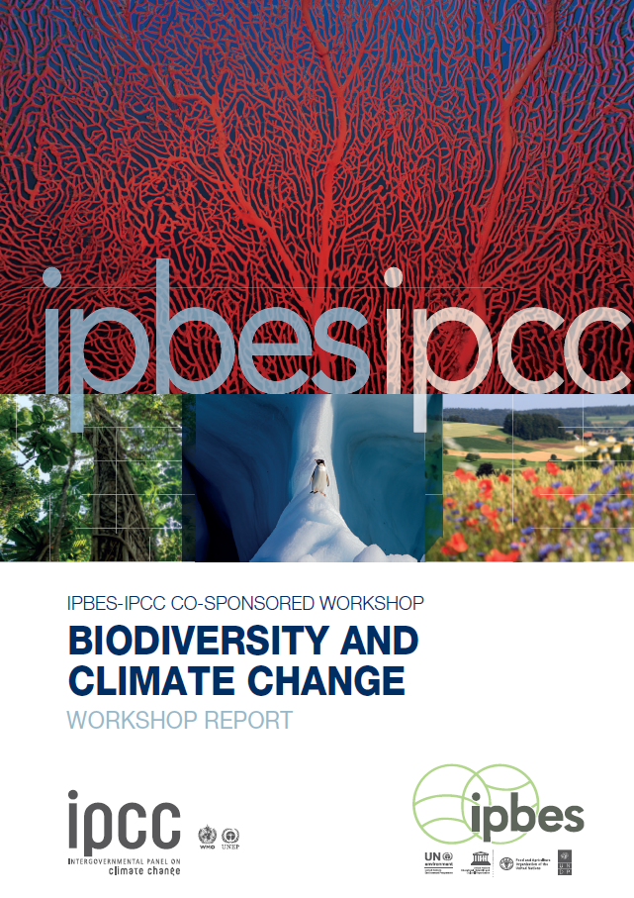
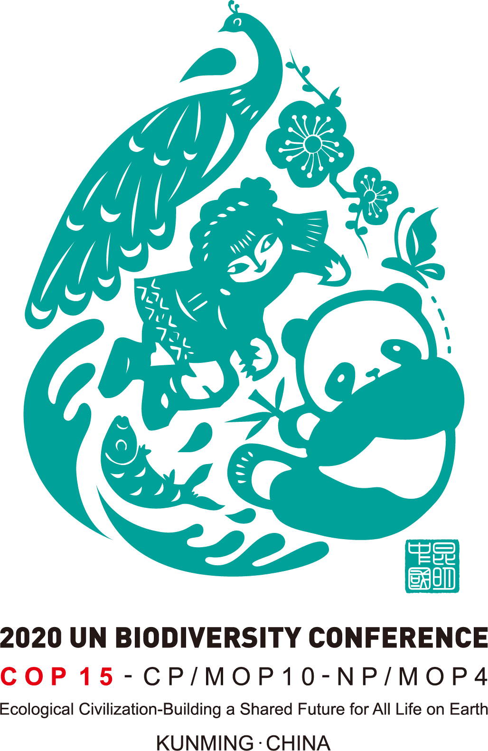
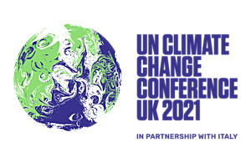
UN IPBES & IPCC Report
Limiting climate change and biodiversity loss are ‘mutually supporting goals’.
Policies that simultaneously address both are the best at maximising co-benefits, minimising trade-offs and reducing mutually harmful effects.
Strong potential for nature-based solutions for both climate
mitigation and adaptation
Notes:
Last year, the UN biodiversity body and the UN Climate body (IPBES and IPCC) published a landmark joint report, timed to be in advance of both COP26 (the big UK UN Climate conference last November), and the convention on biological diversity (CBD) COP15. The latter of which has been delayed until later this year. The report outlines the intersection of the crises, as both cause devastating impacts to ecosystem services, and reinforces that reversing them is intrinsically interconnected and a mutual goal. We need Science and policy that looks to solve both simultaneously if we are to maximise the co-benefits for a sustainable future. It also details key biodiversity loss issues, as well as highlighting the importance of nature based solutions (which I’ll come onto later) for both mitigation of climate change and adapting to new warming temperatures

Slide 4




The Headline Issues
Climate change is recognised as a major driver of biodiversity loss
The ability of ecosystems to respond to climate change decreases as temperatures rise
Biodiversity loss and climate change can create a negative feedback loop, continuing to reinforce each other
Achieving the scale and scope of transformative change needed relies on rapid and direct interventions of a type ‘never before attempted’
Notes:
So what does the report actually say?
On land, the impacts of climate change on the diversity of plants and vertebrates are predicted to exceed those of land use by 2050 – climate change is a major issue in driving biodiversity loss. It details how as climate change progresses, the distribution, functioning and interactions of organisms, and thus ecosystem services, are increasingly altered. Most species simply can’t adapt to fast, large degrees of warming, particularly those at the poles and coral reefs which are seeing the most extreme changes. We are expected to lose 99% of Tropical corals at 2ºC compared to 30% at 1.5 C - highlighting the importance of keeping climate change as low as possible .
The negative feedback loop can be illustrated through the decline in the population of Bees and other insects: Climate change has caused changes to the habitats they live in, with more extreme temperatures and altered precipitation patterns pushing these insects to their limits. As a result, these species are dying out, and the reduction in pollinators has a knock-on effect on entire ecosystem, including the reproduction of plants which are key stores of carbon, exacerbating the warming and subsequent impacts.
Most importantly, the report states how the scale and scope of transformative change needed to reach the goals of COP26 and the upcoming COP15 requires direct, rapid and far-reaching actions (including targeted conservation and strong adaptation efforts), which are on a scale never before attempted. The previous decade’s global biodiversity targets were not met, and the urgency for biodiversity protection must rapidly expand in ambition and scope. The post-2020 biodiversity framework (aiming to reverse biodiversity loss by 2050) which is set to be adopted at COP15 this year, is the most ambitious yet so there is still hope, but we must all do our bit to reduce our environmental impact on more than just emissions

Slide 5
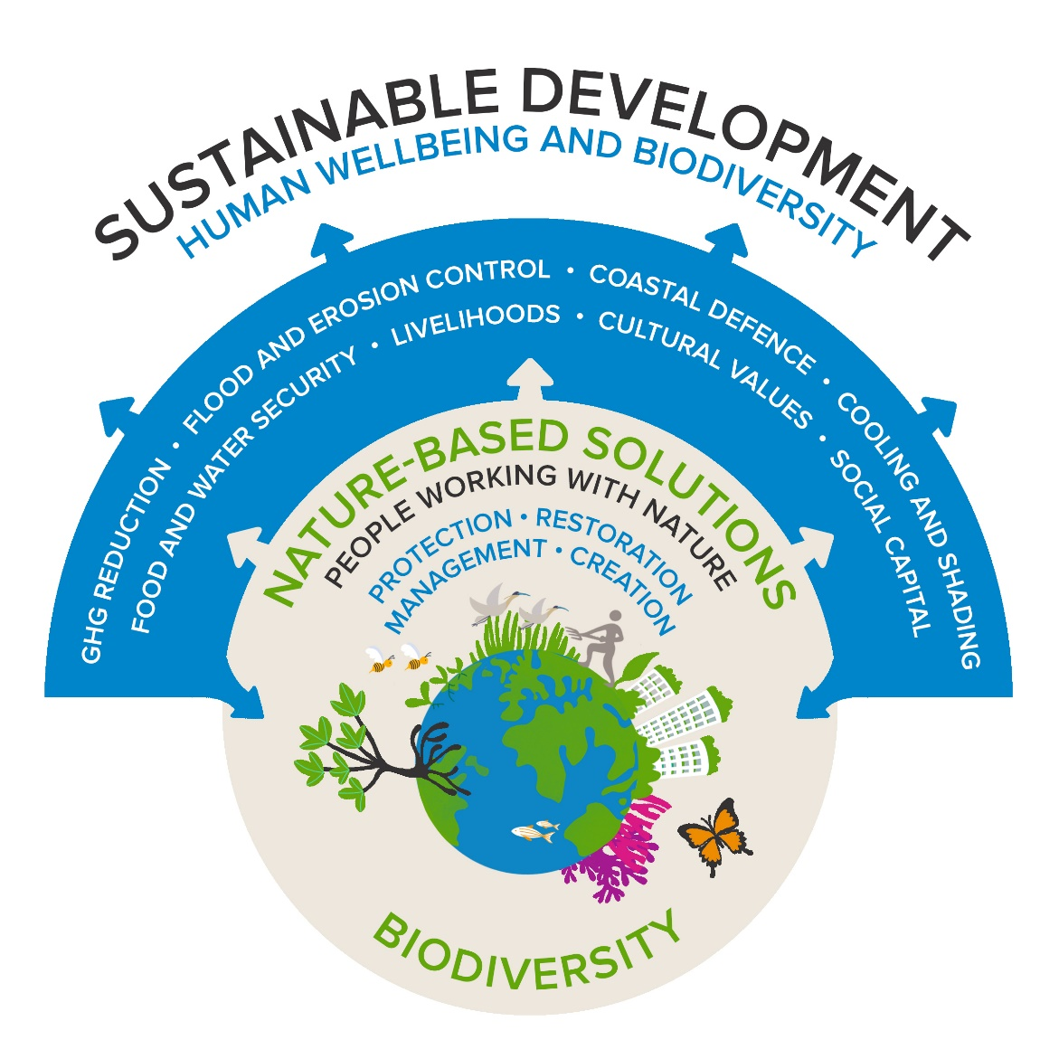
The Importance of Nature-Based Solutions
Nature-based solutions are actions to protect, manage and restore ecosystems
Nature-based solutions are best when targeted at long term gains
We must balance trade-offs - some solutions to climate change can actually be at the expense of nature and climate adaptation
They should not be used to delay climate mitigation elsewhere
Notes:
In order to reach net zero emissions, as the IPCC state, we need to actively remove carbon from our atmosphere. As the sole sinks for carbon emissions, the potential of ecosystems to absorb carbon from the atmosphere and lock it into the earth through nature-based solutions is huge – up to 60 per cent of global human annual emissions. Nature based solutions sustainably address societal challenges (such as climate change in this context) effectively and adaptively, simultaneously providing human well-being and biodiversity benefits. Nature-based solutions are estimated to provide at least 37 per cent of needed climate change mitigation to keep to 1.5°C.
For example, by restoring sea grass habitats and planting new grasses, the meadows provide homes for juvenile fish and protected species like seahorses, while also protecting the seabed from erosion, cleaning the surrounding seawater, and capturing and storing significant amounts of carbon. Per hectare, this is up to twice as much as terrestrial forests.
Carbon and species rich ecosystem restoration like in sea grass meadows is among the cheapest and most rapidly implemented nature-based climate mitigation measures. However, solutions must be targeted, well considered and continuously managed – they are the most effective when planned for longevity and not used for rapid carbon sequestration.

Slide 6
Thank You
Any Questions
Bethan.Morgan2@go-science.gov.uk
www.linkedin.com/in/beemorgan1205
Notes:
So ultimately, as I opened with, it is essential that we work to ‘solve both’ the climate and biodiversity loss crises together, and it’s time we started giving biodiversity and nature the profile they need in everything we do. Thank you and I’ll take any questions.

