Slide 1
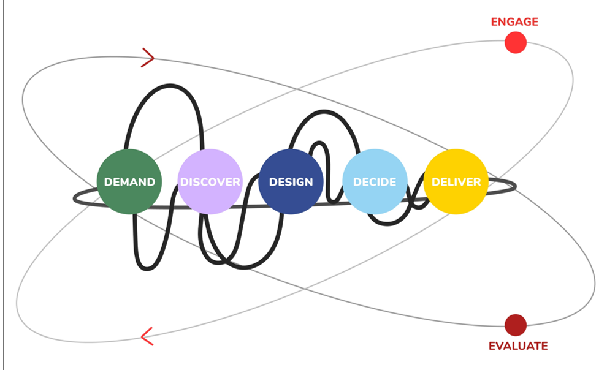



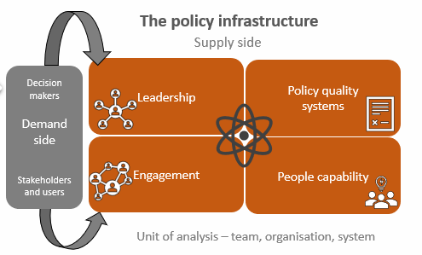
Better policy advice – an infrastructure approach
Vision: what we want to achieve
VISION: a high-performing policy function supporting good government decision-making to deliver desired social, economic and environmental outcomes.
To achieve that vision we need a shared understanding of:
Quality Policy: What does good policy advice look like, what goes into it?
Process model
Critical success factors
Tools and methods
A repeatable scalable model of the policy design process – the 5D Policy Advice value chain model
Policy toolkit
An infrastructure or systems approach to support improvement The processes, evidence, organisational and system enablers to support & enable good policy
A mutually supporting policy capability infrastructure
Leadership for transformation
Leadership , ownership and collaborative change process

