Slide 1
Creating compelling and accessible data visualisations
Catherine Hope
@CatherineCe

Slide 2
Compelling:
“evoking interest, attention, or admiration in a powerfully irresistible way”
Data visualisation:
“the representation of information in the form of a chart, diagram, picture, etc.”

Slide 3
Compelling

Slide 5
Claims to Universal Credit

Slide 6
Claims to Universal Credit peaked when Coronavirus
lockdown began
23 March,
UK lockdown

Slide 7
Claims to Universal Credit peaked when Coronavirus
lockdown began

Slide 8
Claims to Universal Credit peaked when Coronavirus
lockdown began
23 March,
UK lockdown

Slide 9
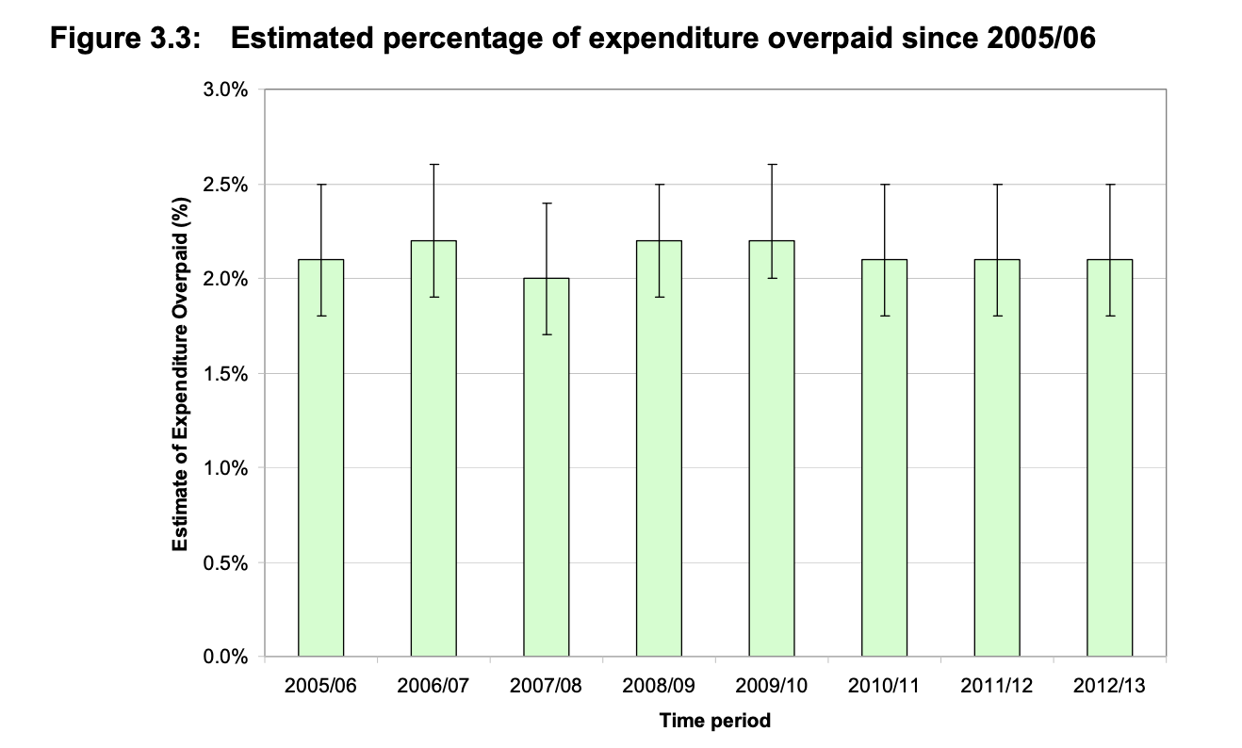
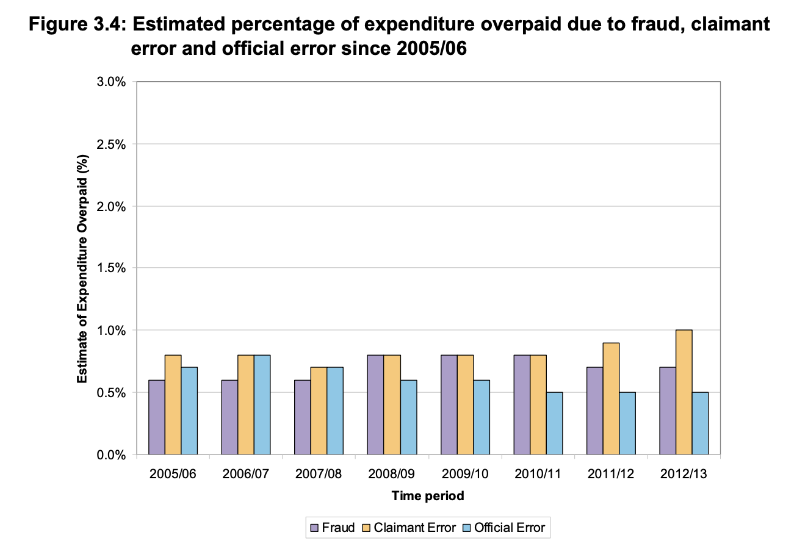
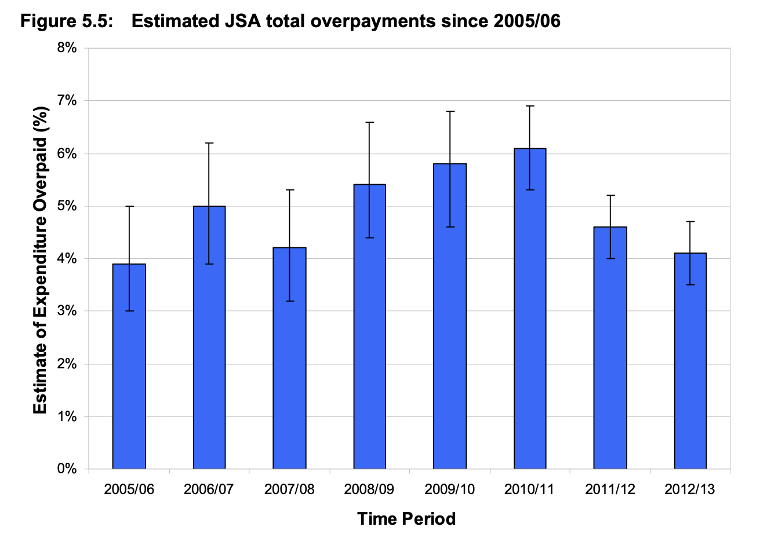
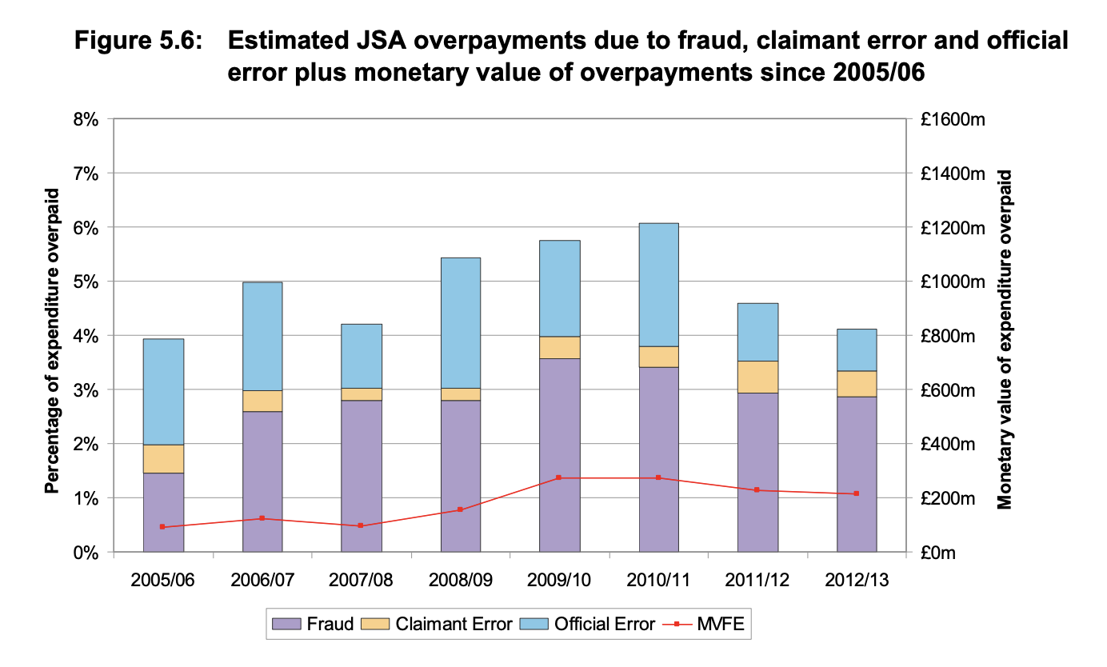
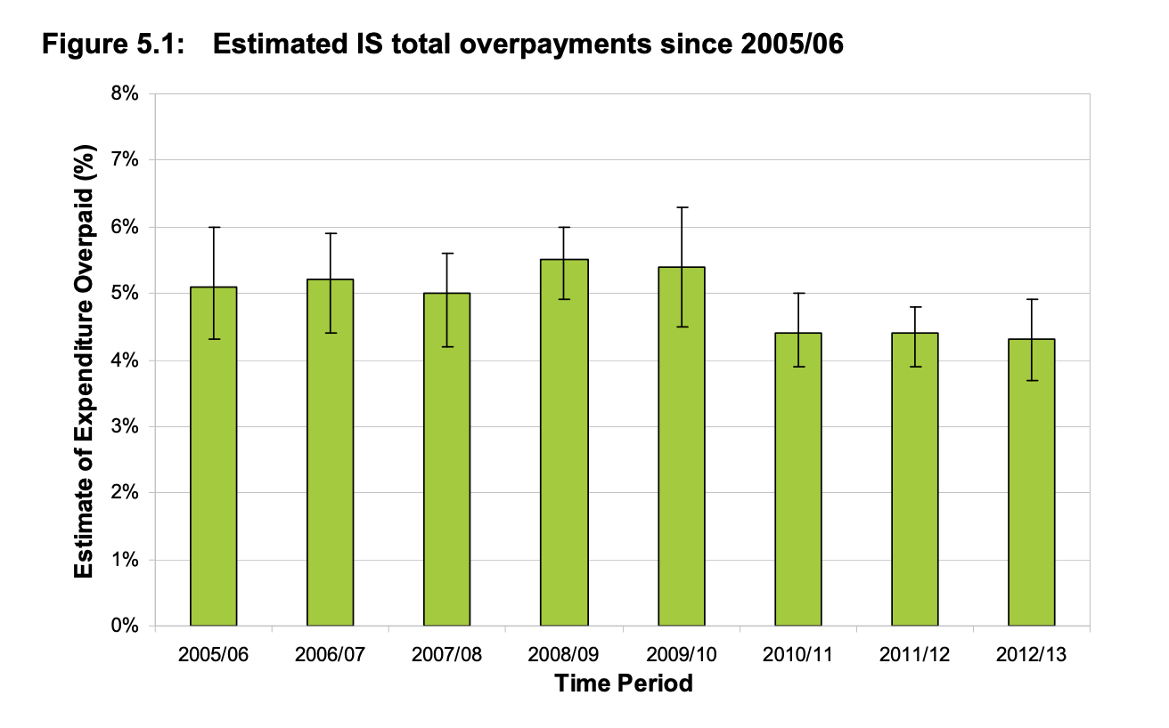
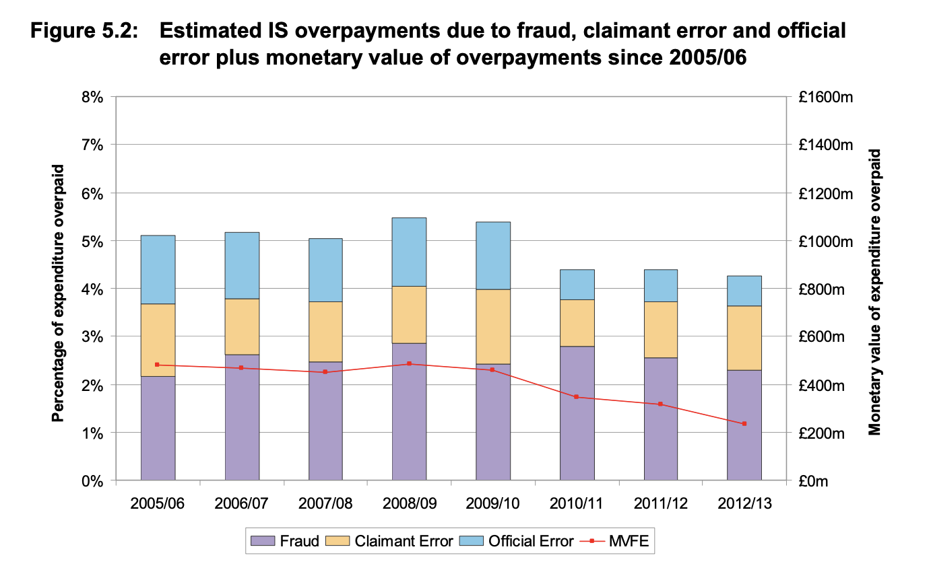
More Charts = More Compelling?
41 charts
121 pages

Slide 10
More Charts = More Compelling

Slide 11
Accessible

Slide 12
How will users access your visualisations?
Being presented to them
Accessing online

Slide 13
Accessible –
Being presented to them

Slide 14
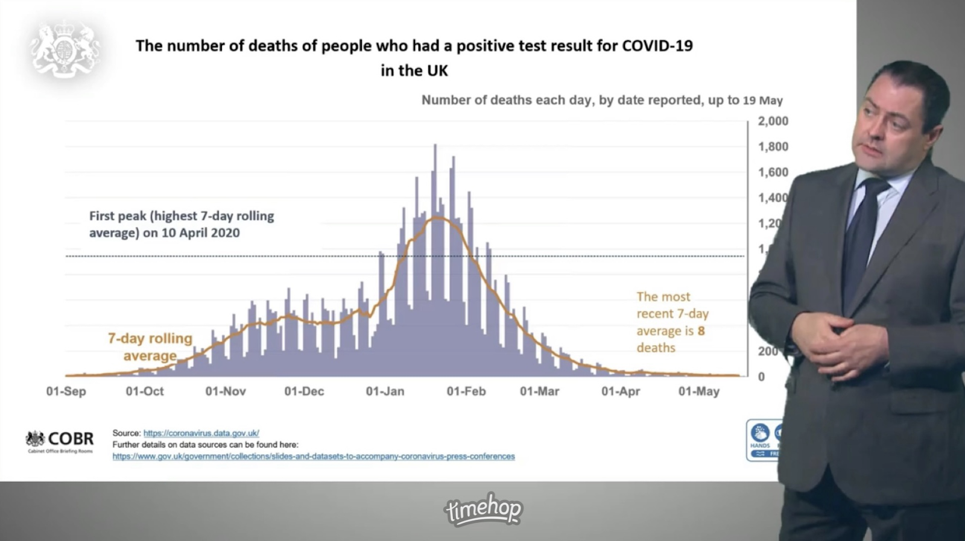
Being presented to them

Slide 15
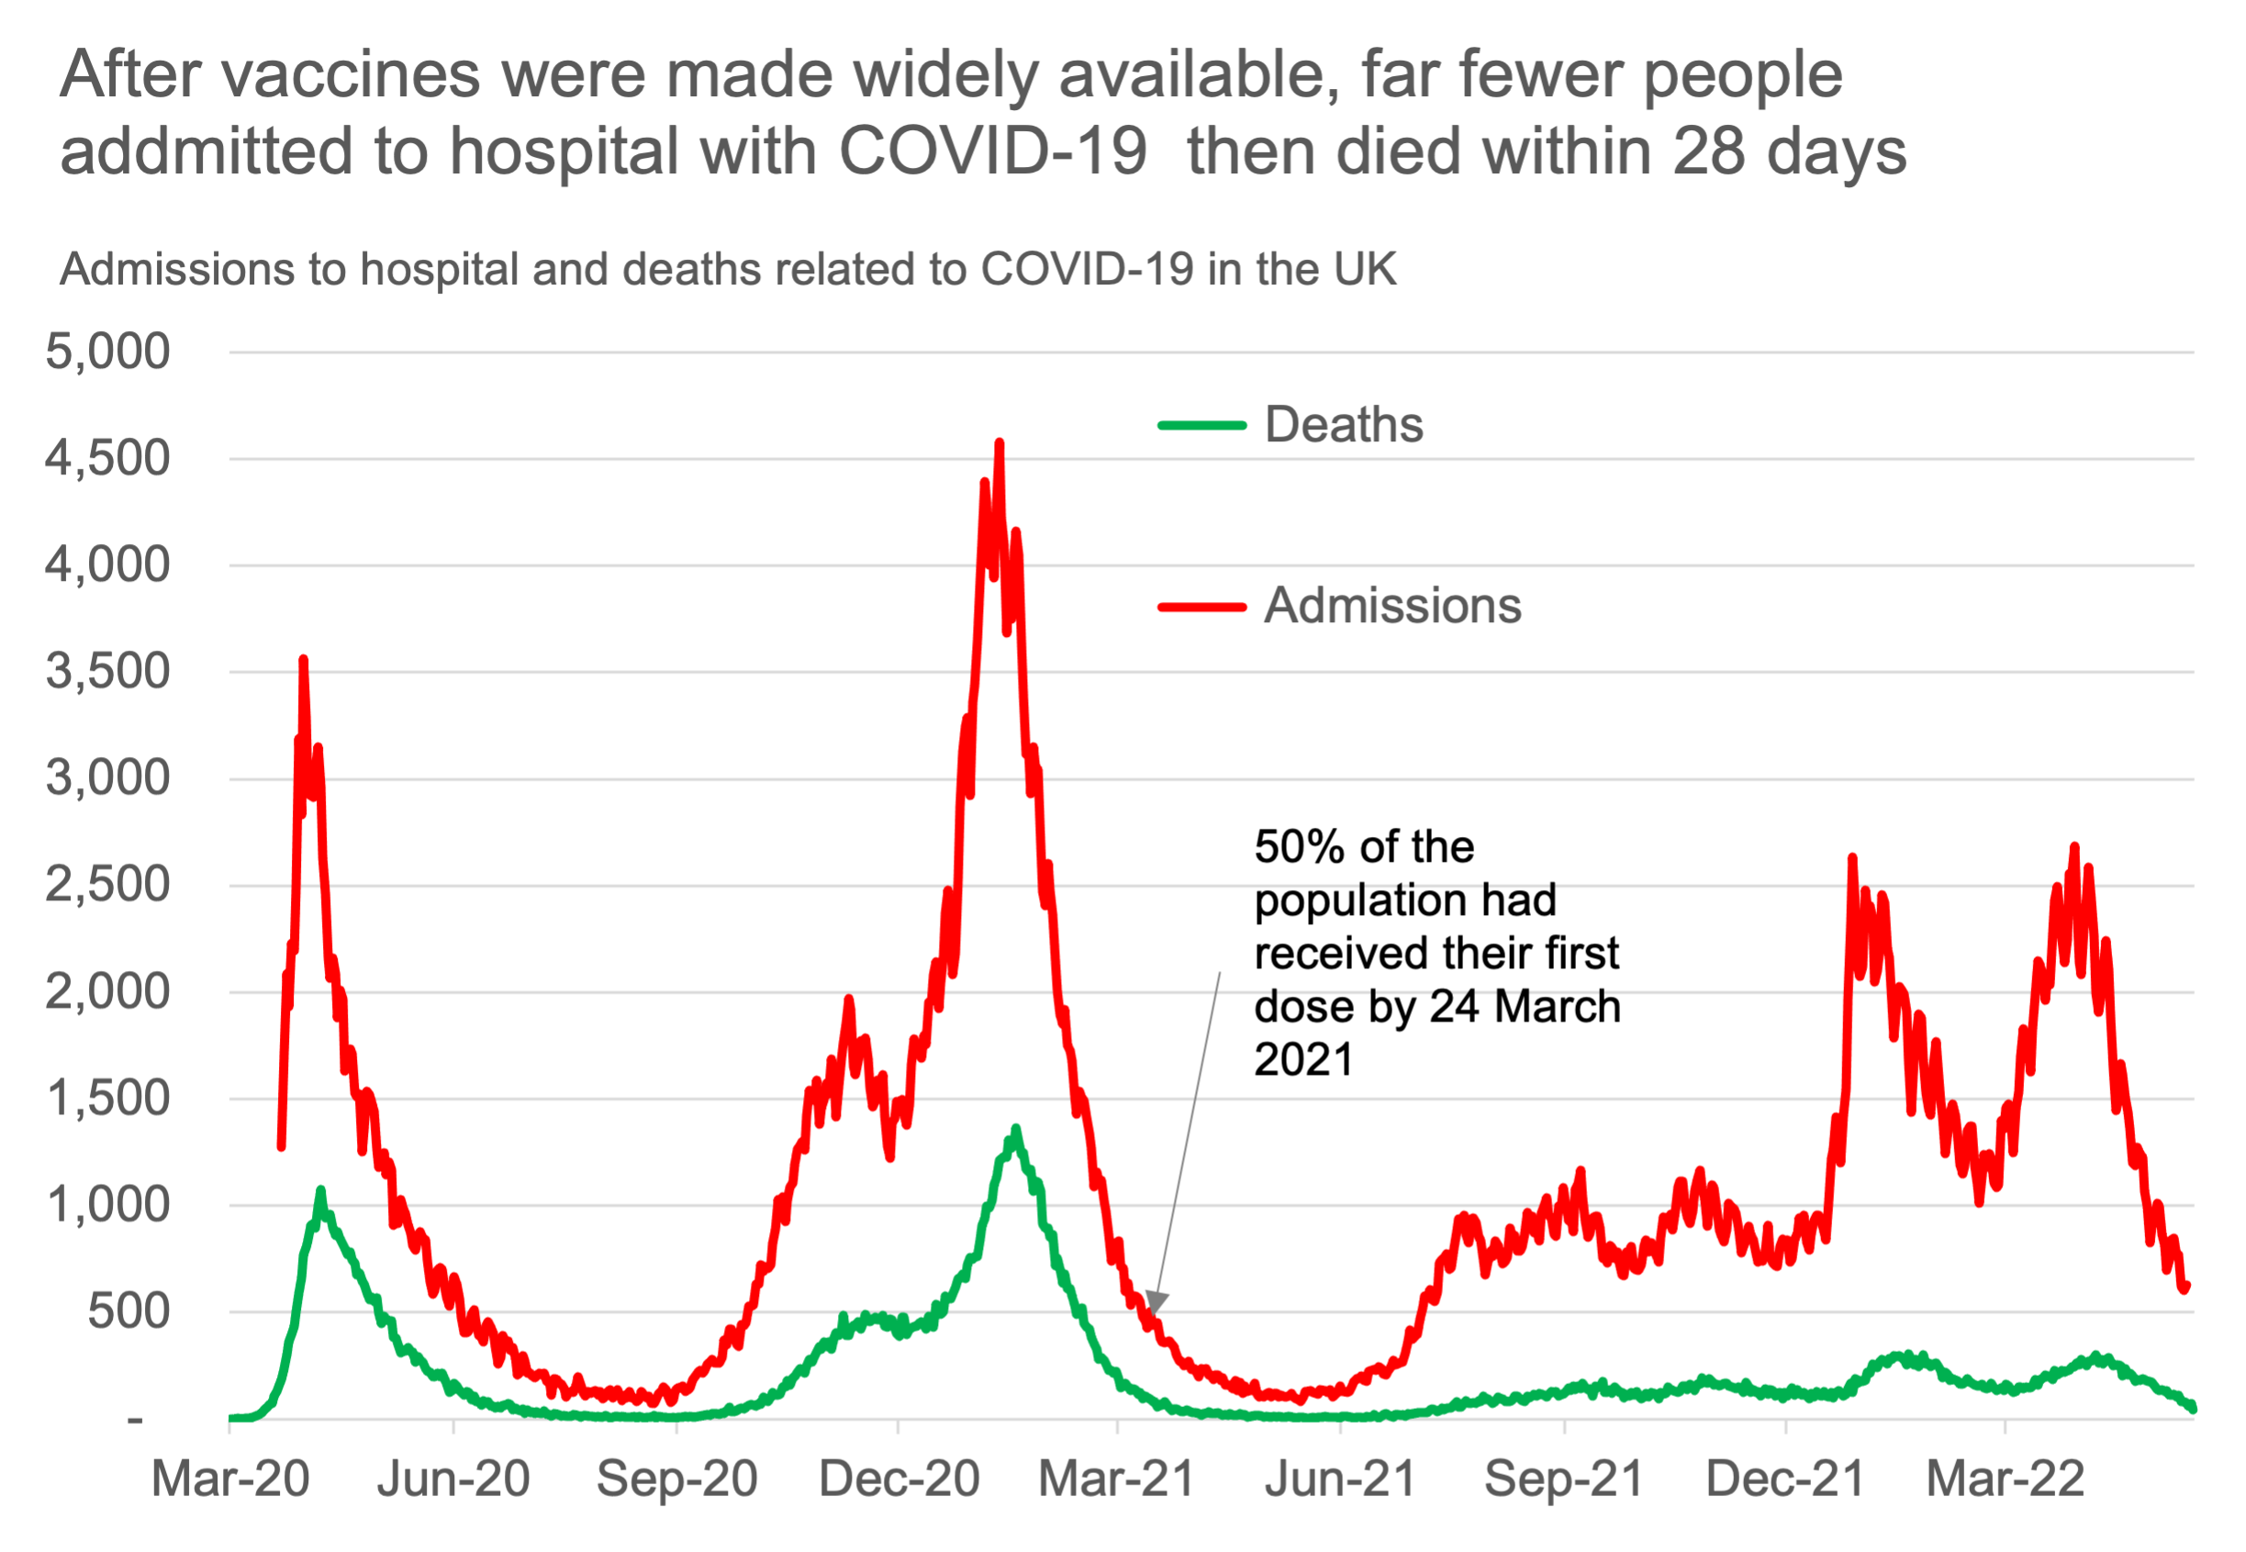
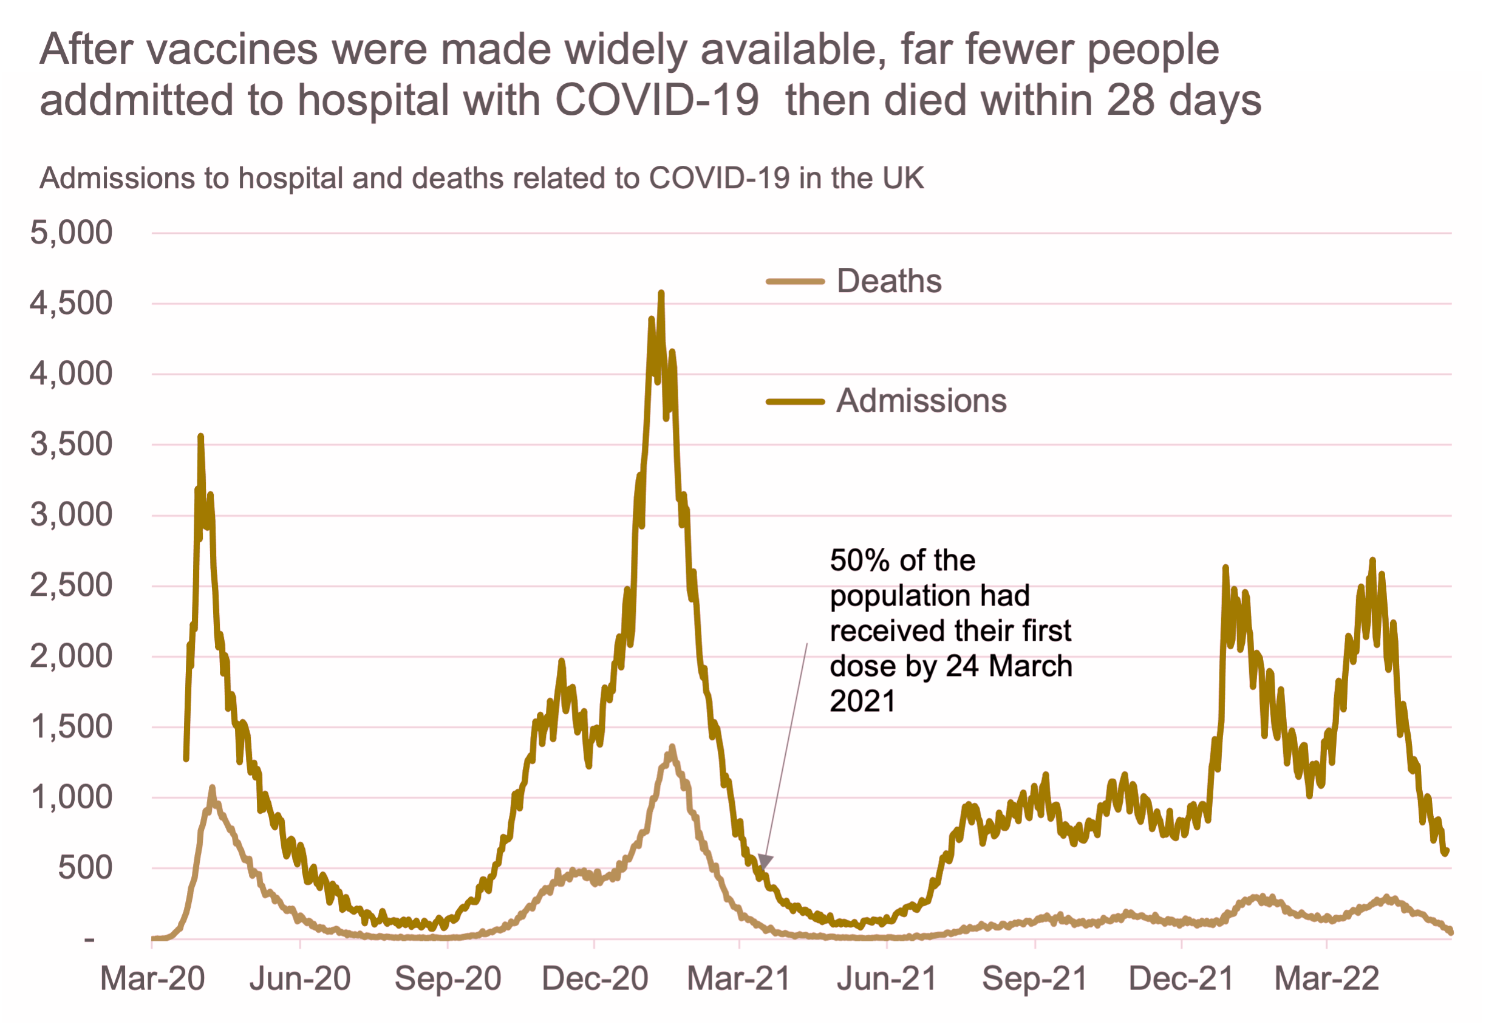
Being presented to them
Source: UK government COVID-19 dashboard
Source: UK government COVID-19 dashboard
Image created with pilestone.com

Slide 16
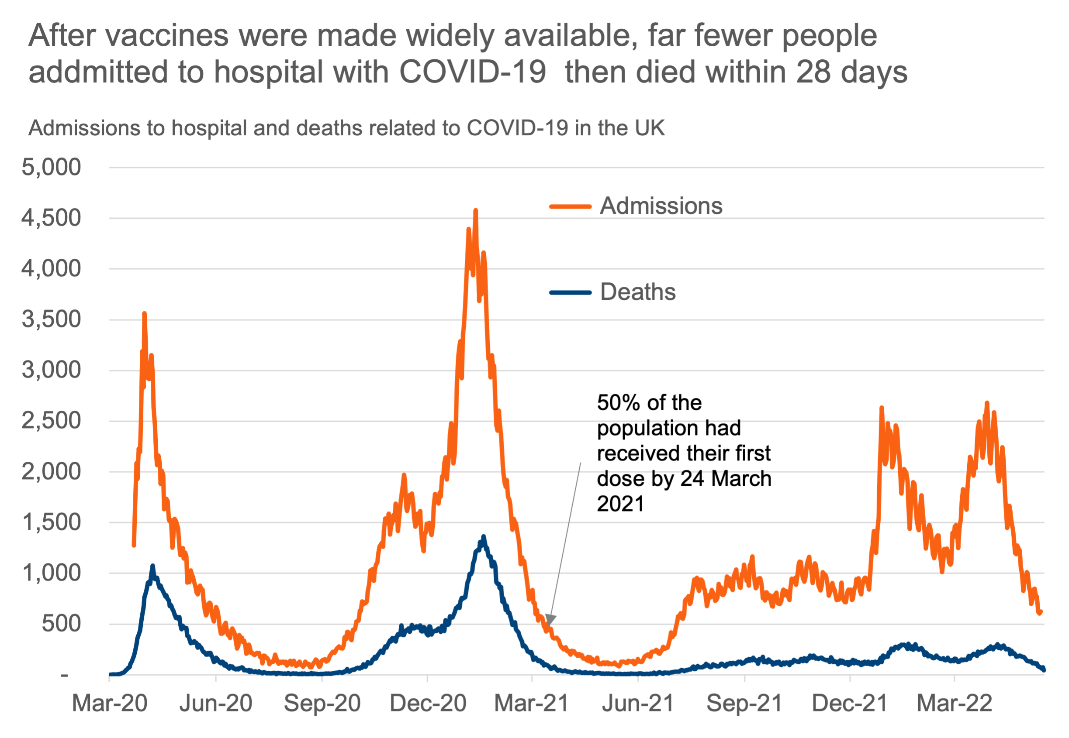
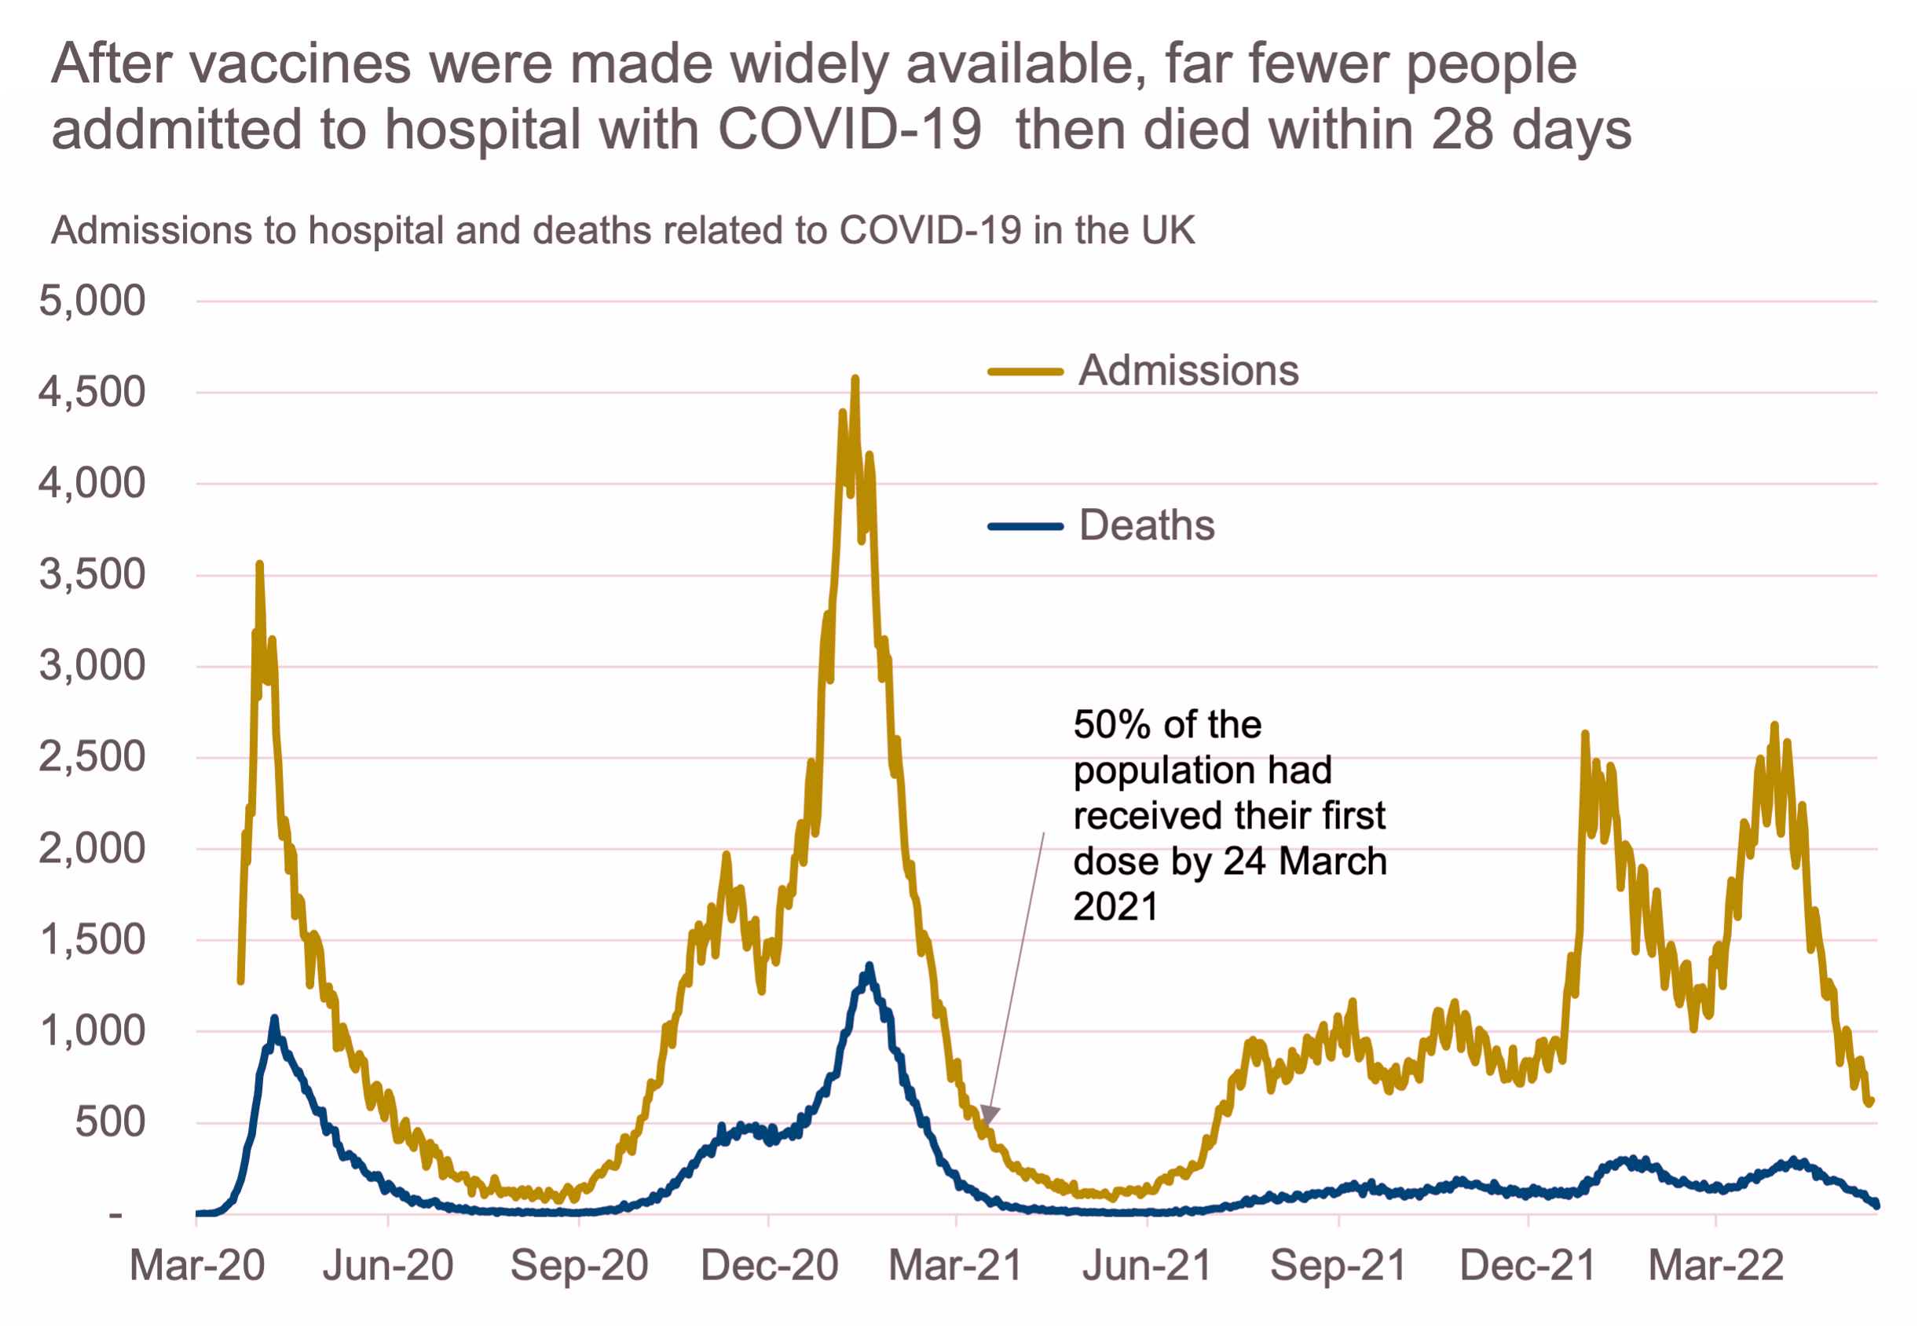
Being presented to them
Source: UK government COVID-19 dashboard
Source: UK government COVID-19 dashboard
Image created with pilestone.com

Slide 17


Slide 18
Accessible –
Online

Slide 19
Accessing online
Web Content Accessibility Guidelines or WCAG
Perceivable
Operable
Understandable
Robust

Slide 20
Perceivable
Make it easier for users to see and hear content.
Provide text alternatives for non-text content.

Slide 21
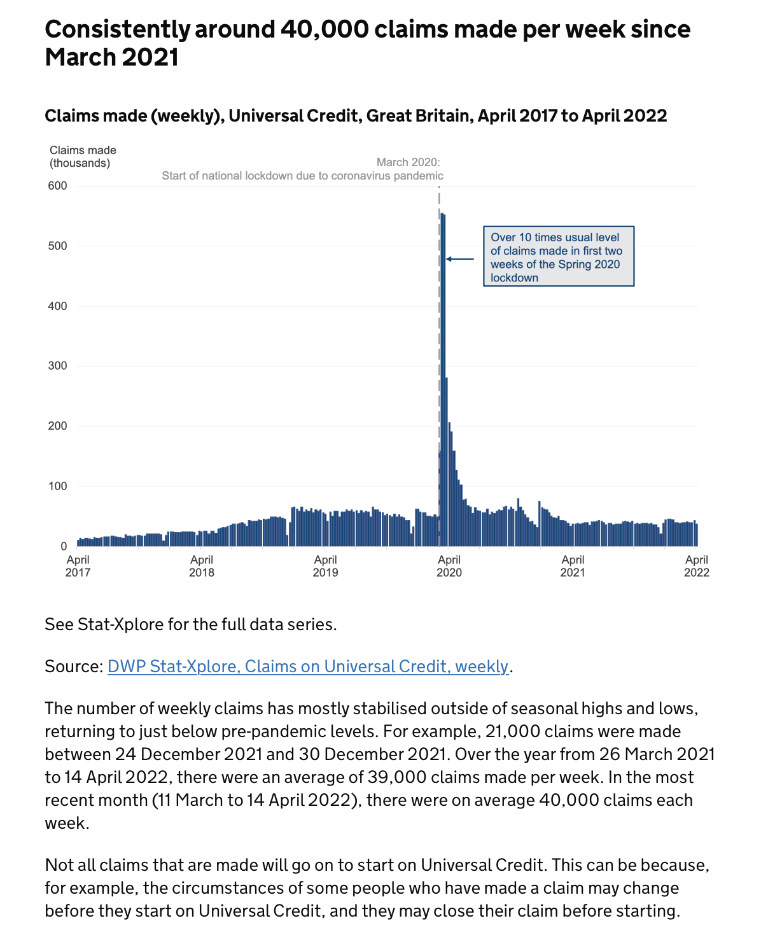

Slide 22
Operable
Make all functionality available from a keyboard.
Help users navigate and find content.

Slide 24
Understandable
Make text and charts readable and understandable.
Help users avoid and correct mistakes.

Slide 26
Robust
Maximize compatibility with current and future user tools.

Slide 27
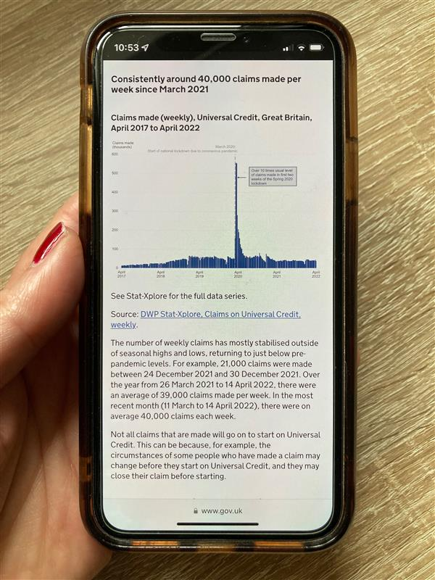

Slide 28
Accessible –
Online

Slide 29
Creating compelling and accessible data visualisations:
Focus on the point you want to get across
Use words and charts to tell that compelling story
Make your visualisations
  Perceivable
  Operable
  Understandable
  Robust

