Slide 1

  How to Nurture Neurodivergent Talent in Public Service
  Abigail Agyei – Senior Policy Advisor, Diversity, Equity and Inclusion Champion, Community Builder and Neurodiversity Advocate

Slide 2
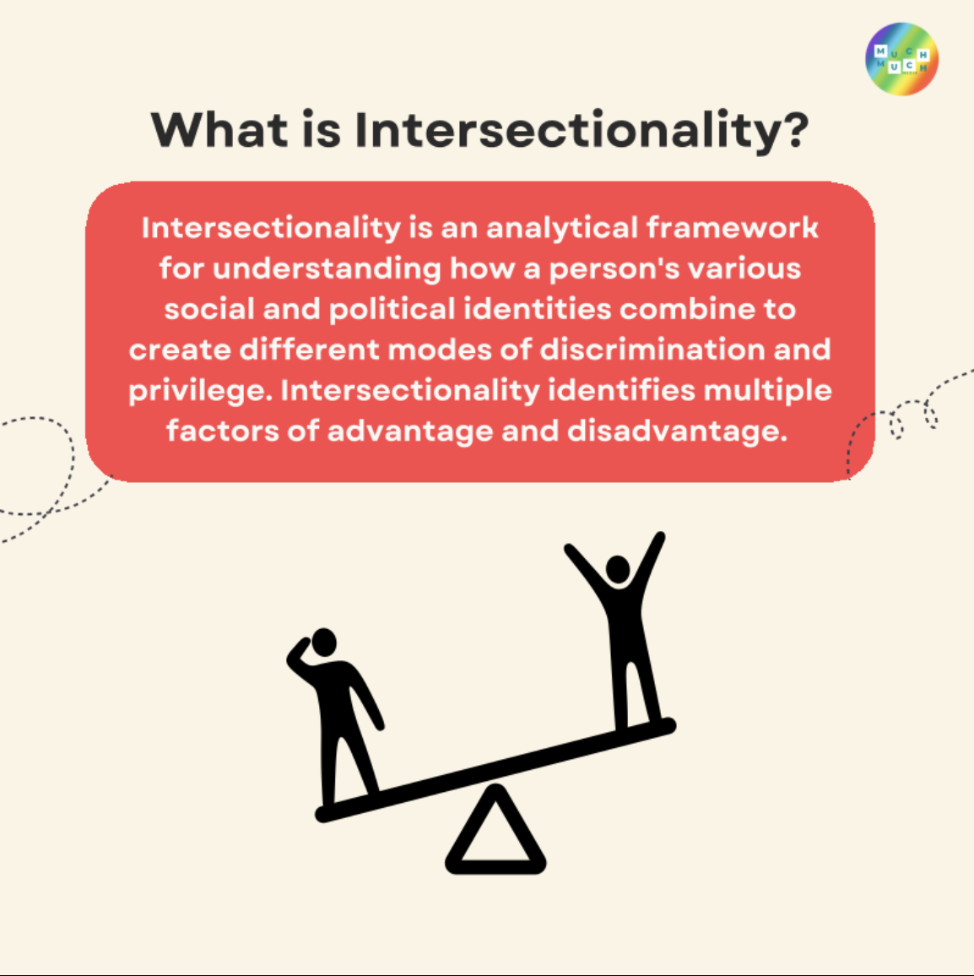
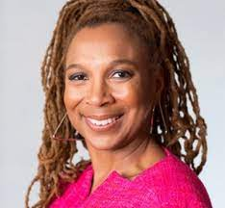
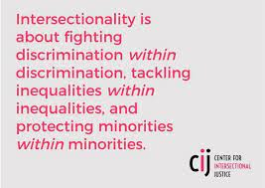
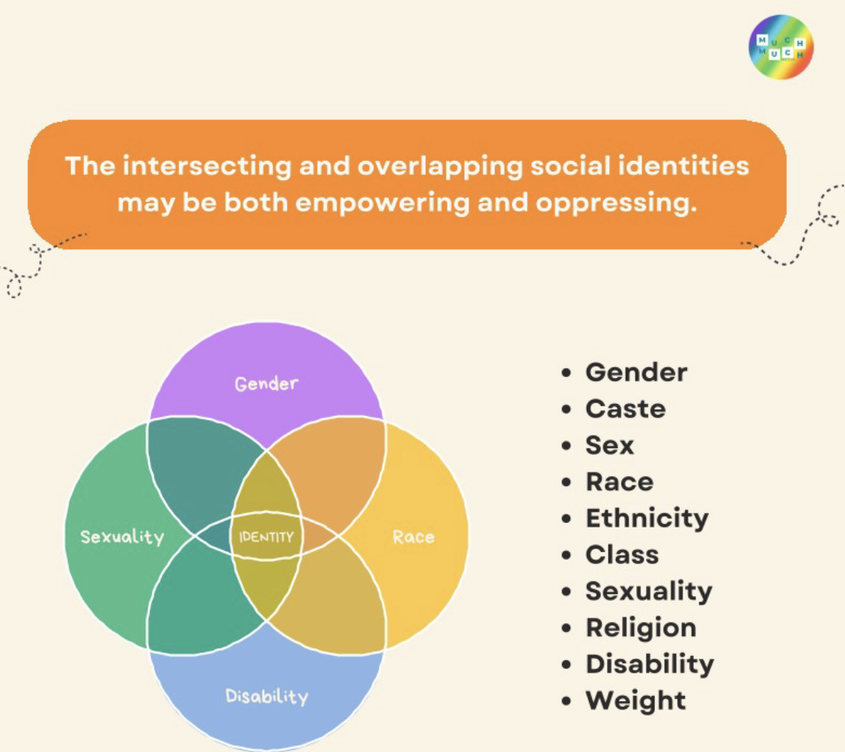

Slide 3
Neurodiversity through the lens of intersectionality @ work
Research into neurodiversity in the workplace found that half of leaders and managers would be uncomfortable employing or line managing someone who is neurodivergent
Almost one third (31 per cent) of Black and ethnicity minority (BME) women report being unfairly passed over for or denied a promotion at work, this rose to nearly half of disabled BME women (45 per cent)
50% of women of Pakistani or Bangladeshi heritage and 48% of women of Black African heritage stated that they had been criticised for behaviours other colleagues get away with at work, compared to 29% of White British women.
Over half of autistics (60 per cent), dyspraxics (55 per cent) and dyscalculics (53 per cent) reported that people in their workplace behave in a way that excludes neurodivergent colleagues. But this feeling is not entirely shared by their neurotypical colleagues, with only 29 per cent agreeing this is the case.
Black Women are more likely to speak out against bias and discrimination at work—and more likely to experience retaliation for doing so.
Black women of Caribbean heritage, and women of East Asian and Chinese heritage were the least likely to report ‘often’ or ‘always’ feeling comfortable in their workplace culture, at 43% and 41%, respectively.

Slide 4
Neurodiversity through the lens of intersectionality @ work continued.
One in ten Black, Asian and minority ethnic LGBTQ+ staff (10 per cent) have similarly been physically attacked because of their sexual orientation and/or gender identity, compared to three per cent of White LGBTQ+ staff
Almost one in five LGBTQ+ staff (18 per cent) have been the target of negative comments or conduct from work colleagues in the last year because they're LGBT.
One in eight trans people (12 per cent) have been physically attacked by customers or colleagues in the last year because of being trans.
Black women are more likely than any other group of employees, including ethnic minority men and women of other races and ethnicities, to spend a substantial amount of time on DEI work that falls outside their formal job responsibilities.
Muslim women were significantly more likely to make changes to themselves at work than non-religious women or women of other religions. 53% of Muslim women changed the clothes they wear at work ‘a great deal’ or ‘quite a bit’, compared to 37% of Christian women and 32% of non-religious women.
Black women face more microaggressions than other groups of women, and are three to four times as likely as white women to be subjected to disrespectful and “othering” comments and behaviour.

Slide 5
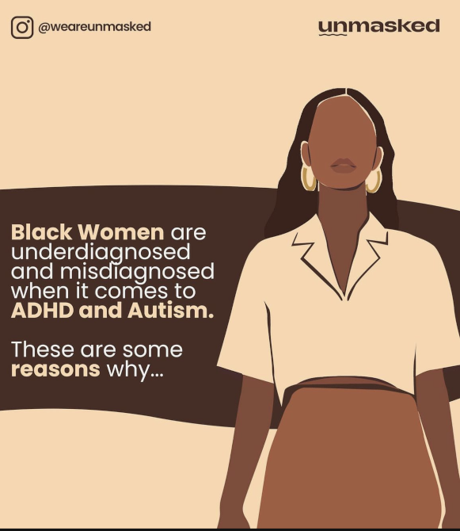
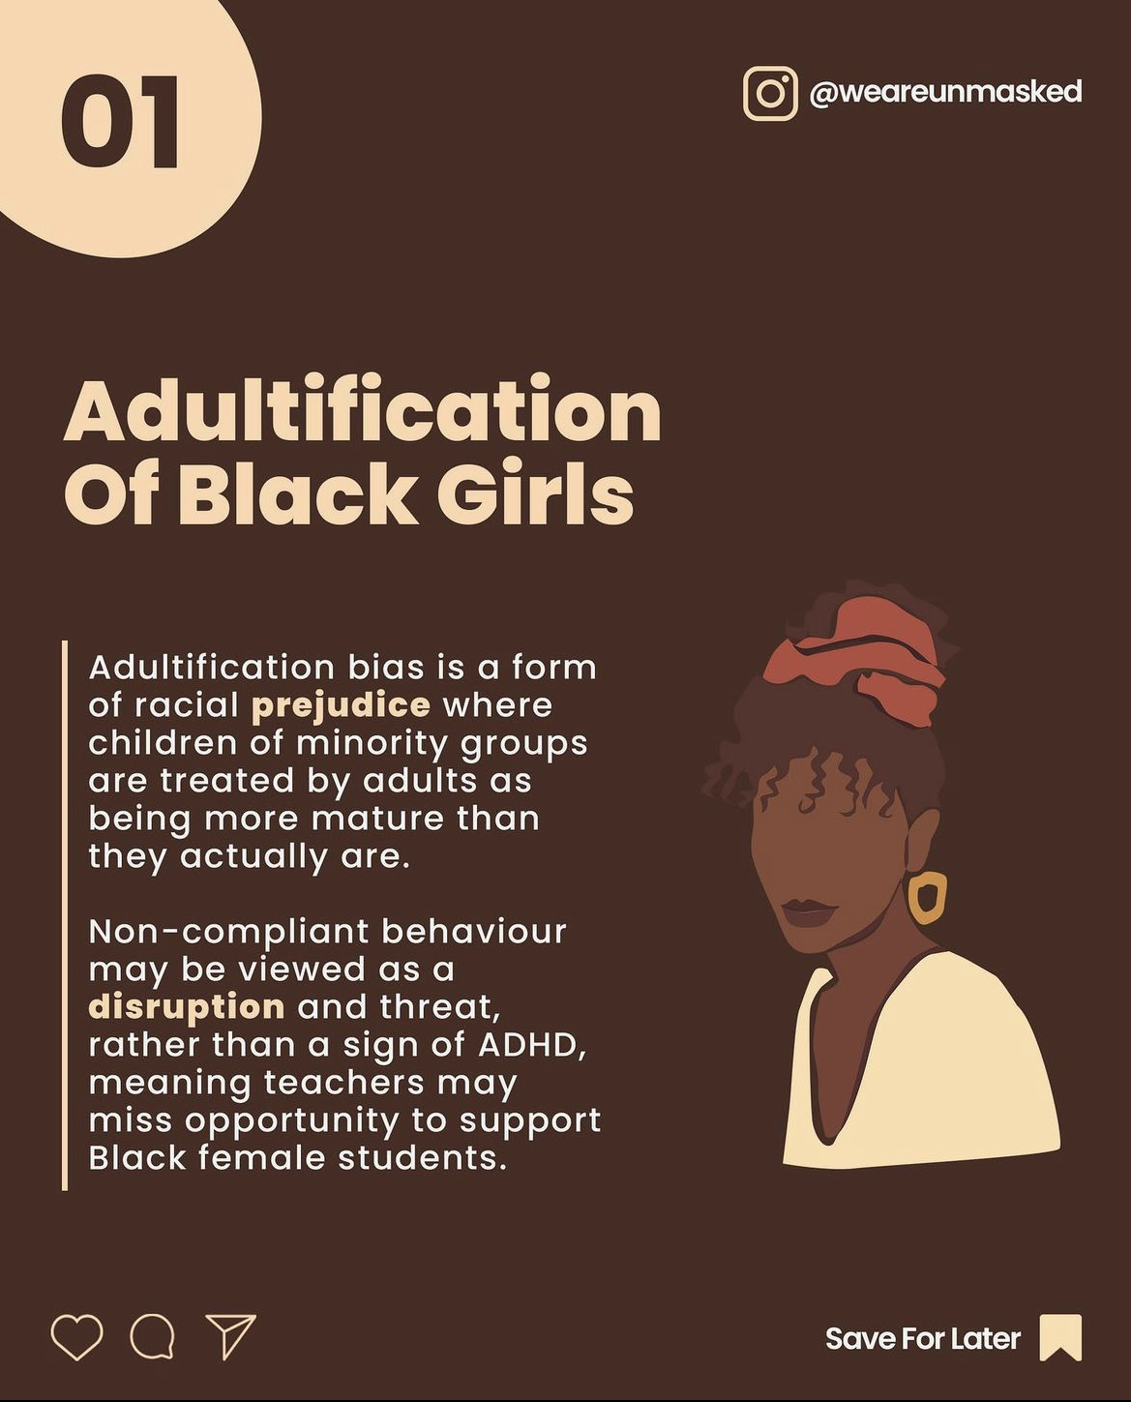
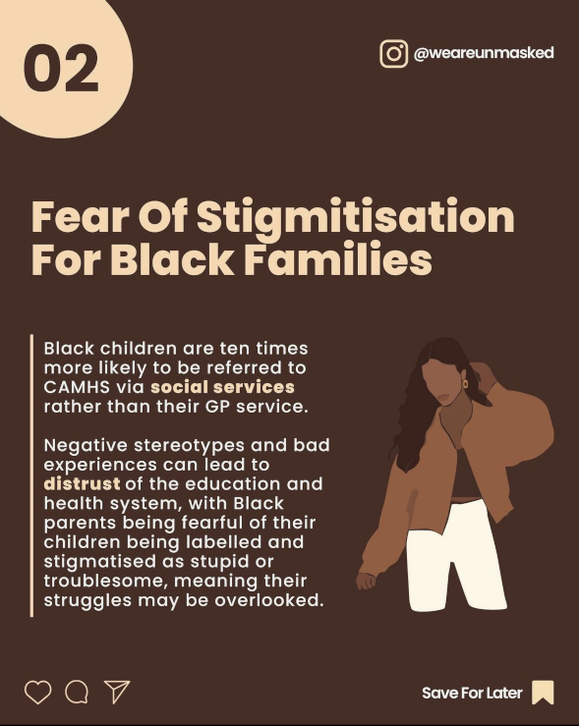

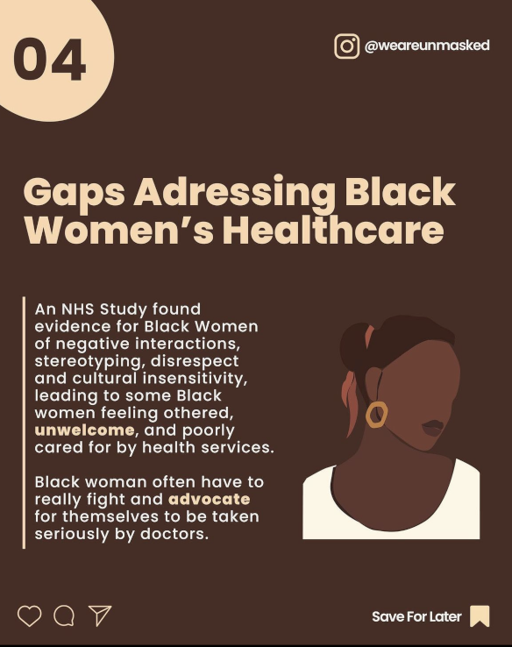
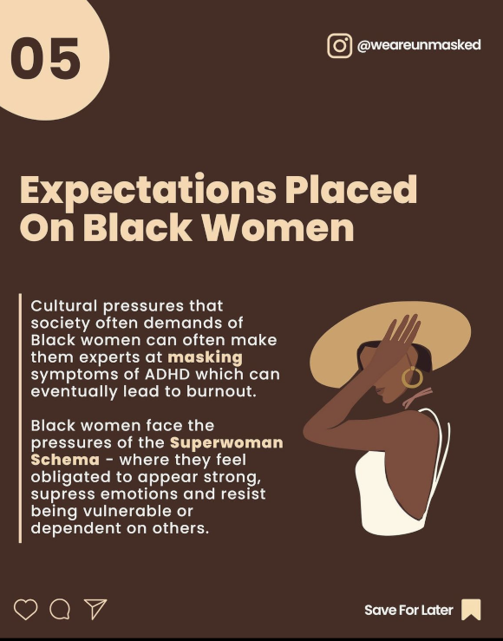
What is Neurodiversity?

Slide 6
How to support neurodivergent employees and those with hidden disabilities?
What is Neurodiversity?
If a colleague has asked for help, let them know it’s good they’re asking for help and make them feel as comfortable as possible
Highlight and discuss with them their areas of strength
Discuss where they feel they need further support, development or any workplace adjust ments, and how you will support them with this (personal preference
Listen empathetically and validate their experiences without judgement
Do your own research!
As a manager it is important to respect confidentiality

Slide 7
Personal preferences and workplace adjustments
Conditions I like to work in
The times/hours I like to work
The best ways to communicate with me
The ways I like to receive feedback
Things I need
Things I struggle with
Things I love
Other things to know about me

Slide 8
Some suggested accommodations for executive functions differences to consider
What is Neurodiversity?
Sending and setting reminders an hour ahead of meetings or tasks
Be specific with instructions and deadlines e.g. I need this completed by 4pm rather then I need this done by tomorrow
Use checklists, diary, calendar, day planner to structure day
Weekly Catch ups (even beginning and end of week), frequent check ins and progress meetings to help stay on track and help with prioritisation indicators
Break tasks down into clear bite size steps
Provide best case examples and templates where possible
Use larger and multiple screens so everything visible help reduce stress
Do not view lateness as necessarily poor attitude
Feed in regular breaks in the day
Follow up verbal instructions with written instructions

Slide 9
SOME FINAL TAKEAWAYS
Take the time to understand to talk to and listen to your colleagues, so you can understand who they really are not just who you perceive them to be.
Be compassionate and listen to hear what colleagues are saying, as opposed to listening to tell them what you think.
Be honest and transparent and be ready to own up to the mistakes made and will most likely make in the future but all with the aim and commitment to do better!
Do not treat this work as ‘flavour of the month’ neurodiversity and a commitment to improving intersectional identities experiences is an ongoing effort that needs to be ingrained within your organisation’s culture.
This is a marathon, not a sprint. Pace yourself for a sustained effort as change is often painful but the results are incredibly worthwhile.

Slide 10
Resources
My Tedx - Yes, Black women have ADHD too and need your attention! | - Abigail Agyei | TEDxUniversityofEssex – YouTube
(2) Abigail Agyei MBE | LinkedIn
Diagnosis Pathways - ADHD UK

