Slide 1

WHY ARE TEETH YELLOW?
HOW IS TOOTH COLOR ASSESSED?

Slide 2
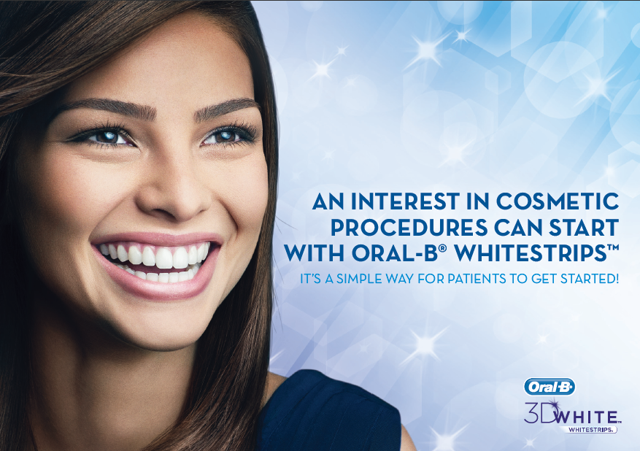
BACKGROUND
Over 85% patients ask their dental professional about whitening.
(U.S. dentalcare.com whitening study 2021)
21% have received whitening treatment from a DP in the past year
(2016 Consumer habits & practices study)
Key barriers to patients taking action?
cost, comfort, convenience

Slide 3
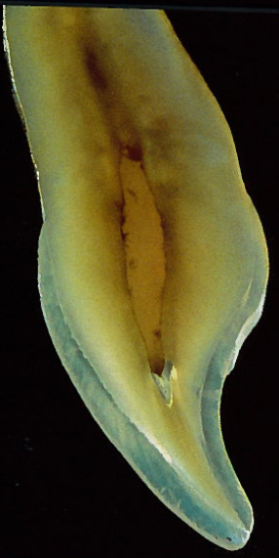
NATURAL TOOTH COLOR
Enamel is translucent
Underlying dentin ranges from very white to very yellow
Dentin continues to yellow as we age (~0.06 b* units / yr.)
Other impacts:
Medications (tetracycline)
Trauma (blood)
Chromogenic food and beverage (wine/coffee)
Non-vital
The sources of natural tooth color include structural features of the teeth including thickness, translucency, dentin color and in the absence of staining may be dominated by genetic factors
Joiner A. Tooth colour: a review of the literature. J Dent. 2004;32 Suppl 1:3-12.
Notes:
Joiner A. Tooth colour: a review of the literature. J Dent. 2004;32 Suppl 1:3-12.

Slide 4
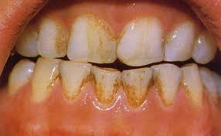
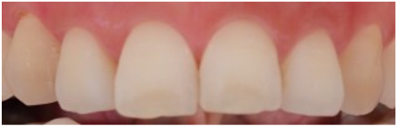
TYPES OF STAIN
STAIN: SOURCE OF DISCOLORATION THAT IS NOT OF NATURAL ORIGIN
EXTRINSIC
Extrinsic
Chromogenic bacteria, food drink, metallic compound exposure.
Will not adhere to smooth enamel surface rather, the acquired pellicle and plaque calculus accumulates the stain. Less likely to occur with effective oral hygiene habits.
Intrinsic
Incorporated into the matrix of the tooth structure.
Structural Composition, Tetracycline, Fluorosis.
IMAGE SOURCE: http://jairjp.com/JANUARY%202013/02%20SRUTHY%20PRATHAP.pdf
INTRINSIC
Understanding the type of stain
Obtaining information on diet, lifestyle, behaviors, oral health habits and occupation will help practitioners identify the cause of the stain which is critical to the discussion of the best treatment options.
Image Courtesy of P&G
Eastabrooks ,D. Oral Hygiene assessment: soft and hard deposits: Dental hugiene: theory and practice 4th ed. Darby ML, Walsh MM. St Louis MO. Saunders/Elsevier Publishing 2015: 282-93.
Notes:
Eastabrooks ,D. Oral Hygiene assessment: soft and hard deposits: Dental hugiene: theory and practice 4th ed. Darby ML, Walsh MM. St Louis MO. Saunders/Elsevier Publishing 2015: 282-93

Slide 5
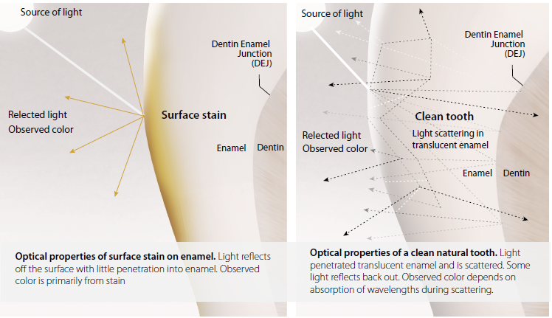
HOW WE SEE TOOTH COLOR
Because teeth are translucent – color is observed from both
on and within the teeth
ON THE TOOTH
WITHIN THE TOOTH
Optical properties of surface stain on enamel.
Light reflects off the surface with little penetration
into enamel. Observed color is primarily from stain.
Optical properties of a clean natural tooth.
Light penetrated translucent enamel and is scattered.
Some light reflects back out. Observed color depends on absorption of wavelengths during scattering.

Slide 6
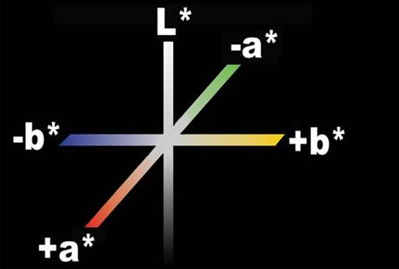
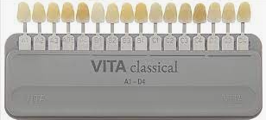
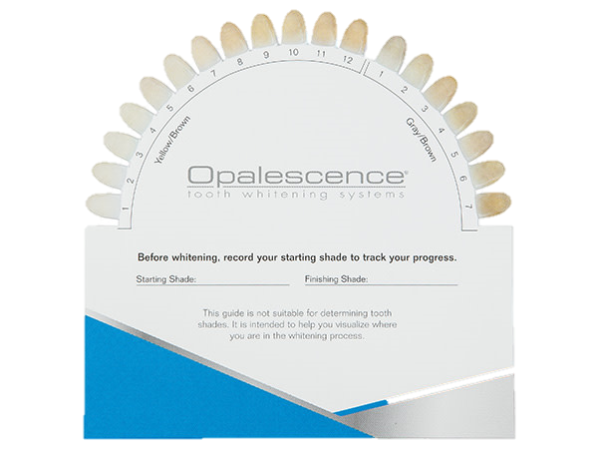
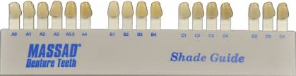
Digital Image Analysis (DIA) removes subjectivity to assess changes in:
ASSESSING TOOTH COLOR
Yellow to blue (Δb*)
Lightness - whiteness (ΔL*)
Luminescence: Red to Green (Δa*)
Limitations such as incorporating differences in lightness, chroma and hue as well as accounting for changes seen with the entire tooth versus only certain areas of the tooth
Laboratory Shade Guides are designed for measuring for restorative materials.

