Slide 1
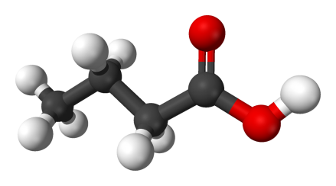
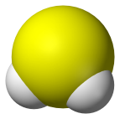
STANNOUS FLUORIDE
INHIBITS PLAQUE GROWTH
Disruption of bacterial cell membrane leading to cell death.
DUAL ACTION
1
Bactericidal
Disruption of bacterial cell membrane leading to cell death
Mode of action most commonly found in antibacterial toothpaste and rinses
2
Bacteriostatic
Inhibition of metabolic activity leading to:
Inhibition of bacterial growth
Reducing extracellular polysaccharides (EPS) so biofilm is thin and less sticky, limiting ability to adhere to oral surfaces
Limits sugar metabolism and the production of VSCs and Short Chain Fatty Acids which boost inflammation leading to gingivitis
Binds to LPS reducing toxicity of Biofilm
Targets Red Complex Bacteria (GNA’s); shifts the microbiome toward healthy, non-inflammatory state.
Reduces Markers of Oxidative Stress
Remaining bacteria have significantly reduced metabolic activity and are less thick and sticky.
Stannous interferes with bacteria carbohydrate metabolism by blocking enzymes converting sugars to short chain fatty acids.
SCFA & VSCs

Slide 2
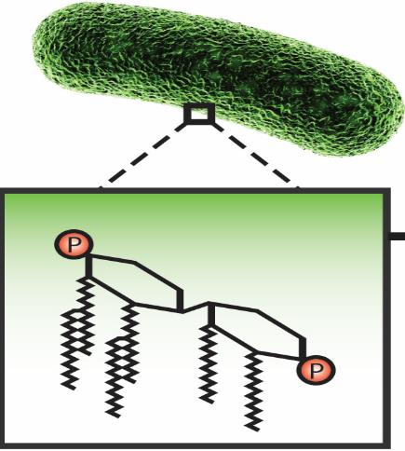
THE THERAPEUTIC PROPERTIES OF STANNOUS FLUORIDE FOR GINGIVAL HEALTH MECHANISMS OF ACTION
Improved Gingival and Periodontal Health
1
Inhibition of Plaque Growth
Reduction in Metabolic Production of Toxins
Direct Suppression of Pathogen Virulence
2
3
Courtesy of Procter & Gamble: Crest & Oral B
Notes:
P&G has been working with stannous fluoride as an antimicrobial antigingivitis ingredient for over 20 years. What has been discovered is that the therapeutic properties of stannous fluoride are defined by three mechanisms.
The first mechanism of stannous fluoride is inhibition of plaque growth. Both bactericidal and bacteriostatic actions of stannous suppress growth and reproduction of bacteria thereby producing a reduction the amount of plaque on the teeth. Historically – this has been the most studied action of most antimicrobials including stannous fluoride.
The second mechanism of action of stannous fluoride is inhibition of plaque metabolism – including metabolic production of periodontapathic toxins. While stannous fluoride effects on bacterial metabolism have been known for decades – the majority of research focused on inhibition of acids which cause dental caries. It has been discovered that this metabolic inhibition also extends to acids associated with periodontal disease – so called short chain fatty acids including butyric and propionic acid. I will show you evidence for this today.
Lastly, over the last several years a third antimicrobial mechanism has been discovered for stannous fluoride. Suppression of pathogen virulence. In this mechanism, stannous fluoride binds to LPS and LTA bacterial surface molecules on pathogenic bacteria. This inhibits their interaction with toll-like receptors in the periodontium. This in turn may decrease immune response and proinflammatory cytokine production – reducing gingival inflammation.
Now lets discuss these properties in more detail and examine the laboratory and clinical evidence.

Slide 3
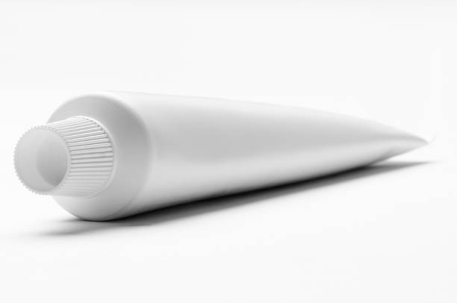
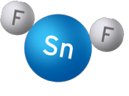
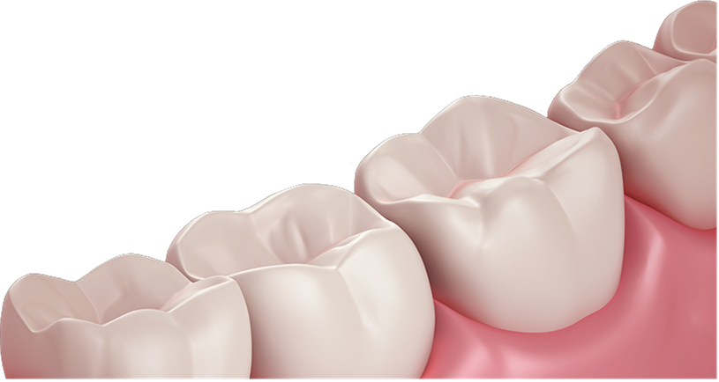
Comparison of Magnitude of Benefit
Bleeding Reduction
Objective
Method
Flossing at 2 weeks = 40%¹
Prophy Benefit 1 week post visit = 40 – 66%²
SnF2 at 3 months versus NaF = 51%³
This Meta-Analyses shows brushing with P&G Stannous provides a
51% reduction in bleeding sites in up to 3 months vs Negative Control.
1. Biesbrock, A., et al. Journal of Periodontology 2006; 77: 1386-1391.
2. McClanahan, et al.. Journal of Periodontology 2001; 72: 383-392.
3. Biesbrock, A et al. The Effects of Bioavailable Gluconate Chelated Stannous. Fluoride Dentifrice on Gingival Bleeding: Meta-Analysis of Eighteen Randomized Controlled Trials. J Clin Periodontal, 2019.

Slide 4
External Sources
2020 – Sanz M, Herrera D, Kebschull M, Chapple I, Jepsen S, Beglundh T, Sculean A, Tonetti MS; EFP Workshop Participants and Methodological Consultants. Treatment of stage I-III periodontitis-The EFP S3 level clinical practice guideline. J Clin Periodontol. 2020 Jul;47 Suppl 22(Suppl 22):4-60. doi: 10.1111/jcpe.13290. Erratum in: J Clin Periodontol. 2021 Jan;48(1):163. PMID: 32383274; PMCID: PMC7891343.
“If an antiseptic dentifrice formulation is going to be adjunctively used, we suggest products containing chlorhexidine, triclosan copolymer and stannous fluoride-sodium hexametaphosphate for the control of gingival inflammation, in periodontitis patients in supportive periodontal care.”
“The magnitude of effect in gingival indices changes, in formulations with more than one study available, was headed by stannous fluoride with sodium hexametaphosphate (n = 2, S-WMD = −1.503), followed by triclosan and copolymer (n = 18, S-WMD = −1.313), and chlorhexidine (n = 2, S-WMD = −1.278, not statistically significant)”
Key Outcome | This meta-review appraised the current state of evidence and found that toothbrushing with a standard fluoride dentifrice does not provide an added effect for the mechanical removal of dental plaque | The present review found that stabilized SnF2 toothpaste had a positive effect on the reduction of dental calculus build-up, dental plaque, gingivitis, stain and halitosis. A tendency towards a more pronounced effect than using toothpastes not containing SnF2 was found. | The studies in this systematic review provide strong evidence of the antiplaque, antigingivitis effects of multiple agents. These results support the use of these agents as part of a typical oral hygiene regimen. | “The use of stabilized stannous fluoride dentifrices to relive dentin hypersensitivity and to prevent the initiation of dental erosion speaks in favor of this treatment strategy” | The use of SnF(2) dentifrices results in gingivitis and plaque reduction when compared with a conventional dentifrice. The precise magnitude of this effect was difficult to assess because of a high level of heterogeneity in study outcomes. | “The antibacterial properties of stannous seem to provide favourable results when formulated with a fluoridated toothpaste.” | The studies in this systematic review provide strong evidence of the antiplaque, antigingivitis effects of multiple agents. These results support the use of these agents as part of a typical oral hygiene regimen. | Conclusions: A new dentifrice with 0.454% stannous fluoride and 2.6% EDTA demonstrated significant improvements in clinical parameters associated with gingivitis compared to other sodium and stannous fluoride containing dentifrices.
Citation | Valkenburg C, Van der Weijden FA, Slot DE. Plaque control and reduction of gingivitis: The evidence for dentifrices. Periodontol 2000. 2019 Feb;79(1):221-232. doi: 10.1111/prd.12257. PMID: 30892760; PMCID: PMC7328759. | Johannsen A, Emilson CG, Johannsen G, Konradsson K, Lingström P, Ramberg P. Effects of stabilized stannous fluoride dentifrice on dental calculus, dental plaque, gingivitis, halitosis and stain: A systematic review. Heliyon. 2019 Dec 9;5(12):e02850. doi: 10.1016/j.heliyon.2019.e02850. PMID: 31872105; PMCID: PMC6909063 | Gunsolley, J. C. (2006). A meta-analysis of six-month studies of antiplaque and antigingivitis agents. Journal of the American Dental Association, 137, 1649-1657. | Konradsson K, Lingström P, Emilson CG, Johannsen G, Ramberg P, Johannsen A. Stabilized stannous fluoride dentifrice in relation to dental caries, dental erosion and dentin hypersensitivity: A systematic review. Am J Dent. 2020 Apr;33(2):95-105. | Paraskevas, S., & Van der Weijden, G. A. (2006). A review of the effects of stannous fluoride on gingivitis. Journal of Clinical Periodontology, 33, 1-13 | Clark-Perry D, Levin L. Comparison of new formulas of stannous fluoride toothpastes with other commercially available fluoridated toothpastes: A systematic review and meta-analysis of randomised controlled trials. Int Dent J. 2020 Dec;70(6):418-426. doi: 10.1111/idj.12588. Epub 2020 Jul 4. | Sälzer, S., Slot, D. E., Dörfer, C. E., & Van der Weijden, G. A. (2015). Comparison of triclosan and stannous fluoride dentifrices on parameters of gingival inflammation and plaque scores: A systemic review and meta-analyses. International Journal of Dental Hygiene, 13, 1-17. | Geisinger ML, Geurs NC, Novy B, Otomo-Corgel J, Cobb CM, Jacobsen PL, Takesh T, Wilder-Smith P. A randomized double-blind clinical trial evaluating comparative plaque and gingival health associated with commercially available stannous fluoride-containing dentifrices as compared to a sodium fluoride control dentifrice. J Periodontol. 2023 Sep;94(9):1112-1121. doi: 10.1002/JPER.22-0675. Epub 2023 Apr 26. PMID: 37016272; PMCID: PMC10524004.

Slide 5
MoA Plaque Toxicity
KEY QUESTION: | To identify technology that binds to LPS | Does Stannous interfere with LPS and LTA Activation | Understand if blocking LPS inhibits endotoxin activation of TLR inflammatory cascade | Does Stannous inhibit cytokine production per various monocytes | Subgingival uptake and retention of stannous fluoride from dentifrice: Gingival crevicular fluid concentrations in sulci post-brushing | Clinical effects of Sn fluoride dentifrice in reducing Plaque microbial Virulence in various level of disease Does the Reduction in cytokine production decrease inflammation | Clinical effects of stannous fluoride dentifrice in reducing plaque microbial virulence III: Lipopolysaccharide and TLR2 reporter cell gene Activation
Citation | Haught JC, Xie S, Circello B, Tansky CS, Khambe D, Sun Y, Lin Y, Sreekrishna K, Klukowska M, Huggins T, White DJ. Lipopolysaccharide and lipoteichoic acid binding by antimicrobials used in oral care formulations. Am J Dent. 2016 Dec;29(6):328-332. PMID: 29178720. | Haught JC, Xie S, Circello B, Tansky CS, Khambe D, Sun Y, Lin Y, Sreekrishna K, Klukowska M, Huggins T, White DJ. Lipopolysaccharide and lipoteichoic acid binding by antimicrobials used in oral care formulations. Am J Dent. 2016 Dec;29(6):328-332. PMID: 29178720. | Lipopolysaccharide and Lipoteichoic Acid Virulence Deactivation by Stannous Fluoride | Lipopolysaccharide and Lipoteichoic Acid Virulence Deactivation by Stannous Fluoride | Subgingival uptake and retention of stannous fluoride from dentifrice: Gingival crevicular fluid concentrations in sulci post-brushing | Klukowska M, Haught JC, Xie S, Circello B, Tansky CS, Khambe D, Huggins T, White DJ. Clinical Effects of Stabilized Stannous Fluoride Dentifrice in Reducing Plaque Microbial Virulence I: Microbiological and Receptor Cell Findings. J Clin Dent. 2017 Jun;28(2):16-26. PMID: 28657701. | Clinical effects of stannous fluoride dentifrice in reducing plaque microbial virulence III: Lipopolysaccharide and TLR2 reporter cell gene activation.
Result | Mass spectroscopy revealed direct binding of stannous fluoride LPS at 1:1 stoichiometric ratios. In the cellular assay, cetylpyridinium chloride and stannous fluoride, but not triclosan, inhibited LPS binding to TLR4. | Stannous salts including stannous fluoride interfered with LPS and LTA reactivity in both dye assays. Lipopolysaccharide and lipoteichoic acid binding by antimicrobials used in oral care formulations | Stannous fluoride inhibited gene expression response of TLR4 and TLR2. | The addition of stannous fluoride suppressed production of TNF-a, IFN-g, IL12p70, IL10, IL-1b, IL2, and IL-6, and increased secretion of Il-8 in dose response fashion. Lipopolysaccharide and Lipoteichoic Acid Virulence Deactivation by Stannous Fluoride. | Significant levels of tin, were detected 30 minutes after brushing at sampling sites up to 4 mm subgingivally and showed an increasing trend with continued use. Subgingival uptake and retention of stannous fluoride from dentifrice: Gingival crevicular fluid concentrations in sulci post-brushing | Clinical assessments showed statistically significant reductions in MGI (24–26%) and GBI (42–53%) gingivitis in both diseased and healthy cohorts following four weeks of dentifrice intervention. Benefits could be seen in both diseased sites, as well as sites not yet exhibiting symptoms of inflammation, supporting the activity of SnF2 not just in treating diseased sites, but also in preventing disease development. | Higher disease cohorts and sites with gingival inflammation generally showed more endotoxins and higher levels of plaque virulence as compared to low disease cohorts or plaque sampled from clinically healthy sites. SnF2 dentifrice treatment was associated with broad scale reductions in endotoxin content and virulence potentiation properties of dental plaque samples.
Link | https://pubmed.ncbi.nlm.nih.gov/29178720/ | https://www.ncbi.nlm.nih.gov/pubmed/29178720 | https://pubmed.ncbi.nlm.nih.gov/29178719/ | https://www.ncbi.nlm.nih.gov/pubmed/28390203 | https://www.ncbi.nlm.nih.gov/pubmed/30106533 | https://www.ncbi.nlm.nih.gov/pubmed/28657701 | https://www.ncbi.nlm.nih.gov/ pubmed/30106539
 |  |  | Huggins T, Haught JC, Xie S, Tansky CS, Klukowska M, Miner MC, White DJ. Quantitation of endotoxin and lipoteichoic acid virulence using toll receptor reporter gene. Am J Dent. 2016 Dec;29(6):321-327. PMID: 29178719. | Huggins T, Haught JC, Xie S, Tansky CS, Klukowska M, Miner MC, White DJ. Quantitation of endotoxin and lipoteichoic acid virulence using toll receptor reporter gene. Am J Dent. 2016 Dec;29(6):321-327. PMID: 29178719. | Up to 4 mm below the Gum line Substantive for 12 hours | Neutralizes gingivitis causing toxins. Even in patients who appear healthy, plaque toxicity is reduced preventing gingivitis symptoms.

