Slide 1
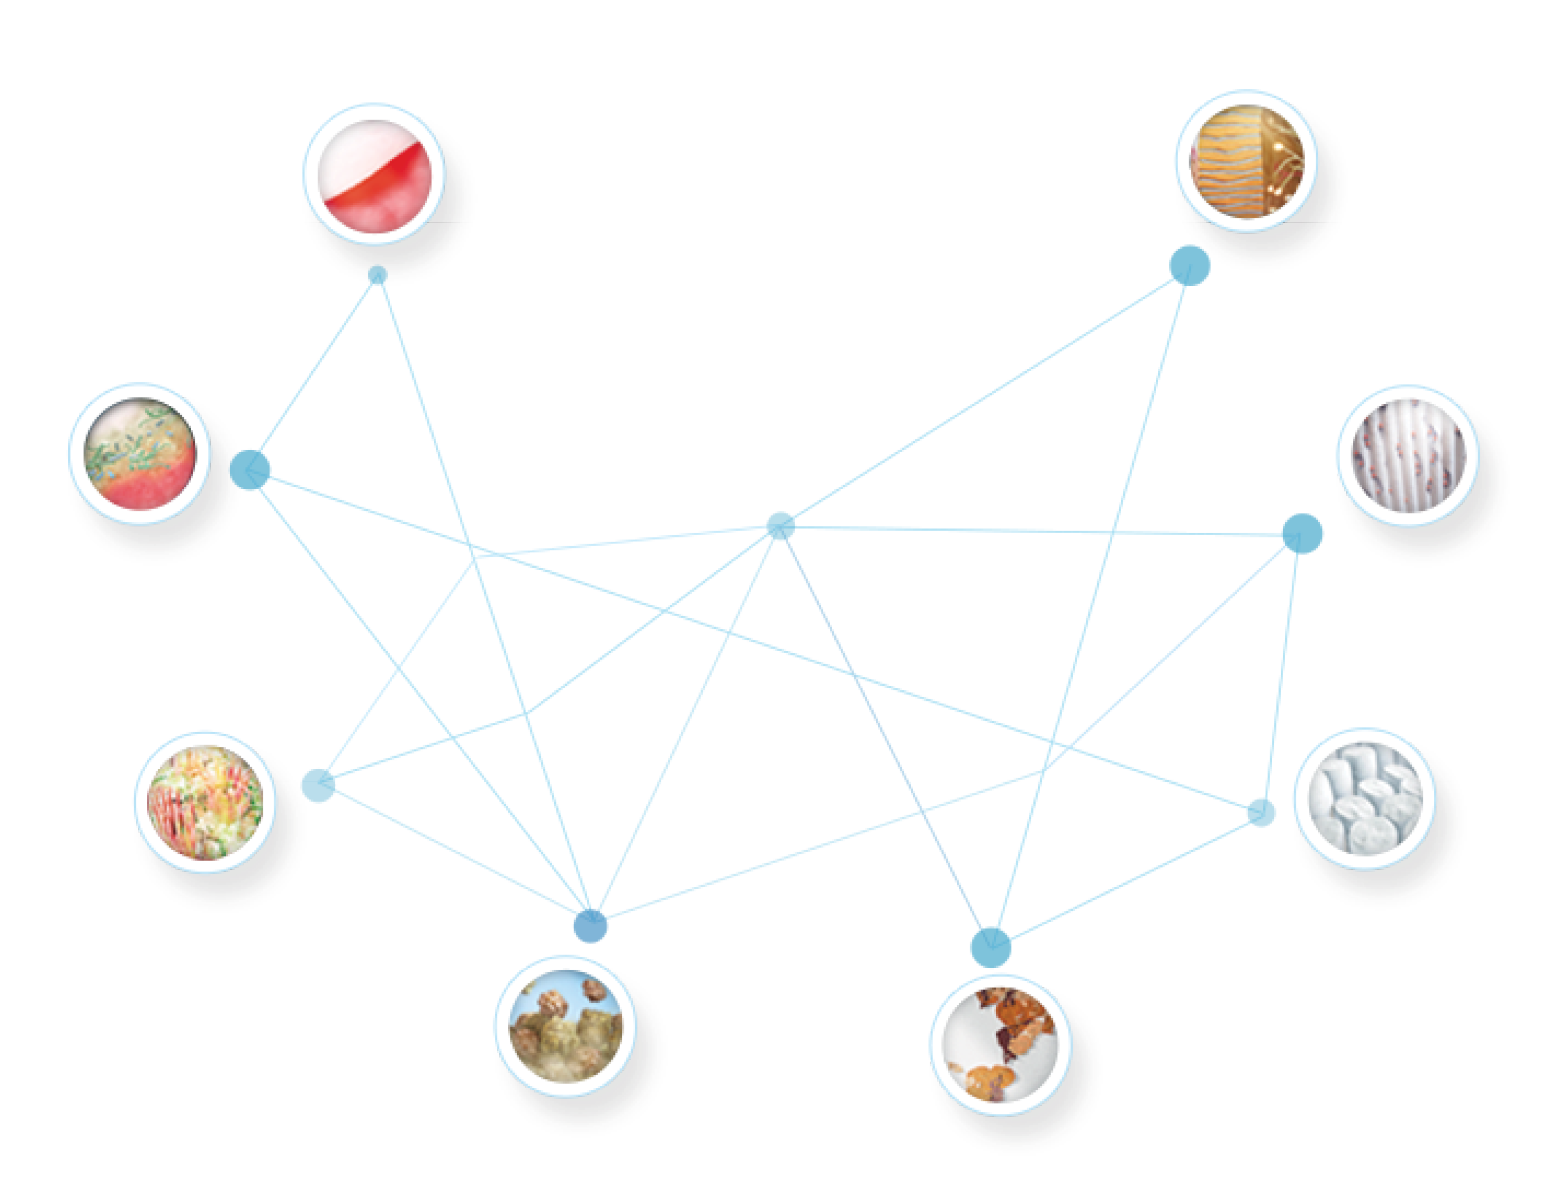
Stannous Fluoride
Stannous fluoride (SnF₂) possesses several oral health benefits beyond traditional fluoride dentifrices, including barrier formation and anti-microbial properties
Anticaries | Sodium fluoride Sodium monofluorophosphate Stannous fluoride / chloride Amine fluoride
Plaque and Gingivitis reducing agents | Triclosan Stannous fluoride / chloride Chlorhexidine Cetylpyridinium chloride, essential oils Sodium Bicarbonate
Desensitizing agents | Potassium nitrate / chloride Stannous fluoride / chloride Strontium chloride / acetate Arginine plus calcium (requires 8%)
Anti Erosion | Stannous fluoride / chloride
Gum problems
Sensitivity
Plaque
Caries
Enamel erosion
Halitosis
Staining
Tartar
Courtesy of Procter & Gamble

