Slide 1
THE SCIENCE BEHIND
BLUE LIGHT WITH WHITENING

Slide 2
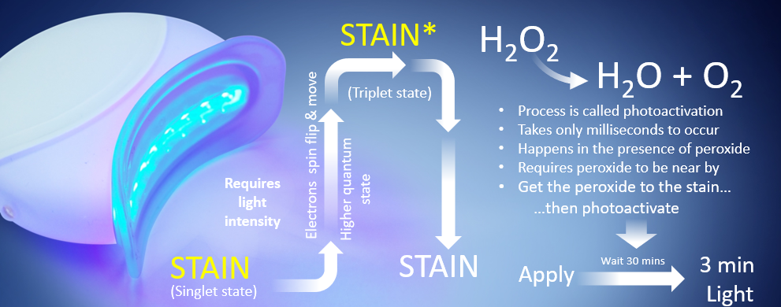
HERE’S HOW
BLUE LIGHT WORKS
Energy

Slide 3
IN PRACTICE

Slide 4
IMPORTANCE OF THE ROLE
OF THE DENTAL PROFESSIONAL
As a dental professional you play a critical role in assessing the best system for the goals of the patient.
Factors in decision making
Oral Health of Patient (contraindications)
Age of the patient (teenager, older?)
Investment
Time
Tooth sensitivity

Slide 5
POSITIONING OF TOOTH WHITENING
Any anterior restorative or cosmetic procedure should include a conversation about Whitening teeth first.
Your Practice
No investment of expensive equipment, minimal chair time, no impressions to fabricate
Opens the door to other cosmetic or restorative procedure conversations
Whitening is a gateway service that may lead patients to choose other cosmetic procedures.
Your Patients
More patients ask about whitening than currently take advantage.
More patients will take advantage of a low-cost, quality elective service that is highly desired.
Patient smile assessment questions (Do you like your smile? Are you happy with how your teeth look? If you could change anything about your smile, what would it be?)
Your Profit
Practice Growth and Profitability via reaching additional patients with a desired service
Notes:
What drives the practice is the cosmetic procedure. ​​ Everyone wants to whiten but only a few can afford it. ​​
If I whiten my teeth I look in the mirror and see the improvement. Now my smile means something to me. ​​Once you see improvement you want to do more, and you may tell friends and family who helped to create that new smile. ​​
Set office procedure-based whitening aside. ​​ You already have that business. The patients​​ who want trays are getting trays. Let’s talk ​​ about the business you don’t yet have.” ​​

