Slide 1
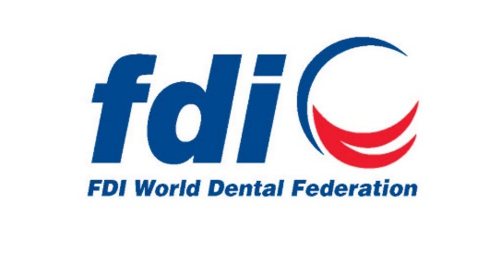
RDA Standardization and Accepted as standard method
This method has been accepted by health organizations around the world
Importantly, the method is
NOT intended to predict abrasivity of toothpastes in the mouth but to help manufacturers determine the cleaning potential
“a lab method that confirms that <1mm of dentin per 100,000 brush strokes”
Notes:
This method has been accepted by health organizations around the world including the US FDA, the ADA, the British Standards Institute, World Dental Federation, and the ISO 11609
Importantly, per the ADA, the method is NOT intended to predict abrasivity of toothpastes in the mouth. Rather, it is a means for standardized comparison of dentifrices in the laboratory. RDA is an in vitro test for manufacturer guidance, thus cannot be directly translated to real life for several reasons

Slide 2
RDA Testing Vs. Real Life Conditions
RDA Testing (in vitro) vs. Real Life Considerations
RDA Testing | Real Life | Significance
No pellicle | Presence of pellicle | Natural forming pellicle plays major role in physical enamel protection; RDA testing utilizes “virgin” mineral
Continuous brushing of surface | Avg. 5 seconds of brushing per surface | RDA method prescribes 1500-3000 toothbrush strokes to one surface, equivalent to 2-6 months worth of normal brushing
Paste and brush are the only elements | Individual habits (e.g. aggressive/too frequent brushing) | Individual habits impact rate of tooth wear more than paste or brush characteristics
Only accounts for abrasion | Tooth wear is multifactorial (e.g. erosion, abrasion attrition) | Erosion driven by diet is the predominant factor in real-life tooth wear, not abrasion
Notes:
lack of relevance of RDA scores to the reality of how our behavior is in real-life. the process to measure is too far removed from realistic behavior.
The following details the key differences to consider between RDA testing and real-life elements and explains why RDA value cannot be directly translated to real life outcomes. The primary element being the pellicle, and its absence in the RDA method. The pellicle is composed of glycoproteins and plays a large role as a lubricant and reducing tooth surface friction and physical forces, thus its absence in in vitro methods does not enable direct translation to real world outcomes. The failure to consider these elements has led to many misinterpretations of RDA values.
Pellicle forms immediately, fully mature 60-90 mins. Continues to mature. Pellicle is what stains. When you brush you may remove some pellicle but with an RDA of 250 you never remove it, NOT remove may thin it but not remove it.
Prophy paste 2000-4000 strips pellicle off can remove tooth minerals.

