Slide 1
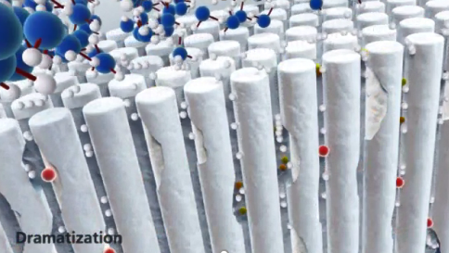
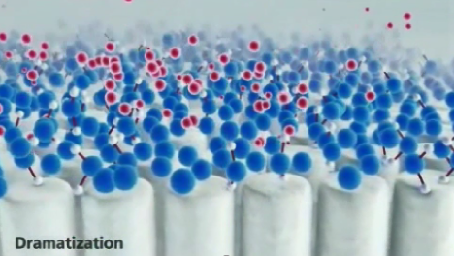
THERE ARE THREE (3) KEYS TO MINERAL LOSS REDUCTION
Stannous Fluoride
1
2
3
Trap & Remove Bacteria
Reduce the amount of acidic biofilm to prevent subsurface mineral loss
Remineralization
Provide a pro mineral formation environment to reinforce HAP crystals to reverse subsurface mineral loss
Surface Protection
Provide a sacrificial barrier on tooth enamel surfaces to reduce surface mineral loss
Sodium Fluoride
Notes:
Voice Over
The key to maintaining natural teeth is to reduce enamel mineral loss. There are three keys to at-home oral care mineral loss reduction.
The trapping and removal of acidogenic bacteria to prevent subsurface mineral loss that leads to carious lesion formation
Aid in the reversal of subsurface mineral loss by facilitation of remineralization.
And finally, providing protection to enamel surfaces against acid and mechanical insult to reduce surface mineral loss.
This presentation will discuss the etiology and pathology of subsurface and surface mineral loss and how stannous fluoride as an active ingredient in dentifrices is uniquely designed to intervene on both types of mineral loss.

Slide 2
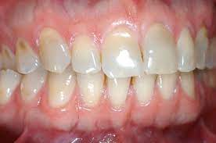
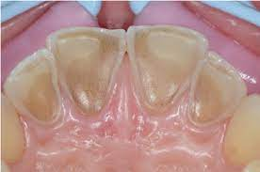
What is ETW?
Changing dietary habits
Higher consumption of acidic beverages (colas, sports / energy drinks) – (especially Children and Athletes)
Higher incidence of xerostomia from medications for chronic conditions Low salivary flow clears acids less quickly (especially Geriatric)
More people retain teeth for a lifetime, and we are living longer
Interaction between attrition (abrasion) and erosion =
Erosive Tooth Wear

Slide 3
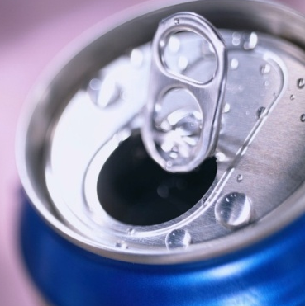
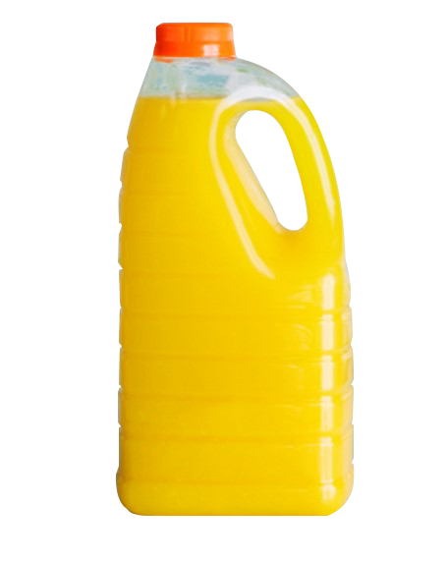
DENTAL EROSIVE WEAR
CHEMICAL WEAR & SURFACE MINERAL LOSS
Surface Softening Leading
to dental erosive wear
“
Normal tooth brushing has no harmful effect on sound dental tissues. The softened tooth surfaces caused by exposure to acidic products are vulnerable to tooth brushing. However, softened enamel is not remineralized by saliva over short time periods, so will be worn away even in the absence of tooth brushing.⁸
”
Intrinsic
Vomiting and GERD
Extrinsic
Consumption of Acidic Foods, Drinks & Carbonated Beverages
Carvalho, T.S., Colon, P., Ganss, C. et al. Consensus report of the European Federation of Conservative Dentistry: erosive tooth wear—diagnosis and management. Clin Oral Invest 19, 1557–1561 (2015). https://doi.org/10.1007/s00784-015-1511-7
Notes:
Voice Over
Chemical wear is the result of low pH environments at the tooth surface causing loss of surface mineral and “surface softening”.
As surfaces are exposed to low pH and mineral loss occurs, surface enamel is susceptible to complete removal from mechanical forces like brushing or even simple forces produced by the tongue. This exposes the dentin underneath ultimately leads to enamel thickness reduction, and pain and sensitivity complications.
The two primary risk factors for creating a chronic low pH environment at the tooth surface include, (1) intrinsic factors such as regurgitation which brings stomach acids which are around a pH 1 into the oral cavity. Such as GERD; and (2) extrinsic factors such as consumption of acidic foods, drinks and carbonated beverages.
8. Carvalho, T.S., Colon, P., Ganss, C. et al. Consensus report of the European Federation of Conservative Dentistry: erosive tooth wear—diagnosis and management. Clin Oral Invest 19, 1557–1561 (2015). https://doi.org/10.1007/s00784-015-1511-7

Slide 4
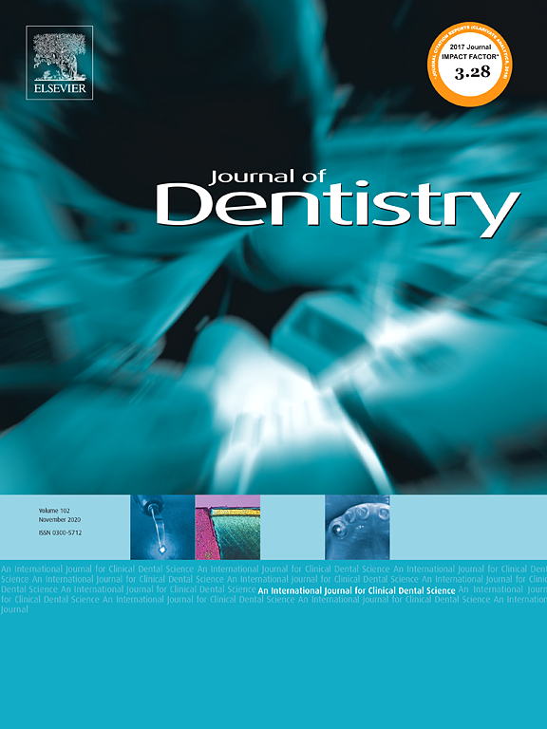
META-ANALYSIS
EROSION
RESULTS
Estimated Average Effect of brushing with Bioavailable Gluconate Chelated Stannous
Erosion
83%
Enamel Surface Loss (p<0.001)
West N. et al. Bioavailable gluconate chelated stannous fluoride toothpaste meta-analyses: Effects on dentine hypersensitivity and enamel erosion. Journal of Dentistry, Volume 105, 2021. . https://doi.org/10.1016/j.jdent.2020.103566

Slide 5
Clinical Evaluation of SnF₂ and Erosion Protection–Eversole et al.
SnF₂ was demonstrated to be significantly more effective at reducing enamel loss than all other treatments including two prescription strength sodium fluorides
Enamel Loss After 5-Day Erosion Cycling
30
25
20
15
Enamel Loss (µm)
*
10
5
SnF₂
NaF (1100 ppm F)
NaF (5000 ppm F)
NaF + acidulated phosphate (5000 ppm F)
Eversole S, et al. J Clin Dent (2015) 26: 44–49
*p<.05 vs. All
Notes:
Eversole et al (2015) utilized the in vitro erosion cycling model to demonstrate mineral loss from exposed tooth samples that were treated with various dentifrices, including SnF2. SnF₂ treated specimens lost 8.0 µm of the enamel surface, demonstrating its use to be significantly more effective than all other treatments including two prescription strength sodium fluorides

Slide 6
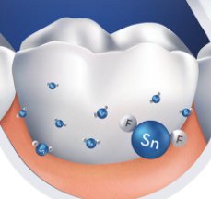
Additional to causal management options, it is possible to use specific protective products or materials. Products (e.g., toothpastes or mouth rinses) containing stannous fluoride or stannous chloride have the potential for slowing the progression of ETW. For other products, data so far are sparse.
“
”
Preventive strategies are essential as first line management for erosion protection once bulk tooth surface structure is lost, erosive wear is irreversible¹²
“
”
Is the ONLY dentifrice with the seal for Enamel Erosion Control
https://www.ada.org/resources/research/science-and-research-institute/ada-seal-of-acceptance/product-search#sort=%40productname%20ascending&f:@category=[Enamel%20Erosion%20Control]
West N. et al. Bioavailable gluconate chelated stannous fluoride toothpaste meta-analyses: Effects on dentine hypersensitivity and enamel erosion. Journal of Dentistry, Volume 105, 2021. . https://doi.org/10.1016/j.jdent.2020.103566
Notes:
12. Carvalho, T. S., Colon, P., Ganss, C., Huysmans, M. C., Lussi, A., …Wiegand, A. (2015). Consensus report of the European Federation of Conservative Dentistry: erosive tooth wear--diagnosis and management. Clinical Oral Investigations, 19, 1557-1561. doi:10.1007/s00784-015-1511-7

Slide 7
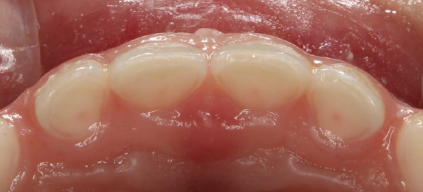
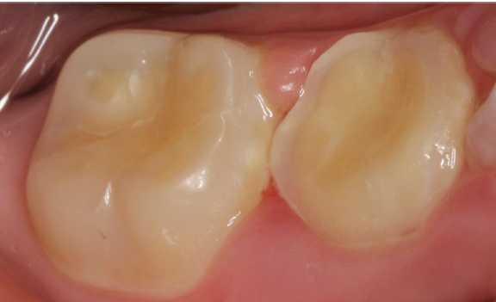
ETW in pediatric population?
European Archives of Paediatric Dentistry
A recent global review of mean prevalence of moderate toothwear in deciduous teeth to be between 30-50%; more common in males and increases with age
Damage to permanent teeth in childhood/adolescence may compromise dentition and impact restorative care for lifetime.
Damage will continue until there is an intervention.
KEY FACTS:
ATHLETES¹:
92% regularly consume sports drinks
Onset of sports drink use: 10.8 years
Erosion prevalence: 36.5%
A 12-year-old male with severe erosive lesions affecting the
primary and permanent molars. The nutrition diary revealed that the boy consumed more than 1 L of a cola type drink per day
Most common sites were lower 1st molars²
1. Mathew et al Caries Research 2002
2 Arnadottir et al 2010

Slide 8
ETW IS NOT WELL DIAGNOSED
WITHOUT DIAGNOSIS, NO PREVENTION STRATEGY CAN BE IMPLEMENTED
https://www.sciencedirect.com/science/article/pii/S0300571220301706?dgcid=rss_sd_al
Dentists had difficulty correctly diagnosing (both detection and differentiation) and managing ETW, across all severity levels and particularly in early stages. These difficulties were particularly apparent when compared to caries. The current results are clinically relevant given the importance of early diagnosis for ETW management.
https://bmcoralhealth.biomedcentral.com/articles/10.1186/s12903-017-0451-9
Tooth wear is a relatively new emerging dental public health problem which has not yet raised sufficient awareness among the public. Even dental professionals are not giving sufficient attention to this issue. Most dental professionals overlook the early stages of tooth erosion and dismissed tooth surface loss as something that is ‘normal’ or physiological and thus does not require any intervention [1]. The terms ‘tooth wear’ and ‘dental erosion’ had been used interchangeably by some whilst others used tooth wear as the cumulative effect of abrasion, attrition and dental erosion [2]. In addition, the terms dental erosion and dental erosive wear had often been considered to be synonymous. Huysmans et al. attempted to differentiate the two by defining, erosion as a partial demineralization of enamel or dentine by intrinsic or extrinsic acids and erosive tooth wear as the combined effect of erosion and mechanical wear (abrasion or attrition) on tooth surface [3] with erosion being the dominant process.

Slide 9
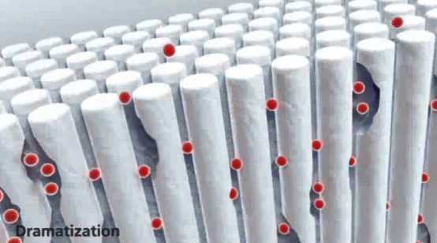
ENAMEL EROSION VS. CARIES
SUB-SURFACE VS. SURFACE MINERAL LOSS
Caries (subsurface phenomenon) | Erosion (surface phenomenon)
Weak acid (e.g. lactic acid) | Strong acid (e.g. citric acid)
Pellicle protects enamel surface | Pellicle can’t protect under such harsh acid conditions
Sub-surface phenomenon | Surface damage
Buffering by saliva helps to neutralize | Buffering of saliva is overwhelmed
Reversible in early stages | Irreversible surface damage
A role for treatment of early lesions | Prevention is key for managing the condition
Notes:
This is a build slide that highlights (in red) the lower right box – “Prevention is key for managing the condition”

Slide 10
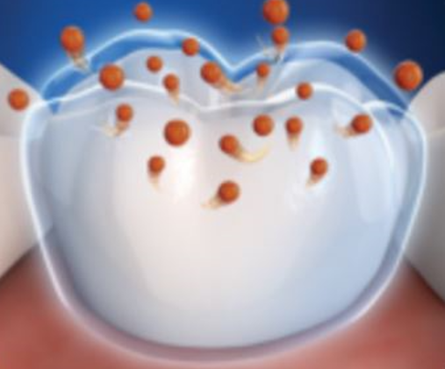
Erosive
Toothwear
Dental Erosion results from a demineralization process that is not the result of bacterial acids. Dietary or Medically related acids can overwhelm the natural, pellicle coated tooth surface and induce a surface softening of the mineral and ultimately surface loss of enamel. Once lost, this mineral cannot be restored naturally.
Link | https://pubmed.ncbi.nlm.nih.gov/33383100/ | https://pubmed.ncbi.nlm.nih.gov/32259415/ | https://rd.springer.com/article/10.1007/s00784-016-1905-1 | https://pubmed.ncbi.nlm.nih.gov/26349125/ | https://www.dentalcare.com/-/media/dentalcareus/research/pdf/am-j-dent/2011/fallerajdaugust2011.pdf?la=en&v=1-201604260314 | https://www.ncbi.nlm.nih.gov/pmc/articles/PMC7559150/
Title | Bioavailable gluconate chelated stannous fluoride toothpaste meta-analyses: Effects on dentine hypersensitivity and enamel erosion | Stabilized Stannous fluoride dentifrice in relation to dental caries, dental erosion and dentin hypersensitivity: A systematic Review | Erosion protection benefits of stabilized SnF2 dentifrice versus an arginine–sodium monofluorophosphate dentifrice: results from in vitro and in situ clinical studies | Erosion Prevention Potential of an Over-the-Counter Stabilized SnF2 Dentifrice Compared to 5000 ppm F Prescription-Strength Products | Enamel Protection: A comparison of marketed dentifrice performance against dental erosion | Stannous Fluoride Effects on Enamel: A Systematic Review
Objective | To compare the effect of bioavailable gluconate-chelated stannous fluoride (SnF2) toothpaste with control toothpastes for treatment of dentine hypersensitivity (DH) and enamel erosion. | To review the scientific evidence for the efficacy of stabilized stannous fluoride dentifrice in relation to dental caries, dental erosion and dentin hypersensitivity. | The aim of these investigations was to assess the ability of two fluoride dentifrices to protect against the initiation and progression of dental erosion using a predictive in vitro erosion cycling model and a human in situ erosion prevention clinical trial for verification of effectiveness. (1.5% Arginine) | To determine the relative ability of various F-containing products to protect enamel against the initiation and progression of tooth surface loss due to erosive acid challenges. | To determine the relative ability of various marketed toothpastes formulated with either stabilized stannous fluoride (SnF2), sodium fluoride (NaF), or sodium monofluorophosphate (SMFP) to protect human enamel against the initiation and progression of damage due to dietary acid attack, using a laboratory erosion cycling model. | The objectives of this review are to highlight all the clinical features concerning stannous fluoride reported in the literature and eventually its chemical interactions. In dental patients, what is the effect of stannous fluoride compositions on oral health compared to other dental healthcare products? And as secondary outcome: On enamel and other hard tooth tissue, what is the effect of stannous fluoride composition on their structure compared to other dental healthcare products?
 | West N Bioavailable gluconate chelated stannous fluoride toothpaste meta-analyses: Effects on dentine hypersensitivity and enamel erosionJ Dent2021;Feb;105:103566Erosion, Meta-analysis, Stannous fluoride | Konradsson K Stabilized stannous fluoride dentifrice in relation to dental caries, dental erosion and dentin hypersensitivity: A systematic review Am J Dent2020;33: 95-105 |  | Eversole SL Erosion Prevention Potential of an Over-the-Counter Stabilized SnF2 Dentifrice Compared to 5000 ppm F Prescription-Strength Products J Clin Dent2015;26:44-49 | Faller RV Enamel protection: a comparison of marketed dentifrice performance against dental erosion Am J Dent2011;24(4):205-10 | Fiorillo L, Cervino G, Herford AS, Laino L, Cicciù M. Stannous Fluoride Effects on Enamel: A Systematic Review. Biomimetics (Basel). 2020 Aug 31;5(3):41. doi: 10.3390/biomimetics5030041. PMID: 32878006; PMCID: PMC7559150.

